Slide 1
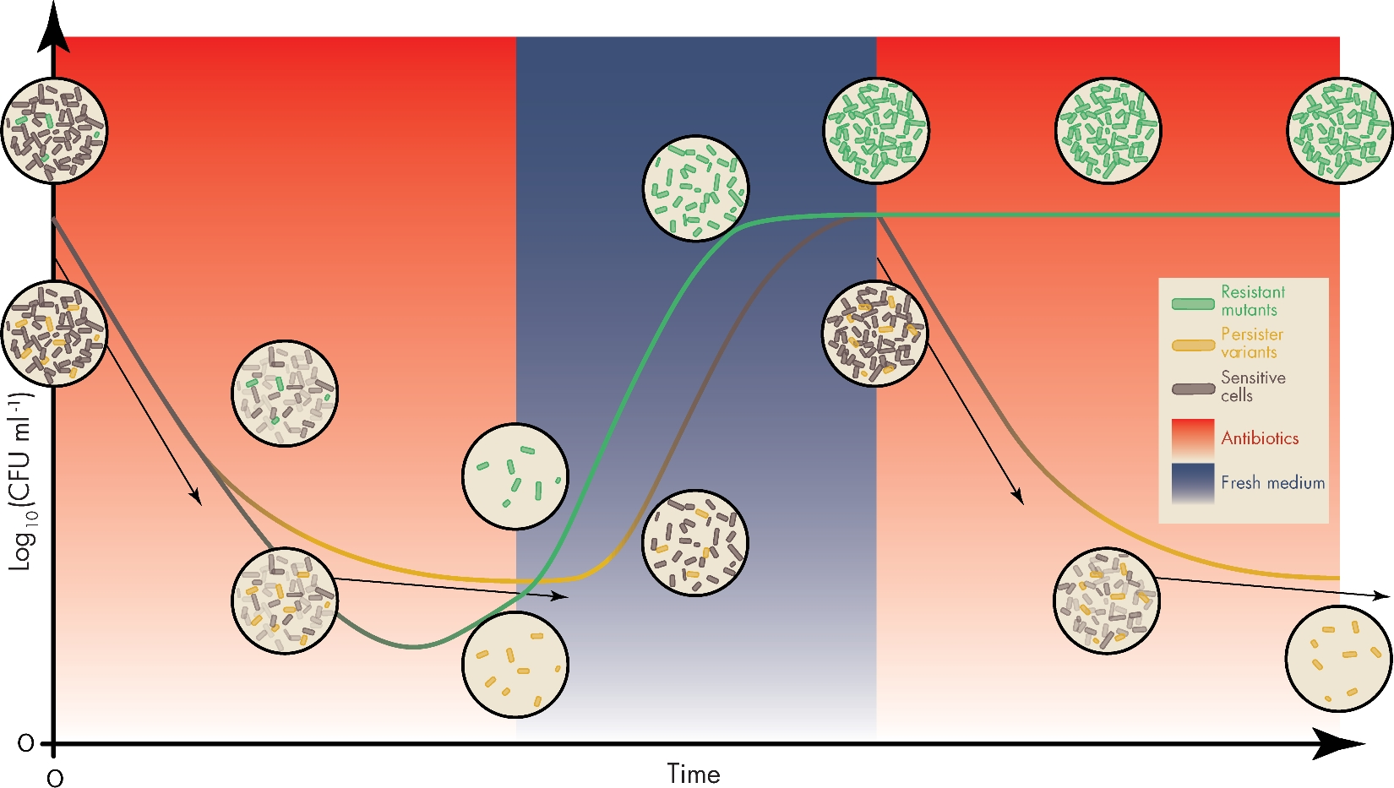
Figure 1. The biphasic killing curve and the difference between persistence and resistance. Conceptual overview of the ...
Notes:
Figure 1. The biphasic killing curve and the difference between persistence and resistance. Conceptual overview of the course of an antibiotic treatment when persisters are present (gold, bottom) or when antibiotic-resistant mutants emerge (green, top) within bacterial populations. In both cases, susceptible cells (gray) are killed rapidly (grayed out, first red zone) and killing dynamics are very similar for both cases (steep arrow). Resistant mutants are, however, capable of dividing during treatment (green ascending curve) while persisters can only survive (slowly descending arrow), leading to the typical biphasic killing pattern for persistence. After antibiotic removal, both surviving types start dividing again at normal rates, although persisters usually have an increased lag time. Persisters will form a population that is as tolerant as the starting one as their tolerance is not heritable (middle blue panel). Antibiotic resistant mutants, however, form a population consisting completely of resistant mutants. This difference highly influences the dynamics of a second subsequent antibiotic treatment (second red zone).
Unless provided in the caption above, the following copyright applies to the content of this slide: © FEMS 2017. All rights reserved. For permissions, please e-mail: journals.permissions@oup.com

Slide 2
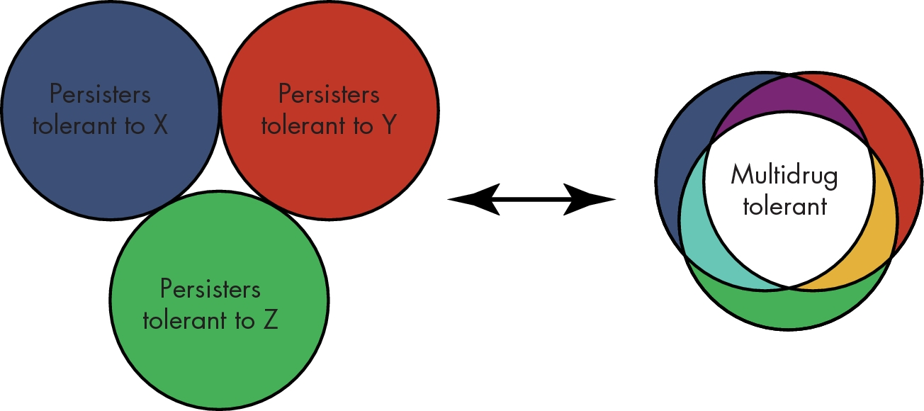
Figure 2. Drug-specific versus multidrug-tolerant persister cells. Schematic representation of extreme cases of ...
Notes:
Figure 2. Drug-specific versus multidrug-tolerant persister cells. Schematic representation of extreme cases of heterogeneous persisters (left) that only display drug-specific tolerance or genuine multidrug-tolerant persisters that can resist the killing activity of many different drugs (right). In the former case, a combination of antibiotics X, Y and Z might eradicate all persisters, while in the latter this will have only marginal effect.
Unless provided in the caption above, the following copyright applies to the content of this slide: © FEMS 2017. All rights reserved. For permissions, please e-mail: journals.permissions@oup.com

Slide 3
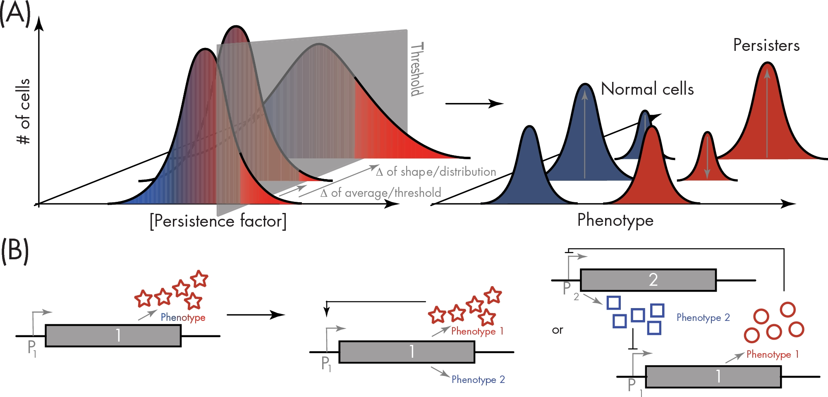
Figure 3. Heterogeneity leading to bistability underlies persistence. (A) In an isogenic bacterial population, even ...
Notes:
Figure 3. Heterogeneity leading to bistability underlies persistence. (A) In an isogenic bacterial population, even when cultured in a homogeneous environment, some level of heterogeneity exists in biochemical molecules or macromolecular complexes. Numbers of proteins, ribosomes, concentrations of metabolites, etc., all show a distribution rather than a fixed value because of random fluctuations in major processes such as transcription, translation, mRNA or protein stability or because of cell aging. This also is true for persistence factors (left). Heterogeneity can lead to a continuum of phenotypes at the single-cell level. In some cases, however, two or more stable phenotypic variants arise and coexist, like in the case with normal cells and persister cells (red and blue, right). A threshold concentration decides on the fate of the cells (gray shaded plane, left). Deterministic processes, like stress responses that are triggered by signals from the environment, can shift the concentration distribution to higher/lower average values, change its shape or increase/decrease the threshold value (gray arrows and extra distribution, left), leading to an effective change in numbers of persisters (right). (B) Positive regulatory feedback (middle) or double-negative regulatory feedback (right) can contribute to generating bistability.
Unless provided in the caption above, the following copyright applies to the content of this slide: © FEMS 2017. All rights reserved. For permissions, please e-mail: journals.permissions@oup.com

Slide 4
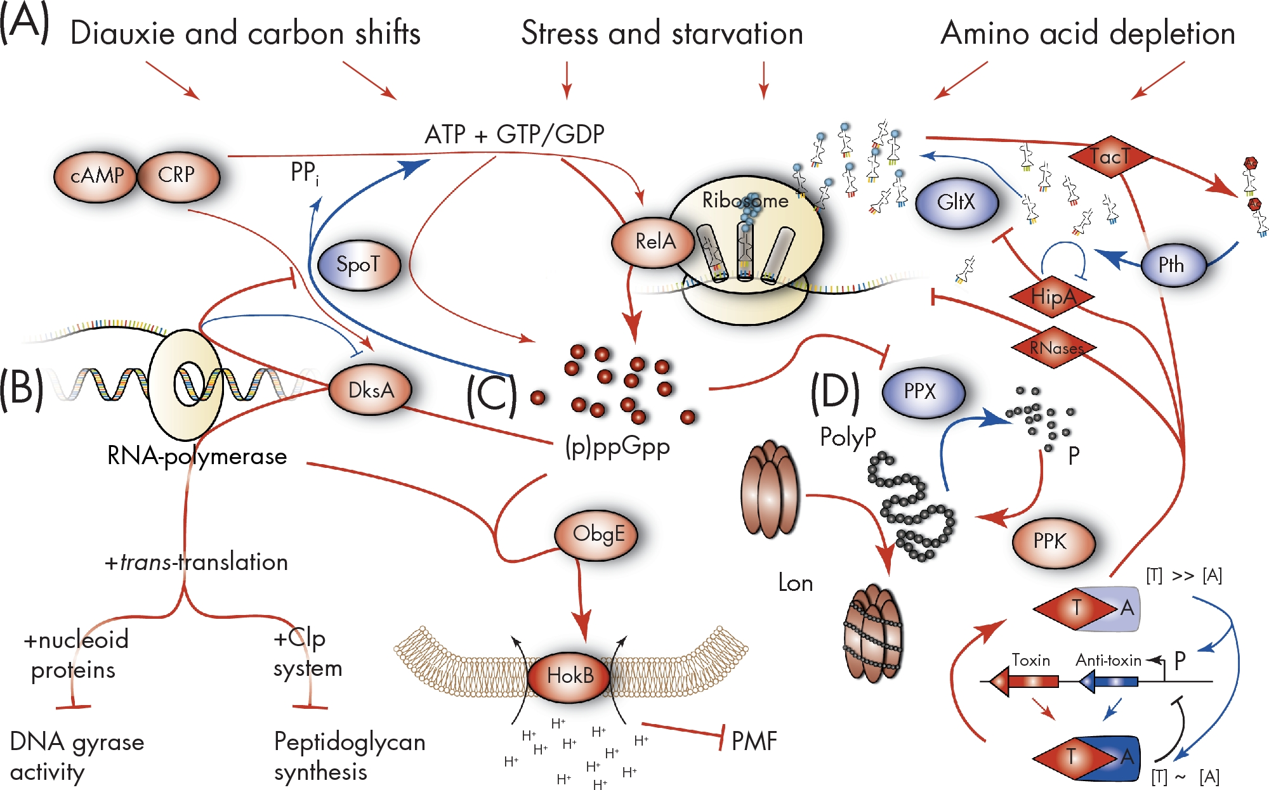
Figure 4. The widespread involvement of the stringent response in persistence. (A) Many signals trigger the stringent ...
Notes:
Figure 4. The widespread involvement of the stringent response in persistence. (A) Many signals trigger the stringent response: diauxie and carbon shifts through the catabolite repression/activation system with cyclic AMP (cAMP) and its receptor protein (CRP) as key players, starvation of nutrients in general and amino acid depletion. Under these situations, SpoT and RelA produce the alarmone (p)ppGpp, while SpoT keeps (p)ppGpp levels low in absence of stress. (B) The stringent response contains a metabolic TA module with a double-negative feedback loop: SpoT inhibits the formation of (p)ppGpp, while (p)ppGpp along with RNA polymerase and DksA inhibit the formation of SpoT. This network along with trans-translation generates tolerant persisters because of shutdown of specific antibiotic targets. Nucleoid-binding proteins aid in the inhibition of DNA gyrase activity, while the Clp system helps in specifically inhibiting peptidoglycan synthesis. (C) In combination with the essential GTPase ObgE, (p)ppGpp is important for HokB-induced persistence. HokB is the toxin part of a type I TA module that inserts in the membrane and induces tolerance through membrane depolarization and loss of proton motive force (PMF). (D) The best described (p)ppGpp regulated path to persistence is via the build-up of polyphosphate because of inhibition of exopolyphosphatase (PPX) and the activity of polyphosphate kinase (PPK). Activated Lon protease subsequently breaks down antitoxin proteins of type II TA systems thereby releasing the toxin and inducing tolerance. The inhibition of translation closes a positive feedback loop leading to bistability, as toxins are more stable than their antitoxins. At least two toxins of type II TA systems are no RNases but rather act upstream by inducing (p)ppGpp production. Both HipA and TacT cause tRNAs to become futile as fuel of translation machinery by inhibiting glutamyl-tRNA sythetase (GltX) and acetylating charged tRNA's, respectively. Potentially ways for persisters to exit their tolerant state have been suggested in (p)ppGppdependent persistence through type II TA systems: (i) autophosphorylation of HipA, (ii) conditional cooperativity in the regulation of type II TA systems (when [T] >> [A], induction of the operon could replenish antitoxin levels) and (iii) additional factors that detoxify the acetylated tRNAs by TacT activity. Factors and paths that lead to persistence are in red, while effectors and reactions that inhibit persister formation are colored blue.
Unless provided in the caption above, the following copyright applies to the content of this slide: © FEMS 2017. All rights reserved. For permissions, please e-mail: journals.permissions@oup.com

Slide 5
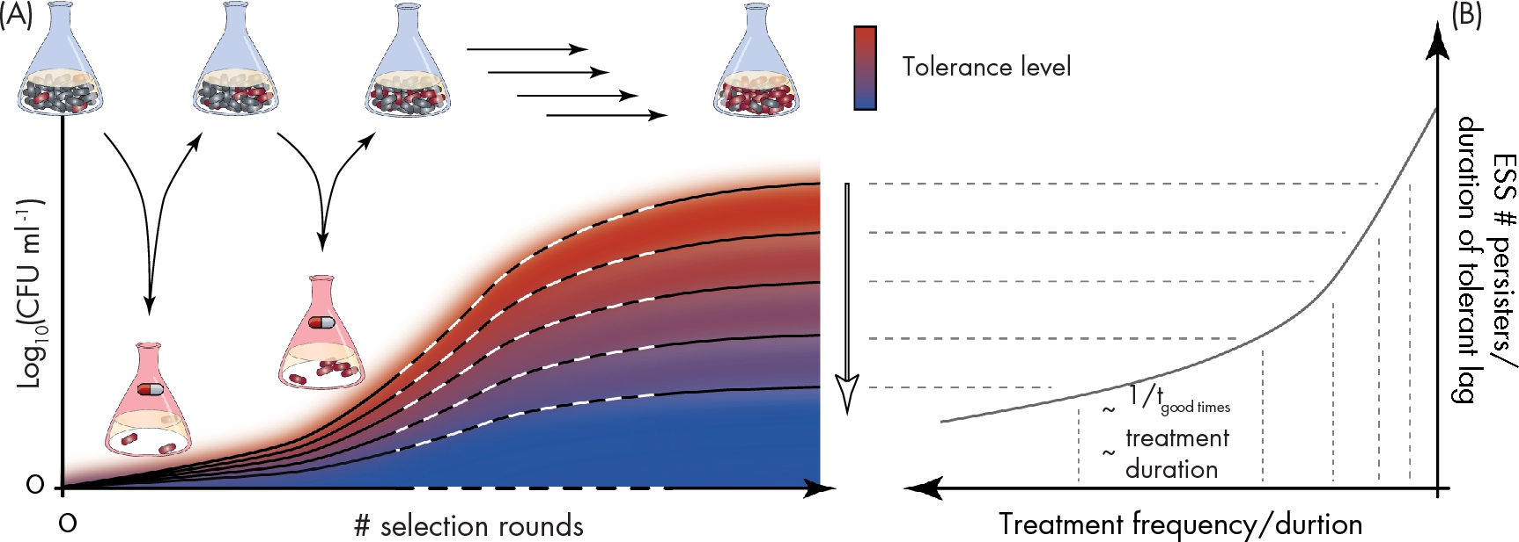
Figure 5. Persistence evolves readily to adapt to the frequency or duration of antibiotic treatments. (A) Recently, in ...
Notes:
Figure 5. Persistence evolves readily to adapt to the frequency or duration of antibiotic treatments. (A) Recently, in vitro evolution experiments were performed that maintained bacteria in conditions that switched between good growing conditions (blue flasks) and antibiotic treatments (red flasks). In the former, the normal antibiotic-sensitive cell type thrives (blue cells) while in the latter, only antibiotic-tolerant cells survive (red cells). Under these conditions, the tolerance level of the populations was shown to increase over time (multiple arrows, white dashed lines). Tolerance levels evolved to agree with the severity of the applied treatment regimen, either in frequency or duration. This is visualized by the different evolutionary trajectories, the open arrow that shows decreasing treatment severity and the red blue color gradient. (B) This correlation is clear when plotting the evolutionary stable state of number of persisters or duration of lag time that results in antibiotic tolerance versus the treatment frequency or duration (dashed gray lines connect A with B). This evolutionary stable state is furthermore approximated by either the inverse of the time that cells experience good conditions between subsequent treatments or the treatment duration. Based on data and figures from Fridman et al. (2014); Brauner et al. (2016); Van den Bergh et al. (2016b).
Unless provided in the caption above, the following copyright applies to the content of this slide: © FEMS 2017. All rights reserved. For permissions, please e-mail: journals.permissions@oup.com

