Slide 1
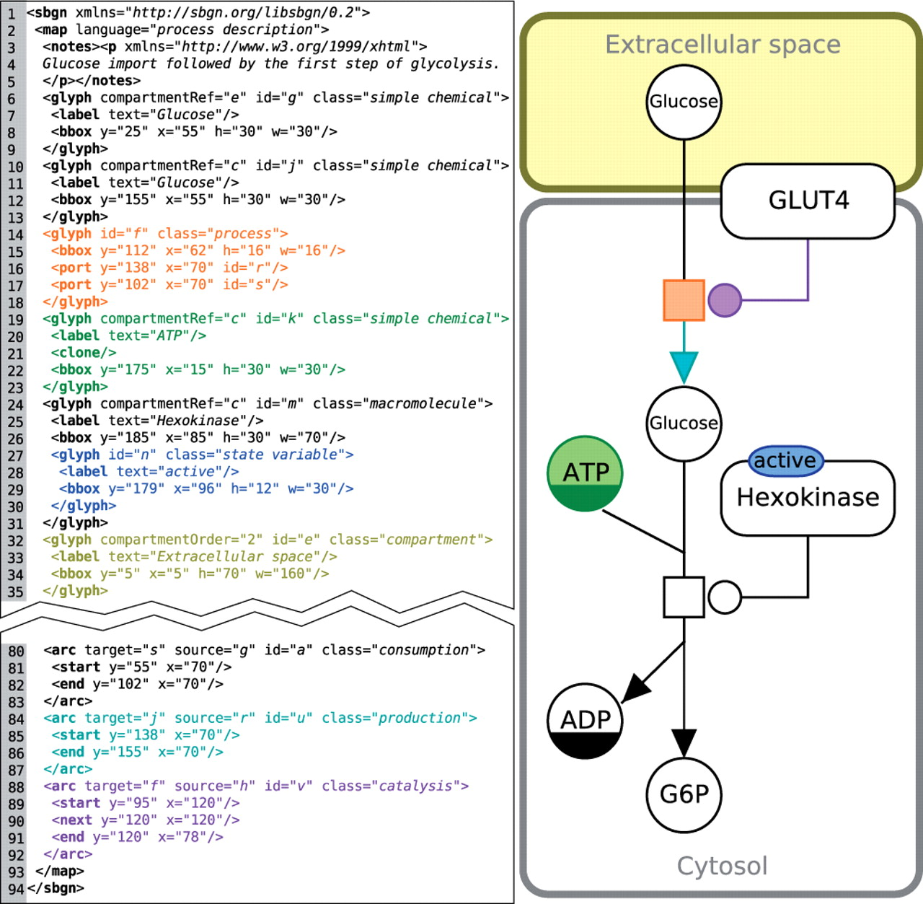
Fig. 1. An example PD map (right) with the corresponding SBGN-ML code (left). This example shows the import of ...
Notes:
Fig. 1. An example PD map (right) with the corresponding SBGN-ML code (left). This example shows the import of glucose followed by the first step of glycolysis. The colors used have no special meaning in SBGN, here they merely indicate the relation between each SBGN glyph and its SBGN-ML representation; a process node in orange, a simple chemical (ATP) in green, a production arc in cyan, a catalysis arc in purple, a compartment in yellow and a state variable in blue
Unless provided in the caption above, the following copyright applies to the content of this slide: © The Author(s) 2012. Published by Oxford University Press.This is an Open Access article distributed under the terms of the Creative Commons Attribution Non-Commercial License (http://creativecommons.org/licenses/by-nc/3.0), which permits unrestricted non-commercial use, distribution, and reproduction in any medium, provided the original work is properly cited.

Slide 2
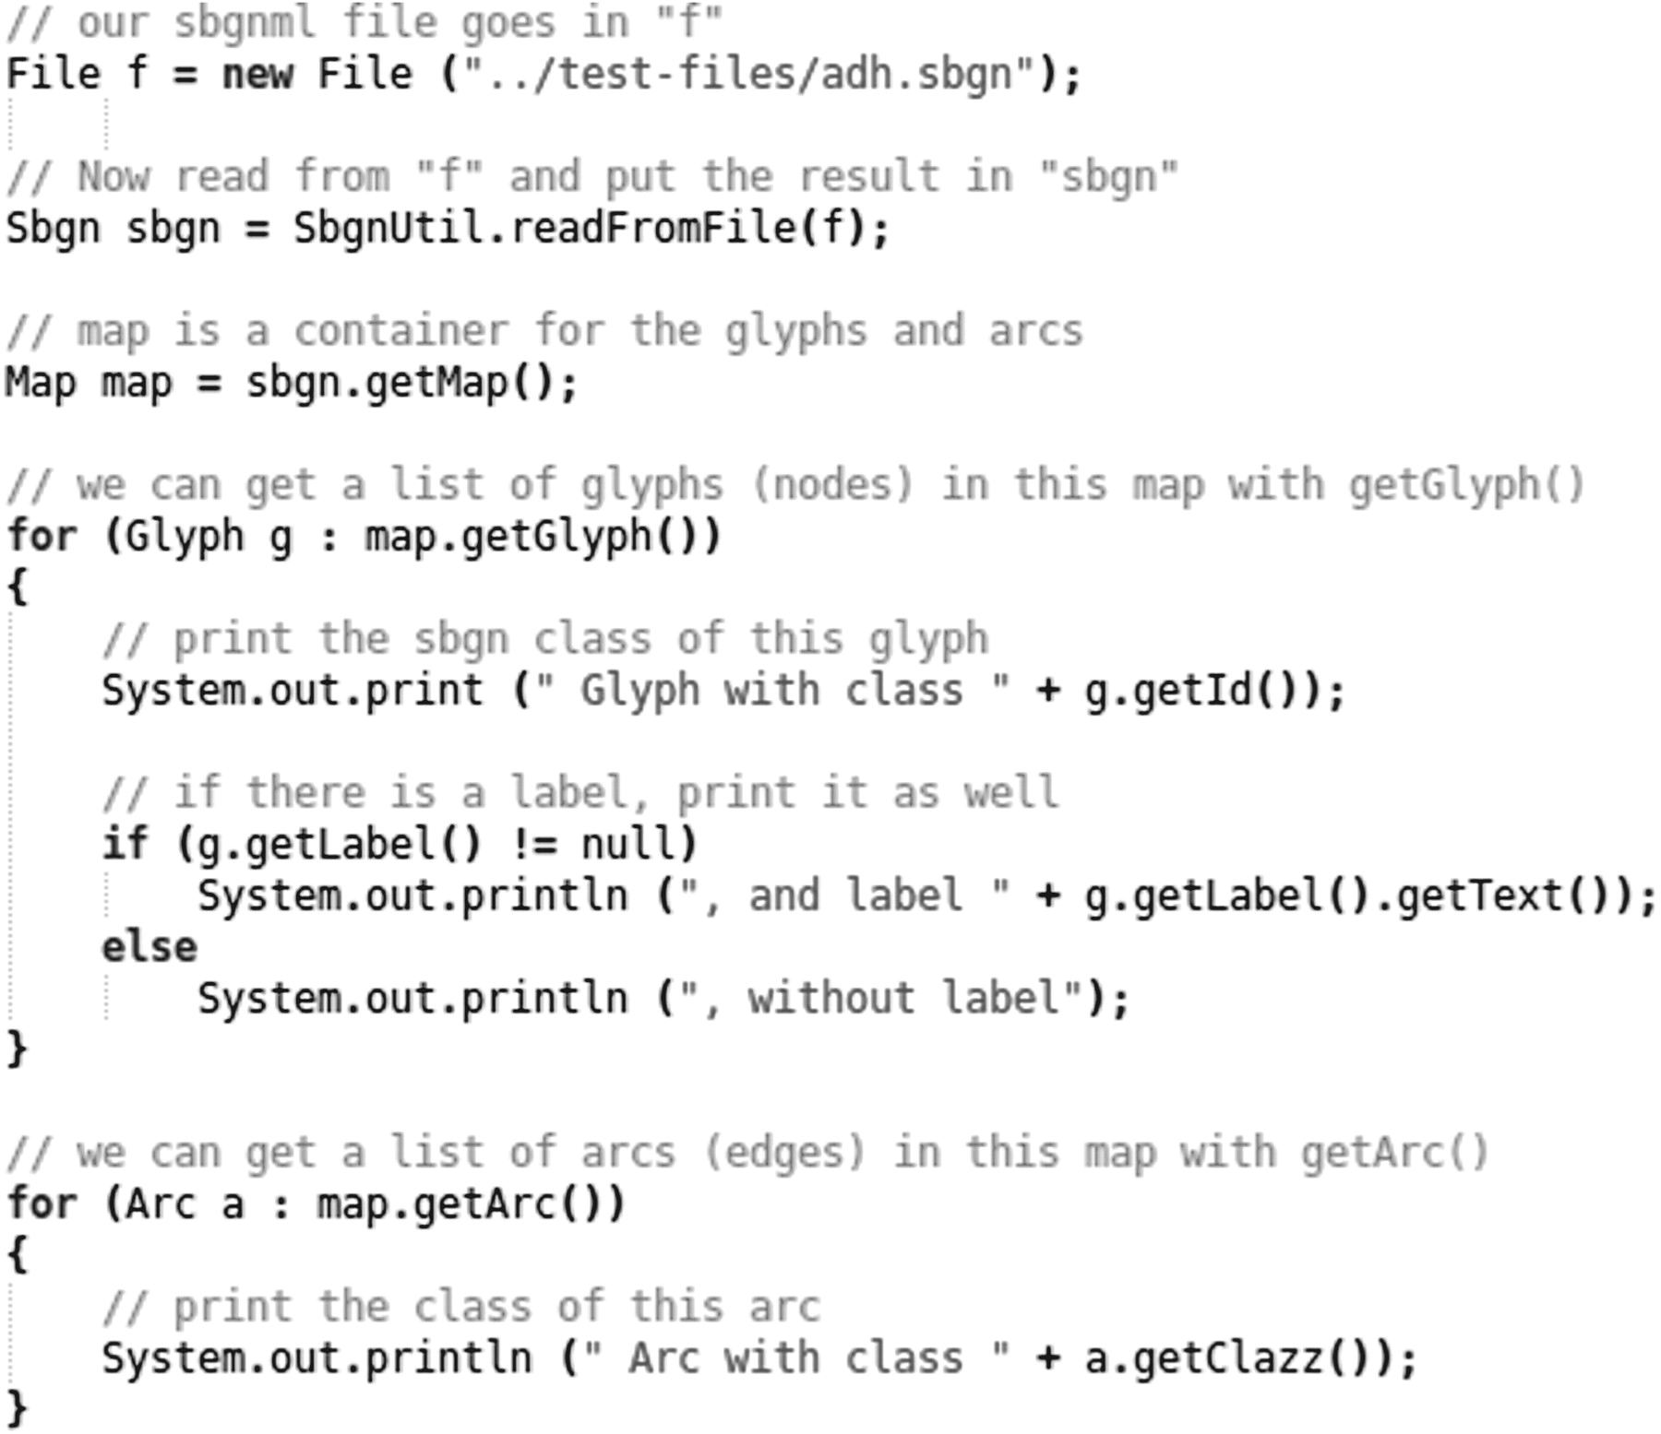
Fig. 2. Example of reading a file using the Java version of LibSBGN. Here an SBGN-ML file named ‘adh.sbgn’ (included ...
Notes:
Fig. 2. Example of reading a file using the Java version of LibSBGN. Here an SBGN-ML file named ‘adh.sbgn’ (included in the LibSBGN source distribution) is read, and some basic information about each glyph in that file is printed to standard output. The complete program can be found as ReadExample.java in the LibSBGN source distribution
Unless provided in the caption above, the following copyright applies to the content of this slide: © The Author(s) 2012. Published by Oxford University Press.This is an Open Access article distributed under the terms of the Creative Commons Attribution Non-Commercial License (http://creativecommons.org/licenses/by-nc/3.0), which permits unrestricted non-commercial use, distribution, and reproduction in any medium, provided the original work is properly cited.

Slide 3
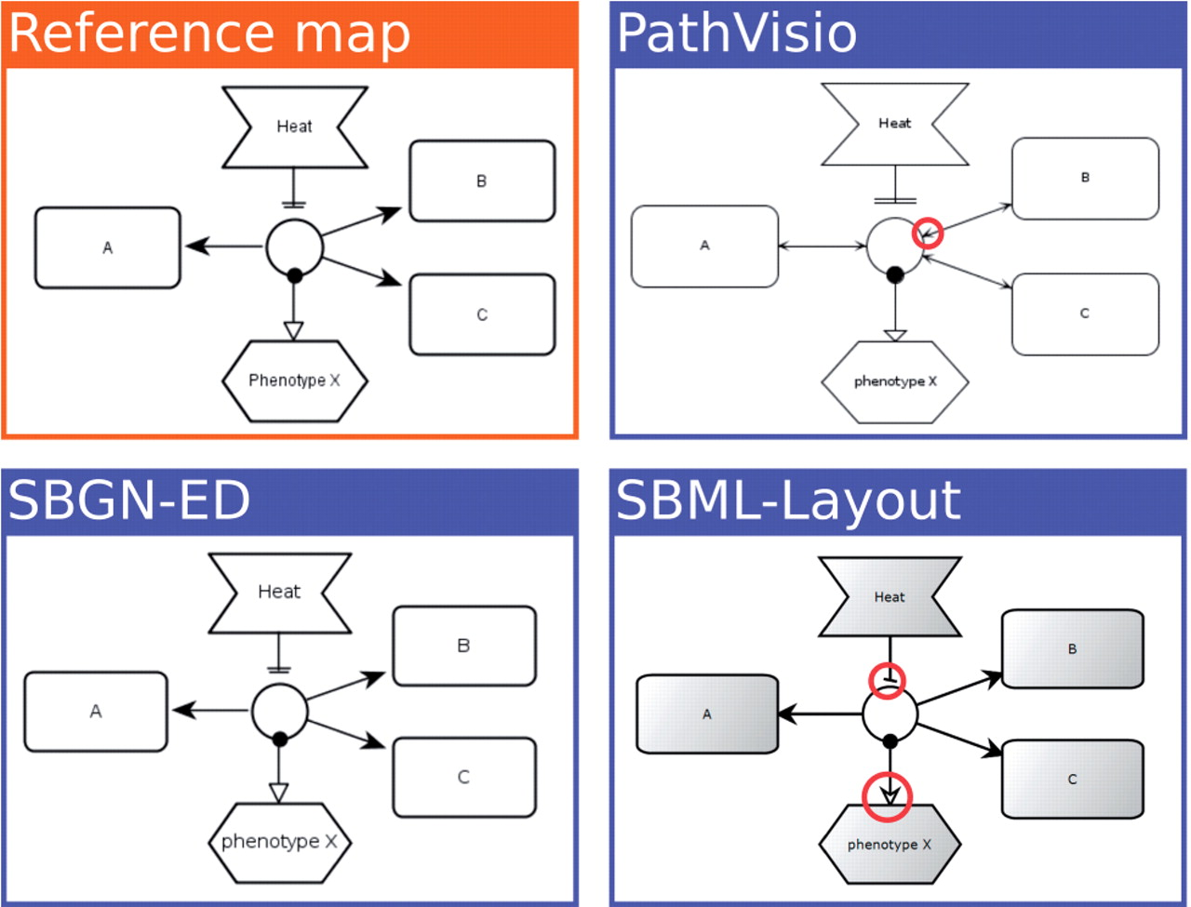
Fig. 3. Rendering comparison. A series of test-cases is rendered by all supported tools in an automated render ...
Notes:
Fig. 3. Rendering comparison. A series of test-cases is rendered by all supported tools in an automated render comparison pipeline. The rendering results are compared with the reference map (top-left), in this case an ER map. A couple of significant differences have been highlighted with red circles. In the PathVisio case (top-right), arrowheads are drawn where none is expected. In the SBML Layout example (bottom-right), the wrong arrowheads are drawn for absolute inhibition and stimulation arcs. Note that these are historical images for illustration purposes, and the highlighted issues have already been fixed
Unless provided in the caption above, the following copyright applies to the content of this slide: © The Author(s) 2012. Published by Oxford University Press.This is an Open Access article distributed under the terms of the Creative Commons Attribution Non-Commercial License (http://creativecommons.org/licenses/by-nc/3.0), which permits unrestricted non-commercial use, distribution, and reproduction in any medium, provided the original work is properly cited.

Slide 4
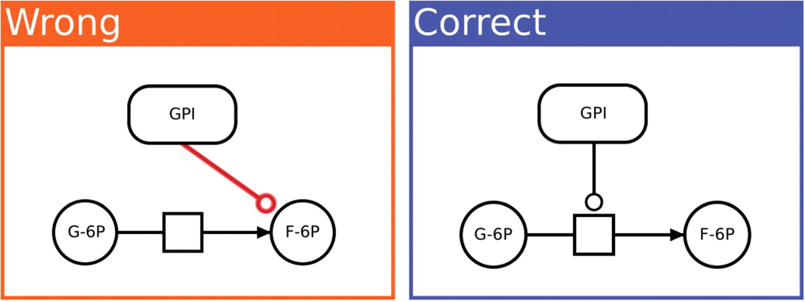
Fig. 4. Typical validator benchmark. This particular example tests the software for rule pd10110: in PD maps, ...
Notes:
Fig. 4. Typical validator benchmark. This particular example tests the software for rule pd10110: in PD maps, catalysis arcs must point to a process node (not to an entity pool node). In the negative test-case on the left, the enzyme GPI appears to ‘catalyze’ a molecule rather than a reaction. This is a logical impossibility. The positive test-case on the right shows correctly how the enzyme GPI catalyzes the reaction from glucose-6P to fructose-6P. Taken together, these test-cases help to prevent bugs in the validation software
Unless provided in the caption above, the following copyright applies to the content of this slide: © The Author(s) 2012. Published by Oxford University Press.This is an Open Access article distributed under the terms of the Creative Commons Attribution Non-Commercial License (http://creativecommons.org/licenses/by-nc/3.0), which permits unrestricted non-commercial use, distribution, and reproduction in any medium, provided the original work is properly cited.

Slide 5
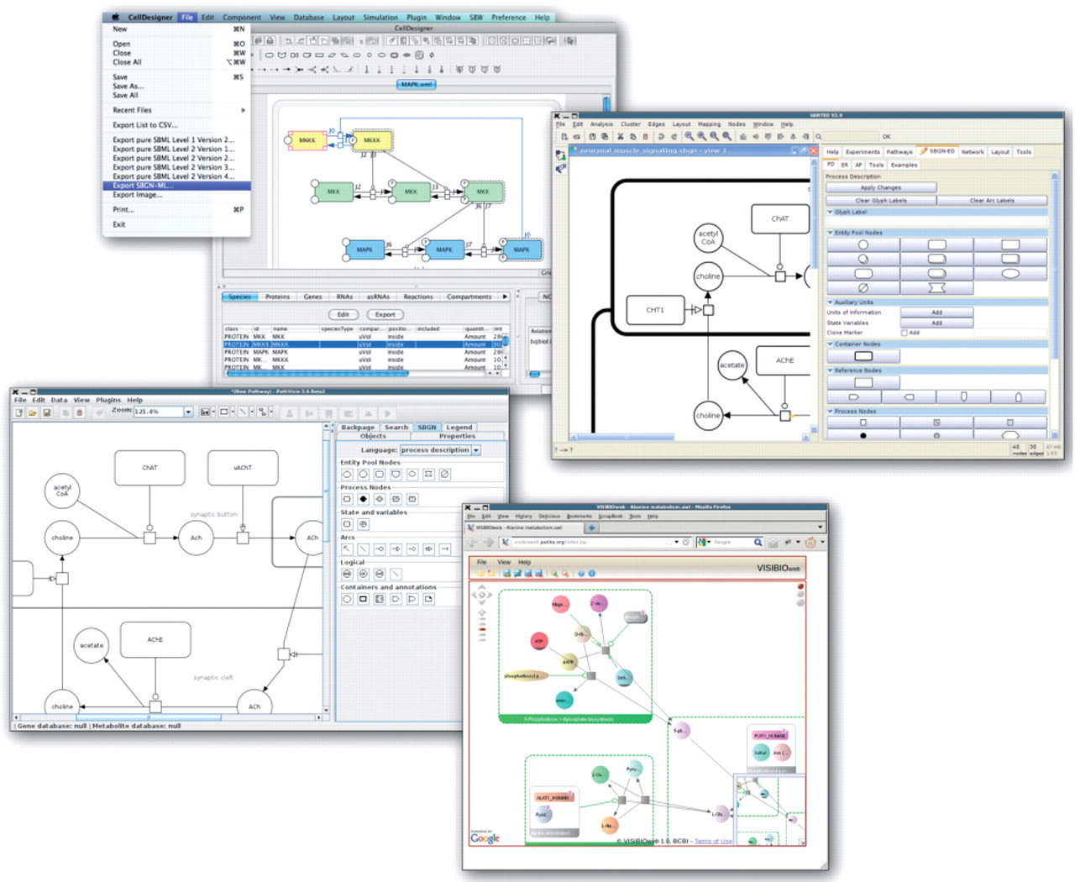
Fig. 5. Screenshots of a number of tools that use LibSBGN. Clockwise, from the top: CellDesigner, SBGN-ED, VISIBIOweb ...
Notes:
Fig. 5. Screenshots of a number of tools that use LibSBGN. Clockwise, from the top: CellDesigner, SBGN-ED, VISIBIOweb and PathVisio. These tools are able to use SBGN-ML for import, export or both. At the time of writing, for some of these tools a version with SBGN support has not been officially released, but is expected soon
Unless provided in the caption above, the following copyright applies to the content of this slide: © The Author(s) 2012. Published by Oxford University Press.This is an Open Access article distributed under the terms of the Creative Commons Attribution Non-Commercial License (http://creativecommons.org/licenses/by-nc/3.0), which permits unrestricted non-commercial use, distribution, and reproduction in any medium, provided the original work is properly cited.

