Slide 1
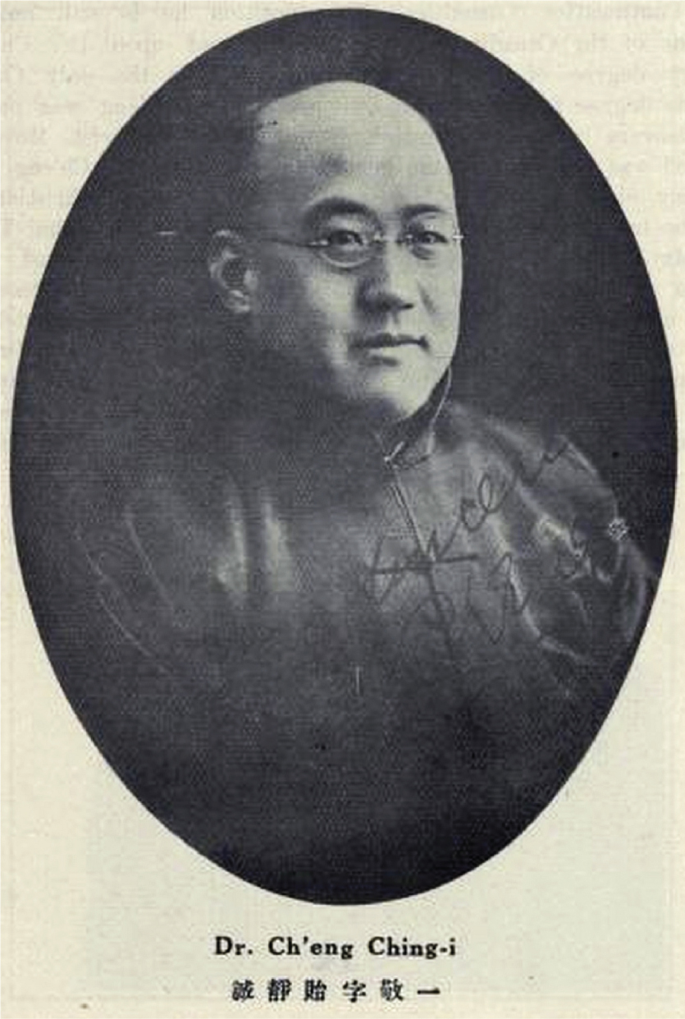
Figure 1: Cheng Jingyi. From Who’s Who in China, 3rd ed. (Shanghai, 1925), 153.
Notes:
Figure 1: Cheng Jingyi. From Who’s Who in China, 3rd ed. (Shanghai, 1925), 153.
Unless provided in the caption above, the following copyright applies to the content of this slide: © The Author(s) 2017. Published by Oxford University Press on behalf of the American Historical Association. All rights reserved. For permissions, please e-mail journals.permissions@oup.com.

Slide 2
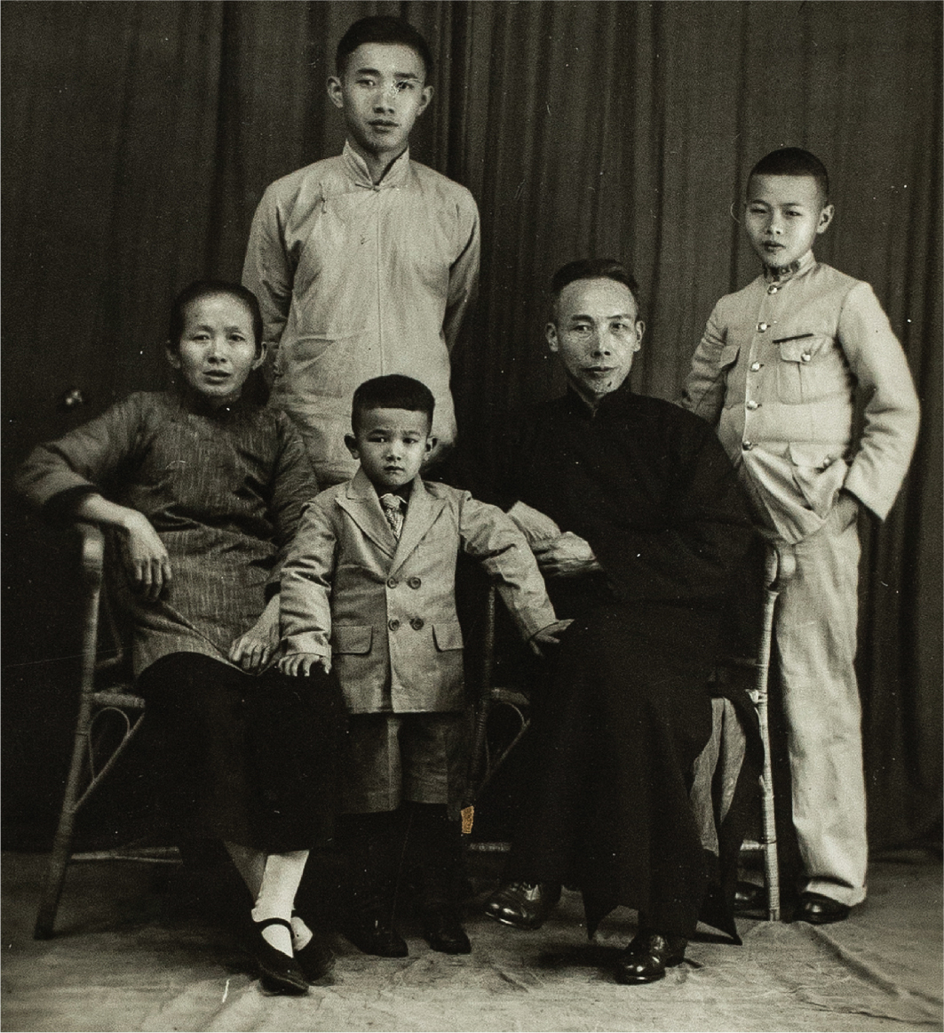
Figure 3: Pastor Ling Deyuan (1883–1951) with his family. Archive of the Berlin Missionary Society, Berlin, BMW ...
Notes:
Figure 3: Pastor Ling Deyuan (1883–1951) with his family. Archive of the Berlin Missionary Society, Berlin, BMW 2/1210-1.
Unless provided in the caption above, the following copyright applies to the content of this slide: © The Author(s) 2017. Published by Oxford University Press on behalf of the American Historical Association. All rights reserved. For permissions, please e-mail journals.permissions@oup.com.

Slide 3
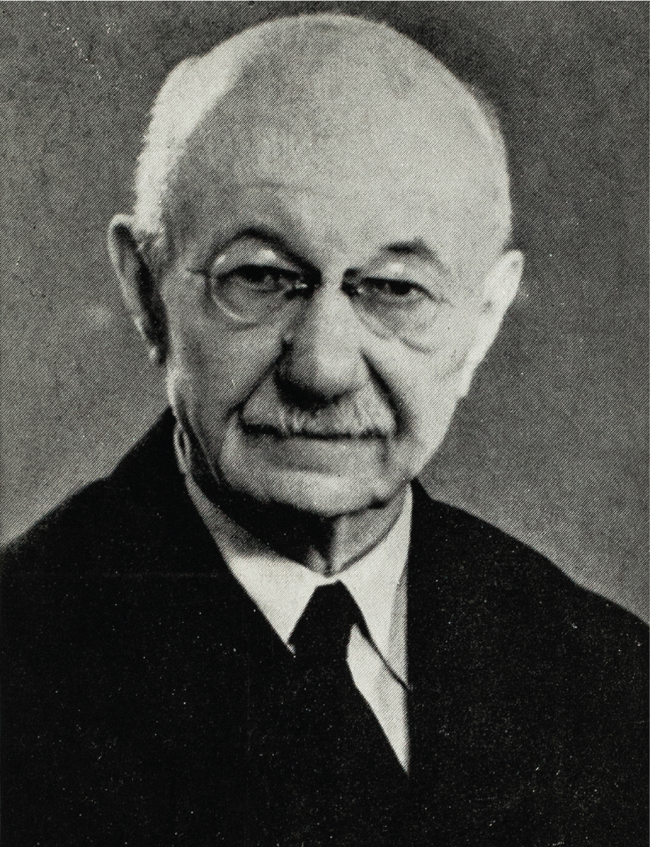
Figure 2: Siegfried Knak (1875–1955), undated photo. Archive of the Berlin Missionary Society, Berlin, BMW ...
Notes:
Figure 2: Siegfried Knak (1875–1955), undated photo. Archive of the Berlin Missionary Society, Berlin, BMW 2/1134-6823.
Unless provided in the caption above, the following copyright applies to the content of this slide: © The Author(s) 2017. Published by Oxford University Press on behalf of the American Historical Association. All rights reserved. For permissions, please e-mail journals.permissions@oup.com.

Slide 4
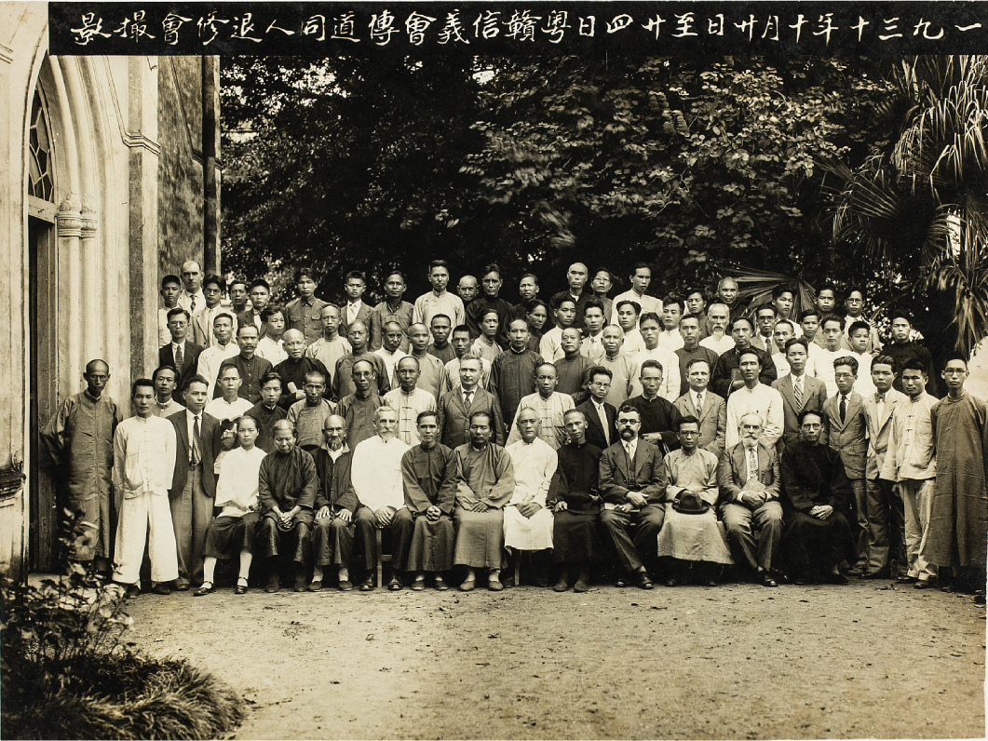
Figure 4: A Lutheran retreat for Chinese pastors and preachers that the Berlin Missionary Society helped organize in ...
Notes:
Figure 4: A Lutheran retreat for Chinese pastors and preachers that the Berlin Missionary Society helped organize in 1930. Archive of the Berlin Missionary Society, Berlin, BMW 2/454-1.
Unless provided in the caption above, the following copyright applies to the content of this slide: © The Author(s) 2017. Published by Oxford University Press on behalf of the American Historical Association. All rights reserved. For permissions, please e-mail journals.permissions@oup.com.

Slide 5
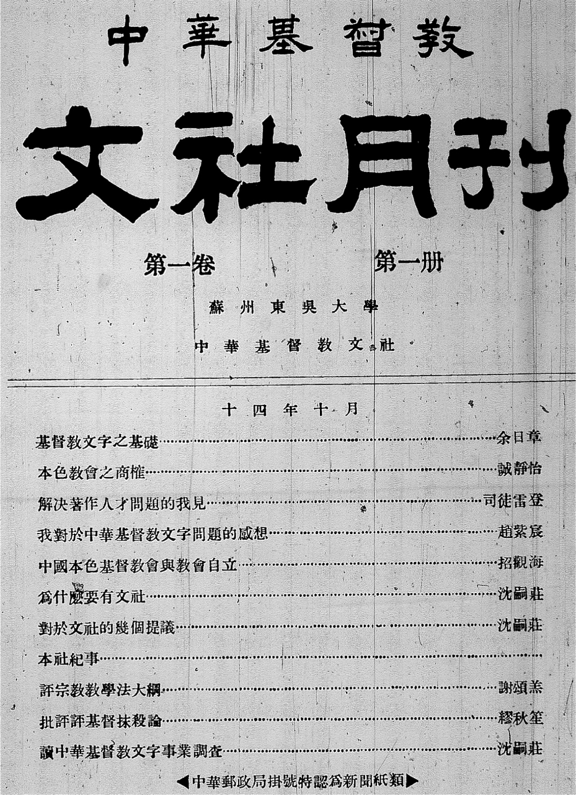
Figure 5: Cover of the inaugural issue of the Wenshe Monthly, 1925.
Notes:
Figure 5: Cover of the inaugural issue of the Wenshe Monthly, 1925.
Unless provided in the caption above, the following copyright applies to the content of this slide: © The Author(s) 2017. Published by Oxford University Press on behalf of the American Historical Association. All rights reserved. For permissions, please e-mail journals.permissions@oup.com.

Slide 6
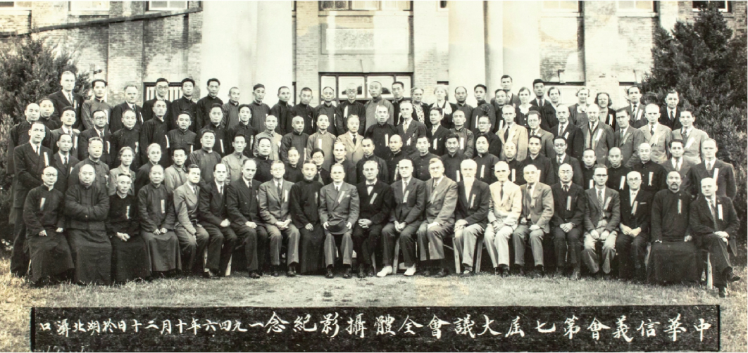
Figure 6: The first Synod of the Lutheran Alliance after the Second World War, October 1946. Archive of the Berlin ...
Notes:
Figure 6: The first Synod of the Lutheran Alliance after the Second World War, October 1946. Archive of the Berlin Missionary Society, Berlin, BMW 2/459-116.
Unless provided in the caption above, the following copyright applies to the content of this slide: © The Author(s) 2017. Published by Oxford University Press on behalf of the American Historical Association. All rights reserved. For permissions, please e-mail journals.permissions@oup.com.

