Slide 1
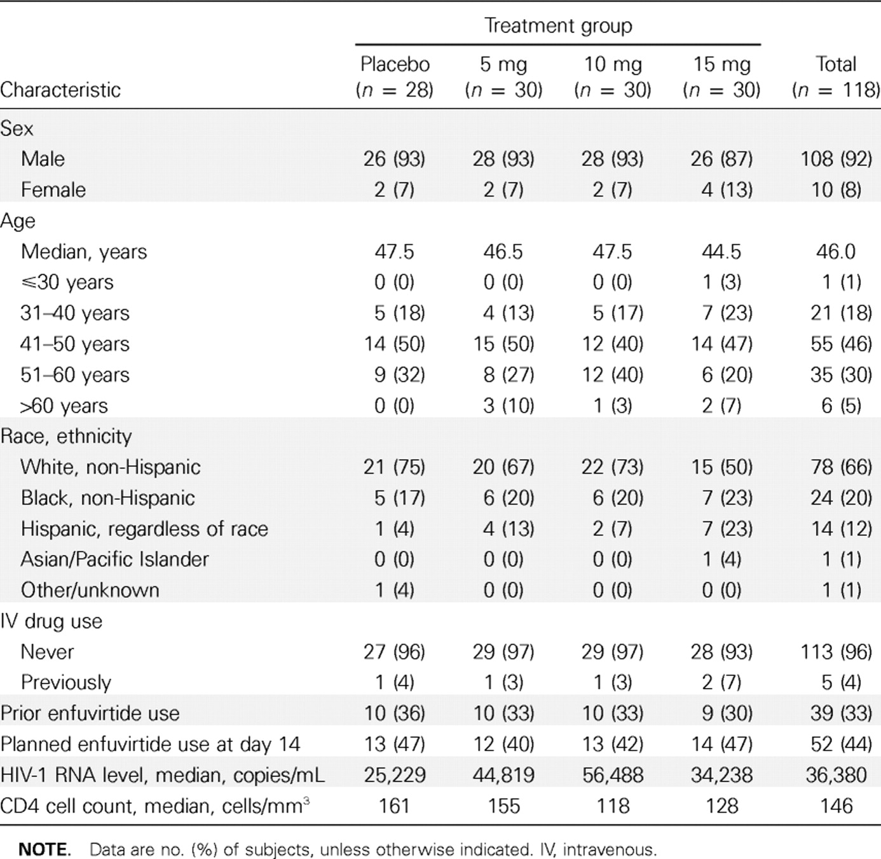
Table 1. Baseline characteristics of the study subjects.
Notes:
Table 1. Baseline characteristics of the study subjects.
Unless provided in the caption above, the following copyright applies to the content of this slide: © 2007 by the Infectious Diseases Society of America

Slide 2
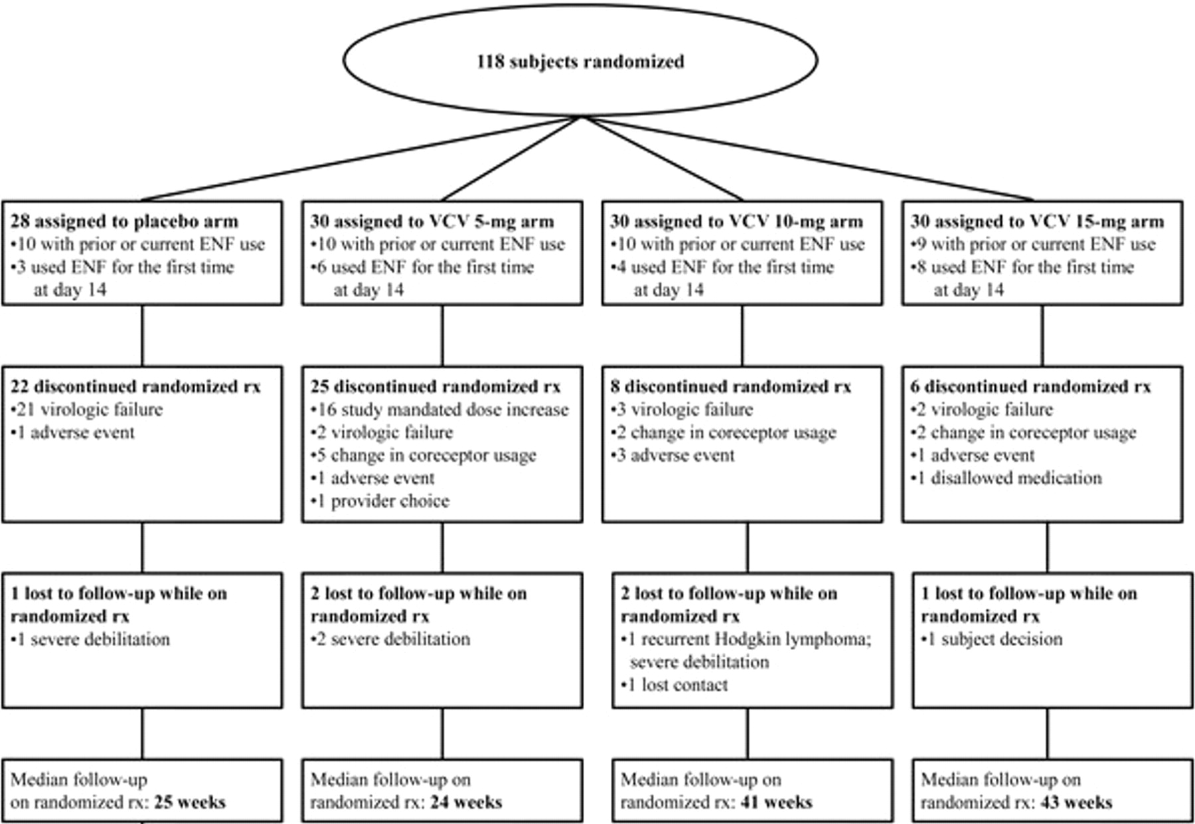
Figure 1. Disposition of the study subjects. ENF, enfuvirtide; rx, treatment; VCV, vicriviroc.
Notes:
Figure 1. Disposition of the study subjects. ENF, enfuvirtide; rx, treatment; VCV, vicriviroc.
Unless provided in the caption above, the following copyright applies to the content of this slide: © 2007 by the Infectious Diseases Society of America

Slide 3
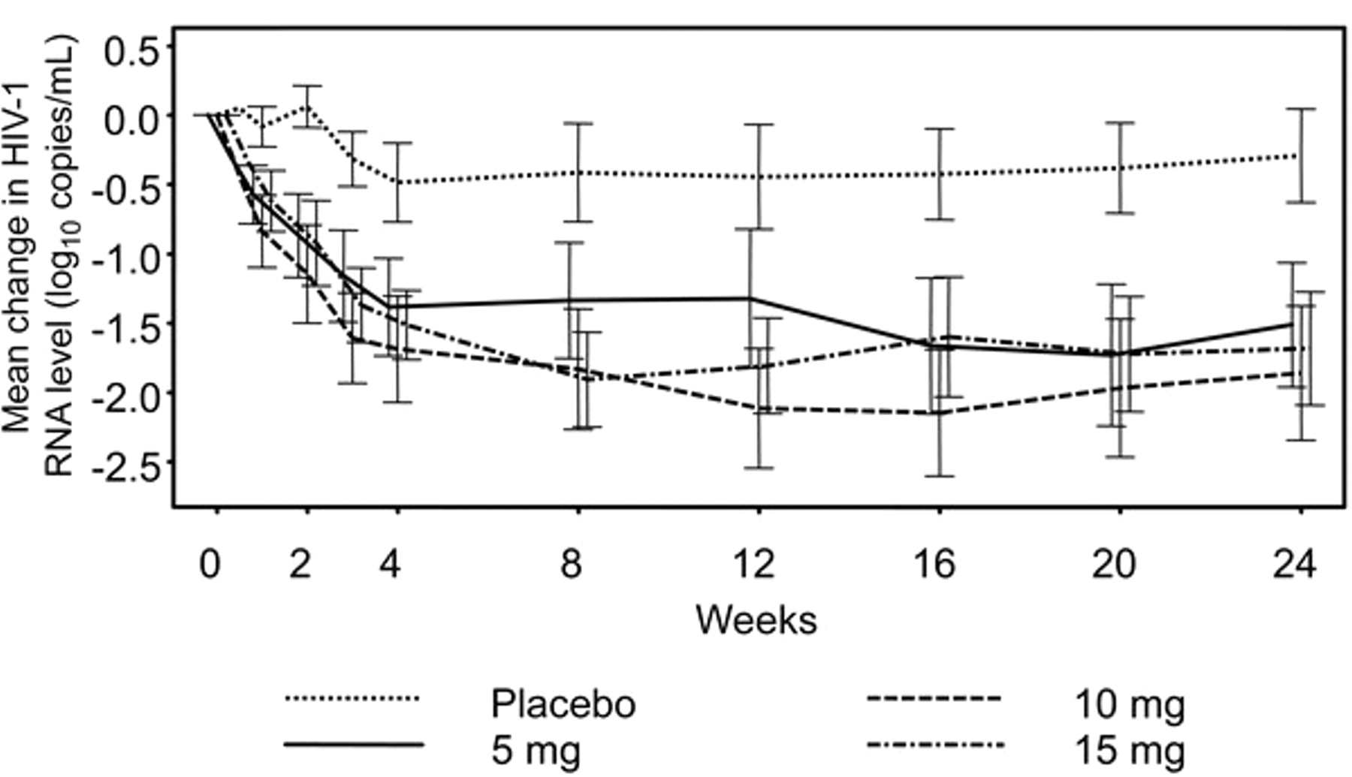
Figure 2. Mean change in HIV-1 RNA level (log₁₀ copies/mL) through week 24. Bars represent the 95% ...
Notes:
Figure 2. Mean change in HIV-1 RNA level (log10 copies/mL) through week 24. Bars represent the 95% confidence intervals.
Unless provided in the caption above, the following copyright applies to the content of this slide: © 2007 by the Infectious Diseases Society of America

Slide 4
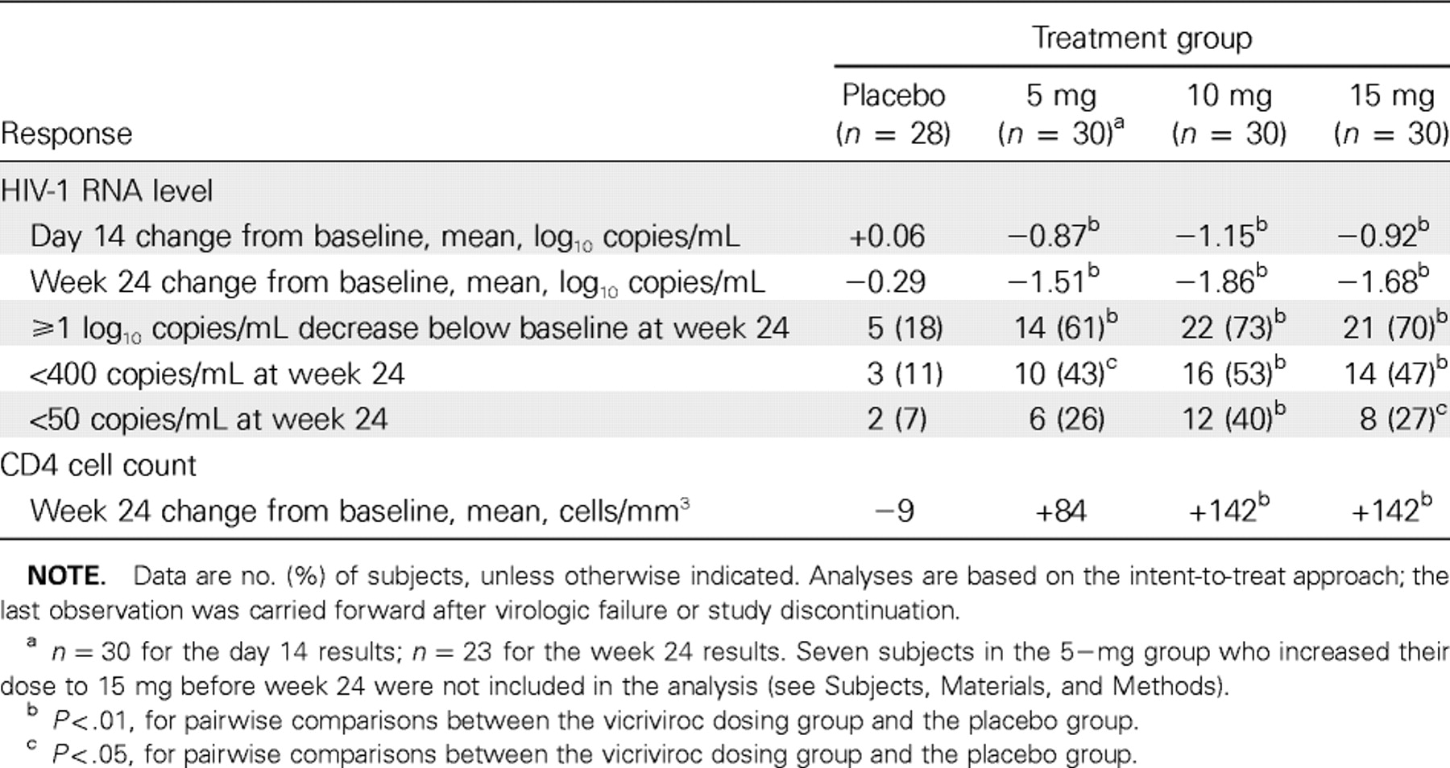
Table 2. Virologic and immunologic responses.
Notes:
Table 2. Virologic and immunologic responses.
Unless provided in the caption above, the following copyright applies to the content of this slide: © 2007 by the Infectious Diseases Society of America

Slide 5
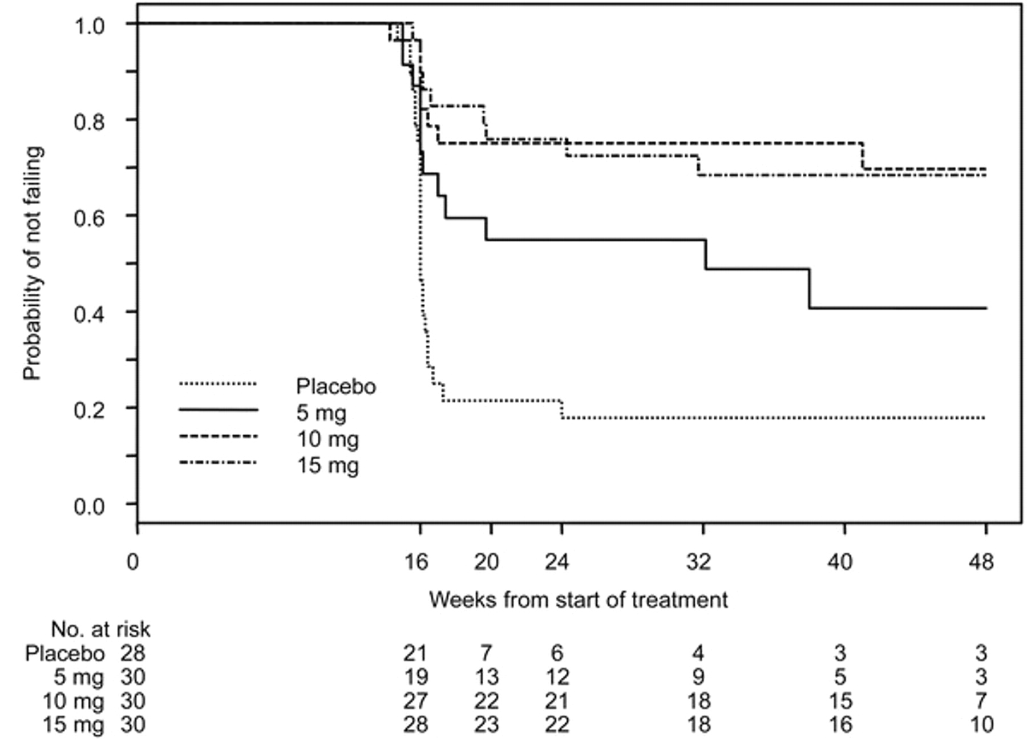
Figure 3. Time to virologic failure through week 48
Notes:
Figure 3. Time to virologic failure through week 48
Unless provided in the caption above, the following copyright applies to the content of this slide: © 2007 by the Infectious Diseases Society of America

Slide 6
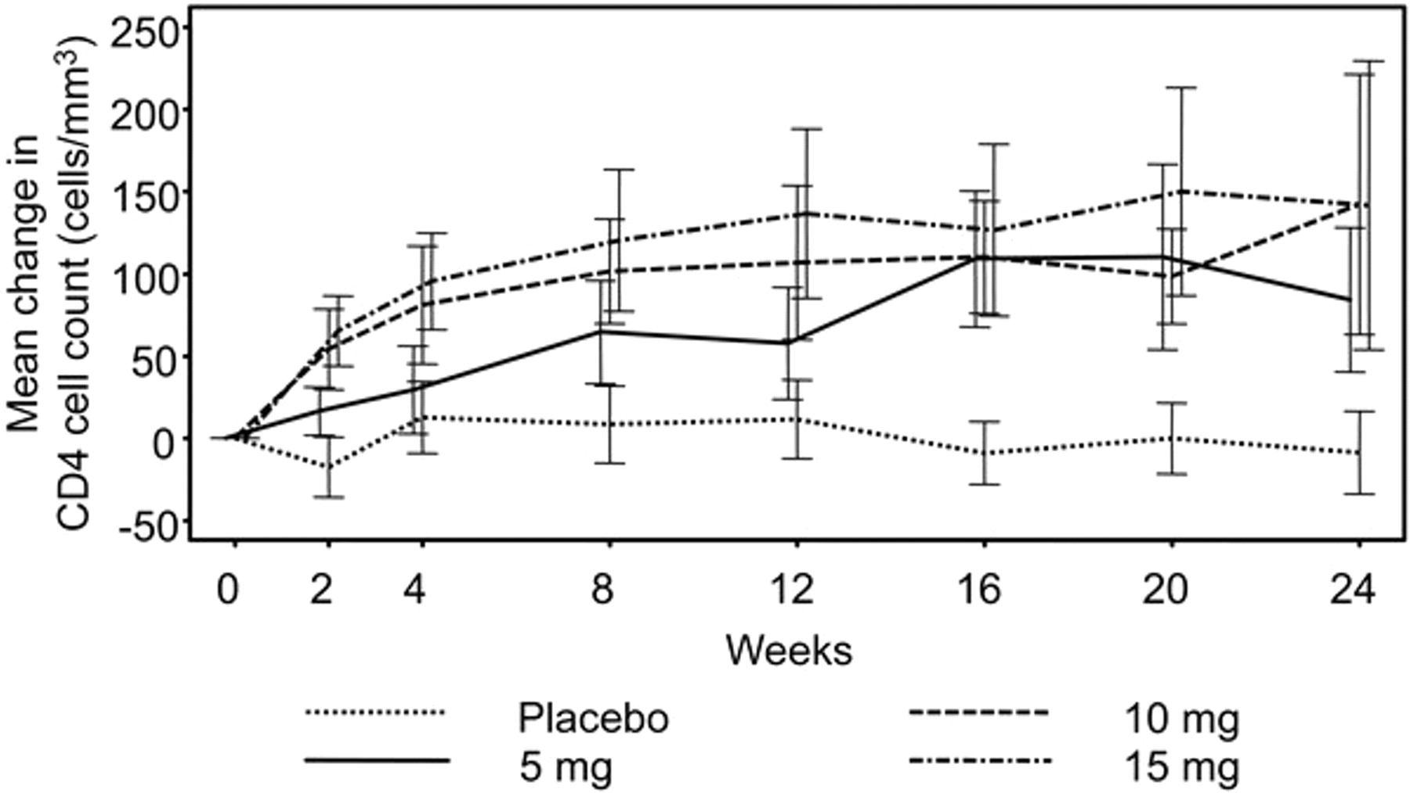
Figure 4. Mean change in CD4 cell count (cells/mm3) through week 24. Bars represent the 95% confidence intervals.
Notes:
Figure 4. Mean change in CD4 cell count (cells/mm3) through week 24. Bars represent the 95% confidence intervals.
Unless provided in the caption above, the following copyright applies to the content of this slide: © 2007 by the Infectious Diseases Society of America

