Slide 1
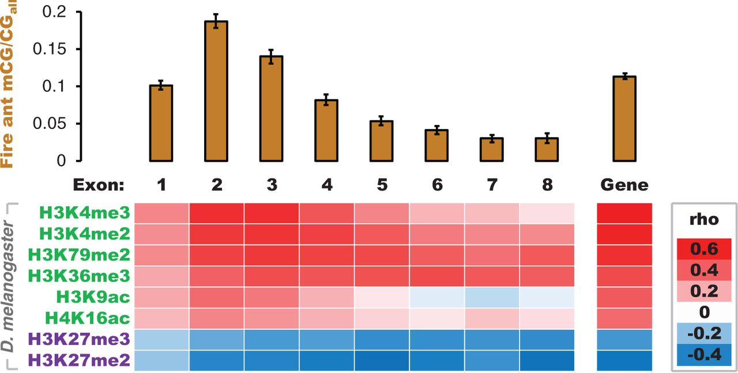
Fig. 1.— DNA methylation is targeted to genes marked by active histone modifications. Bars indicate mean DNA ...
Notes:
Fig. 1.— DNA methylation is targeted to genes marked by active histone modifications. Bars indicate mean DNA methylation level (mCG/CGall) in the fire ant with 95% confidence intervals. The heatmap conveys the strength and direction of Spearman’s rank correlation coefficients (rho) between DNA methylation levels in the fire ant Solenopsis invicta and enrichment of histone modifications targeted to orthologs in the fly Drosophila melanogaster. Histone modifications in green are associated with active transcription and those in purple are associated with repression of transcription (Kharchenko et al. 2011). Exon position is indicated from 5′ to 3′ relative to the translation start site in each species and “gene” indicates the gene body (introns included but excluding untranslated regions).
Unless provided in the caption above, the following copyright applies to the content of this slide: © The Author(s) 2013. Published by Oxford University Press on behalf of the Society for Molecular Biology and Evolution.This is an Open Access article distributed under the terms of the Creative Commons Attribution Non-Commercial License (http://creativecommons.org/licenses/by-nc/3.0/), which permits unrestricted non-commercial use, distribution, and reproduction in any medium, provided the original work is properly cited.

Slide 2
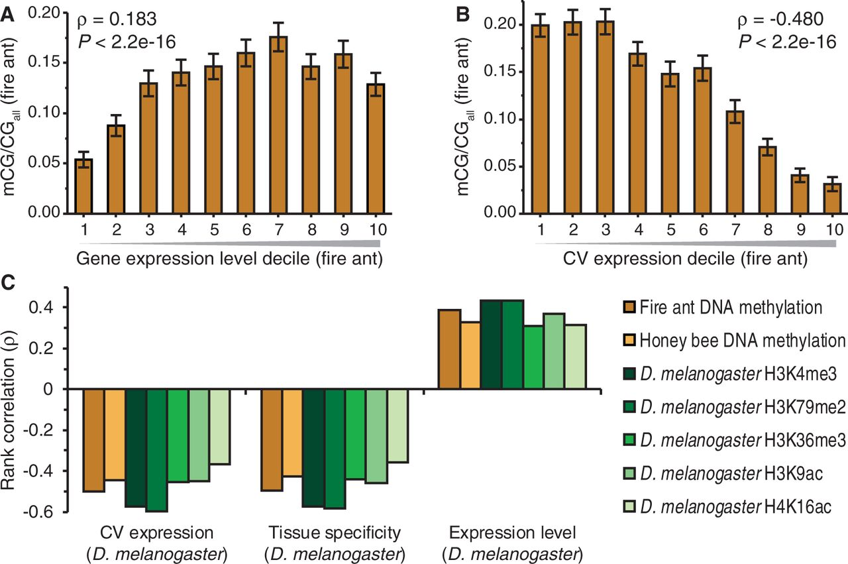
Fig. 2.— Both DNA methylation and active histone modifications are similarly associated with transcriptional ...
Notes:
Fig. 2.— Both DNA methylation and active histone modifications are similarly associated with transcriptional regulation. Mean fire ant coding sequence DNA methylation level (mCG/CGall) exhibits (A) a generally positive but bell-shaped relationship with gene expression level, and (B) a negative relationship with the CV in gene expression (CV expression). Error bars indicate 95% confidence intervals (n = 3,201 for panels A and B). (C) Gene expression measures in Drosophila melanogaster are strongly negatively (CV expression and tissue specificity) or positively (expression level) correlated with enrichment of active histone modifications in D. melanogaster and DNA methylation in Solenopsis invicta and Apis mellifera (n = 3,892 orthologous genes). All correlations are highly significant (P < 2.2 × 10−16).
Unless provided in the caption above, the following copyright applies to the content of this slide: © The Author(s) 2013. Published by Oxford University Press on behalf of the Society for Molecular Biology and Evolution.This is an Open Access article distributed under the terms of the Creative Commons Attribution Non-Commercial License (http://creativecommons.org/licenses/by-nc/3.0/), which permits unrestricted non-commercial use, distribution, and reproduction in any medium, provided the original work is properly cited.

Slide 3
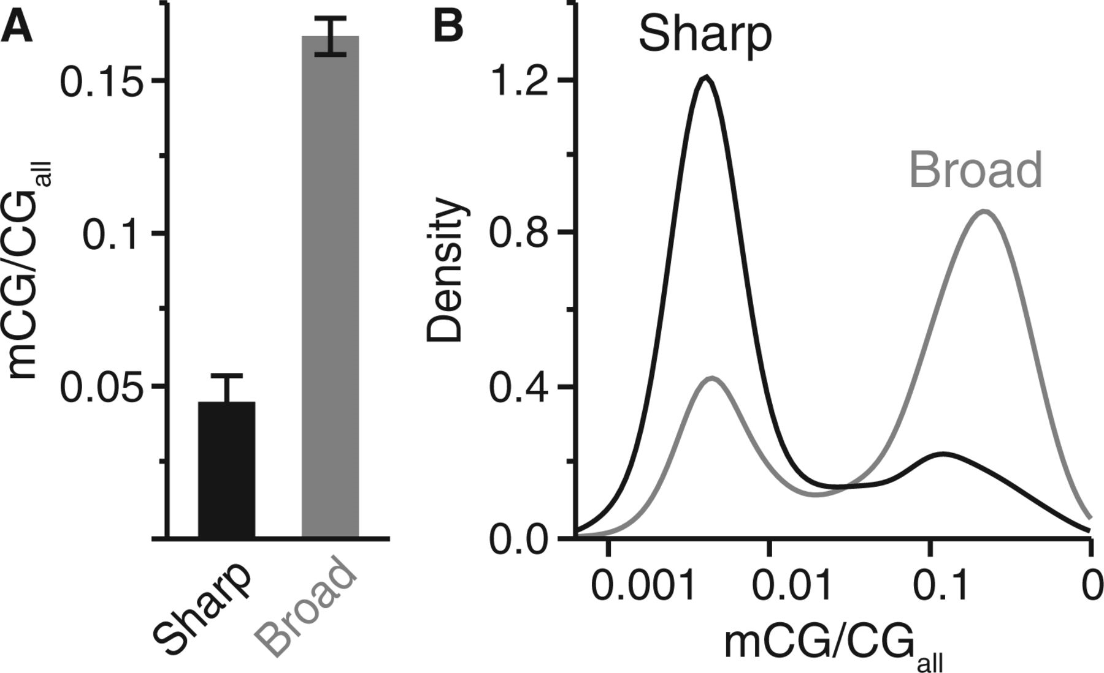
Fig. 3.— DNA methylation patterns differ based on promoter architectural classification. (A) Mean DNA methylation ...
Notes:
Fig. 3.— DNA methylation patterns differ based on promoter architectural classification. (A) Mean DNA methylation level in fire ant coding sequences differ according to sharp (n = 530) and broad (n = 2,919) core promoter architecture classifications of Drosophila melanogaster orthologs (Mann–Whitney U test, P < 2.2 × 10−16). (B) Density graph comparison of fire ant DNA methylation distributions for each promoter class-based gene category, illustrating high relative representation of methylated genes associated with broad core promoters.
Unless provided in the caption above, the following copyright applies to the content of this slide: © The Author(s) 2013. Published by Oxford University Press on behalf of the Society for Molecular Biology and Evolution.This is an Open Access article distributed under the terms of the Creative Commons Attribution Non-Commercial License (http://creativecommons.org/licenses/by-nc/3.0/), which permits unrestricted non-commercial use, distribution, and reproduction in any medium, provided the original work is properly cited.

Slide 4
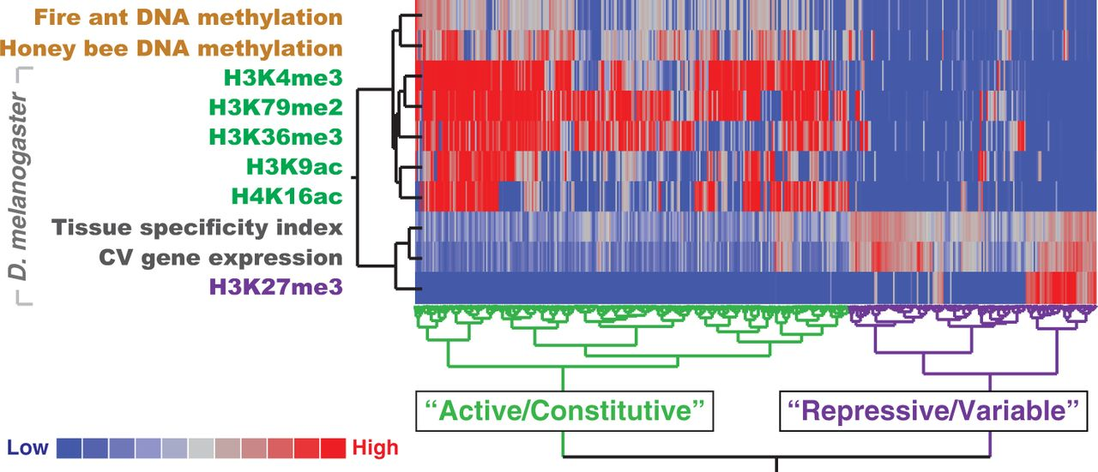
Fig. 4.— Histone modifications, DNA methylation patterning, and gene expression profiles define constitutively and ...
Notes:
Fig. 4.— Histone modifications, DNA methylation patterning, and gene expression profiles define constitutively and variably expressed genes in insects. A heatmap of coding sequence DNA methylation levels, histone modification enrichment, and gene expression measures produced by the Ward hierarchical clustering method with dendrograms proportional to distance. Two clusters emerge (n = 3,892 orthologous genes).
Unless provided in the caption above, the following copyright applies to the content of this slide: © The Author(s) 2013. Published by Oxford University Press on behalf of the Society for Molecular Biology and Evolution.This is an Open Access article distributed under the terms of the Creative Commons Attribution Non-Commercial License (http://creativecommons.org/licenses/by-nc/3.0/), which permits unrestricted non-commercial use, distribution, and reproduction in any medium, provided the original work is properly cited.

