Slide 1
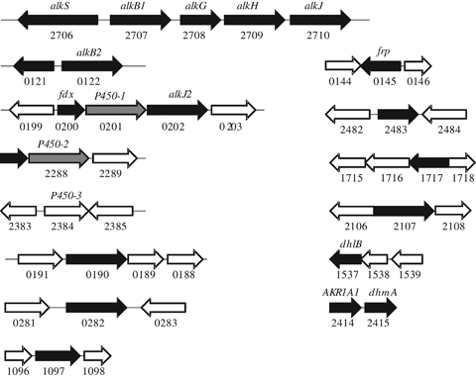
1 Combined schematic representation of genomic regions containing genes encoding monooxygenases and enzymes ...
Notes:
1 Combined schematic representation of genomic regions containing genes encoding monooxygenases and enzymes presumably involved in the initial oxidation of alkanes derived from the analysis of proteomic (Sabirova, 2006) and transcriptomic data. Genes upregulated in alkane-grown cells are shown in black; white-colored ORFs with black frames show genes in the Alcanivorax borkumensis genome that seem not to be upregulated; grey-colored ORFs show the P450-1 and P450-2 genes (ABO_0201 and ABO_2288, correspondingly), encoding identical p450 cytochrome proteins.
Unless provided in the caption above, the following copyright applies to the content of this slide: © 2011 Federation of European Microbiological Societies. Published by Blackwell Publishing Ltd. All rights reserved

Slide 2
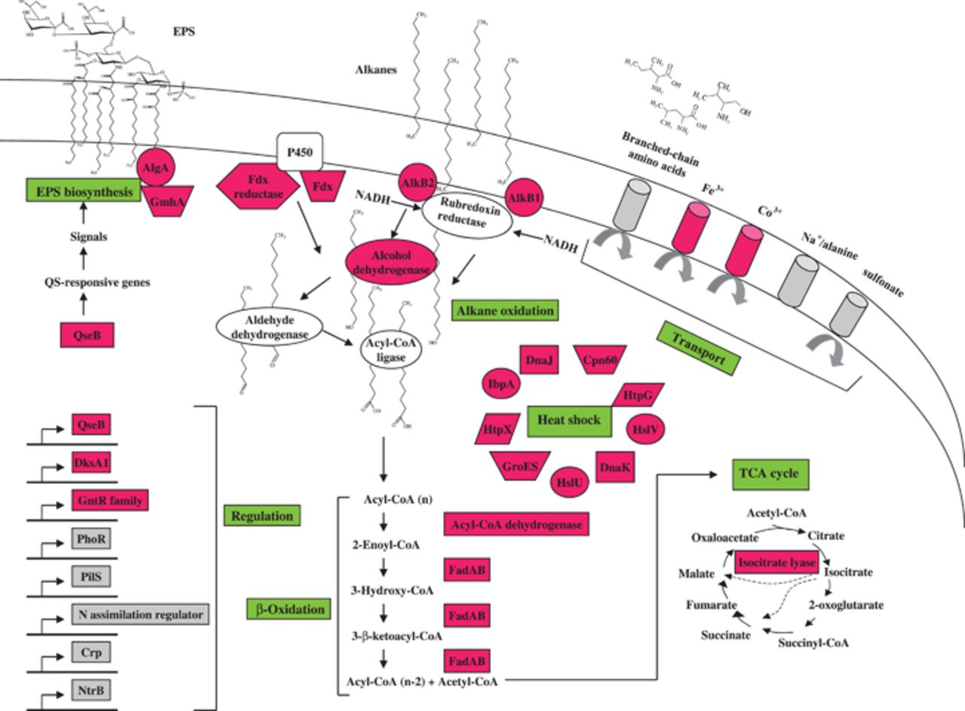
2 Representation of the metabolic response of Alcanivorax borkumensis SK2 to alkane exposure as opposed to ...
Notes:
2 Representation of the metabolic response of Alcanivorax borkumensis SK2 to alkane exposure as opposed to pyruvate. Genes repressed or induced after exposure to alkanes are shown with a grey or a red background, respectively.
Unless provided in the caption above, the following copyright applies to the content of this slide: © 2011 Federation of European Microbiological Societies. Published by Blackwell Publishing Ltd. All rights reserved

Slide 3
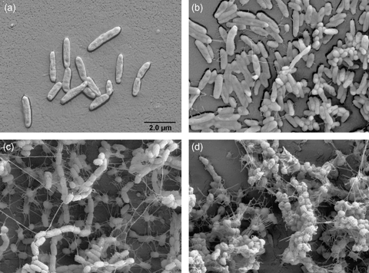
3 Transmission electron microscopy observations of Alcanivorax borkumensis SK2 cells, their adhesion, and ...
Notes:
3 Transmission electron microscopy observations of Alcanivorax borkumensis SK2 cells, their adhesion, and biofilm formation on abiotic surfaces. The cells were grown on either pyruvate (a, b) or hexadecane (c, d) on Permanox slides in ONR7a medium. The biofilms were monitored after 4 days (a, c) and 10 days (b, d) of growth.
Unless provided in the caption above, the following copyright applies to the content of this slide: © 2011 Federation of European Microbiological Societies. Published by Blackwell Publishing Ltd. All rights reserved

