Slide 1
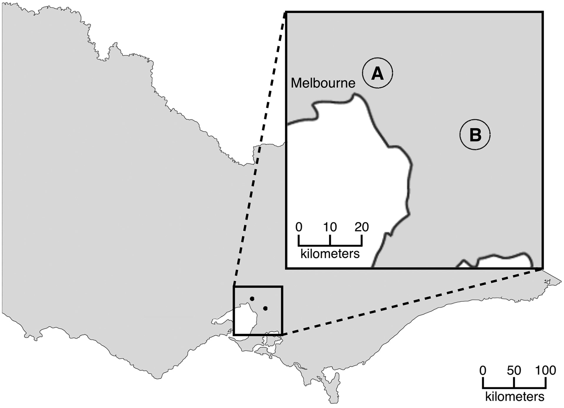
Figure 1. Map of the Victorian state showing the two distinct regional clusters A (inner east of Melbourne) and B* ...
Notes:
Figure 1. Map of the Victorian state showing the two distinct regional clusters A (inner east of Melbourne) and B* (outer south-west ~35 km from Melbourne) where the 9 fentanyl and heroin combination deaths occurred. *Region where exhibits were located have confirmed by the laboratory to contain fentanyl-laced heroin.
Unless provided in the caption above, the following copyright applies to the content of this slide: © Crown copyright 2017

