Slide 1
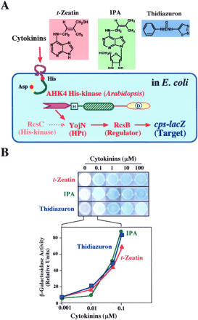
Fig. 1 The Arabidopsis AHK4 His-kinase functions as a cytokinin sensor in E. coli. (A) Structures of ...
Notes:
Fig. 1 The Arabidopsis AHK4 His-kinase functions as a cytokinin sensor in E. coli. (A) Structures of cytokinins, and conceptual views that explain how the Arabidopsis AHK4 protein functions as a sensor for cytokinins in E. coli (Suzuki et al. 2001). Three representatives of cytokinins are shown, including trans-zeatin, isopentenyl-adenosine (IPA), and thidiazuron. As illustrated, the E. coli RcsC→YojN→RcsB multistep phosphorelay is responsible for activation of the cps operon. The E. coli mutant (ΔrcsC) used in this study carries a cps::lacZ fusion gene on the chromosome (Takeda et al. 2001). When the Arabidopsis AHK4 gene is expressed in this particular mutant, AHK4 is capable of signaling the downstream YojN→RcsB→csp::lacZ pathway in response to external cytokinins. Consequently, the target csp::lacZ gene is activated. (B) Based on these experimental rationales, E. coli cells carrying the plasmid that encompasses the AHK4 gene were grown on agar plates, supplemented with 5-bromo-4-chloro-3-indoylyl-β-d-galactoside (X-Gal) (spot assay). Note that the cells were grown at 25°C on Luria-agar plates, supplemented with and without each indicated cytokinin. After 40 h incubation, the plates were photographed. Also, β-galactosidase activities were assayed with E. coli cells, grown in liquid medium containing varied concentrations of cytokinins (β-galactosidase assay). Such experiments were repeated several times, and representative data are shown.
Unless provided in the caption above, the following copyright applies to the content of this slide:

Slide 2
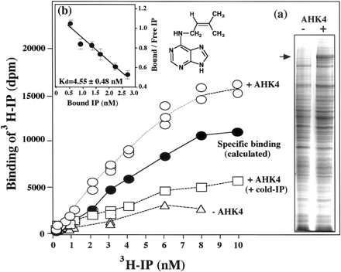
Fig. 2 In vitro binding assay of cytokinins with the AHK4 protein in the S. pombe membrane. The AHK4 gene was ...
Notes:
Fig. 2 In vitro binding assay of cytokinins with the AHK4 protein in the S. pombe membrane. The AHK4 gene was introduced into a certain S. pombe strain (phk1/2/3Δ) with use of an appropriate S. pombe expression vector (Suzuki et al. 2001). The AHK4 gene was cloned onto an S. pombe versatile expression vector (pREP1). In this plasmid, the entire AHK4-cDNA was cloned under the S. pombenmt1+ promoter. S. pombe cells were grown in EMM medium at 30°C. The S. pombe cells, with and without the AHK4 gene, were harvested, and then they were fractionated into soluble and membrane fractions. The membrane fraction was loaded onto a sucrose-density gradient, and then centrifuged. A certain membrane fraction from this sucrose-density gradient was analyzed by sodium dodecyl sulfate polyacrylamide gel electrophoresis (see inset-a). The major band, indicated by an arrow, was found exclusively in the AHK4-plus membrane. This membrane fraction was used as AHK4-containing S. pombe membranes for the following in vitro cytokinin-binding assay. For the binding assay, 3H-labeled isopentenyl-adenine (3H-IP) was synthesized as follows. First, 3H-labeled isopentenyl-adenosine (3H-IPA) was synthesized from 3H-AMP and dimethyl-allyl-diphosphate (DAP) by incubating with an isopentenyl transferase. The product was treated with an alkaline phosphatase to remove the phosphoryl group at the position of C5 of the adenosine moiety. The resulting 3H-IPA was purified, and the yield was 44,276 dpm pmol–1. To obtain 3H-IP, the 3H-IPA product was treated with 0.1 M HCl at 100°C. The yield of 3H-IP was 39,393 dpm pmol–1. This purified 3H-IP in H2O was stored at –25°C, and used for the following binding assay. More details will be described elsewhere (Takei, unpublished data). The AHK4-containg S. pombe membrane (50 µg) was incubated with varied concentrations of 3H-IP in a buffer (100 µl), comprising 10 mM MES (pH 6.0), 1 mM MgCl2, 0.05 MnCl2, 0.1 mM CaCl2, 10% glycerol, 0.1 mg bovine serum albumin. When necessary, an excess amount (200-fold) of non-radioactive (cold) IP was also added. The mixture was incubated for 30 min at 25°C. The bound and free 3H-IP were separated by a filter-equipped mini-centrifuge tube (Ultrafree 0.1 µm filter, Millipore) by centrifugation. They are quantified by scintillation counter. Specific binding was determined by subtracting the binding in the presence of cold-IP from total binding. The binding assays were independently repeated three times, and all of these values are plotted. To estimate the binding affinity, the dissociation constant (Kd) was calculated by plotting the mean values according to the standard formula (Scatchard’s plot), as shown in inset-b.
Unless provided in the caption above, the following copyright applies to the content of this slide:

Slide 3
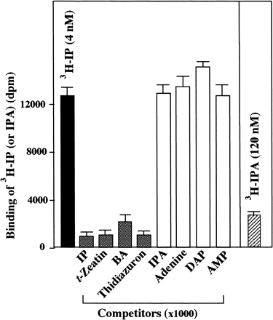
Fig. 3 Competitive cytokinin-binding assay. Binding assays with the AHK4-containing S. pombe membrane and ...
Notes:
Fig. 3 Competitive cytokinin-binding assay. Binding assays with the AHK4-containing S. pombe membrane and 3H-IP was carried out in the absence and presence of an excess amount (1,000-fold) of indicated cytokinin-related chemicals, as described in Fig. 2. Similarly, a binding assay was carried out with 3H-IPA without competitor. The average of two experiments is shown.
Unless provided in the caption above, the following copyright applies to the content of this slide:

Slide 4
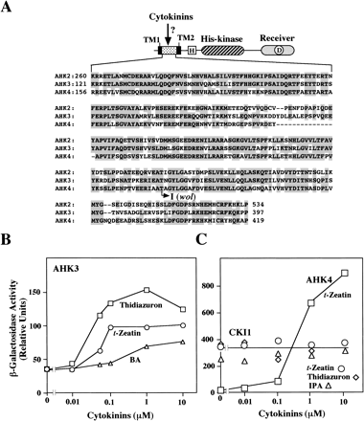
Fig. 4 (A) Structure of AHK4 and comparison with other His-kinases, AHK2 and AHK3. As reported previously ...
Notes:
Fig. 4 (A) Structure of AHK4 and comparison with other His-kinases, AHK2 and AHK3. As reported previously (Ueguchi et al. 2001), Arabidopsis has three homologous His-kinases (AHK2, AHK3, AHK4), the entire amino acid sequences are highly similar to each other, as schematically shown. The similarities are seen not only in the common His-kinase and receiver domains, but also in their N-terminal extensions. Each N-terminal extension encompasses two putative membrane-spanning regions (TM1 and TM2) and an intervening sequence. Among AHK2, AHK3, and AHK4, the amino acid sequences of these intervening regions are aligned, in which conserved amino acids are shaded. Note that two possible initiation methionine residues can be inferred for AHK4 (Mahonen et al. 2000, Inoue et al. 2001, Suzuki et al. 2001). The upstream one was adopted here. The previously reported wol mutant has the single amino acid substitution at the position of 301 (Thr to Ile), as indicated (Mahonen et al. 2000). (B) AHK3 also functions as a cytokinin sensor in E. coli. The AHK3 gene was cloned onto an E. coli versatile expression vector (pIN-III), similarly as in the case of the AHK4 gene (Suzuki et al. 2001). The AHK3 gene was introduced into the E. coli strain (ΔrcsCcps::lacZ) (see Fig. 1). The cells were grown in the presence of varied concentrations of cytokinins (trans-zeatin, BA, or thidiazuron), and then they were assayed for β-galctosidase activity. (C) CKI1 functions as a His-kinase in E. coli, but it does not respond to cytokinins. The CKI1 gene was cloned onto an E. coli versatile expression vector (pBlue-Script). This is a kind gift from T. Kakimoto (1996). The CKI1 gene was introduced into the same E. coli strain, and then characterized, as described above, with special reference to its responsiveness to cytokinins (trans-zeatin, IPA, or thidiazuron). The function of AHK4 was also monitored in this experiment, as an appropriate reference.
Unless provided in the caption above, the following copyright applies to the content of this slide:

Slide 5
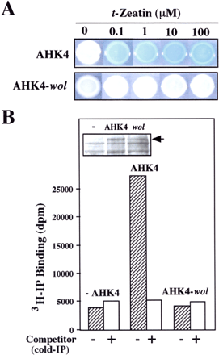
Fig. 5 Natures of a certain AHK4 mutant, named wooden leg (wol). The previously reported wol mutant of ...
Notes:
Fig. 5 Natures of a certain AHK4 mutant, named wooden leg (wol). The previously reported wol mutant of Arabidopsis is allelic to the AHK4 gene (Mahonen et al. 2000). The mutant product is designated here as AHK4-wol, which has the Thr-301 to Ile amino acid substitution (see Fig. 4). The natures of this mutant protein was compared with the wild-type protein. (A) AHK-wol has no ability to propagate cytokinin-signals in the E. coli assay system. The AHK4-wol gene, encoding the mutant AHK4 protein with the Thr-301 to Ile substitution, was constructed on an E. coli plasmid vector by means of site-directed mutagenesis. A spot assay was carried out for E. coli cells carrying the mutant AHK4-wol gene, with varied concentrations of trans-zeatin in agar-plates, as described in Fig. 1. (B) AHK4-wol has no ability to bind cytokinins in the in vitro binding assay with the S. pombe membrane. The AHK4-wol mutant gene was cloned onto an S. pombe versatile expression vector, similarly as in the case of the wild-type AHK4 gene. The S. pombe membrane fraction containing the AHK4-wol protein was examined for its ability to bind 3H-IP in vitro, in the presence and absence (+ and –) of the competitor (IP) (200-fold), as described in Fig. 2. Such binding-assays were repeated three times, and representative data are shown. The S. pombe membranes with and without the wild-type AHK4 protein were also examined, as references. These S. pombe membranes were analyzed by sodium dodecyl sulfate polyacrylamide gel electrophoresis, in order to make sure that each contains a comparable amount of AHK4-polypeptide (see inset).
Unless provided in the caption above, the following copyright applies to the content of this slide:

