Slide 1
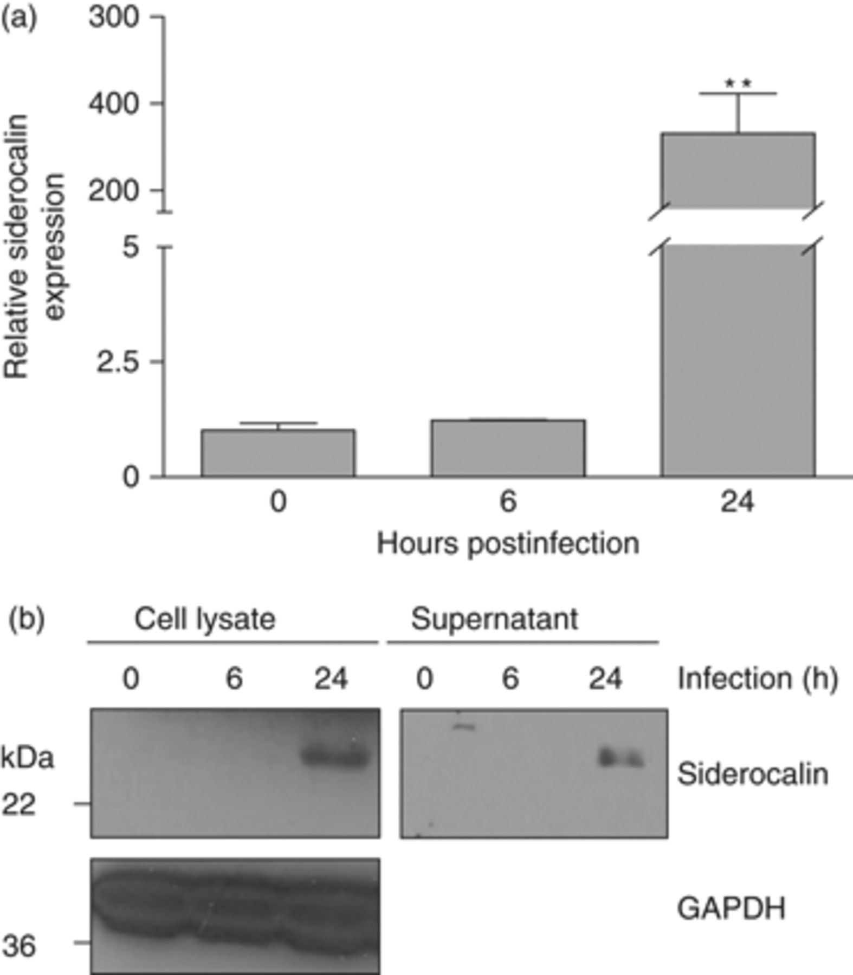
1 Mycobacterium tuberculosis infection stimulates siderocalin expression in murine macrophages. RAW264.7 murine ...
Notes:
1 Mycobacterium tuberculosis infection stimulates siderocalin expression in murine macrophages. RAW264.7 murine macrophages were infected with M.tb at an MOI of 5 : 1. (a) Cells were harvested in TRIZOL reagent at the indicated time points. Relative siderocalin expression was determined using qRT-PCR. Gene expression corresponds to the between siderocalin and a reference gene (GAPDH). (b) Cell lysate and culture media (supernatant) were harvested and subjected to Western blotting with antisiderocalin mAb. GAPDH served as a loading control. For statistical analysis, the means±SEM from an individual experiment (n=3) are shown. **P≤0.01 using the Student t-test. Similar results were obtained in separate experiments.
Unless provided in the caption above, the following copyright applies to the content of this slide: © 2009 Federation of European Microbiological Societies. Published by Blackwell Publishing Ltd. All rights reserved

Slide 2
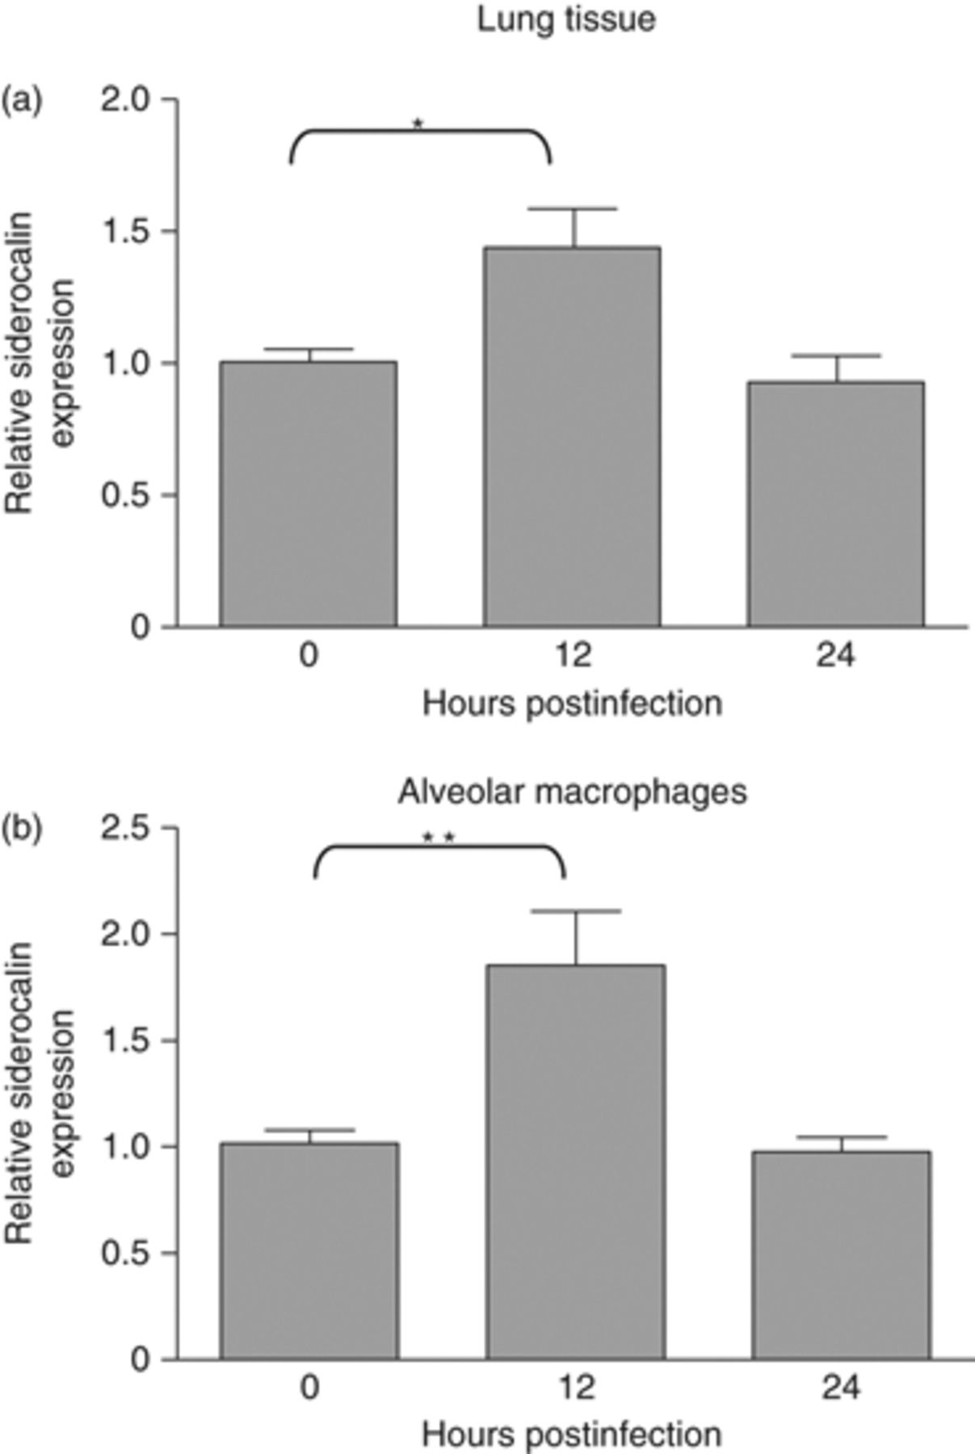
2 Siderocalin is induced in lung tissue and alveolar macrophages following M.tb infection. Seven- to 9-week-old ...
Notes:
2 Siderocalin is induced in lung tissue and alveolar macrophages following M.tb infection. Seven- to 9-week-old female C57BL/6J mice were infected with the Erdmann strain of M.tb via aerosol. (a) Lungs were surgically removed 12 and 24 h postinfection and homogenized in TRIZOL to prepare total RNA. (b) Bronchoalveolar lavage fluid was collected at 12 and 24 h after infection and alveolar macrophages were prepared. The cells were homogenized in TRIZOL. Siderocalin expression was determined in total lung and alveolar macrophages using qRT-PCR. Gene expression corresponds to the between siderocalin and a reference gene (36B4). For statistical analysis, the means±SEM from a single experiment (n=5) for lung and alveolar macrophages are shown. *P≤0.05; **P≤0.01, using the Student t-test.
Unless provided in the caption above, the following copyright applies to the content of this slide: © 2009 Federation of European Microbiological Societies. Published by Blackwell Publishing Ltd. All rights reserved

Slide 3
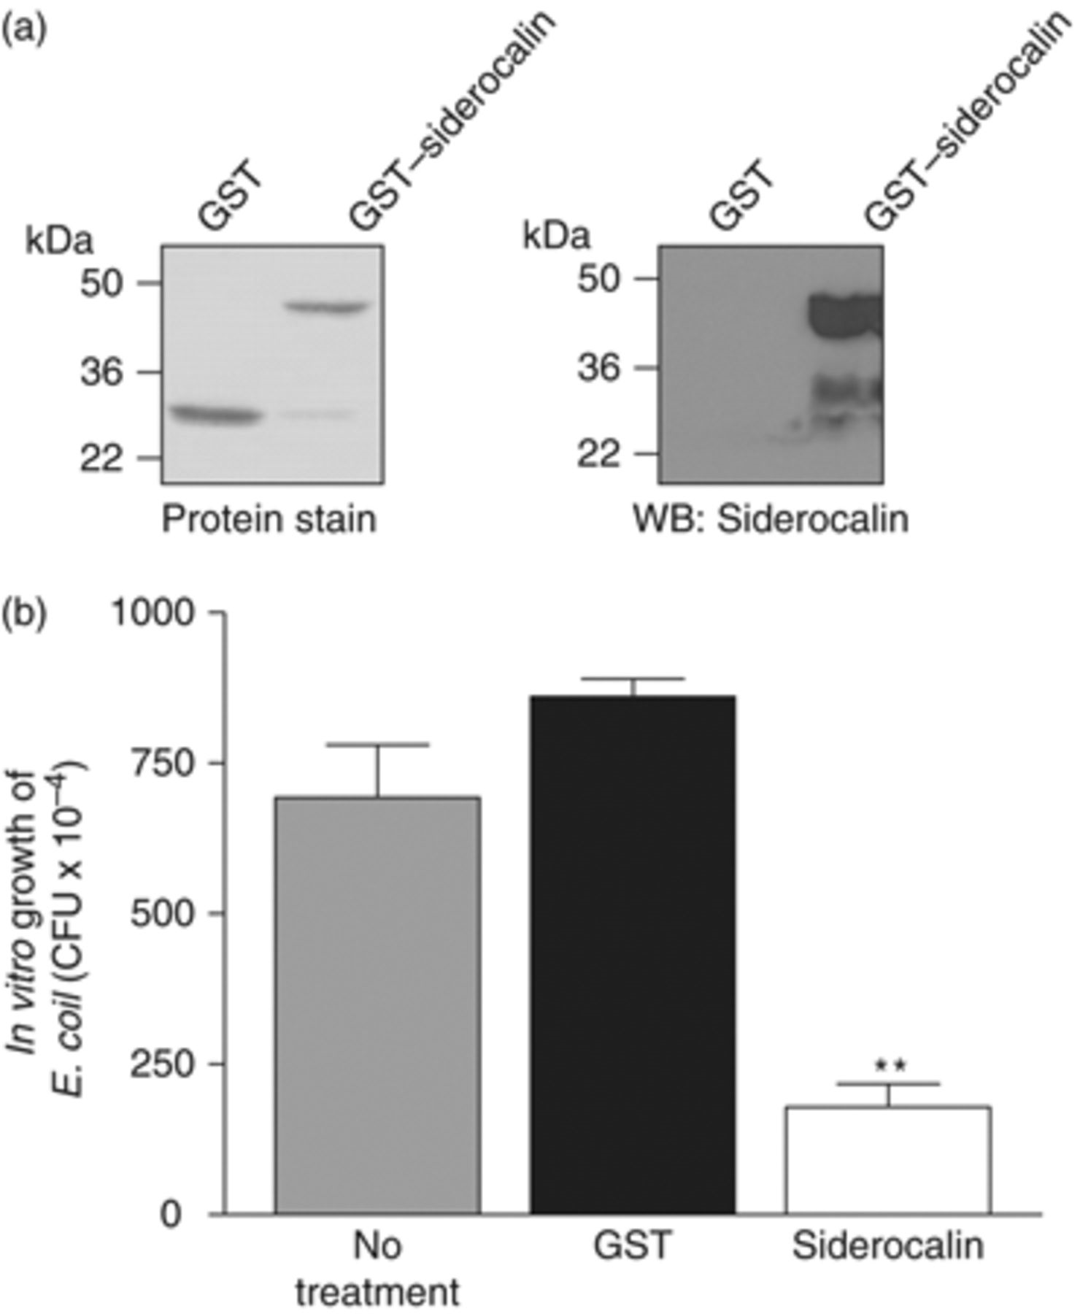
3 Purification and efficacy of recombinant siderocalin. (a) Coomassie staining was used to assess the purity ...
Notes:
3 Purification and efficacy of recombinant siderocalin. (a) Coomassie staining was used to assess the purity and molecular weight of recombinant protein preparations. The identity of the recombinant siderocalin was determined using Western blotting with a monoclonal antisiderocalin antibody. (b) Escherichia coli was treated for 6 h with10 µg mL−1 recombinant GST or GST–siderocalin. The treated cultures were then serially diluted in order to quantify CFU. For statistical analysis, the means±SEM from a single experiment (n=3) are shown. **P≤0.01, using the Student t-test.
Unless provided in the caption above, the following copyright applies to the content of this slide: © 2009 Federation of European Microbiological Societies. Published by Blackwell Publishing Ltd. All rights reserved

Slide 4
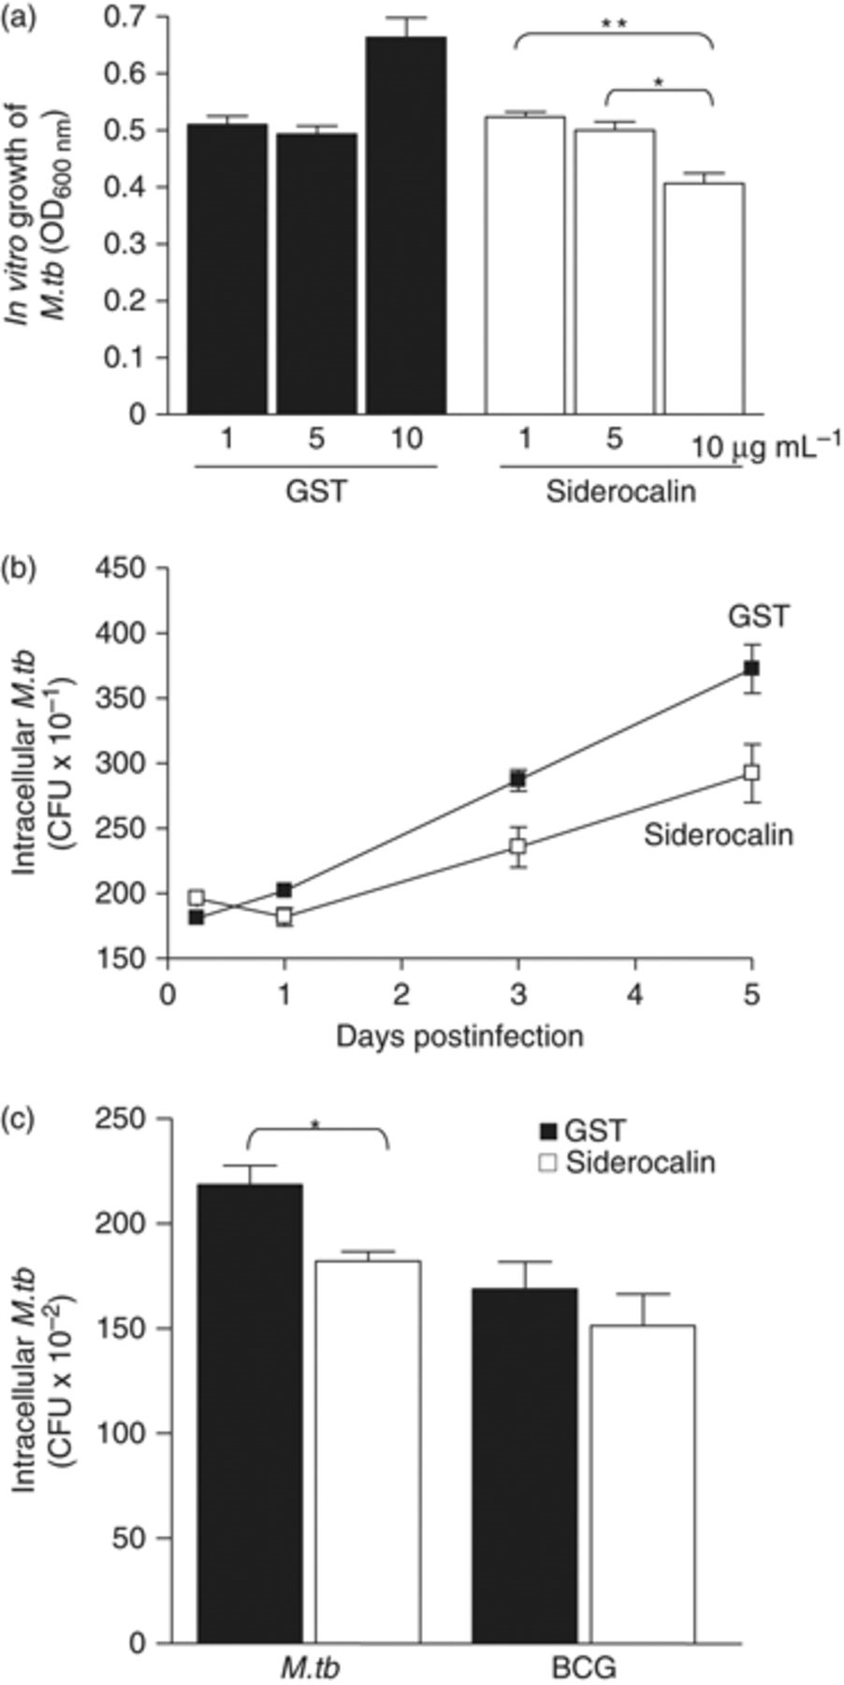
4 Recombinant siderocalin inhibits M.tb growth. (a) Mycobacterium tuberculosis (3 × 10⁴ CFU ...
Notes:
4 Recombinant siderocalin inhibits M.tb growth. (a) Mycobacterium tuberculosis (3 × 104 CFU mL−1) was grown in 7H9 broth containing the indicated concentrations of GST or GST–siderocalin. Growth was assayed by determining the OD600 nm. For statistical analysis, the means±SEM from a single experiment (n=3) are shown. **P≤0.01; *P≤0.05 using the Student t-test. (b) RAW264.7 cells were infected with M.tb at an MOI of 1 : 1. Ten micrograms per milliliter of GST or GST–siderocalin was added to the culture medium daily over the time course. The replication of intracellular bacteria was assessed by determining CFU. The means±SEM from one experiment (n=3) are shown. Statistical analysis using two-way anova determined that the curves were significantly different; P<0.0001. (c) RAW264.7 cells were infected with M.tb or BCG at an MOI of 1 : 1. Ten micrograms per milliliter of GST or GST–siderocalin was added to the culture medium daily for 3 days. The replication of intracellular bacteria was determined by counting CFU. The means±SEM from one experiment (n=3) are shown. *P≤0.05 using the Student t-test. For all experiments, similar results were obtained on separate occasions.
Unless provided in the caption above, the following copyright applies to the content of this slide: © 2009 Federation of European Microbiological Societies. Published by Blackwell Publishing Ltd. All rights reserved

Slide 5
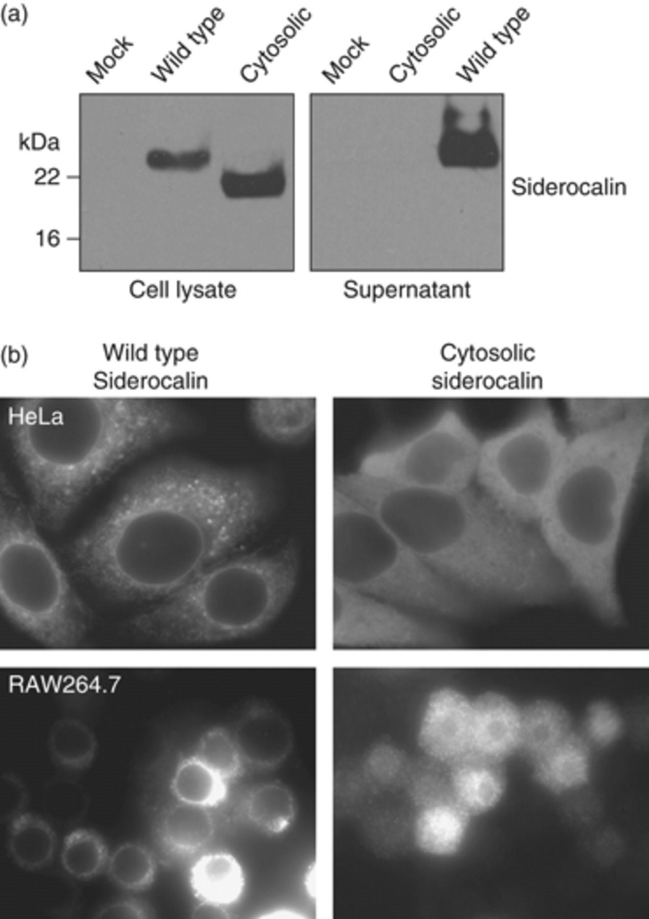
5 Generation of cells overexpressing siderocalin. (a) HeLa cells were transfected with the indicated ...
Notes:
5 Generation of cells overexpressing siderocalin. (a) HeLa cells were transfected with the indicated siderocalin expression plasmid using Lipofectamine 2000. Expression levels were evaluated by Western blotting with a monoclonal antisiderocalin antibody. (b) HeLa cells and RAW246.7 cells transfected with the indicated expression plasmid were analyzed by immunofluorescence to determine siderocalin expression.
Unless provided in the caption above, the following copyright applies to the content of this slide: © 2009 Federation of European Microbiological Societies. Published by Blackwell Publishing Ltd. All rights reserved

Slide 6
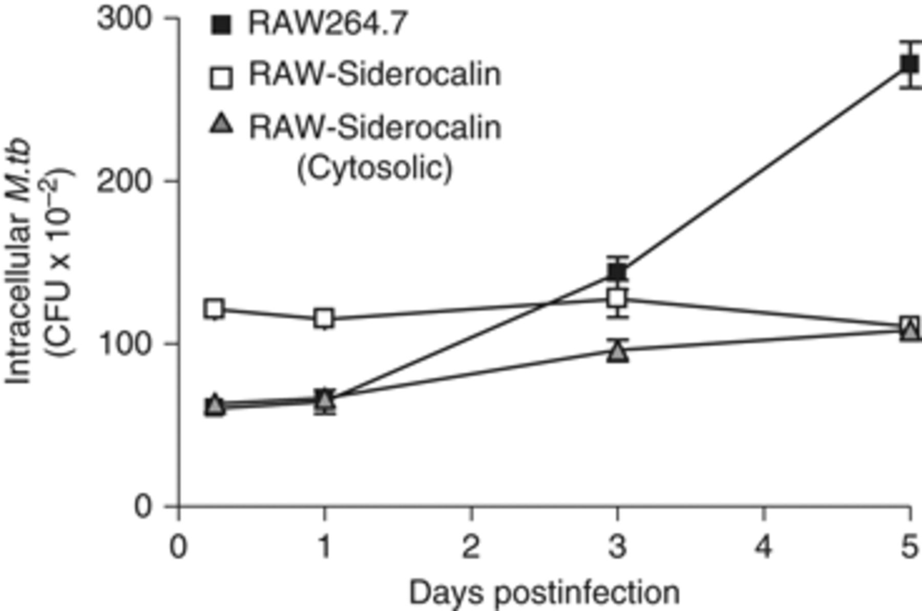
6 Overexpression of wild-type or cytosolic siderocalin significantly reduces intracellular M.tb growth. ...
Notes:
6 Overexpression of wild-type or cytosolic siderocalin significantly reduces intracellular M.tb growth. RAW264.7 cells stably expressing wild-type or cytosolic siderocalin were infected with M.tb at an MOI of 1 : 1. The replication of intracellular bacteria was analyzed by determining CFU at the indicated time points. The means±SEM from one experiment (n=3) are shown. Statistical analysis using two-way anova determined that the curves for the overexpressing cell lines were significantly different from the control; P<0.0001. Similar results were obtained on separate occasions.
Unless provided in the caption above, the following copyright applies to the content of this slide: © 2009 Federation of European Microbiological Societies. Published by Blackwell Publishing Ltd. All rights reserved

Slide 7
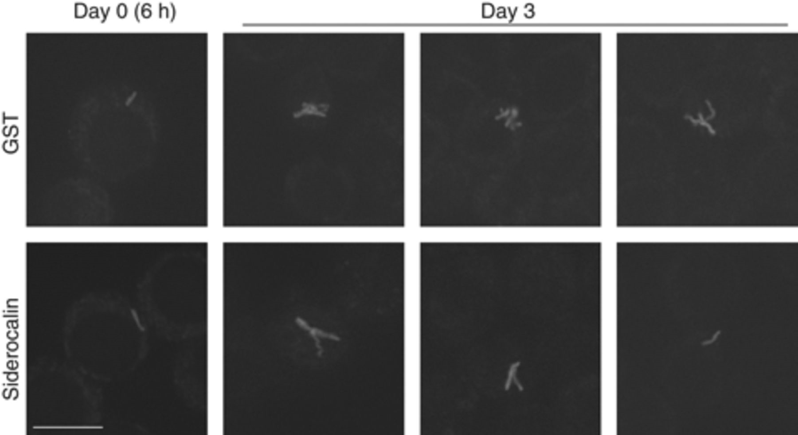
7 Siderocalin treatment results in intracellular growth arrest of M.tb. RAW264.7 cells grown on glass ...
Notes:
7 Siderocalin treatment results in intracellular growth arrest of M.tb. RAW264.7 cells grown on glass coverslips were infected with virulent H37Rv GFP-M.tb and incubated with recombinant GST–siderocalin or GST for 3 days. Cells were fixed using 3.7% paraformaldehyde and M.tb morphology was visualized using immunofluorescence.
Unless provided in the caption above, the following copyright applies to the content of this slide: © 2009 Federation of European Microbiological Societies. Published by Blackwell Publishing Ltd. All rights reserved

