Slide 1
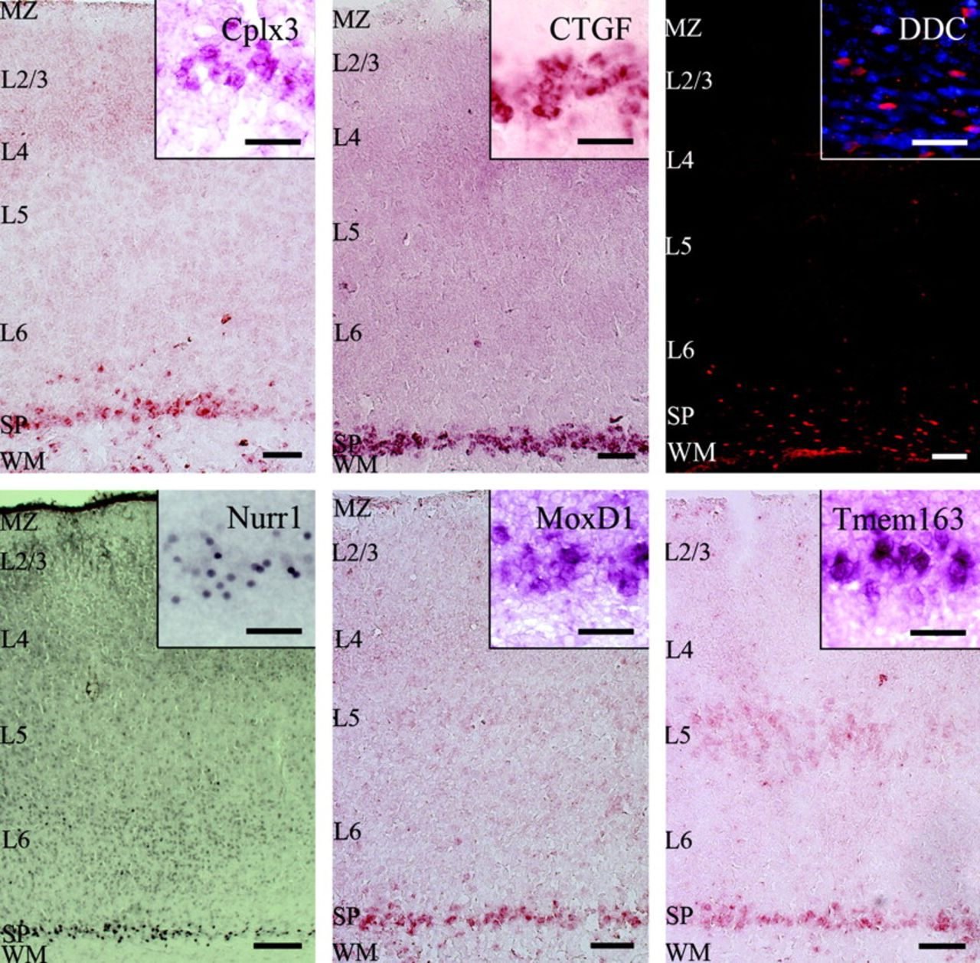
Figure 1. Subplate-selective gene expression in P8 mouse cortex. The panels of this figure show six genes that are each ...
Notes:
Figure 1. Subplate-selective gene expression in P8 mouse cortex. The panels of this figure show six genes that are each expressed in the subplate but not in adjacent layer 6. Cplx3 and CTGF show subplate-specific mRNA localization in mouse P8 cortex. Tmem163 (2610024A01Rik) and MoxD1 mRNA are present in the subplate and at a lower level also in cortical layer 5 at P8. In dorsal mouse cortex at P8, the DDC protein is localized to cells in the subplate and white matter, whereas the transcription factor Nurr1/Nr4a2 is localized to the subplate only in dorsal cortex (shown here). Cortical layers are indicated by the abbreviations: MZ, marginal zone; L2/3, layer 2/3; L4, layer 4; L5, layer 5; L6, layer 6; SP, subplate; WM, white matter. Scale bars 100 and 50 μm (inset).
Unless provided in the caption above, the following copyright applies to the content of this slide: © The Author 2008. Published by Oxford University Press. All rights reserved. For permissions, please e-mail: journals.permissions@oxfordjournals.org

Slide 2
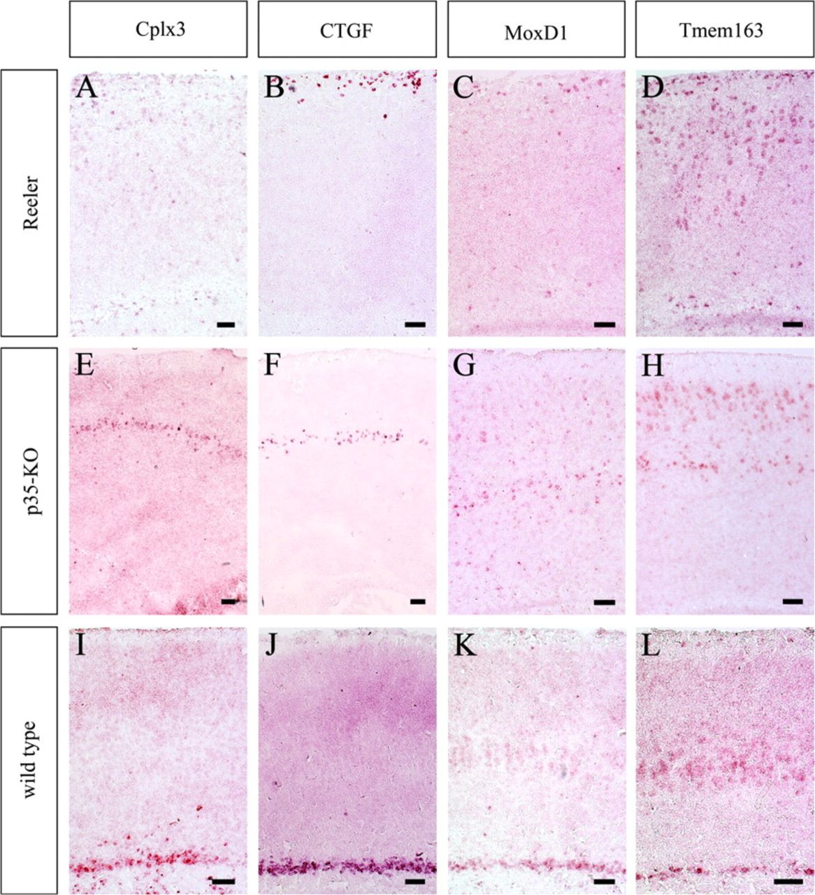
Figure 2. mRNA localization of subplate gene expression in mutants affecting cortical plate formation. The panels of ...
Notes:
Figure 2. mRNA localization of subplate gene expression in mutants affecting cortical plate formation. The panels of this figure show in situ hybridization signal in P8 reeler (A–D) and p35-KO (E–H) cortices for 4 genes selectively expressed in the subplate of wild-type mice. In reeler brains, the cortical preplate fails to split into marginal zone and subplate such that subplate cells are relocated to the superplate, that is, the outermost layer of cortex. All CTGF-, MoxD1-, and Tmem163-expressing “subplate” cells are located in the superplate of reeler brains (B, C, D), but only some Cplx3-expressing subplate cells are shifted to the superplate (A). The remainder of the Cplx3-expressing subplate cells is shifted downward into the white matter in reeler brains (A). In p35-KO brains, subplate cells are relocated to a thin layer of cells in the middle of cortex. All subplate cells expressing Cplx3, CTGF, MoxD1, or Tmem163 are relocated to the middle of the cortical plate in p35-KO brains (E–H), whereas Tmem163- and MoxD1-labeled layer 5 cells are shifted outward to just underneath the marginal zone. Scale bars = 100 μm.
Unless provided in the caption above, the following copyright applies to the content of this slide: © The Author 2008. Published by Oxford University Press. All rights reserved. For permissions, please e-mail: journals.permissions@oxfordjournals.org

Slide 3
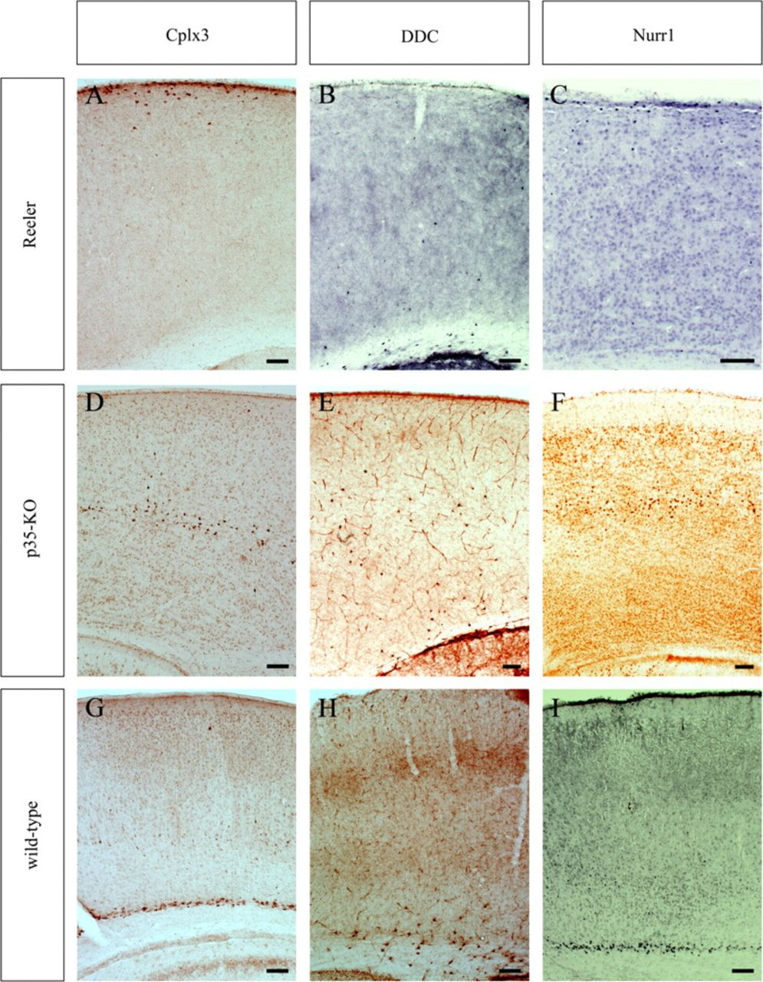
Figure 3. Protein localization of putative subplate cell markers in mutants affecting cortical plate formation. The ...
Notes:
Figure 3. Protein localization of putative subplate cell markers in mutants affecting cortical plate formation. The Cplx3 and Nurr1 protein localization shifts from the normal position in the subplate in wild-type brains to the superplate in reeler brains (A, C) and to a thin band in the middle of the cortical plate in p35-KO brains at P8 (D, F). DDC protein, which is normally localized to cells in the subplate, white matter, and lower layer 6, is only rarely detectable in cells in the superplate in reeler mutants, but DDC-positive cells are distributed across the lower half of the cortex (B), in a band broader than in the wild type (H). DDC-positive cells can also be found in the middle of cortex in p35-KO brains (E). However, the majority of DDC-positive cells remains in the white matter and subplate in both mutants. Scale bars = 100 μm.
Unless provided in the caption above, the following copyright applies to the content of this slide: © The Author 2008. Published by Oxford University Press. All rights reserved. For permissions, please e-mail: journals.permissions@oxfordjournals.org

Slide 4
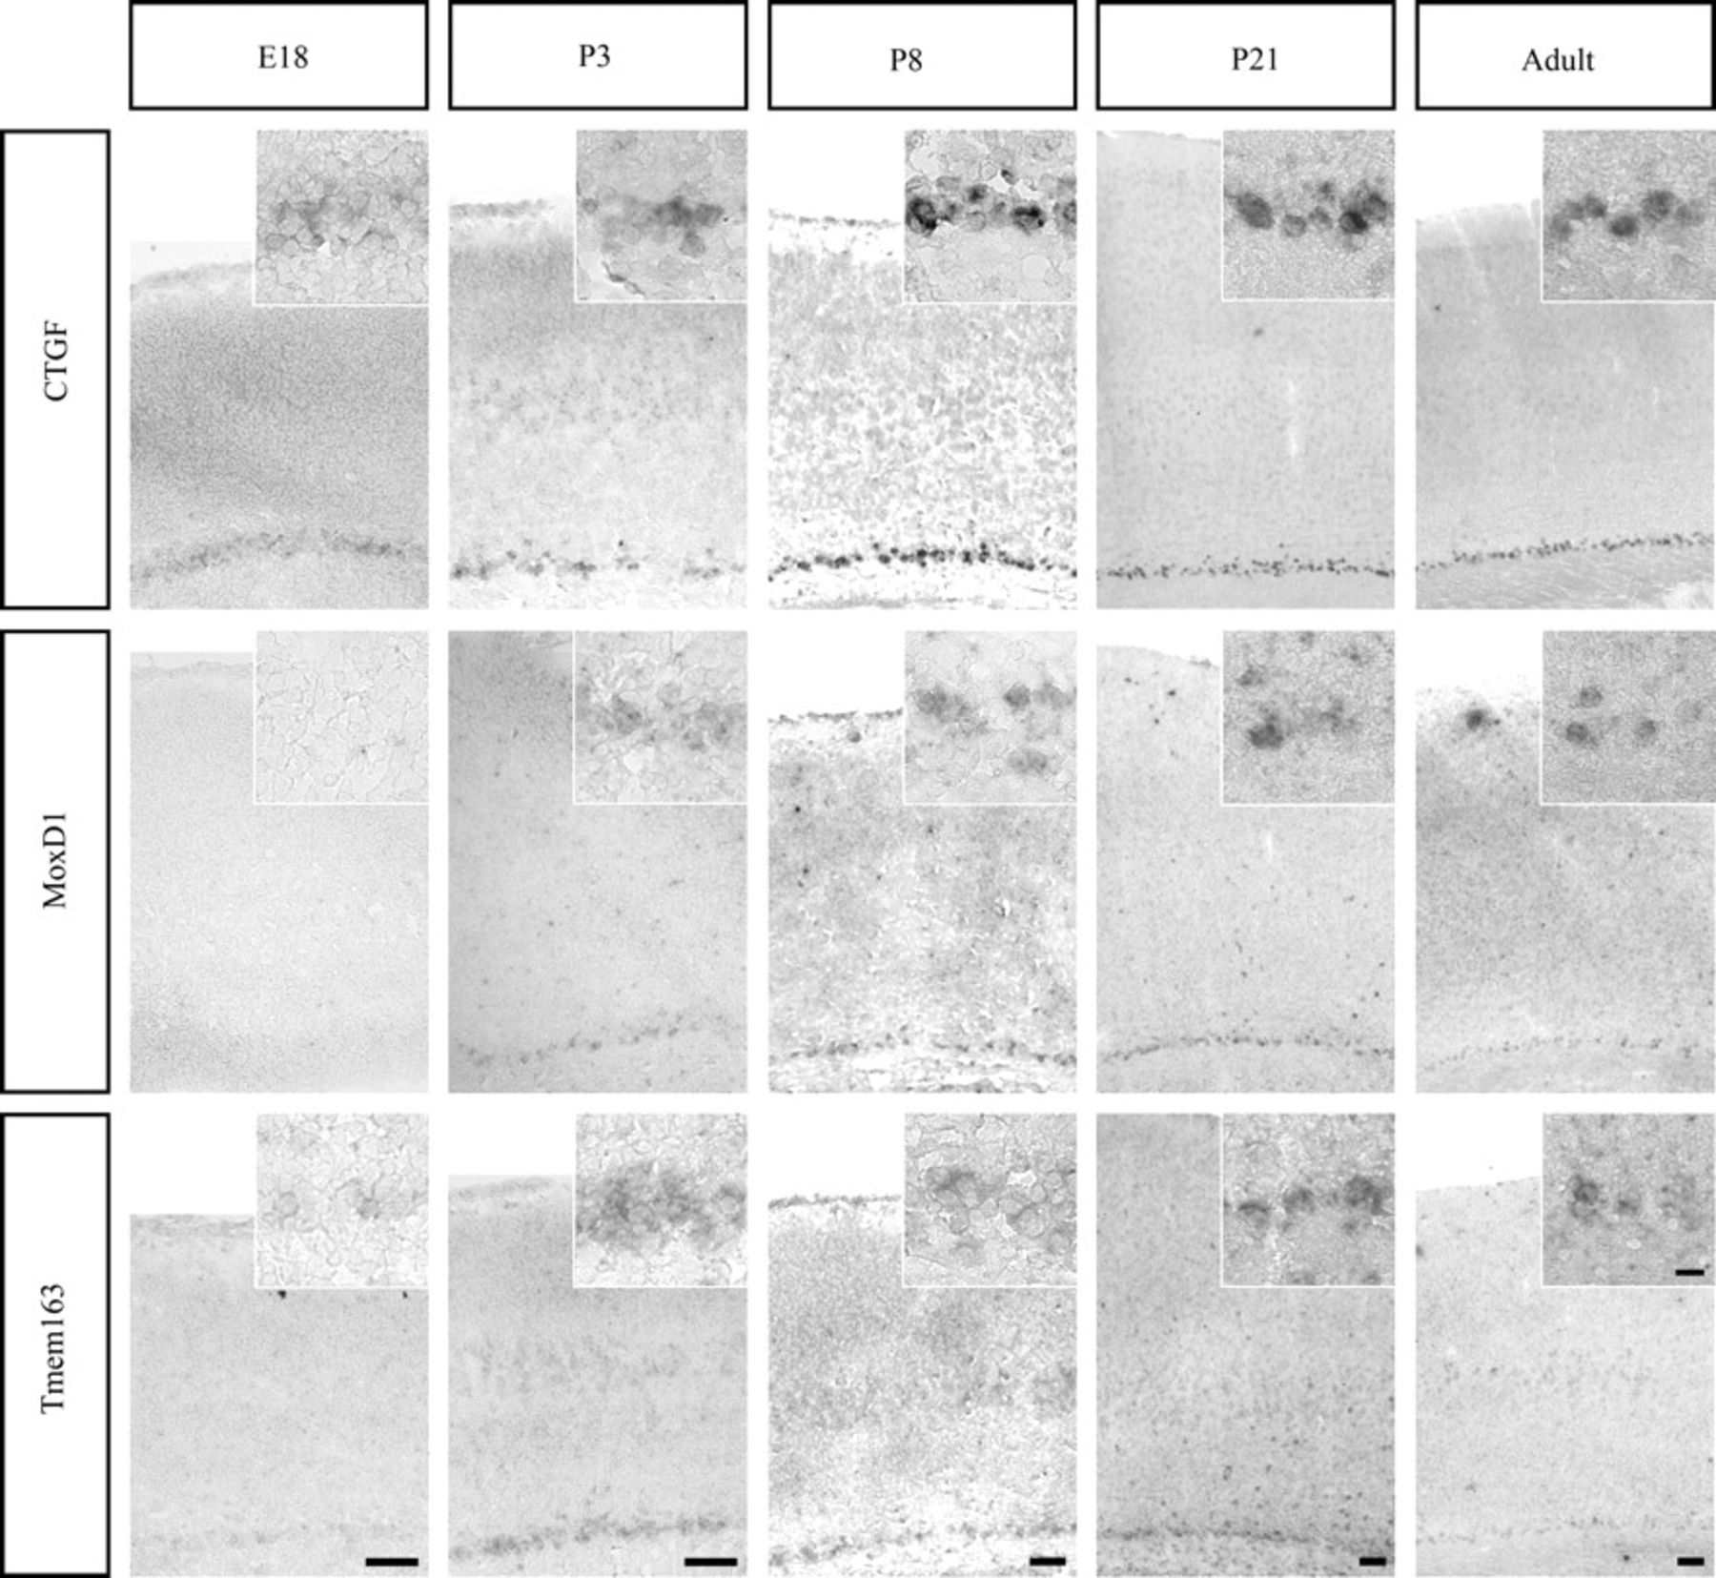
Figure 4. Time course of subplate gene expression in wild-type. CTGF expression is already detectable in the subplate ...
Notes:
Figure 4. Time course of subplate gene expression in wild-type. CTGF expression is already detectable in the subplate region at E18 and increases in the number of cells and the intensity of labeling at P3 and P8. Expression levels remain similar at P21 and in adult brains. Tmem163 expression follows a similar time course with very weak expression seen at E18 and higher levels at P3, P8, and P21. In contrast to CTGF expression, Tmem163 is only expressed in few cells in the adult subplate. Layer 5 labeling is strongest at P8 and barely visible at most other ages. MoxD1 expression is not detected at E18. Some cells are labeled in the P3 subplate, and labeling continues with similar intensity and cell numbers at P8 and P21, but fewer cells are labeled in the adult subplate. None of the brains used for the time series showed MoxD1 expression in layer 5. Scale bars = 100 μm (applies to all large panels in the same column) and 20 μm (for all insets).
Unless provided in the caption above, the following copyright applies to the content of this slide: © The Author 2008. Published by Oxford University Press. All rights reserved. For permissions, please e-mail: journals.permissions@oxfordjournals.org

Slide 5
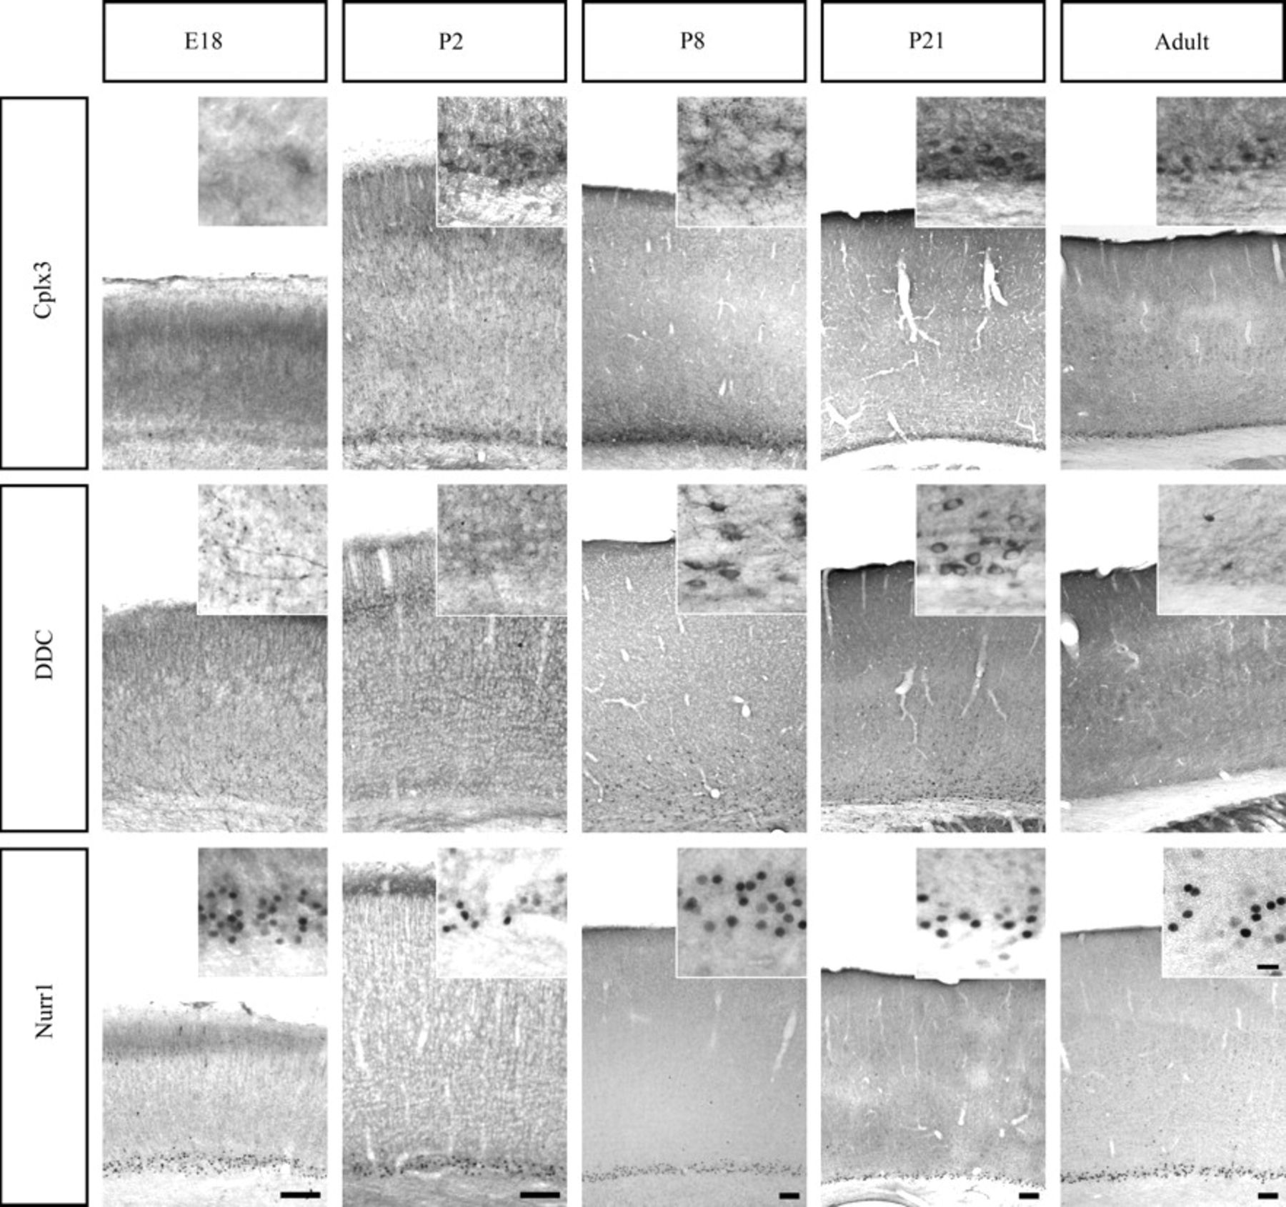
Figure 5. Time course of subplate marker protein localization in wild-type. Cplx3 is not detectable at E18, but by P2, ...
Notes:
Figure 5. Time course of subplate marker protein localization in wild-type. Cplx3 is not detectable at E18, but by P2, cells including proximal processes are labeled in the subplate. Number of labeled cells and processes increases by P8 with a dense fiber network in the area of the subplate. Labeled cells continue to be visible at P21 and in the adult subplate region. DDC is not seen in cells at E18, but labeled fibers span the lower half of cortex and are particularly dense in the subplate area. At P2, neither fibers nor cells are labeled. Labeled cells and proximal processes are visible in the subplate, white matter, and layer 6 at P8 and P21 but only very rarely in the adult cortex. Nurr1 is detectable at E18 and continues to be present at similar levels throughout all postnatal ages tested. Scale bars = 100 μm (applies to all large panels in the same column) and 20 μm (for all insets).
Unless provided in the caption above, the following copyright applies to the content of this slide: © The Author 2008. Published by Oxford University Press. All rights reserved. For permissions, please e-mail: journals.permissions@oxfordjournals.org

Slide 6
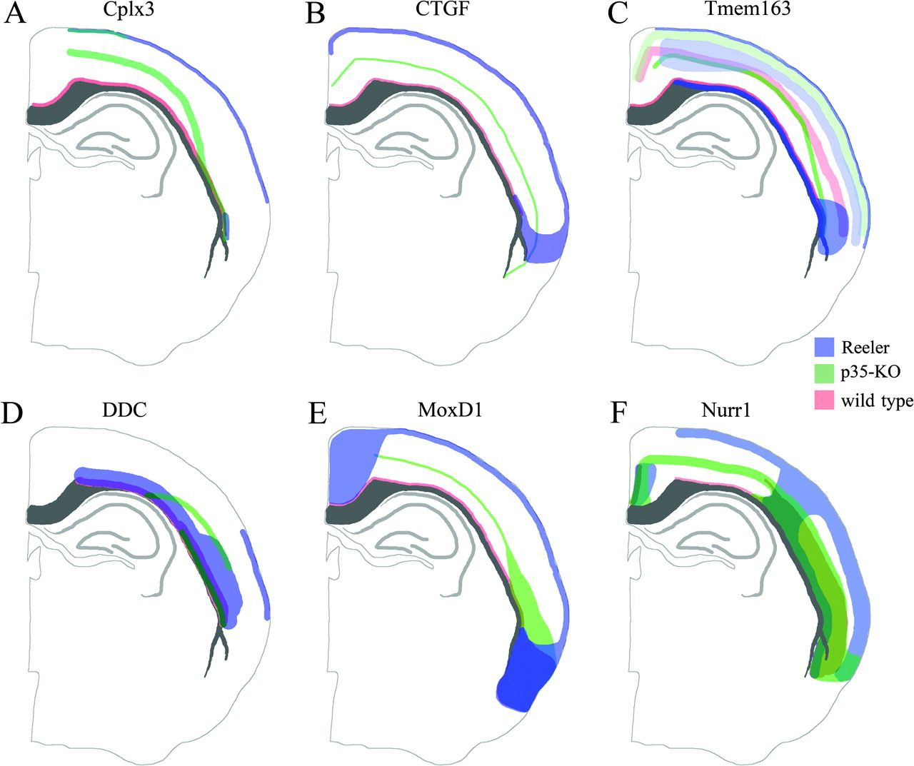
Figure 6. Schematic summary of gene expression or protein localization for putative subplate markers in wild type, ...
Notes:
Figure 6. Schematic summary of gene expression or protein localization for putative subplate markers in wild type, reeler, and p35-KO brains. The distribution of cells labeled with putative subplate markers is affected differently according to dorsolateral position in some of the mutant brains. The colored bands represent the area in which labeled cells are found but do not correspond to any measure of cell density or intensity of cell label. Some areas contain labeled cells in both mutant and wild-type brains and are therefore labeled in the respective color mixtures of red, blue, and green. (A) Distribution of Cplx3-expressing cells, (B) distribution of CTGF-expressing cells, (C) distribution of Tmem163-expressing cells, (D) distribution of DDC+ cells, (E) distribution of MoxD1-expressing cells, (F) distribution of Nurr1+ cells.
Unless provided in the caption above, the following copyright applies to the content of this slide: © The Author 2008. Published by Oxford University Press. All rights reserved. For permissions, please e-mail: journals.permissions@oxfordjournals.org

Slide 7
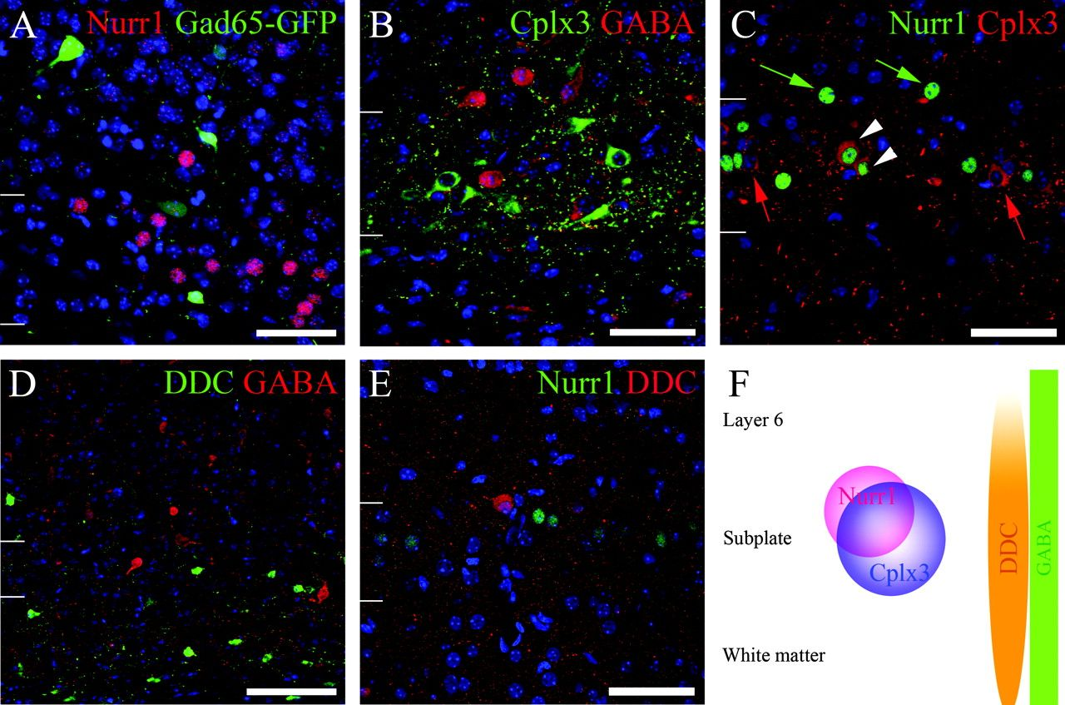
Figure 7. Cellular colocalization of putative subplate markers with each other and with Gad65-GFP or GABA. Half of ...
Notes:
Figure 7. Cellular colocalization of putative subplate markers with each other and with Gad65-GFP or GABA. Half of GABAergic cells in the adult cortex of Gad65-GFP mice are GFP positive, and this is used here as a marker for putative GABAergic interneurons. (A) Confocal image of the protein colocalization of Nurr1 (red) with Gad65-GFP (green). No colocalization was observed. (B) Confocal image of Cplx3 (green) protein colocalization with GABA (red). No colocalization was observed. (C) Confocal image of Nurr1 protein (green) colocalization with Cplx3 (red). Cplx3+/Nurr1+ double-labeled cells are indicated by a white arrowhead, Cplx3-only cells are indicated by a red arrow and Nurr1-only cells are indicated by a green arrow. Approximately two-thirds of all Nurr1+ cells were also Cplx3+. Conversely, approximately half of all Cplx3+ cells were also Nurr1+. (D) Confocal image of the protein colocalization of DDC (green) with GABA (red). No colocalization was observed. (E) Confocal image of Nurr1 protein (green) colocalization with DDC (red). No colocalization was observed. The blue label in panels (A–E) is the nuclear counterstain DAPI, and narrow white lines delineate the subplate. (F) Schematic distribution of putative subplate cell markers and GABA across different cell layers in the dorsal mouse cortex at P8, and preliminary subdivision of the subplate into different groups of cells. Scale bar = 50 μm for A - C, E and 100μm for GP.
Unless provided in the caption above, the following copyright applies to the content of this slide: © The Author 2008. Published by Oxford University Press. All rights reserved. For permissions, please e-mail: journals.permissions@oxfordjournals.org

