Slide 1
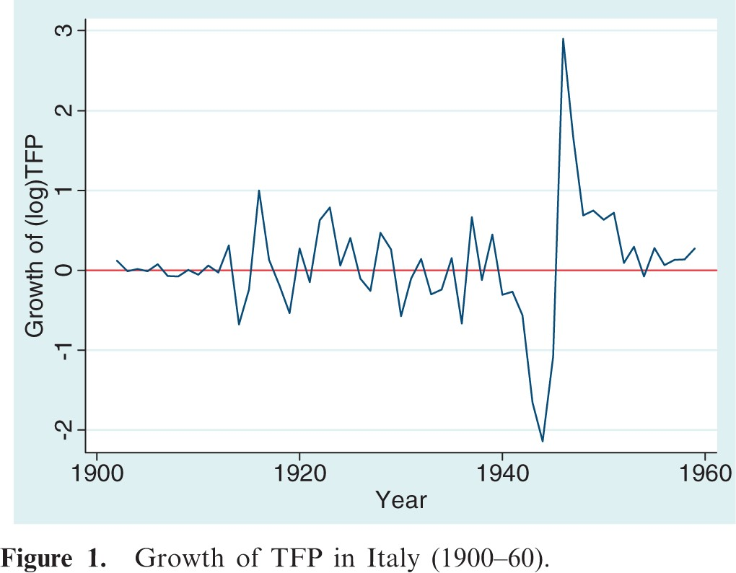
Figure 1. Growth of TFP in Italy (1900–60).
Notes:
Figure 1. Growth of TFP in Italy (1900–60).
Unless provided in the caption above, the following copyright applies to the content of this slide: © The Author 2013. Published by Oxford University Press. All rights reserved. For Permissions, please email: journals.permissions@oup.com

Slide 2
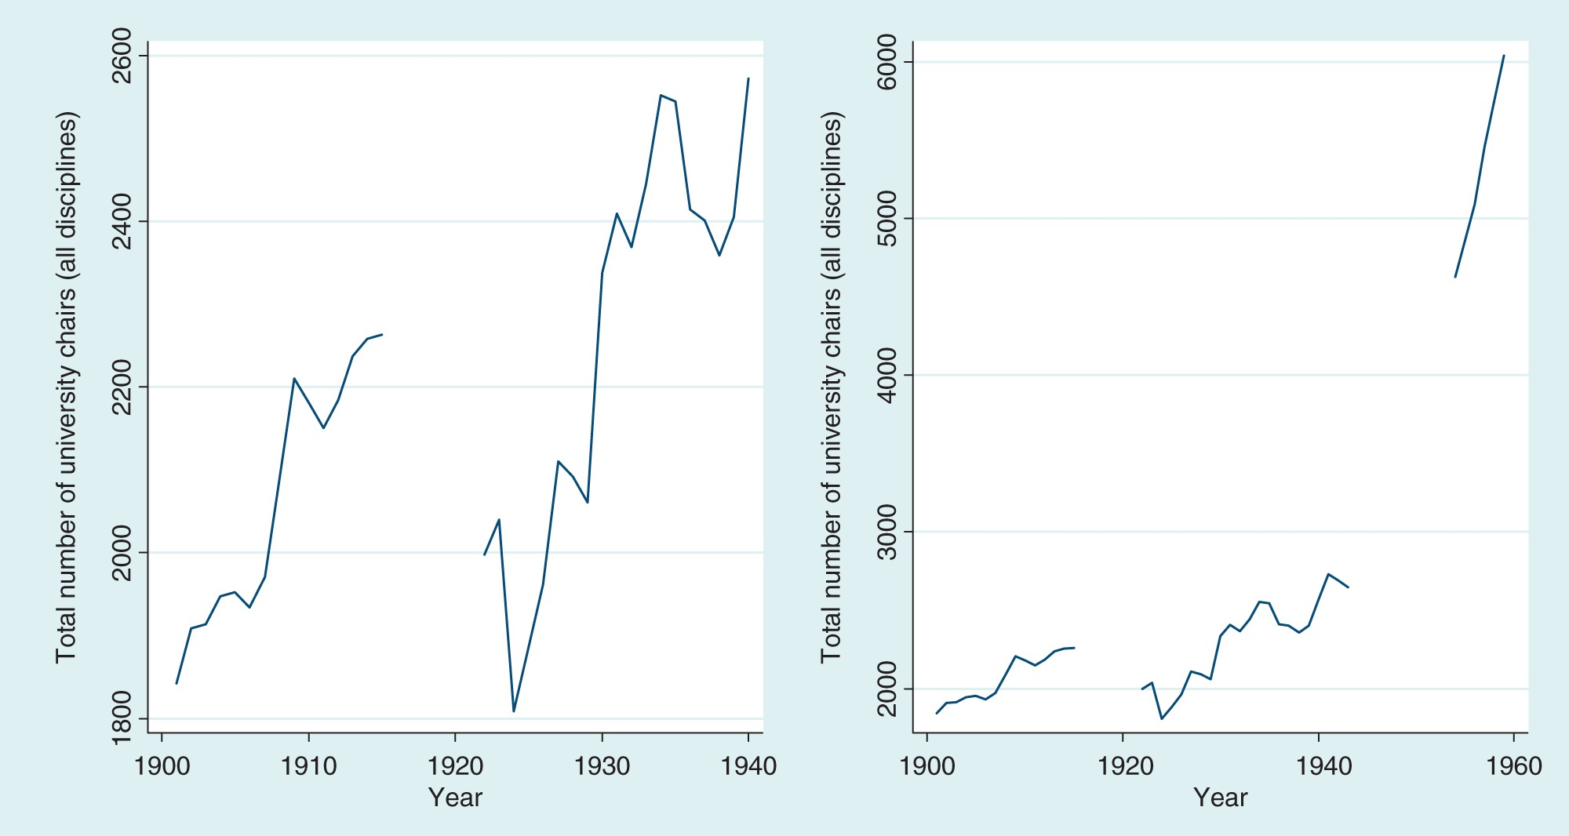
Figure 2. Total number of chairs in Italy (1900–40 and 1900–60).
Notes:
Figure 2. Total number of chairs in Italy (1900–40 and 1900–60).
Unless provided in the caption above, the following copyright applies to the content of this slide: © The Author 2013. Published by Oxford University Press. All rights reserved. For Permissions, please email: journals.permissions@oup.com

Slide 3
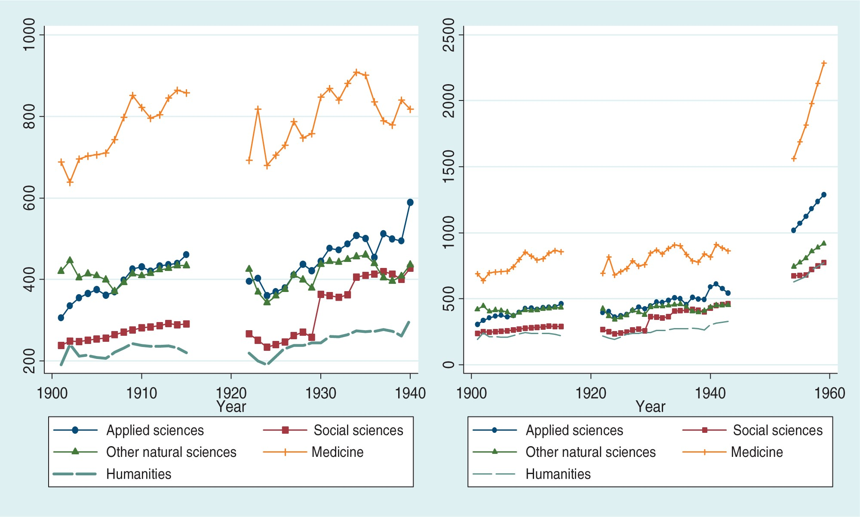
Figure 3. Number of chairs in Italy, divided by disciplinary field (1900–40 and 1900–60).
Notes:
Figure 3. Number of chairs in Italy, divided by disciplinary field (1900–40 and 1900–60).
Unless provided in the caption above, the following copyright applies to the content of this slide: © The Author 2013. Published by Oxford University Press. All rights reserved. For Permissions, please email: journals.permissions@oup.com

