Slide 1
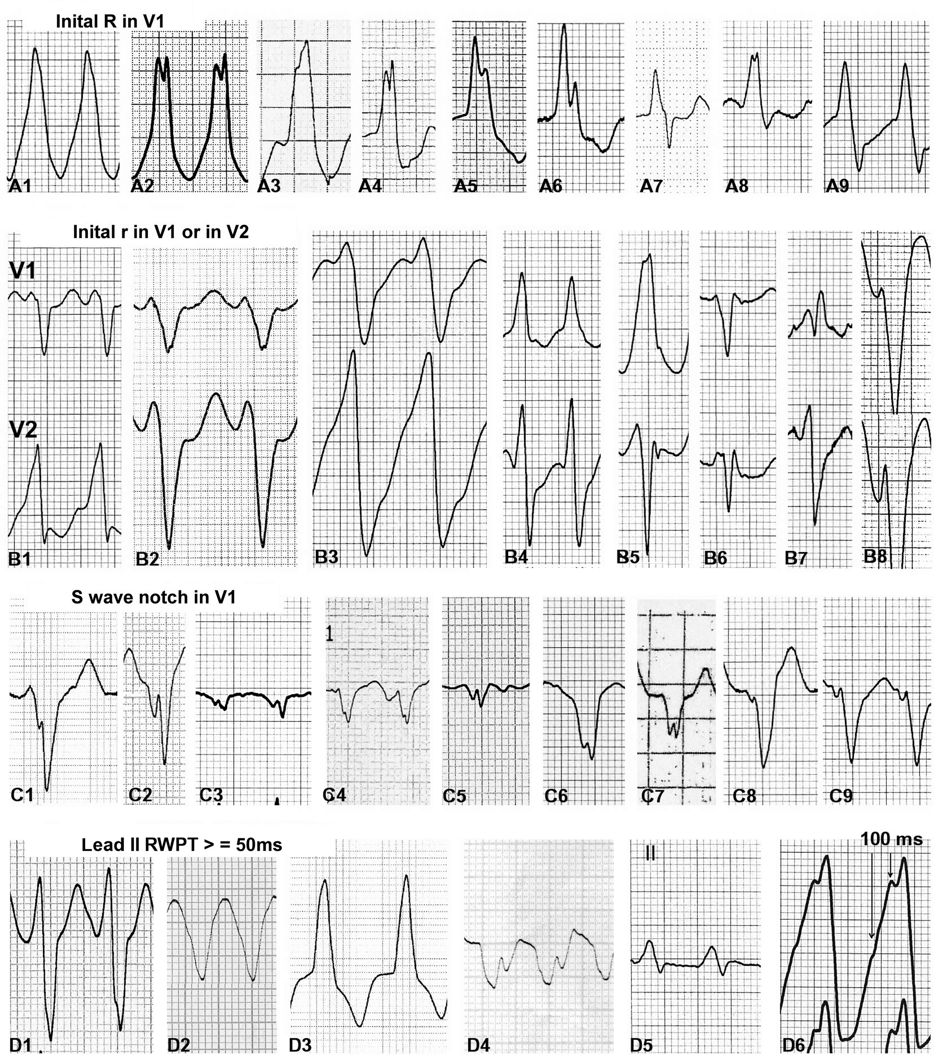
Figure 1 Ventricular tachycardia score criteria; representative QRS morphologies. For panel descriptions see the ...
Notes:
Figure 1 Ventricular tachycardia score criteria; representative QRS morphologies. For panel descriptions see the text.
Unless provided in the caption above, the following copyright applies to the content of this slide: Published on behalf of the European Society of Cardiology. All rights reserved. © The Author 2015. For permissions please email: journals.permissions@oup.com.

Slide 2
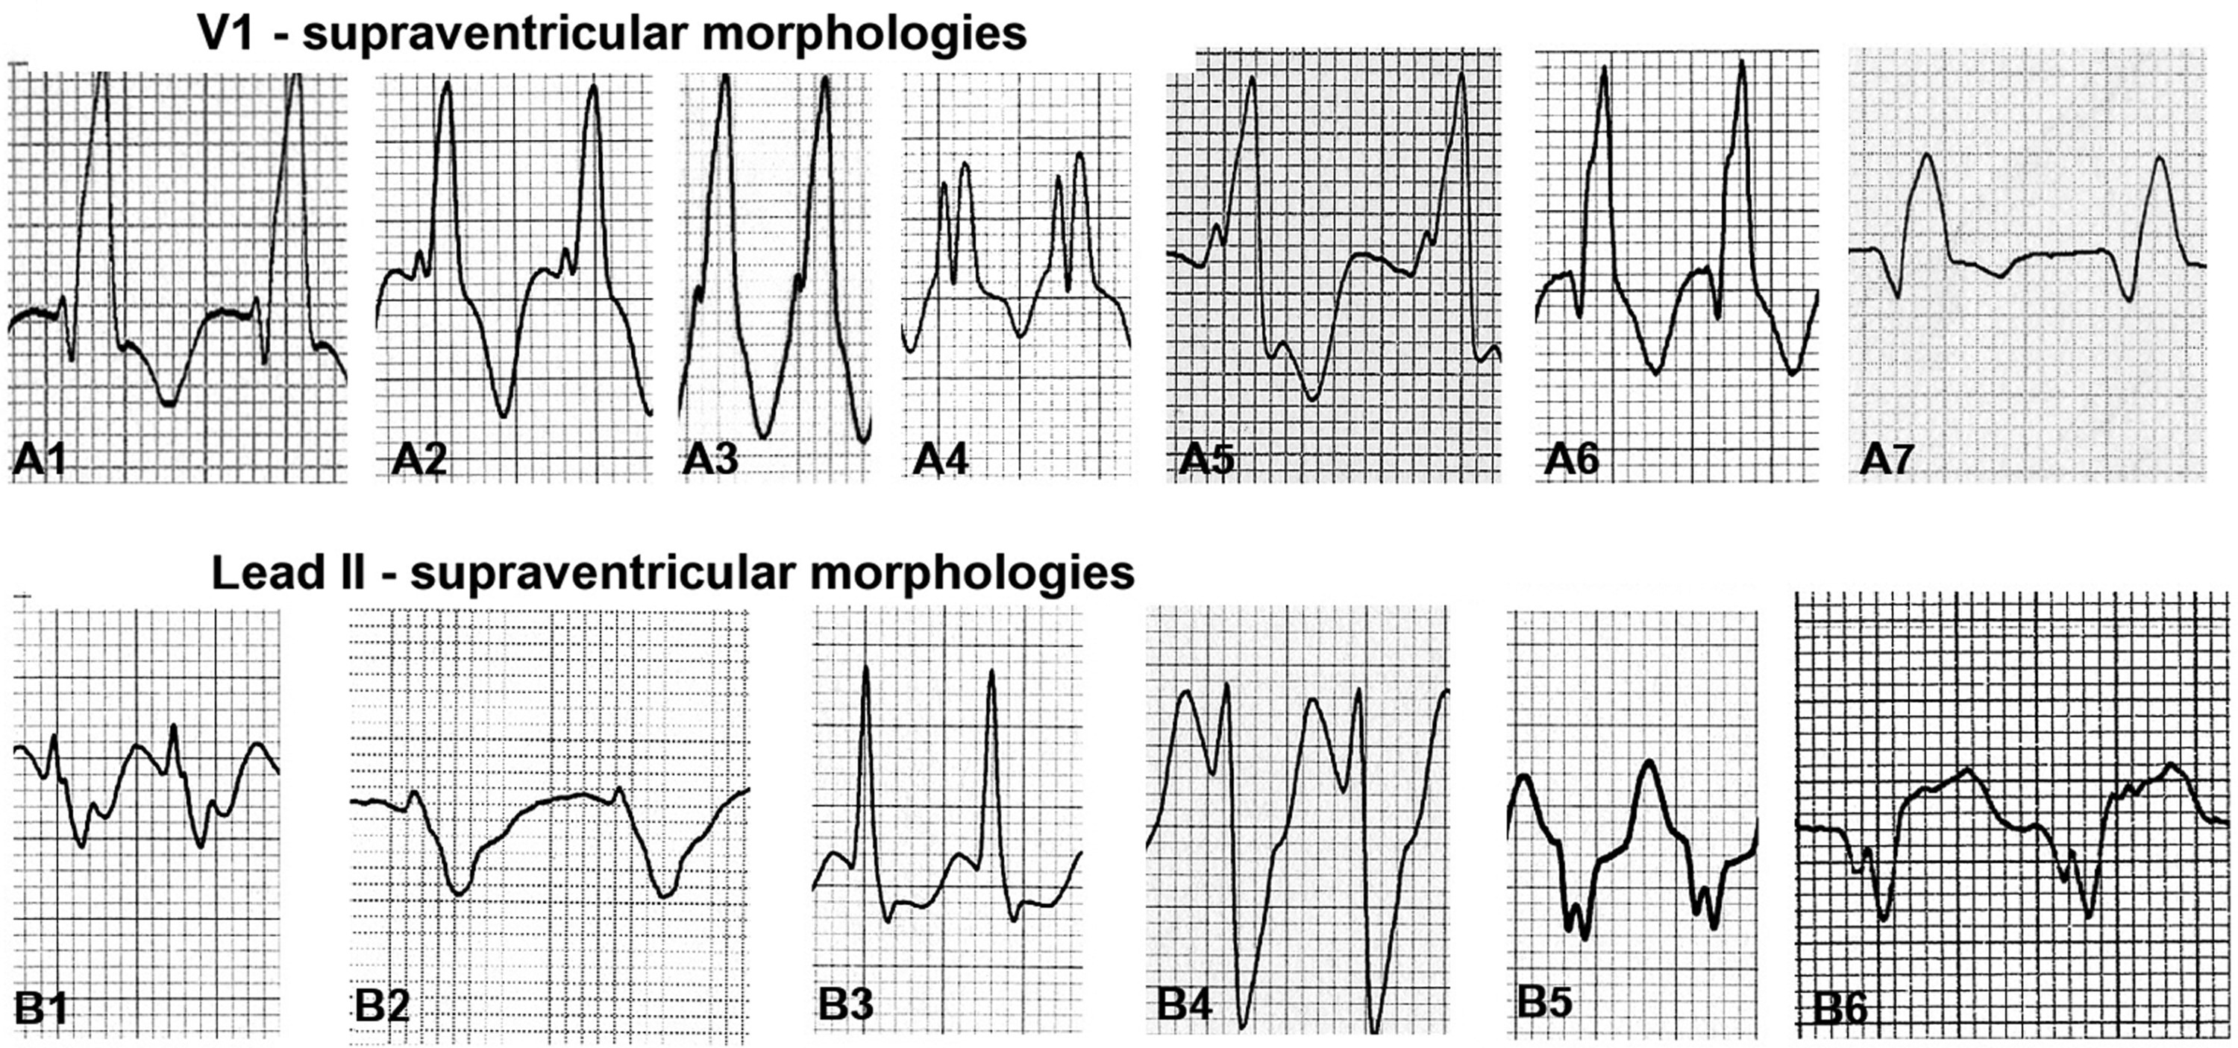
Figure 2 Examples of QRS morphologies in leads V1 and II that do not fulfil the criteria of VT score morphologies. ...
Notes:
Figure 2 Examples of QRS morphologies in leads V1 and II that do not fulfil the criteria of VT score morphologies. (A1) Classic rsR′ pattern of right bundle branch block. (A2–A5) Notch on the ascending limb of the R wave with the notch's nadir in the lower part of the R wave. (A6 and –A7) qR pattern. (B1–B4) Short RWPT (R-wave peak time): from the beginning of the QRS to the r or R wave peak there is <50 ms. (B5 and B6) Short interval from the beginning of the QRS to the S wave notch.
Unless provided in the caption above, the following copyright applies to the content of this slide: Published on behalf of the European Society of Cardiology. All rights reserved. © The Author 2015. For permissions please email: journals.permissions@oup.com.

Slide 3
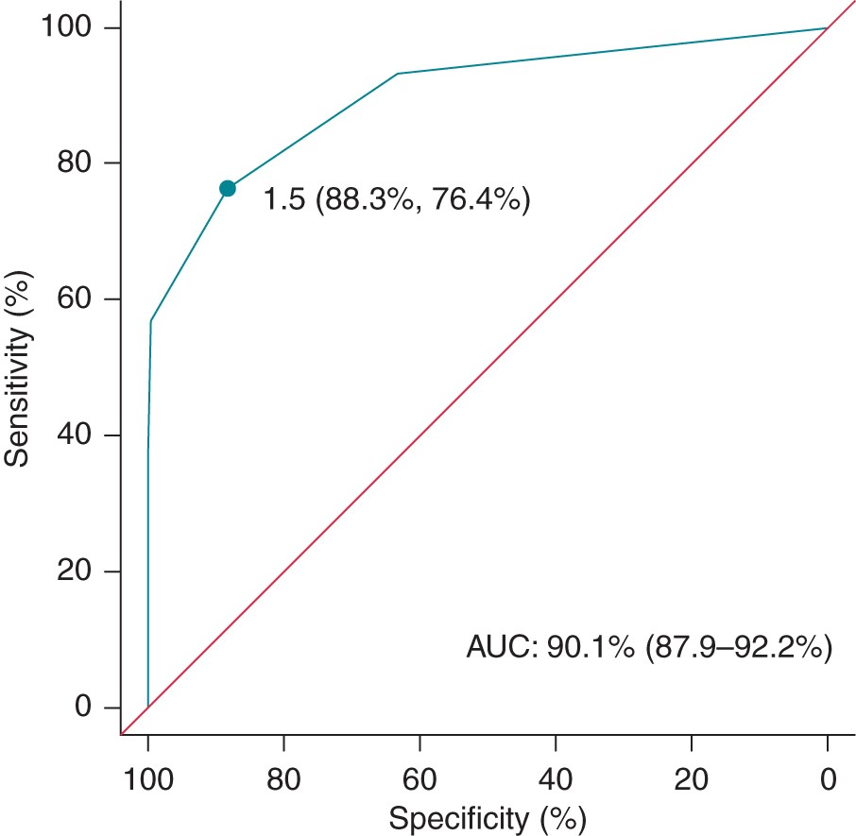
Figure 3 Receiver operating characteristic curve for VT score. AUC, area under the curve.
Notes:
Figure 3 Receiver operating characteristic curve for VT score. AUC, area under the curve.
Unless provided in the caption above, the following copyright applies to the content of this slide: Published on behalf of the European Society of Cardiology. All rights reserved. © The Author 2015. For permissions please email: journals.permissions@oup.com.

