Slide 1
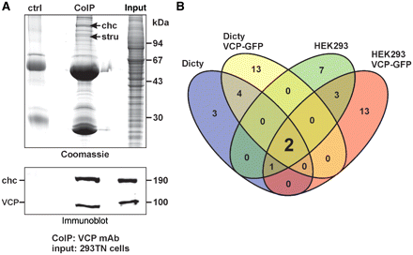
Figure 1 VCP co-immunoprecipitation analysis. (A) Top: Coomassie stained SDS–PAGE gel of a VCP co-immunoprecipitation ...
Notes:
Figure 1 VCP co-immunoprecipitation analysis. (A) Top: Coomassie stained SDS–PAGE gel of a VCP co-immunoprecipitation experiment. Arrows indicate the position of clathrin heavy chain (chc) and strumpellin (stru) identified by mass spectrometry. CoIP = co-precipitated proteins by the VCP antibody; ctrl = beads incubated with bovine serum albumin instead of monoclonal VCP antibody; input = soluble lysate of HEK293 cells. Bottom: immunoblot verification of the presence of VCP and clathrin heavy chain in the immunoprecipitate and input. (B) Venn diagram summarizing the results of VCP co-immunoprecipitation experiments performed in wild-type and VCP-green fluorescent protein expressing Dictyostelium discoideum (Dicty) cells as well as wild-type and VCP-green fluorescent protein overexpressing HEK293 cells. In all four experimental settings VCP co-immunoprecipitations identified two proteins (enlarged ‘2’), namely clathrin heavy chain [a previously established VCP-binding partner (Pleasure et al., 1993)] and strumpellin. These findings indicate an evolutionary highly conserved VCP binding to these proteins. mAb = monoclonal antibody.
Unless provided in the caption above, the following copyright applies to the content of this slide: © The Author (2010). Published by Oxford University Press on behalf of the Guarantors of Brain. All rights reserved. For Permissions, please email: journals.permissions@oxfordjournals.org

Slide 2
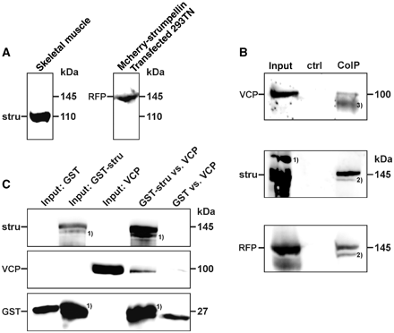
Figure 2 (A) Strumpellin (stru) immunoblot analysis of a total protein extract from murine skeletal muscle (left) and ...
Notes:
Figure 2 (A) Strumpellin (stru) immunoblot analysis of a total protein extract from murine skeletal muscle (left) and mRFPmars immunodetection of mCherry-strumpellin overexpression in 293TN cells (right). (B) Immunoblot analysis of a strumpellin co-immunoprecipitation experiment. CoIP = co-precipitated proteins by the strumpellin antibody; ctrl = beads incubated with bovine serum albumin instead of polyclonal strumpellin antibody; input = soluble lysate of mCherry-strumpellin transfected 293TN cells; RFP = red fluorescent protein; stru = strumpellin; (1) = unspecific signal from the strumpellin antibody; (2) = degradation product of mCherry–strumpellin; (3) = signal from the strumpellin antibody heavy chain. (C) Pull-down experiment using recombinant GST–strumpellin coupled to beads and soluble VCP (GST-stru versus VCP). This experiment confirms a direct interaction between both proteins. As a negative control, beads were coated with GST (GST versus VCP). For illustration purposes individual lines from the original western blot were digitally re-arranged. (1) = strumpellin degradation products.
Unless provided in the caption above, the following copyright applies to the content of this slide: © The Author (2010). Published by Oxford University Press on behalf of the Guarantors of Brain. All rights reserved. For Permissions, please email: journals.permissions@oxfordjournals.org

Slide 3
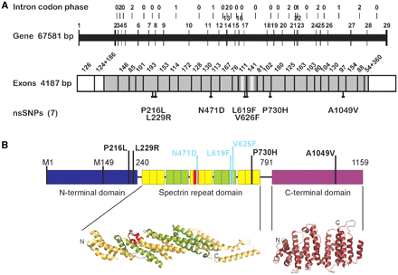
Figure 3 (A) Schematic structure of the human strumpellin gene. The human strumpellin (KIAA0196) locus comprises ...
Notes:
Figure 3 (A) Schematic structure of the human strumpellin gene. The human strumpellin (KIAA0196) locus comprises ∼68 kbp at position 126.1 Mb in chromosome 8q24.13, adjacent to the SQLE (squalene epoxidase) and NSMCE2 (non-SMC element 2) genes and linked within 1.5 Mbp to annexin A13 (NCBI reference NC_000008.19). It consists of one non-coding plus 28 protein-coding exons and an elevated incidence of phase 2 introns between codon base positions 2 and 3 in all vertebrate species examined. Known non-synonymous polymorphisms (nsSNPs) are indicated as P216 L, L229 R, N471D*, L619 F*, V626 F* (5′ exon 16, 141 bp), P730 H and A1049 V identified by HapMap or the 1000 human genomes projects (*based on clinical data). (B) Schematic structure of the human strumpellin protein. Strumpellin consists of an N-terminal domain, a ‘spectrin-like’ repeat domain (five repeats), and a C-terminal domain. No structural similarity to known domains was found for the N-terminal domain. The strumpellin ‘spectrin-like’ repeat is predicted to be structurally similar to Exo70 (protein data bank accession number 2pft) and importin beta-2 (protein data bank accession number 2z5 k). The structure of Exo70 is shown for illustration only; the position of the polyclonal strumpellin antibody epitope (red) and the mutations known to cause hereditary spastic paraplegia (cyan) are highlighted at their approximate positions. Further known non-synonymous polymorphisms are indicated (black). The C-terminal domain of strumpellin has predicted similarity to exportin-5 (protein data bank accession number 3a6p) and importin beta-1 (protein data bank accession number 2 bpt). The structure of exportin-5 is also shown for illustration only. A potential splicing variant is indicated (M149). Prediction of secondary-structure elements of strumpellin as well as structural similarity searches were carried out using PSIPRED (Bryson et al., 2005). Structure-based sequence alignments for the spectrin repeats were generated manually using the structure of the 16th repeat from chicken brain alpha-spectrin [protein data bank accession number 1aj3; (Pascual et al., 1997)] as template. Figure prepared with PyMOL (DeLano, 2002).
Unless provided in the caption above, the following copyright applies to the content of this slide: © The Author (2010). Published by Oxford University Press on behalf of the Guarantors of Brain. All rights reserved. For Permissions, please email: journals.permissions@oxfordjournals.org

Slide 4
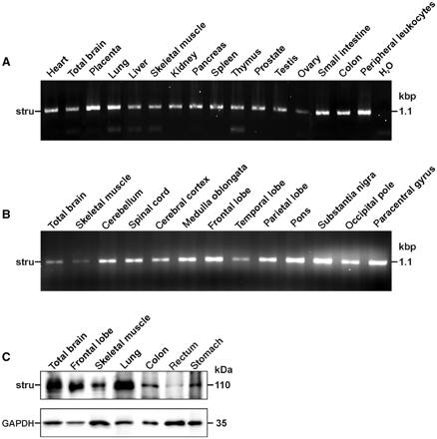
Figure 4 (A) Strumpellin (stru) mRNA and protein expression studies. Reverse transcription polymerase chain reaction ...
Notes:
Figure 4 (A) Strumpellin (stru) mRNA and protein expression studies. Reverse transcription polymerase chain reaction analysis demonstrated strumpellin mRNA expression in all human tissues analysed. Kbp = kilo base pairs. (B) Due to its known pathogenic role in hereditary spastic paraplegia, we analysed the expression of strumpellin in various areas of the human central nervous system by reverse transcription polymerase chain reaction. Strumpellin mRNA was ubiquitously detected. (C) Immunoblot analyses demonstrated the presence of strumpellin in various human tissues. For illustration purposes individual lines from the original western blot were digitally re-arranged. The loading control was GAPDH. kDa = kilo Dalton.
Unless provided in the caption above, the following copyright applies to the content of this slide: © The Author (2010). Published by Oxford University Press on behalf of the Guarantors of Brain. All rights reserved. For Permissions, please email: journals.permissions@oxfordjournals.org

Slide 5
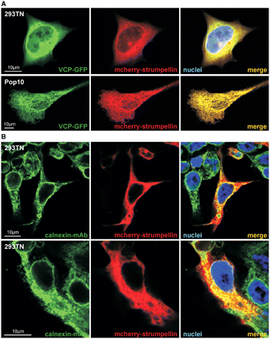
Figure 5 (A) Double transfection of 293TN and Pop10 cells using mCherry-strumpellin and VCP-green fluorescent protein ...
Notes:
Figure 5 (A) Double transfection of 293TN and Pop10 cells using mCherry-strumpellin and VCP-green fluorescent protein (GFP) expression constructs demonstrated cytoplasmic co-localization of both proteins. (B) Calnexin staining of mCherry-strumpellin transfected 293TN cells demonstrated co-localization at the endoplasmic reticulum-level in addition to a diffuse cytosolic strumpellin signal.
Unless provided in the caption above, the following copyright applies to the content of this slide: © The Author (2010). Published by Oxford University Press on behalf of the Guarantors of Brain. All rights reserved. For Permissions, please email: journals.permissions@oxfordjournals.org

Slide 6
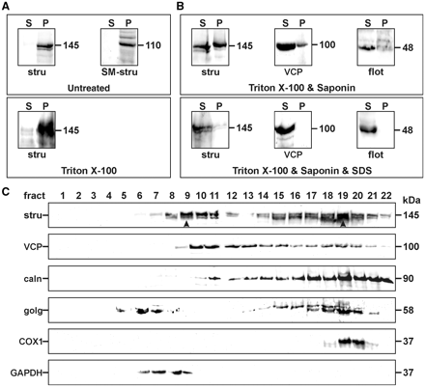
Figure 6 (A) High-speed (100 000 g) fractionation of total homogenates of 293TN cells expressing mCherry–strumpellin ...
Notes:
Figure 6 (A) High-speed (100 000 g) fractionation of total homogenates of 293TN cells expressing mCherry–strumpellin (stru; 145 kDa) and murine skeletal muscle (SM-stru; 110 kDa) tissue. Note that strumpellin is exclusively present in the pellet fraction (P) from cell and tissues homogenates (top). Addition of Triton X-100 only solubilizes a very small amount of strumpellin from the pellet fraction (bottom). S = supernatant. (B) Top: Double treatment with Triton X-100 and saponin leads to a marked shift of strumpellin and its direct strumpellin interaction partner VCP (100 kDa) into the soluble fraction. For control, the almost complete solubilization of the lipid raft marker flotillin-1 (flot; 48 kDa) is shown. Bottom: Treatment with Triton X-100, saponin and sodium dodecyl sulphate leads to an almost complete solubilization of strumpellin and a complete solubilization of VCP. (C) Discontinuous sucrose density gradient fractionation of nucleus-free organelle-preserved lysates from mCherry-transfected 293TN cells display that strumpellin (stru) co-distributes with VCP. Arrowheads in fractions 9 and 19 indicate highest strumpellin signal intensities. In conjunction with the results from our transfection studies this analysis strongly indicates that strumpellin is present in the cytosolic (GAPDH) and endoplasmic reticulum-containing fraction (calnexin). caln = calnexin; golg = Golgi 58 K protein; COX1 = cytochrome C oxidase.
Unless provided in the caption above, the following copyright applies to the content of this slide: © The Author (2010). Published by Oxford University Press on behalf of the Guarantors of Brain. All rights reserved. For Permissions, please email: journals.permissions@oxfordjournals.org

Slide 7
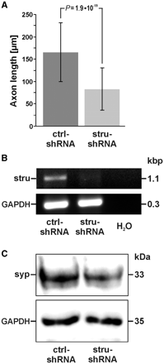
Figure 7 Small hairpin RNA mediated knockdown of strumpellin (stru) in human SH-SY5 Y neuroblastoma cells. (A) ...
Notes:
Figure 7 Small hairpin RNA mediated knockdown of strumpellin (stru) in human SH-SY5 Y neuroblastoma cells. (A) Strumpellin knockdown resulted in a highly significant decrease of outgrowing cellular extensions. ctrl small hairpin RNA (shRNA) = non-target control small hairpin RNA. (B) Semi-quantitative reverse transcription polymerase chain reaction demonstrated a nearly complete knockdown of strumpellin mRNA expression. (C) Immunoblot analysis of total protein extracts from SH-SY5 Y cells after strumpellin knockdown and differentiation. Note the marked reduction of synaptophysin (syp), which serves as a pre-synaptic marker protein for axons. GAPDH was the loading control.
Unless provided in the caption above, the following copyright applies to the content of this slide: © The Author (2010). Published by Oxford University Press on behalf of the Guarantors of Brain. All rights reserved. For Permissions, please email: journals.permissions@oxfordjournals.org

Slide 8
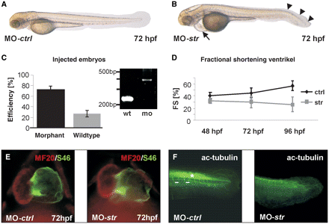
Figure 8 Effects of the strumpellin knockdown on zebrafish embryonic development. (A and B) Lateral view of wild-type ...
Notes:
Figure 8 Effects of the strumpellin knockdown on zebrafish embryonic development. (A and B) Lateral view of wild-type (MO-ctrl) (A) and strumpellin (MO-str) morphants (B) at 72 h postfertilization (hpf). Strumpellin morphants develop pericardial oedema (arrow) due to impaired ventricular contractility and a severe tail curvature (arrowheads). (C) Seventy-three percent of embryos injected with MO-strumpellin (morphant) display the strumpellin phenotype (bar chart). Injection of MO-strumpellin results in an abnormal splice product of 382 bp (integration of intron 3) (mo), predicted to lead to premature termination of translation of zebrafish strumpellin. wt = wild-type (D) Fractional shortening (FS) of the ventricular chamber of wild-type (ctrl) and strumpellin (str) morphant embryos measured at different developmental stages [48, 72 and 96 h postfertilization (hpf)]. Ventricular fractional shortening of strumpellin morphants decreased over time. At 96 h postfertilization the fractional shortening of strumpellin morphants was about half that measured in wild-type zebrafish. (E) Strumpellin morphants display normal heart morphology. Double-immunofluorescent staining with antibodies against meromyosin (MF20; TRITC) and against the atrium-specific myosin heavy chain (S46; FITC) demonstrated proper differentiated atrial and ventricular cardiomyocytes in MO-control (MO-ctrl) and MO-strumpellin (MO-str) injected zebrafish embryos. (F) Immunofluorescent staining analysis of the caudal part of MO-control (MO-ctrl) and MO-strumpellin (MO-str) knockdown embryos with an antibody directed against acetylated tubulin at 72 h postfertilization. Note the nearly completely abolished acetylated tubulin (ac-tubulin) staining in the neuronal tube (asterisk) as well as the lack of ventral and caudal motoneurons (double-sided arrows).
Unless provided in the caption above, the following copyright applies to the content of this slide: © The Author (2010). Published by Oxford University Press on behalf of the Guarantors of Brain. All rights reserved. For Permissions, please email: journals.permissions@oxfordjournals.org

Slide 9
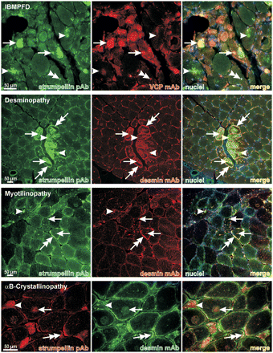
Figure 9 Immunofluorescence analysis of IBMPFD muscle tissue (R155 C VCP mutation) and myofibrillar myopathies due to ...
Notes:
Figure 9 Immunofluorescence analysis of IBMPFD muscle tissue (R155 C VCP mutation) and myofibrillar myopathies due to heterozygous desmin (R350 P), myotilin (S55 F) and αB-crystallin (G154 S) mutations. Note that cytoplasmic strumpellin positive pathological protein aggregates (arrows) were present in all cases analysed. In IBMPFD strumpellin labelling was also observed in a VCP positive nucleus (double-arrowhead). Double-arrows denote subsarcolemmal strumpellin and desmin positive structures, whereas arrowheads demonstrate protein aggregates that are exclusively labelled by the strumpellin antibody. mAb = monoclonal antibody; pAb = polyclonal antibody.
Unless provided in the caption above, the following copyright applies to the content of this slide: © The Author (2010). Published by Oxford University Press on behalf of the Guarantors of Brain. All rights reserved. For Permissions, please email: journals.permissions@oxfordjournals.org

Slide 10
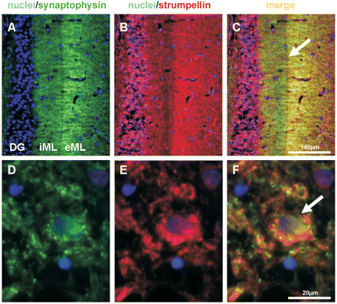
Figure 10 (A–C) Co-localization of strumpellin with the pre-synaptic glycoprotein synaptophysin. Most prominent ...
Notes:
Figure 10 (A–C) Co-localization of strumpellin with the pre-synaptic glycoprotein synaptophysin. Most prominent immunoreactivity for strumpellin was detected within the external two-thirds of the molecular layer (eML). DG = dentate gyrus, iML = i nner third of molecular layer. The arrow in C points to the sharp boundary between the eML and iML in the human hippocampus. (D–F) This motoneuron from the ventral horn of the human spinal cord (arrow in F) showed numerous synapses attaching to the cellular membrane (synaptophysin in green). Merged images in F revealed a large co-localization with strumpellin (red) immunoreactive profiles. Nuclei counterstained with Hoechst 33342.
Unless provided in the caption above, the following copyright applies to the content of this slide: © The Author (2010). Published by Oxford University Press on behalf of the Guarantors of Brain. All rights reserved. For Permissions, please email: journals.permissions@oxfordjournals.org

Slide 11
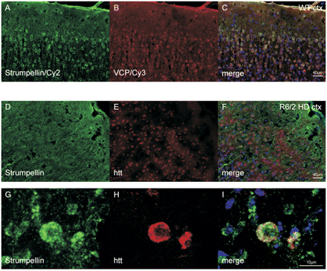
Figure 11 Immunofluorescence analysis of strumpellin distribution in the cortex of wild-type and R6/2 Huntington’s ...
Notes:
Figure 11 Immunofluorescence analysis of strumpellin distribution in the cortex of wild-type and R6/2 Huntington’s disease transgenic mice. (A–C) Strumpellin and VCP immunoreactivity in the cortex (ctx) of wild-type (WT) mice. Note the cytoplasmic and dendritic strumpellin staining pattern in almost all pyramidal neurons. (D–F) In the cortex of R6/2 Huntington’s disease transgenic mice, the dendritic staining of strumpellin was more pronounced while the cytoplasmic staining seemed attenuated. However, strumpellin was present in cortical neurons with multiple huntingtin (htt)-immunoreactive foci. (G–H) Higher magnifications demonstrated large pyramidal neurons with an inhomogeneous cytoplasmic immunoreactivity for strumpellin. Apotom-based Z-stack analysis in merged images provided evidence for a partial co-localization of strumpellin and huntingtin (htt) in cytoplasmatic foci.
Unless provided in the caption above, the following copyright applies to the content of this slide: © The Author (2010). Published by Oxford University Press on behalf of the Guarantors of Brain. All rights reserved. For Permissions, please email: journals.permissions@oxfordjournals.org

