Slide 1
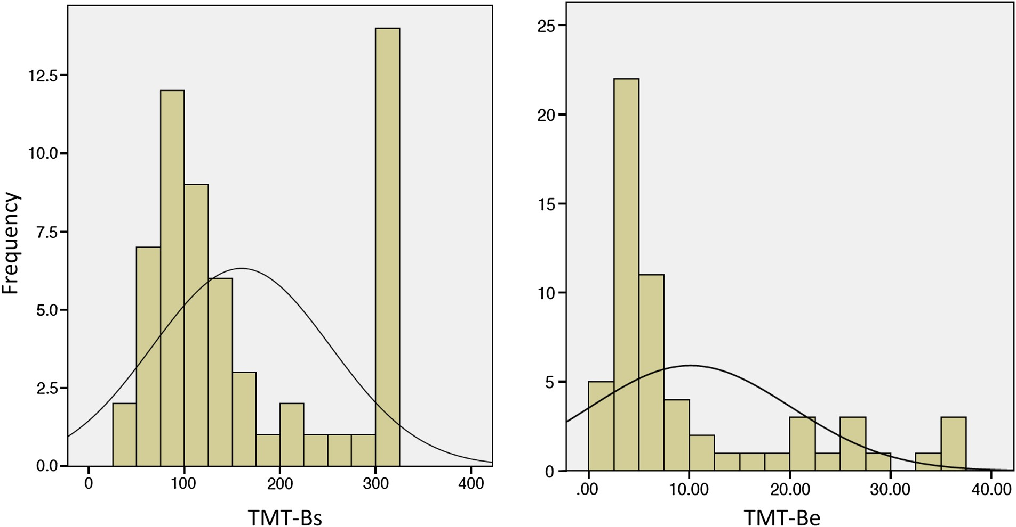
Fig. 1. Histogram with normal curve for standard TMT-B (TMT-Bs in seconds) and TMT-B efficiency (TMT-Be) (n = 59). ...
Notes:
Fig. 1. Histogram with normal curve for standard TMT-B (TMT-Bs in seconds) and TMT-B efficiency (TMT-Be) (n = 59). (The extension of the normal curves beyond the actual highest and lowest TMT-Bs and TMT-Be scores is a graphical artifact inherent in SPSS.)
Unless provided in the caption above, the following copyright applies to the content of this slide: Published by Oxford University Press 2015. This work is written by (a) US Government employee(s) and is in the public domain in the US.

Slide 2
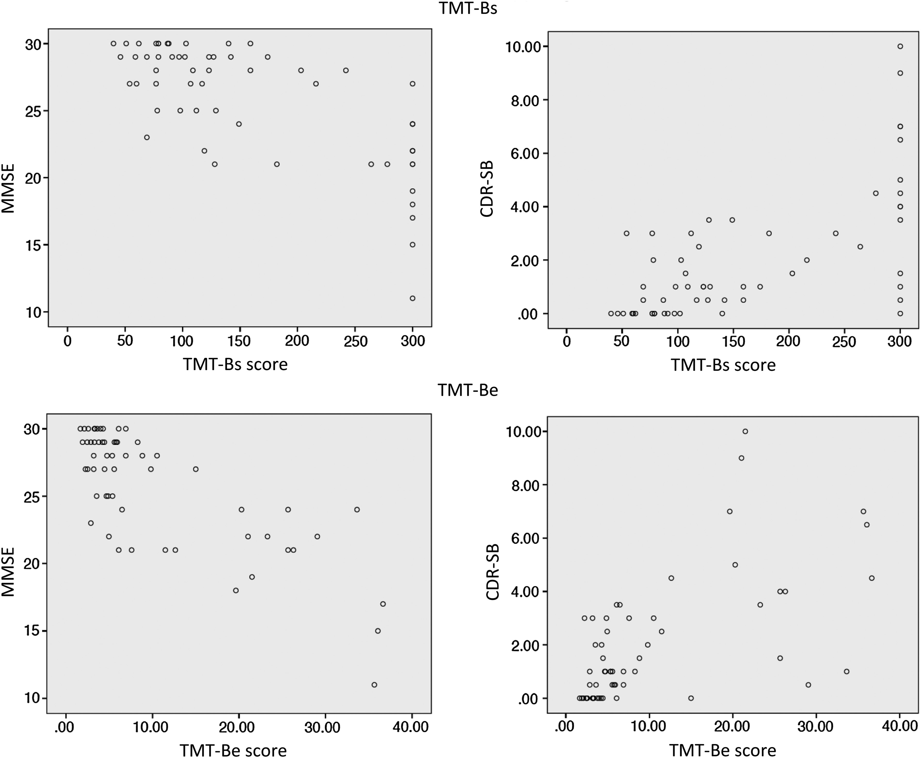
Fig. 2. Correlation of TMT-B metrics (TMT-Bs score is in seconds) with MMSE and CDR-SB (n = 59). MMSE = Mini Mental ...
Notes:
Fig. 2. Correlation of TMT-B metrics (TMT-Bs score is in seconds) with MMSE and CDR-SB (n = 59). MMSE = Mini Mental State Examination; CDR-SB = Clinical Dementia Rating Scale Sum of Boxes.
Unless provided in the caption above, the following copyright applies to the content of this slide: Published by Oxford University Press 2015. This work is written by (a) US Government employee(s) and is in the public domain in the US.

Slide 3
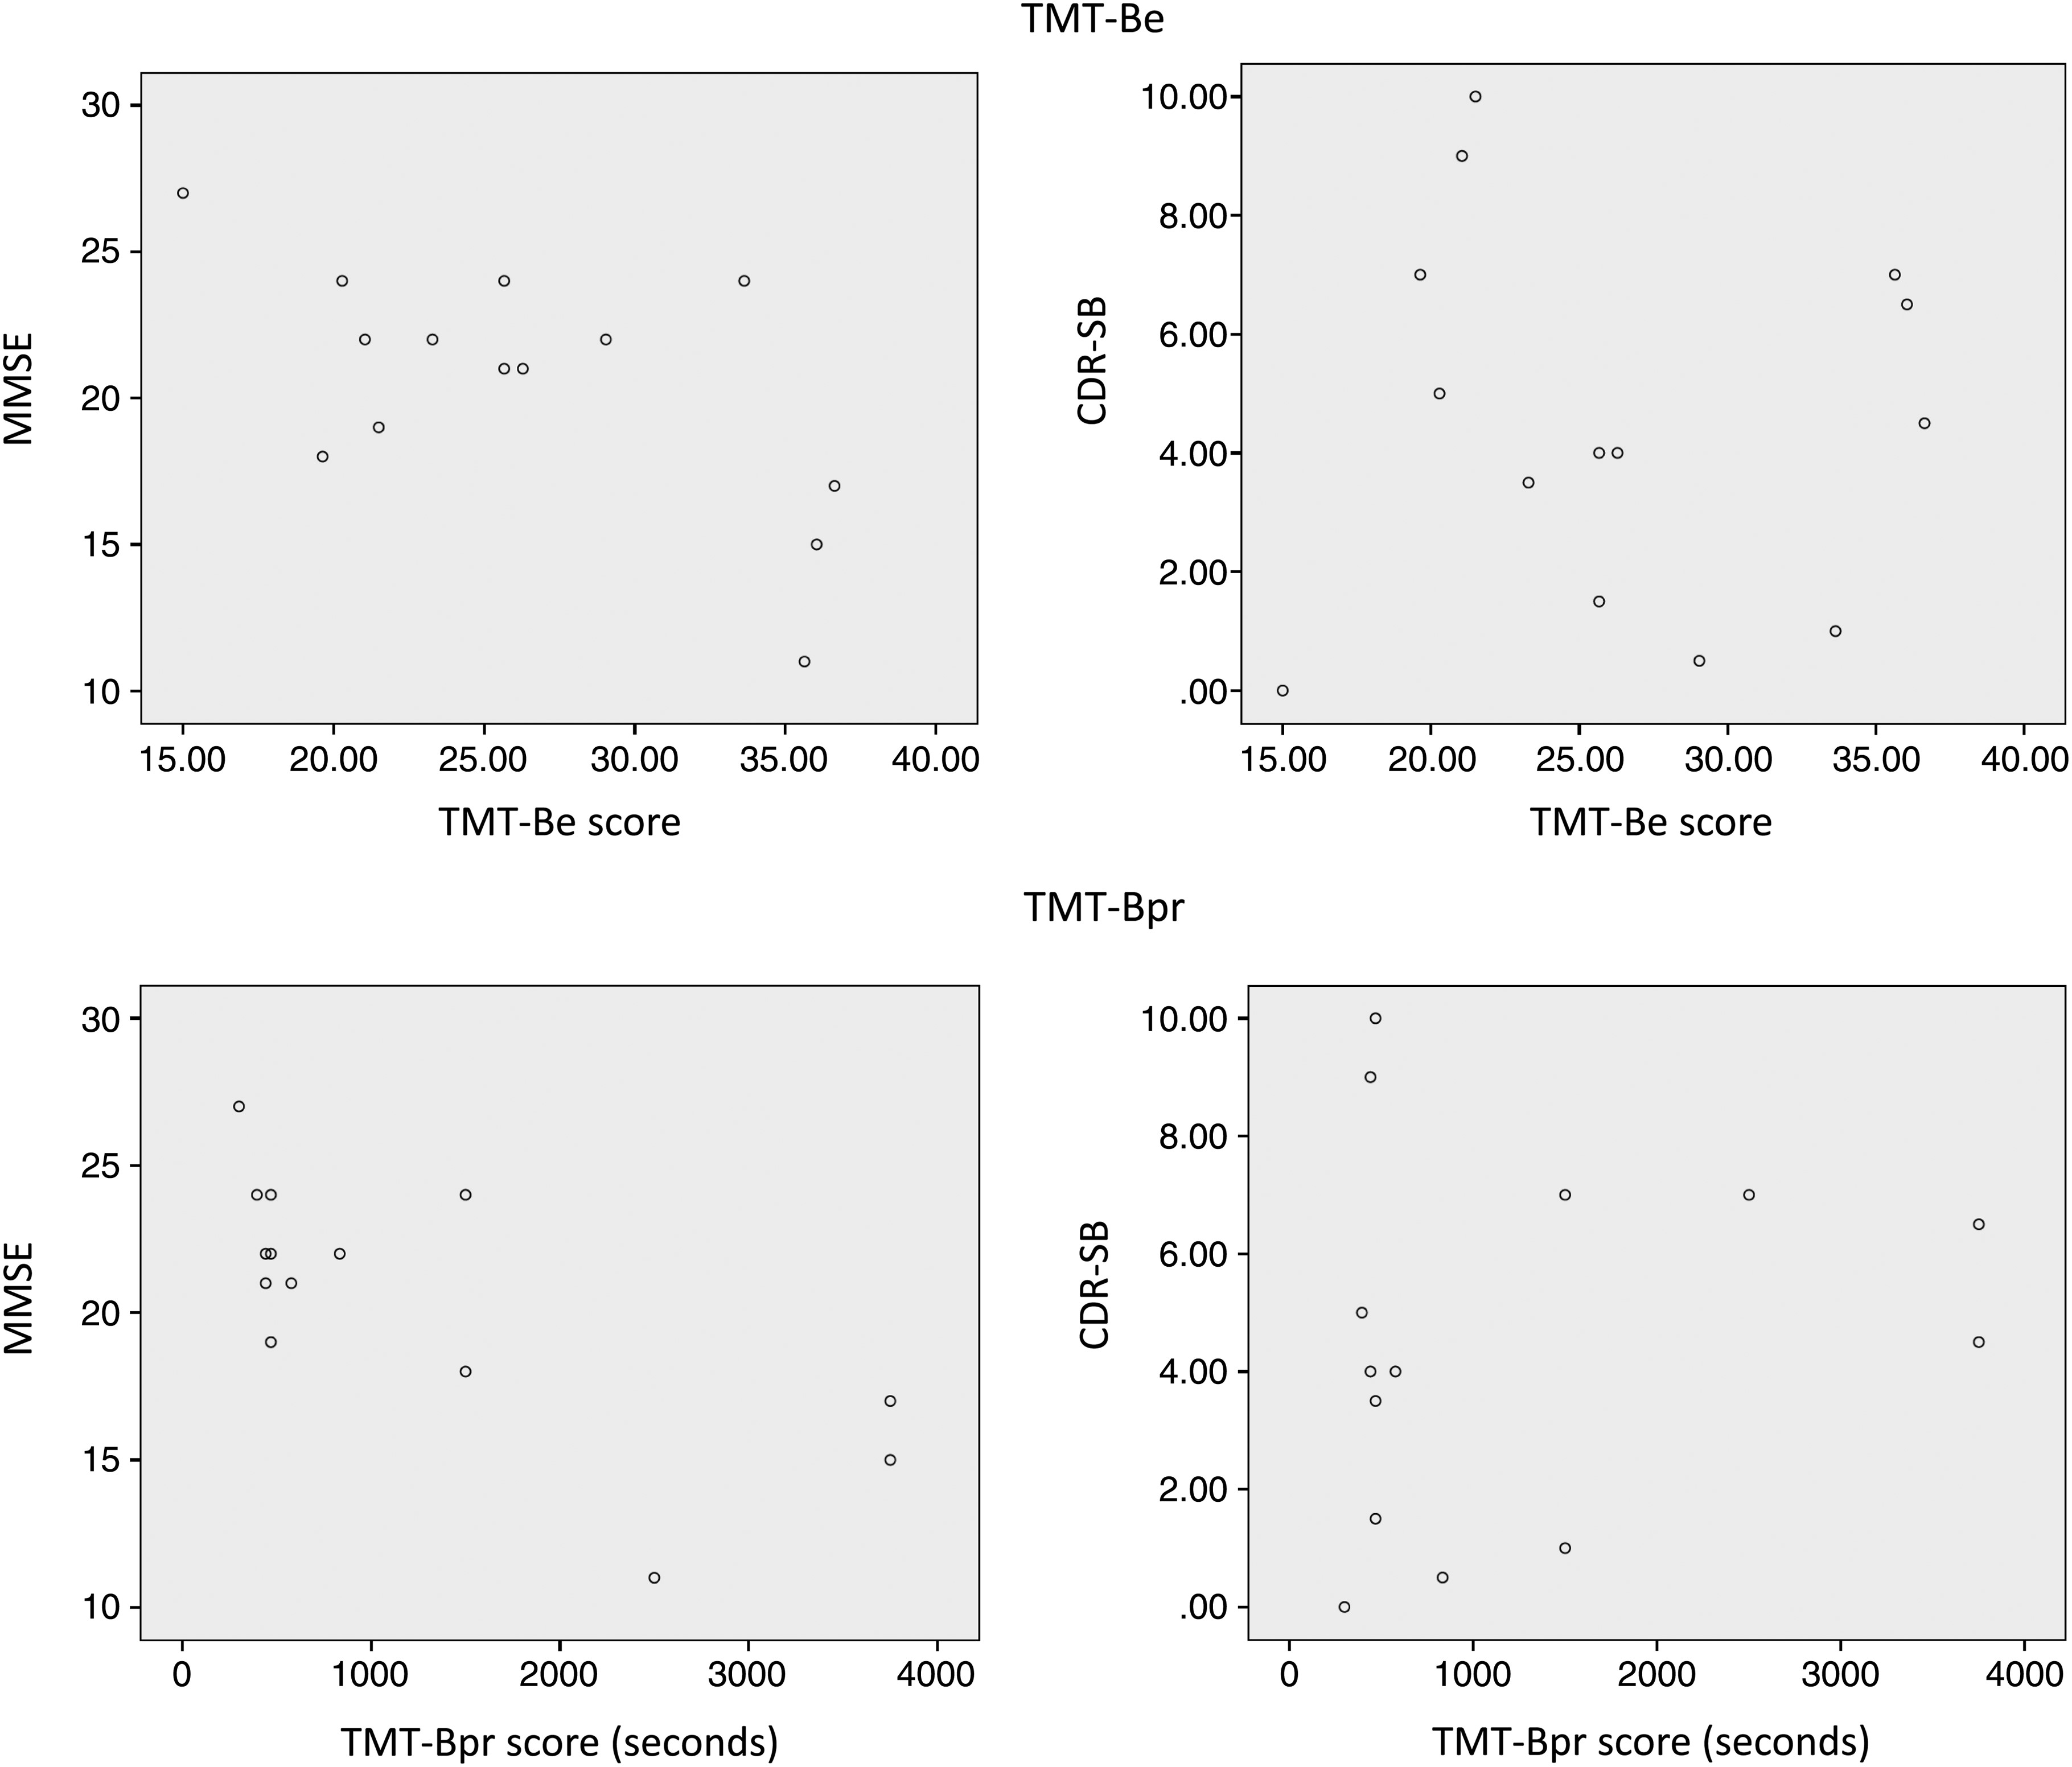
Fig. 3. Correlation of TMT-B efficiency (TMT-Be) and prorated TMT-B (TMT-Bpr) with MMSE and CDR-SB for participants ...
Notes:
Fig. 3. Correlation of TMT-B efficiency (TMT-Be) and prorated TMT-B (TMT-Bpr) with MMSE and CDR-SB for participants with standard TMT-B (TMT-Bs) = 300 s (n = 14). MMSE = Mini Mental State Examination; CDR-SB = Clinical Dementia Rating Scale Sum of Boxes.
Unless provided in the caption above, the following copyright applies to the content of this slide: Published by Oxford University Press 2015. This work is written by (a) US Government employee(s) and is in the public domain in the US.

