Slide 1
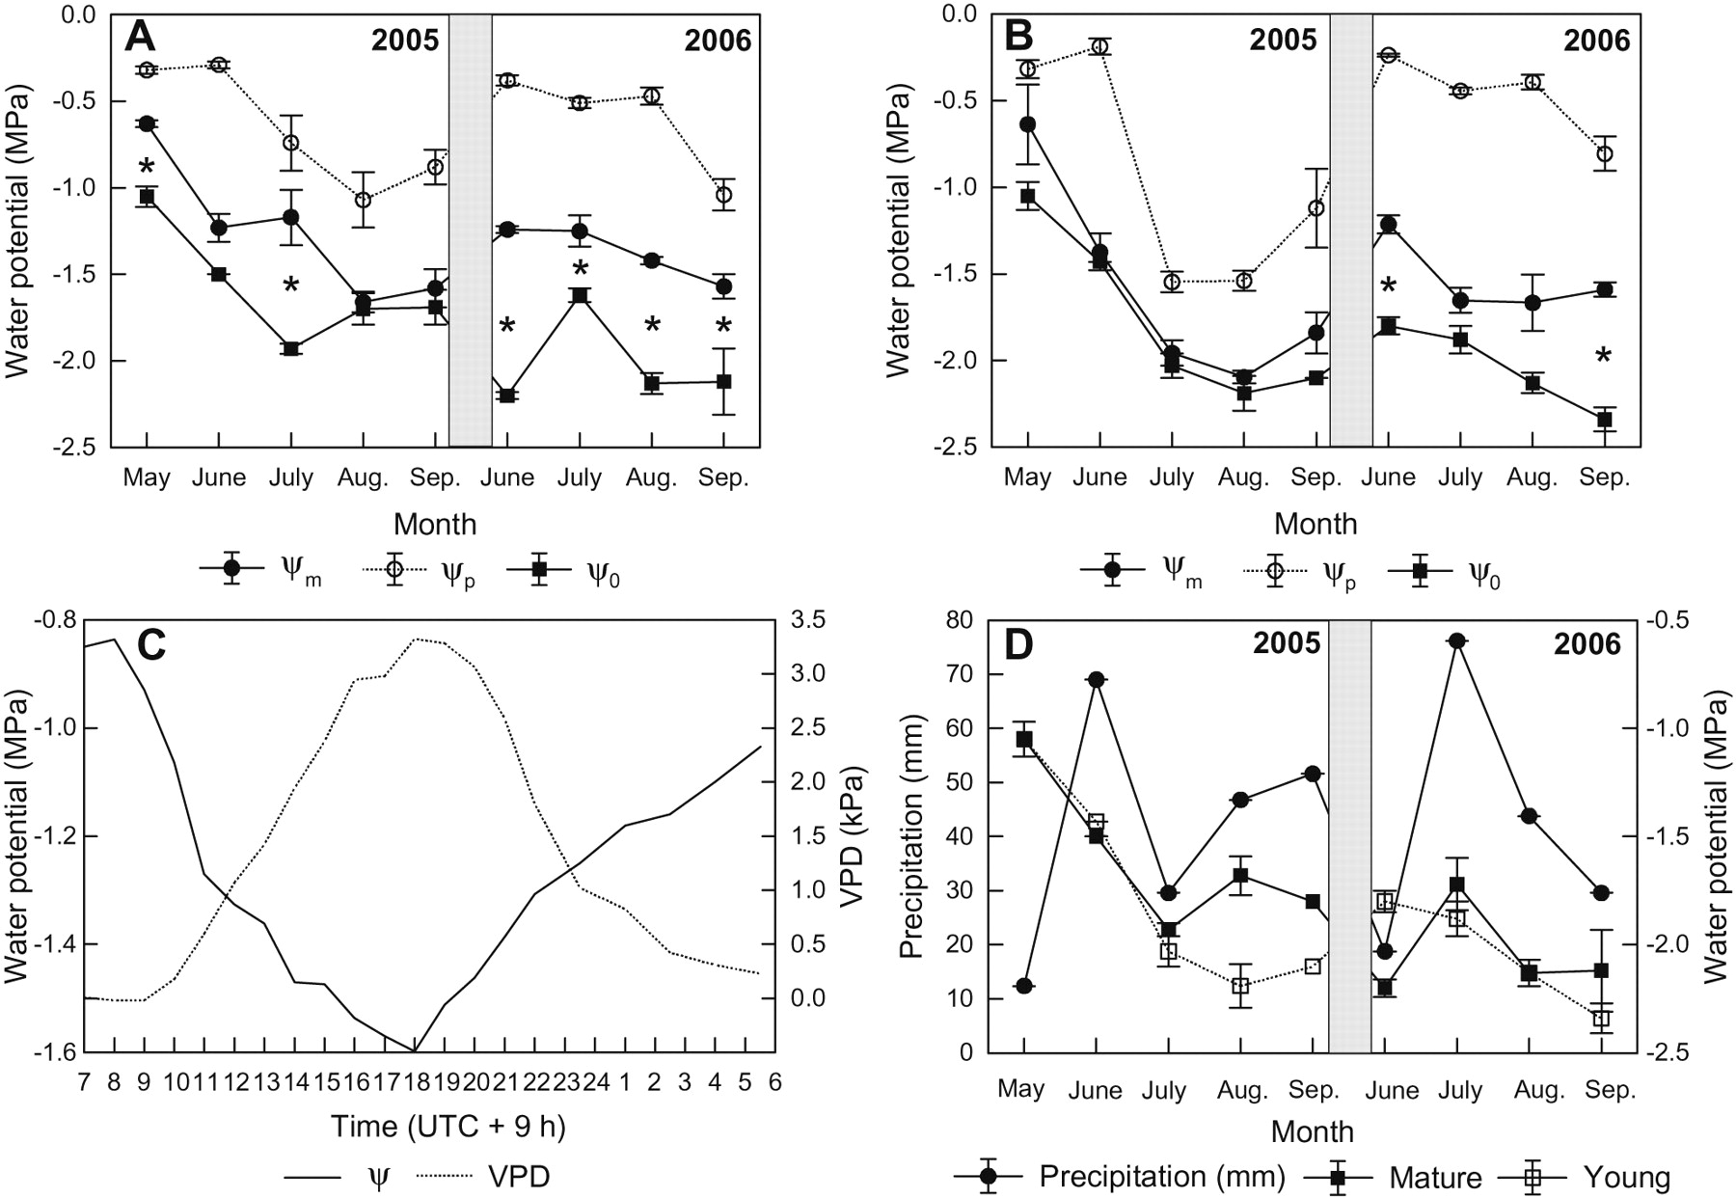
Figure 1. Seasonal and diurnal variation of the shoot water potential in L. sibirica growing at the forest line to the ...
Notes:
Figure 1. Seasonal and diurnal variation of the shoot water potential in L. sibirica growing at the forest line to the steppe at Mt. Bayantogol, western Khentey. (A, B) Minimum (Ψm) and predawn (Ψp) shoot water potentials as well as points of zero turgor Ψ0 in (A) mature (N = 5) and (B) young trees (N = 3) in the growing seasons 2005 and 2006. Asterisks indicate significant difference between Ψm and Ψ0 (P ≤ 0.05, Bonferroni-corrected t test). (C) Diurnal variation of the shoot water potential in a mature tree and VPD on August 12, 2005. (D) Variation of the point of zero turgor (Ψ0) with monthly precipitation in mature and young L. sibirica.
Unless provided in the caption above, the following copyright applies to the content of this slide: © The Author 2008. Published by Oxford University Press. All rights reserved. For Permissions, please email: journals.permissions@oxfordjournals.org

Slide 2
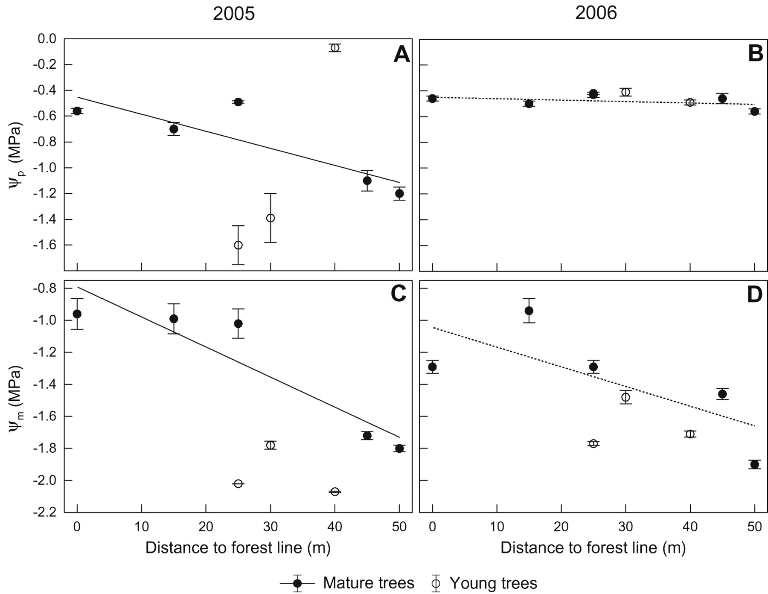
Figure 2. July values of predawn (Ψ_{p}) and minimum (Ψ_{m}) leaf water potentials in L. sibirica ...
Notes:
Figure 2. July values of predawn (Ψp) and minimum (Ψm) leaf water potentials in L. sibirica growing in the meadow steppe at different distances from the forest line on Mt. Bayantogol, western Khentey. (A) Ψp, 2005; (B) Ψp, 2006; (C) Ψm, 2005; (D) Ψm, 2006. Linear regression lines were calculated for mature trees only; dotted lines refer to non-significant relationships: (A) r = −0.86, P = 0.03; (B) r = −0.43, P = 0.24; (C) r = −0.92, P = 0.01; (D) r = −0.73, P = 0.08. Different scales for Ψp and Ψm on the ordinates should be noted.
Unless provided in the caption above, the following copyright applies to the content of this slide: © The Author 2008. Published by Oxford University Press. All rights reserved. For Permissions, please email: journals.permissions@oxfordjournals.org

Slide 3
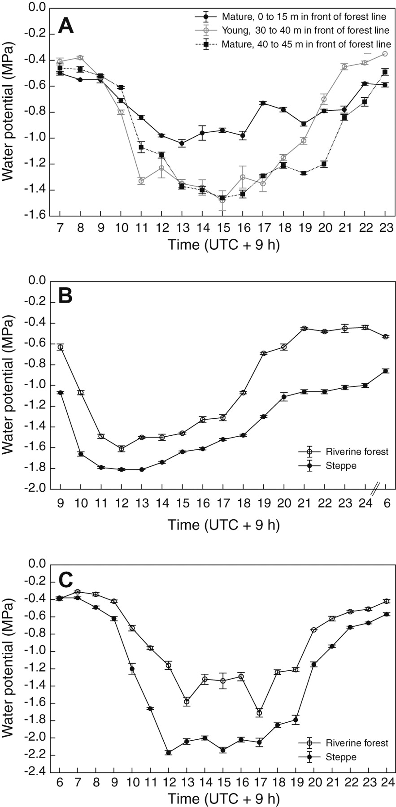
Figure 3. Diurnal variation of the shoot water potential in L. sibirica in the western Khentey. (A) Mature trees on the ...
Notes:
Figure 3. Diurnal variation of the shoot water potential in L. sibirica in the western Khentey. (A) Mature trees on the meadow steppe 0–15 m (N = 3) or 40–45 m (N = 2) in front of the forest line and young trees 30–40 m (N = 3) in front of the forest line on July 31, 2006. (B, C) Mature trees (N = 5) on the meadow steppe and in riverine forest on August 13, 2005 (B) and August 4, 2006 (C).
Unless provided in the caption above, the following copyright applies to the content of this slide: © The Author 2008. Published by Oxford University Press. All rights reserved. For Permissions, please email: journals.permissions@oxfordjournals.org

Slide 4
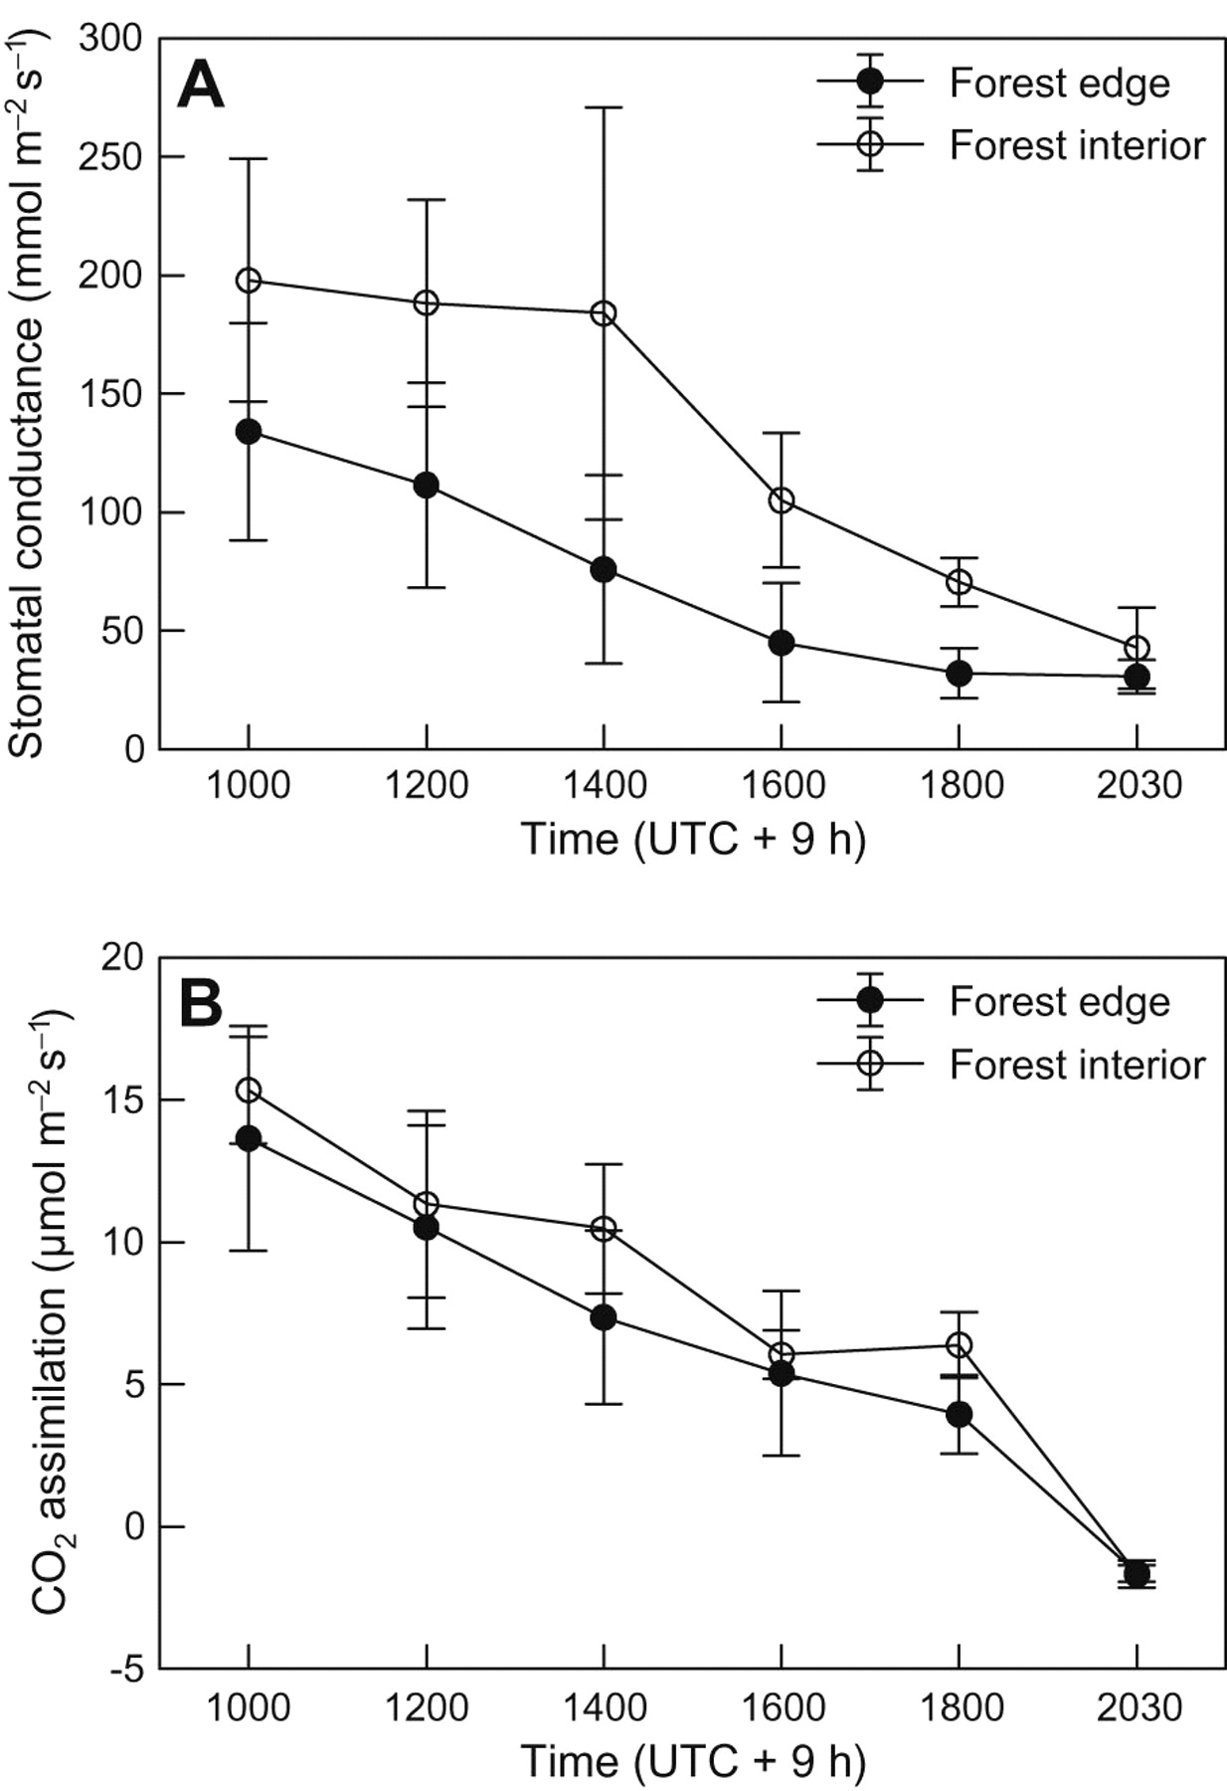
Figure 4. Diurnal variation of (A) stomatal conductance and (B) net CO₂ assimilation rate (N = 3) in L. ...
Notes:
Figure 4. Diurnal variation of (A) stomatal conductance and (B) net CO2 assimilation rate (N = 3) in L. sibirica growing at the forest line to the steppe and in the forest interior at Mt. Bayantogol, western Khentey on August 23, 2006.
Unless provided in the caption above, the following copyright applies to the content of this slide: © The Author 2008. Published by Oxford University Press. All rights reserved. For Permissions, please email: journals.permissions@oxfordjournals.org

Slide 5
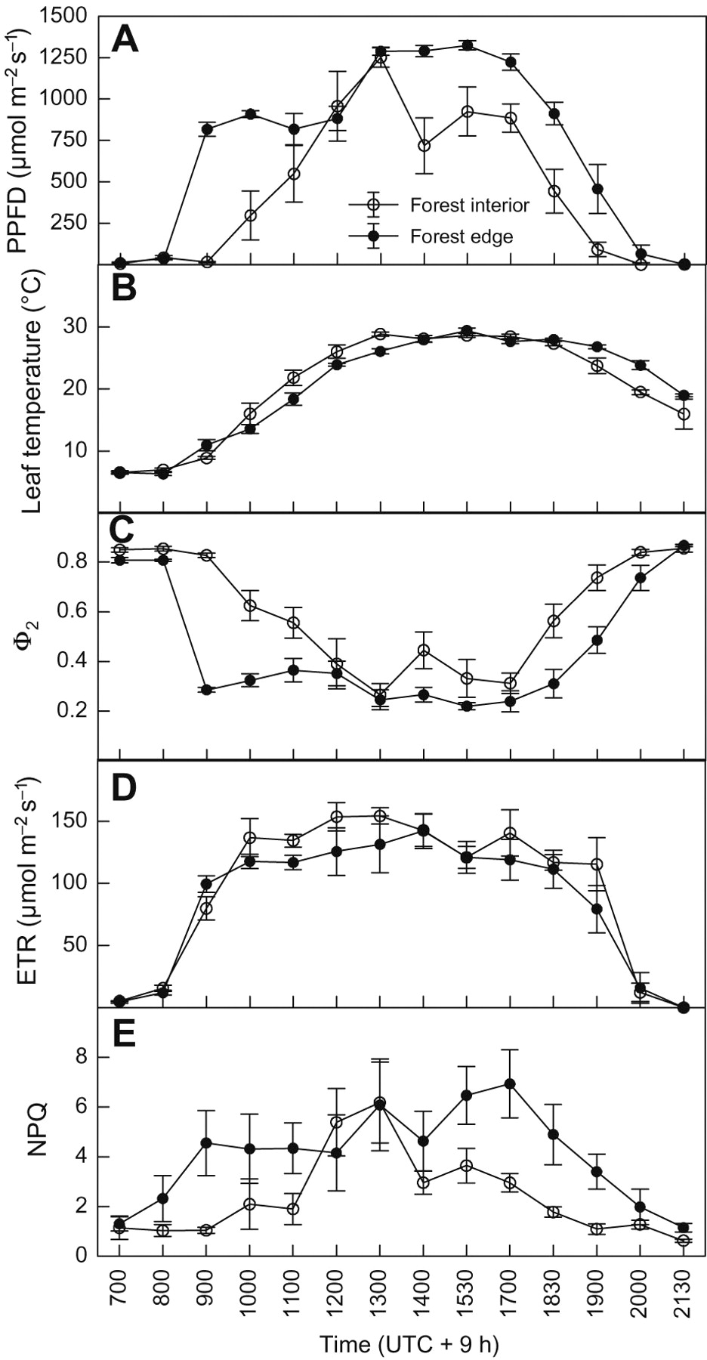
Figure 5. Diurnal variation of chlorophyll fluorescence and climatic parameters in L. sibirica growing in the forest ...
Notes:
Figure 5. Diurnal variation of chlorophyll fluorescence and climatic parameters in L. sibirica growing in the forest interior and at the forest line to the steppe (N = 5) on August 23, 2006. (A) Photosynthetically active photon flux density (PPFD), (B) leaf temperature, (C) Φ2, (D) ETR, (E) NPQ.
Unless provided in the caption above, the following copyright applies to the content of this slide: © The Author 2008. Published by Oxford University Press. All rights reserved. For Permissions, please email: journals.permissions@oxfordjournals.org

