Slide 1
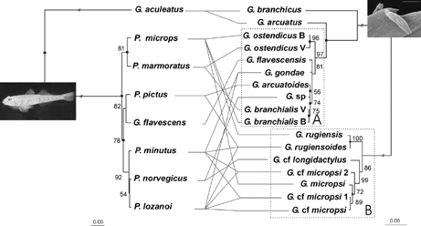
Figure 1 Evolutionary patterns of host association in Gyrodactylus species. Comparison of the goby host (left) and ...
Notes:
Figure 1 Evolutionary patterns of host association in Gyrodactylus species. Comparison of the goby host (left) and Gyrodactylus (right) phylograms, constructed from 12S and 16S mtDNA and the V4 and ITS region, respectively. TreeMap 1.0 (Page, 1994) called upon seven cospeciation events (denoted as a black circle; P = 0.01) to reconcile both trees. Branch lengths are proportional to the amount of evolutionary change, except for the branches connecting the ingroup with the outgroup sequences. Bootstrap support from minimum evolution analysis (n = 1000). Evolutionary rate for host and parasite 1% and 5.5%, respectively, per million years (Huyse et al., 2004b; Ziętara and Lumme, 2002). “B” and “V” following the species G. ostendicus and G. branchialis stand for the collection sites “Belgium” and “Venice” respectively. Groups A and B are boxed with dotted lines. (Picture from Pomatoschistus microps by Van Kampen; scanning electron micrograph of Gyrodacylus ostendicuswith scale bar = 100 μm).
Unless provided in the caption above, the following copyright applies to the content of this slide: © 2005 Society of Systematic BiologistsThis article is published and distributed under the terms of the Oxford University Press, Standard Journals Publication Model (https://academic.oup.com/journals/pages/open_access/funder_policies/chorus/standard_publication_model)

Slide 2
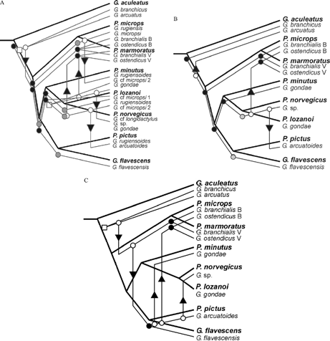
Figure 2 Reconciliation by TreeMap 2.0β (Page and Charleston, 2002) of goby and Gyrodactylus phylogenies. A shows the ...
Notes:
Figure 2 Reconciliation by TreeMap 2.0β (Page and Charleston, 2002) of goby and Gyrodactylus phylogenies. A shows the optimization for the complete data set (P = 0.02 ± 0.01); B and C represent two alternative jungles for group A (P = 0.01 ± 0.01). Arrows indicate a host-switching event; black circles, cospeciation; grey circles, sorting; and white squares and circles, duplication events.
Unless provided in the caption above, the following copyright applies to the content of this slide: © 2005 Society of Systematic BiologistsThis article is published and distributed under the terms of the Oxford University Press, Standard Journals Publication Model (https://academic.oup.com/journals/pages/open_access/funder_policies/chorus/standard_publication_model)

