Slide 1
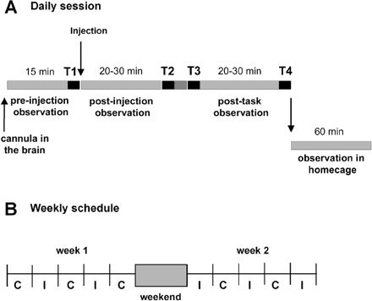
Fig. 1 (A) Daily schedules of experiments. Each session includes four task blocks (T1–T4, black line) and three ...
Notes:
Fig. 1 (A) Daily schedules of experiments. Each session includes four task blocks (T1–T4, black line) and three observation periods of spontaneous behaviour. The first observation period and task block (T1) are performed after the cannula has been positioned at the injection site and before the microinjection of bicuculline. The period beginning after the microinjection is divided into two subperiods (post-injection and post-task) by the T2 and T3 task blocks. Behaviour is also recorded in the homecage for 60 min. Control sessions (without microinjection) are organized similarly. (B) Example of the experimental schedule over a 2-week period, showing the alternation between microinjection days (I) and control days (C). A maximum of two or three microinjections are performed during each week.
Unless provided in the caption above, the following copyright applies to the content of this slide: Brain Vol. 127 No. 9 © Guarantors of Brain 2004; all rights reserved

Slide 2
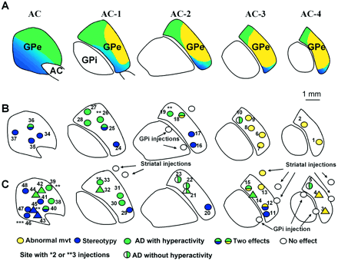
Fig. 2 Functional territories and localization of microinjection sites in the GPe. (A) Representation of the ...
Notes:
Fig. 2 Functional territories and localization of microinjection sites in the GPe. (A) Representation of the associative (green), limbic (blue) and sensorimotor (yellow) territories within the GPe, as previously defined (Haber et al., 1993; François et al., 1994). An overview of the localization of microinjection sites and the nature of the responses obtained in monkey H (B), and in monkey A (circle) and monkey B (triangle) (C). AC = anterior commissure; AD = attention deficit; GPe = external globus pallidus; GPi = internal globus pallidus.
Unless provided in the caption above, the following copyright applies to the content of this slide: Brain Vol. 127 No. 9 © Guarantors of Brain 2004; all rights reserved

Slide 3
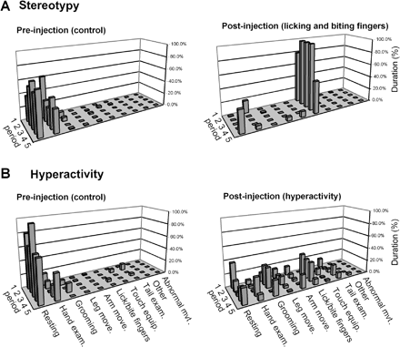
Fig. 3 Examples of stereotypy (A) and behavioural hyperactivity (B) produced by bicuculline microinjections into the ...
Notes:
Fig. 3 Examples of stereotypy (A) and behavioural hyperactivity (B) produced by bicuculline microinjections into the GPe in monkey A. Left panel: control period preceding the microinjection (five periods of 3 min) with normal behaviour, consisting of resting and examination of the hands. After a microinjection of bicuculline (site 46) into the limbic territory of the GPe (A, right panel), the monkey's behaviour was confined to two dominant behaviours: licking and biting the fingers (stereotypy). Following a bicuculline microinjection (site 33) into the associative territory of the GPe (B, right panel), behaviours were more variable, with rapid changes between the different types of behaviour (hyperactivity). Each line represents the different behaviours during an observation period of 3 min. Each behaviour is expressed as a percentage of this 3 min period devoted to this particular activity. Following these microinjections, the effect continued during the post-task period.
Unless provided in the caption above, the following copyright applies to the content of this slide: Brain Vol. 127 No. 9 © Guarantors of Brain 2004; all rights reserved

Slide 4
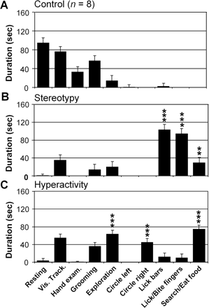
Fig. 4 Examples of abnormal behaviours assessed in the homecage after bicuculline microinjections in monkey B. (A) ...
Notes:
Fig. 4 Examples of abnormal behaviours assessed in the homecage after bicuculline microinjections in monkey B. (A) Behavioural pattern in control conditions (n = 8). The monkey mainly displayed resting, visual tracking and grooming behaviours. (B) During expression of stereotypy after the microinjection into site 43, observation of the monkey in the homecage showed an increased expression of searching for or eating food behaviour and licking behaviour directed either at the environment (homecage bars) or at the monkey's own body (fingers). (C) During the expression of hyperactivity after the microinjection into site 32, exploration, contralateral circling and searching for and eating food were the main behaviours expressed. Each column of the histograms represents the duration of one behaviour over 12 consecutive periods of 5 min following a single microinjection. Control values obtained from eight control days were pooled (**P < 0.01; ***P < 0.001).
Unless provided in the caption above, the following copyright applies to the content of this slide: Brain Vol. 127 No. 9 © Guarantors of Brain 2004; all rights reserved

Slide 5
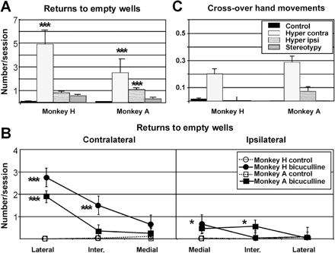
Fig. 5 Errors on a simple choice task associated with hyperactivity. (A and B) Returns to empty wells; (C) ...
Notes:
Fig. 5 Errors on a simple choice task associated with hyperactivity. (A and B) Returns to empty wells; (C) cross-over hand movements in control conditions and after microinjections that induced hyperactivity. In A and C, the mean number of errors per session for the half-boards contralateral and ipsilateral to the microinjection site during hyperactivity are compared with the values obtained in control and stereotypy conditions. In B, the spatial distribution of returns to empty wells during hyperactivity is compared with the values obtained in control conditions (monkeys H and A are superimposed). There were significantly more returns to both contralateral (in the most lateral column) and ipsilateral (in the most medial column) empty wells during the hyperactivity effect. This effect was, however, greater on the contralateral side (A and B). In contrast, no effect was observed during microinjections inducing stereotypies. For both monkeys, the increase in cross-over hand movements was confined to the contralateral half-board. As there was no difference in the frequency of errors between the right and left sides for the control and stereotypy values, data from both sides were pooled. Results for monkey B, which had fewer microinjections than monkeys H and A, are not represented (*P < 0.05; **P < 0.01; ***P < 0.001).
Unless provided in the caption above, the following copyright applies to the content of this slide: Brain Vol. 127 No. 9 © Guarantors of Brain 2004; all rights reserved

Slide 6
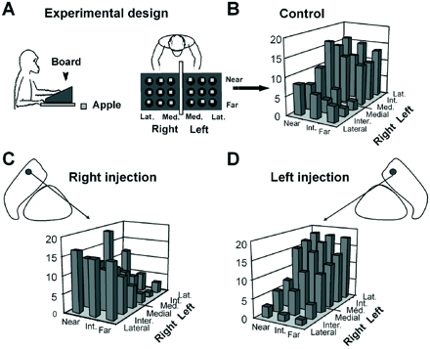
Fig. 6 Effect of bicuculline on a simple food reward task. (A) Schematic representation of the behavioural task ...
Notes:
Fig. 6 Effect of bicuculline on a simple food reward task. (A) Schematic representation of the behavioural task set-up showing the board with two separate groups of nine wells. (B) A normal spatial sequence of reward retrieval in monkey H with rewards being picked up from the medial to the lateral column, beginning on the right side and finishing on the left side. The level of each bar (low to high) indicates the chronological order in which the rewards were taken from the corresponding wells (mean of 30 control sessions). (C) Microinjection of bicuculline (site 18) into the right GPe in this monkey caused a shift in spatial strategy, the monkey starting at the far left side of the board, contralateral to the microinjection side. (D) Microinjections at symmetrical sites (site 19) into the left GPe induced opposite effects.
Unless provided in the caption above, the following copyright applies to the content of this slide: Brain Vol. 127 No. 9 © Guarantors of Brain 2004; all rights reserved

Slide 7
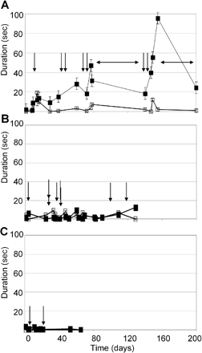
Fig. 7 Evolution of spontaneous behaviour during control sessions over the entire experimental period. A, B and C ...
Notes:
Fig. 7 Evolution of spontaneous behaviour during control sessions over the entire experimental period. A, B and C show the time course of two kinds of behaviours observed during stereotypy effect, for monkeys H, A and B, respectively: licking/biting fingers (filled symbols) and tail examination (open symbols). Each value represents the mean duration of one behaviour over 6–12 three min periods during the post-injection and post-task periods. Abscissas show the time elapsed (in days) since the beginning of experimentation. Vertical arrows represent the moment of microinjections that induced stereotypies. (A) For monkey H, horizontal arrows show the two periods when experiments were interrupted. The level of expression of licking/biting fingers behaviour increased during control days close to microinjection days that induced stereotypy (filled symbols). The level of the other behaviour involved in the stereotypy effect (tail examination) remained stable throughout the entire period (open symbols). (B and C) For the other two monkeys (monkeys A and B), the expression of these behaviours was unchanged during the whole period.
Unless provided in the caption above, the following copyright applies to the content of this slide: Brain Vol. 127 No. 9 © Guarantors of Brain 2004; all rights reserved

