Slide 1
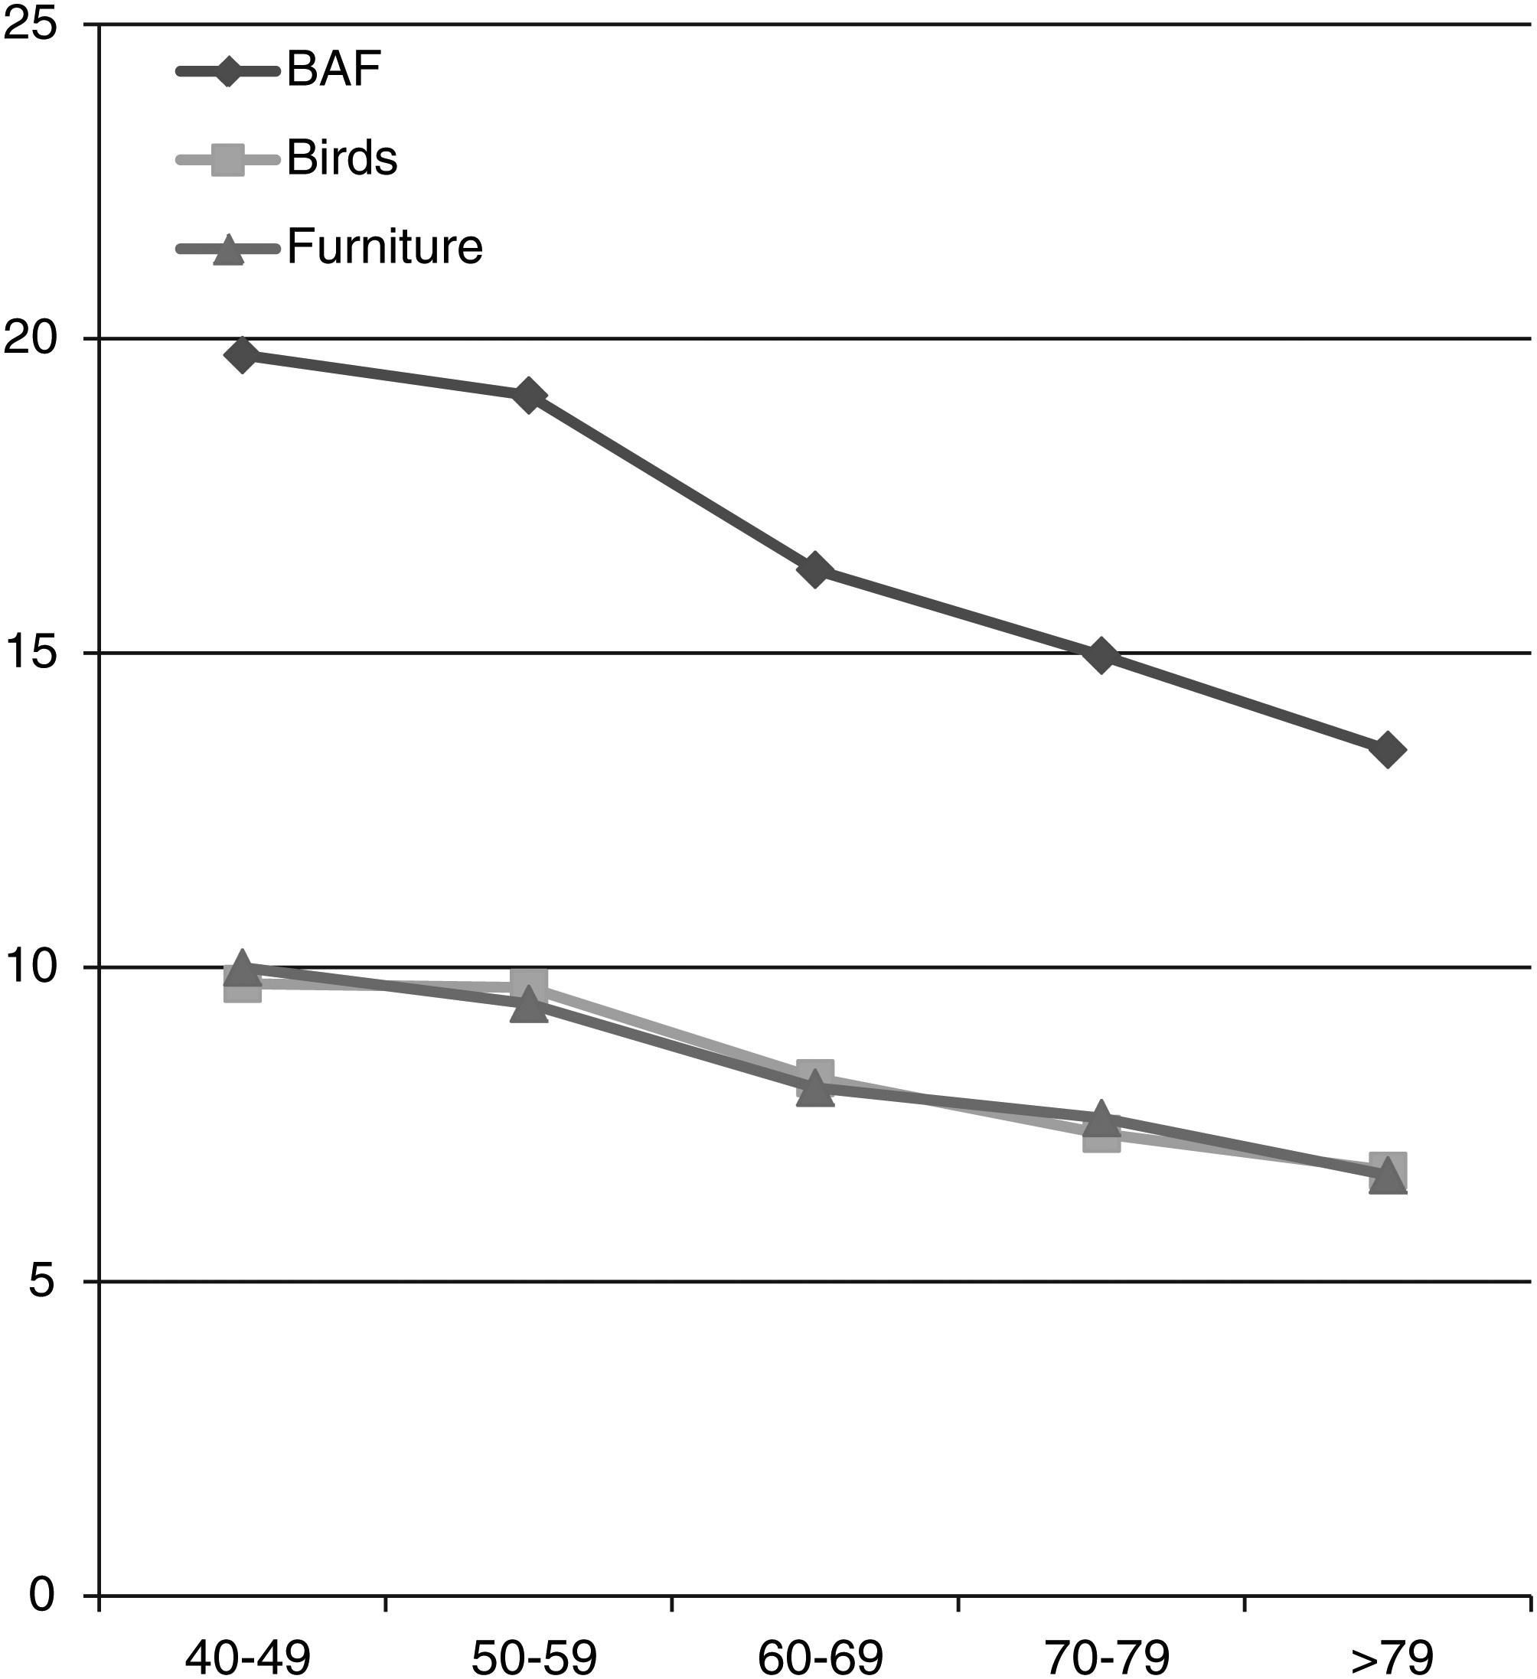
Fig. 1. Mean number of lexical entries produced on BAF, birds, and articles of furniture according to age.
Notes:
Fig. 1. Mean number of lexical entries produced on BAF, birds, and articles of furniture according to age.
Unless provided in the caption above, the following copyright applies to the content of this slide: © The Author 2016. Published by Oxford University Press. All rights reserved. For permissions, please e-mail: journals.permissions@oup.com.

Slide 2
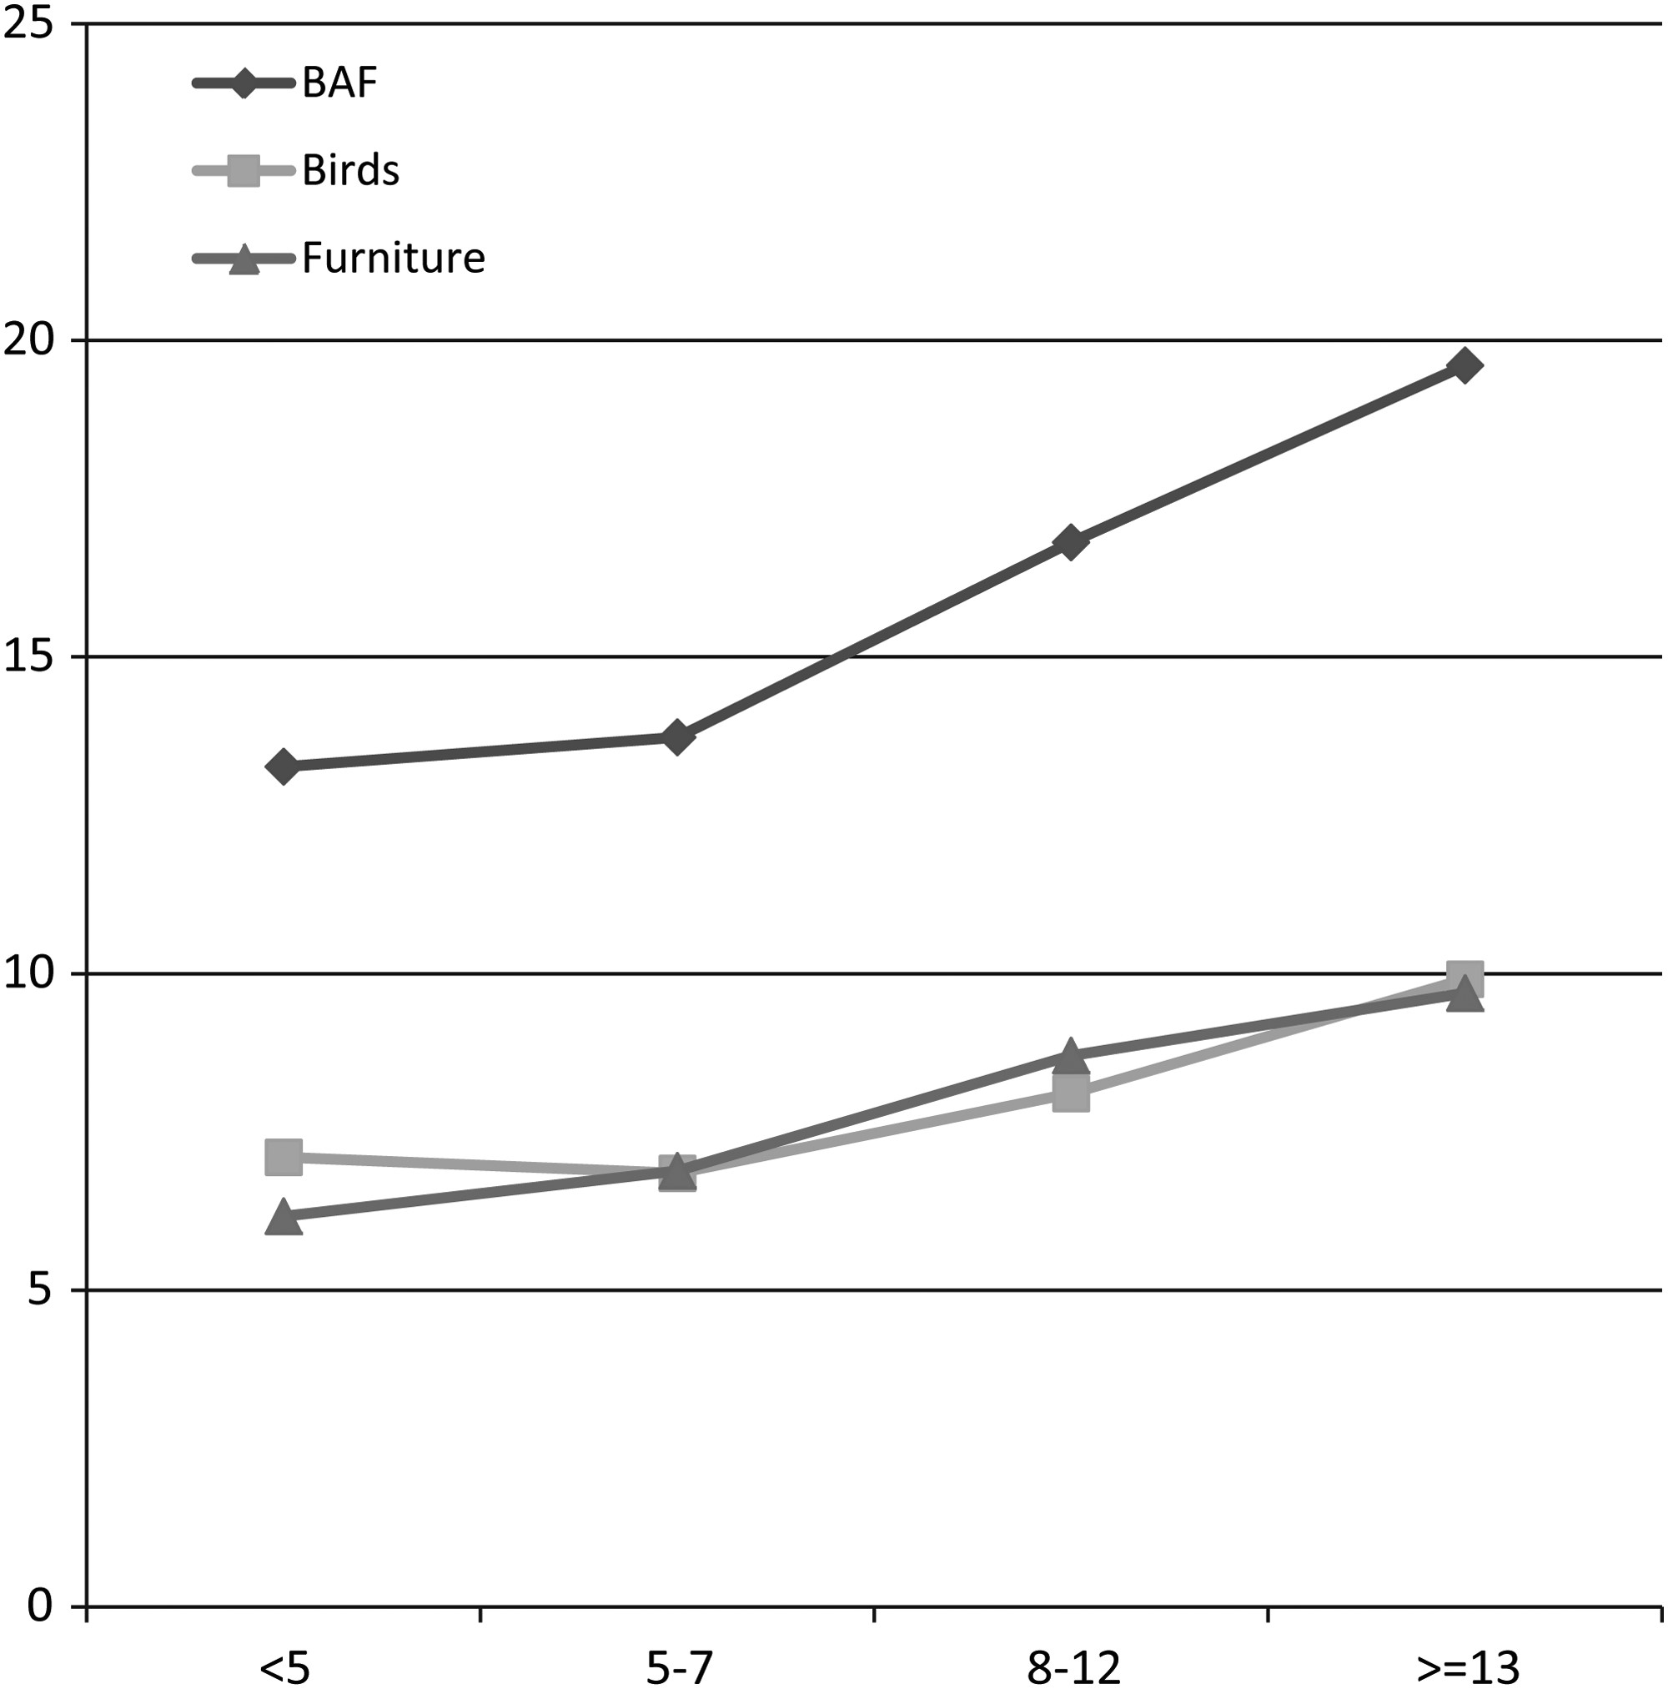
Fig. 2. Mean number of lexical entries produced on BAF, birds, and articles of furniture according to education.
Notes:
Fig. 2. Mean number of lexical entries produced on BAF, birds, and articles of furniture according to education.
Unless provided in the caption above, the following copyright applies to the content of this slide: © The Author 2016. Published by Oxford University Press. All rights reserved. For permissions, please e-mail: journals.permissions@oup.com.

