Slide 1
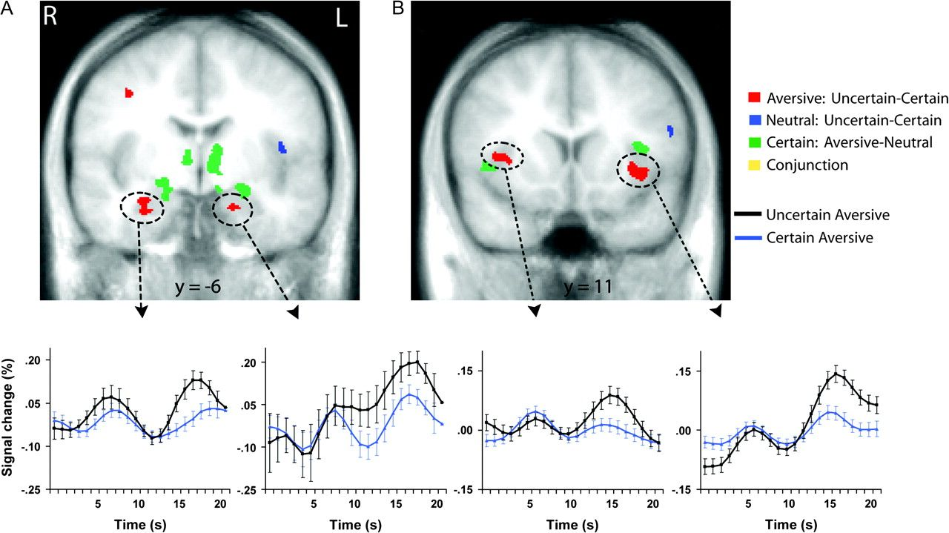
Figure 1. Amygdala (A) and mid-insula (B) regions responding to uncertainty and aversion. Red areas showed greater ...
Notes:
Figure 1. Amygdala (A) and mid-insula (B) regions responding to uncertainty and aversion. Red areas showed greater activation to aversive pictures preceded by the uncertain cue than to aversive pictures preceded by the certain aversive cue. Blue areas showed greater activation to neutral pictures preceded by the uncertain cue than to neutral pictures preceded by the certain neutral cue. Green areas showed greater activation to aversive pictures preceded by the certain aversive cue than to neutral pictures preceded by the certain neutral cue. Each contrast corresponds to a voxelwise t-test (P < 0.05, corrected). Time series plots of the circled clusters illustrate average percentage signal change across all time points of trials with aversive pictures preceded by the uncertain cue (black) and trials with aversive pictures preceded by the certain aversive cue (blue). Error bars are for the SEM after adjusting for between-subject variance (Loftus and Masson 1994). R = right; L = left.
Unless provided in the caption above, the following copyright applies to the content of this slide: © The Author 2009. Published by Oxford University Press. All rights reserved. For permissions, please e-mail: journals.permissions@oxfordjournals.org

Slide 2
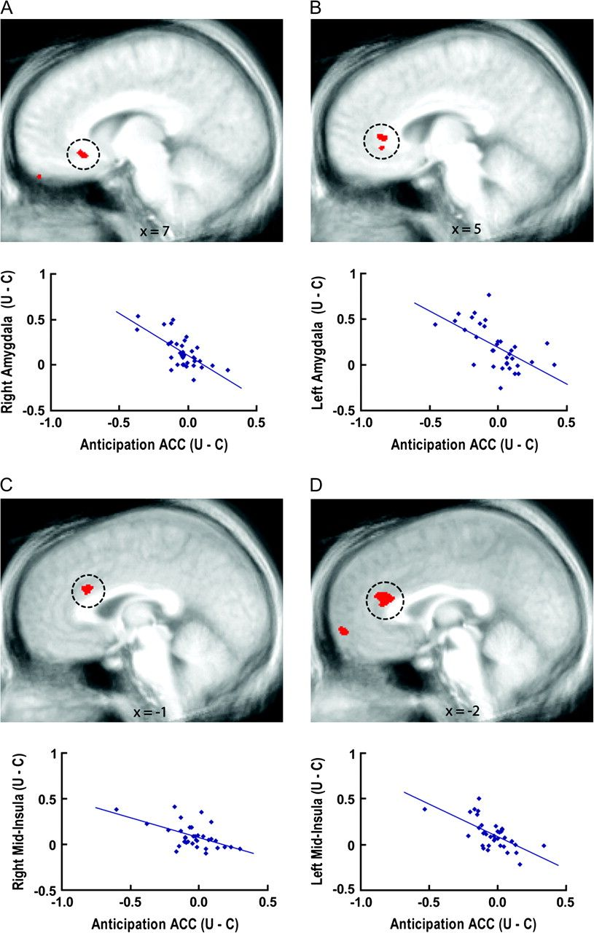
Figure 2. Anticipatory ACC activation associated with amygdala and mid-insula responses modulated by uncertainty. ...
Notes:
Figure 2. Anticipatory ACC activation associated with amygdala and mid-insula responses modulated by uncertainty. Voxelwise regressions (P < 0.05, corrected) indicated relationships between anticipatory activation in circled ACC regions and activation in the right amygdala (A), left amygdala (B), right mid-insula (C), and left mid-insula (D) areas circled in Figure 1 that were modulated by uncertainty. Plots illustrate that individual differences in anticipatory ACC activity were inversely associated with mid-insula and amygdala responses, such that individuals with greater ACC activation to the uncertain cue than the certain aversive cue showed the smallest uncertainty-related enhancement of mid-insula and amygdala activation to aversive pictures. U = uncertain condition; C = certain condition.
Unless provided in the caption above, the following copyright applies to the content of this slide: © The Author 2009. Published by Oxford University Press. All rights reserved. For permissions, please e-mail: journals.permissions@oxfordjournals.org

Slide 3
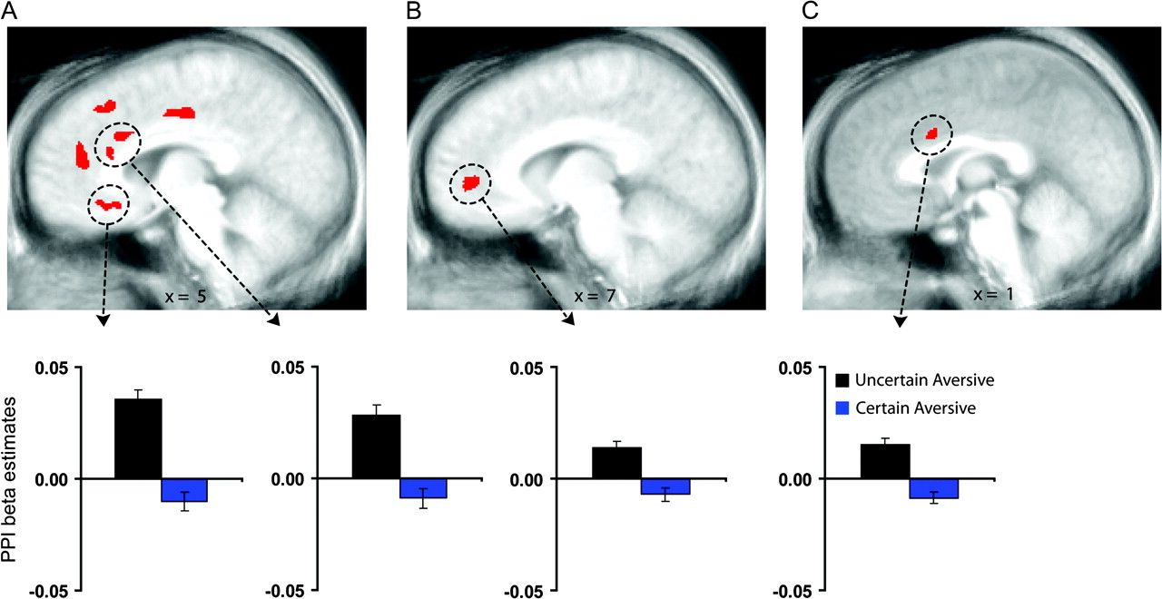
Figure 3. Greater coupling of ACC with the amygdala and mid-insula following uncertainty. Circled ACC regions showed ...
Notes:
Figure 3. Greater coupling of ACC with the amygdala and mid-insula following uncertainty. Circled ACC regions showed greater coupling with the right amygdala (A), left amygdala (B), and left mid-insula (C) clusters circled in Figure 1 (P < 0.05, corrected) during aversive pictures preceded by the uncertain cue than during aversive pictures preceded by the certain cue. Bar graphs of the circled clusters illustrate average psychophysical interaction (PPI) beta coefficients of the aversive pictures preceded by the uncertain cue (black) and aversive pictures preceded by the certain aversive cue (blue). Error bars are for the SEM after adjusting for between-subject variance (Loftus and Masson 1994).
Unless provided in the caption above, the following copyright applies to the content of this slide: © The Author 2009. Published by Oxford University Press. All rights reserved. For permissions, please e-mail: journals.permissions@oxfordjournals.org

Slide 4
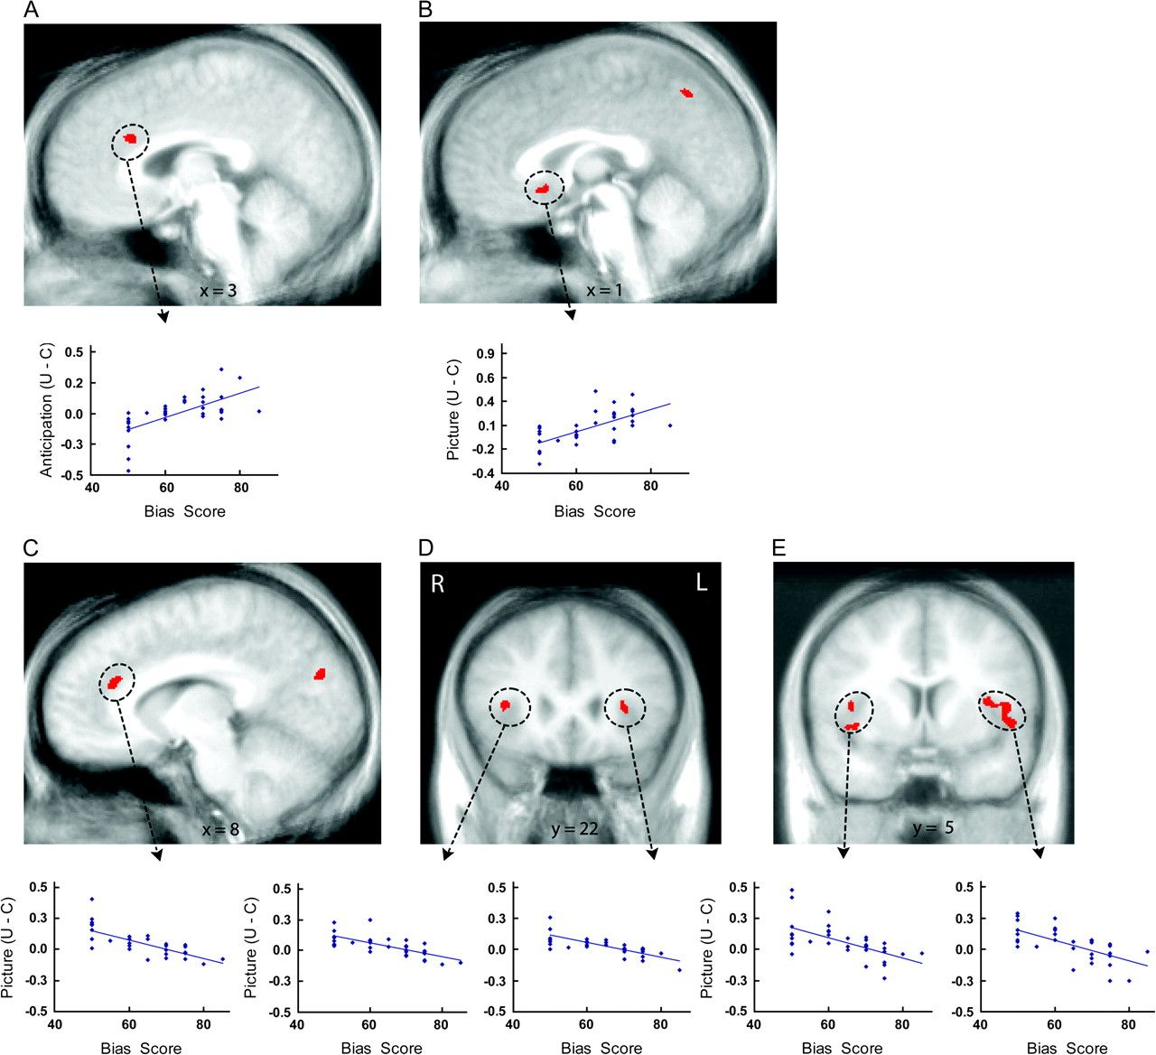
Figure 4. Individual differences in covariation bias associated with uncertainty-related activation. Voxelwise ...
Notes:
Figure 4. Individual differences in covariation bias associated with uncertainty-related activation. Voxelwise regressions (P < 0.05, corrected) indicated relationships between covariation bias scores and uncertainty-related activation in the ACC and insula. Top plots illustrate positive associations between covariation estimates and greater anticipatory activation to the uncertain cue than the certain aversive cue in the supragenual ACC (A) and greater activation to aversive pictures preceded by the uncertain cue than aversive pictures preceded by the certain aversive cue in the subgenual ACC (B). Bottom plots illustrate negative associations between covariation estimates and activation to aversive pictures preceded by the uncertain cue than aversive pictures preceded by the certain aversive cue in the supragenual ACC (C), anterior insula (D) and mid-insula (E) regions. U = uncertain condition; C = certain condition; R = right; L = left.
Unless provided in the caption above, the following copyright applies to the content of this slide: © The Author 2009. Published by Oxford University Press. All rights reserved. For permissions, please e-mail: journals.permissions@oxfordjournals.org

