Slide 1
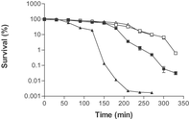
1 Mid-exponential phase C. jejuni CI 120 were challenged at pH 4.5. Cells were either unadapted (open symbols) ...
Notes:
1 Mid-exponential phase C. jejuni CI 120 were challenged at pH 4.5. Cells were either unadapted (open symbols) or adapted (solid symbols). Cells were adapted either at pH 5.75 for 5 h (solid squares) or pH 5.5 for 5 h under aerobic conditions (solid triangles). Experiments were undertaken in triplicate. Average values are shown with the standard error of the mean as error bars. Error bars are present but cannot be seen.
Unless provided in the caption above, the following copyright applies to the content of this slide: © 2003 Federation of European Microbiological Societies. Published by Elsevier Science B.V. All rights reserved.

Slide 2
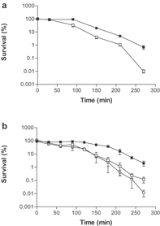
2 Early stationary phase cells of C. jejuni CI 120 were challenged at pH 4.5. a: Cells were either unadapted ...
Notes:
2 Early stationary phase cells of C. jejuni CI 120 were challenged at pH 4.5. a: Cells were either unadapted (open squares) or adapted at pH 5.5 for 5 h (solid squares). b: Cells were either unadapted (open squares), adapted with the incorporation of chloramphenicol (open circles) or adapted at pH 5.5 for 5 h under aerobic conditions (solid squares). Experiments were undertaken in triplicate. Average values are shown with the standard error of the mean as error bars. Error bars are present but cannot be seen.
Unless provided in the caption above, the following copyright applies to the content of this slide: © 2003 Federation of European Microbiological Societies. Published by Elsevier Science B.V. All rights reserved.

Slide 3
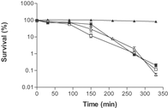
3 Late stationary phase cells of C. jejuni CI 120. Survival of cells challenged at pH 4.5. Cells were either ...
Notes:
3 Late stationary phase cells of C. jejuni CI 120. Survival of cells challenged at pH 4.5. Cells were either unadapted (open symbols) or adapted at pH 5.5 for 5 h (solid symbols). Cells were adapted either at pH 5.75 for 5 h (solid squares) or pH 5.5 for 5 h under aerobic conditions (solid triangles). Experiments were undertaken in triplicate. Average values are shown with the standard error of the mean as error bars.
Unless provided in the caption above, the following copyright applies to the content of this slide: © 2003 Federation of European Microbiological Societies. Published by Elsevier Science B.V. All rights reserved.

Slide 4
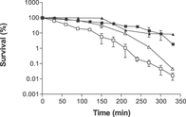
4 Aerobic induced cross protection to acid. Survival of cells challenged at pH 4.5. Early stationary phase ...
Notes:
4 Aerobic induced cross protection to acid. Survival of cells challenged at pH 4.5. Early stationary phase cells (squares) and late stationary phase cells (triangles) were either unadapted (open symbols) or adapted at pH 7.0 aerobically for 5 h (solid symbols). Experiments were undertaken in triplicate. Average values are shown with the standard error of the mean as error bars. Error bars are present but cannot be seen.
Unless provided in the caption above, the following copyright applies to the content of this slide: © 2003 Federation of European Microbiological Societies. Published by Elsevier Science B.V. All rights reserved.

