Slide 1
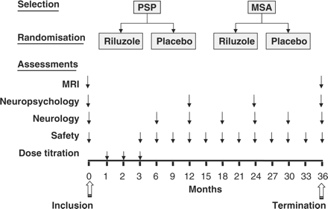
Fig. 1 Trial Flow Chart. At the selection stage, patients were assigned to either the MSA or PSP strata according to ...
Notes:
Fig. 1 Trial Flow Chart. At the selection stage, patients were assigned to either the MSA or PSP strata according to the NNIPPS diagnostic criteria. Following Inclusion, patients within each stratum were randomly allocated to either the riluzole or placebo group on 1:1 ratio and followed-up 3 monthly for 36 months in double-blind fashion. Arrows indicate the time of each assessment.
Unless provided in the caption above, the following copyright applies to the content of this slide: © 2008 The Author(s)This is an Open Access article distributed under the terms of the Creative Commons Attribution Non-Commercial License (http://creativecommons.org/licenses/by-nc/2.0/uk/) which permits unrestricted non-commercial use, distribution, and reproduction in any medium, provided the original work is properly cited.

Slide 2
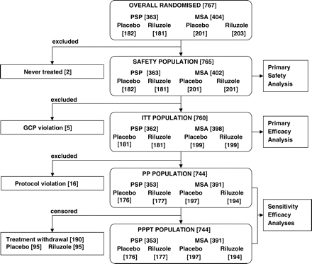
Fig. 2 NNIPPS populations in analyses.
Notes:
Fig. 2 NNIPPS populations in analyses.
Unless provided in the caption above, the following copyright applies to the content of this slide: © 2008 The Author(s)This is an Open Access article distributed under the terms of the Creative Commons Attribution Non-Commercial License (http://creativecommons.org/licenses/by-nc/2.0/uk/) which permits unrestricted non-commercial use, distribution, and reproduction in any medium, provided the original work is properly cited.

Slide 3
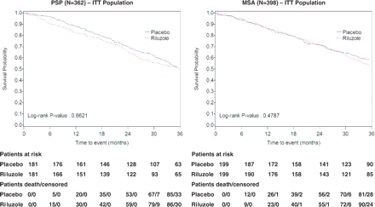
Fig. 3 Kaplan–Meier survival curves of riluzole and placebo groups in PSP and MSA strata.
Notes:
Fig. 3 Kaplan–Meier survival curves of riluzole and placebo groups in PSP and MSA strata.
Unless provided in the caption above, the following copyright applies to the content of this slide: © 2008 The Author(s)This is an Open Access article distributed under the terms of the Creative Commons Attribution Non-Commercial License (http://creativecommons.org/licenses/by-nc/2.0/uk/) which permits unrestricted non-commercial use, distribution, and reproduction in any medium, provided the original work is properly cited.

Slide 4
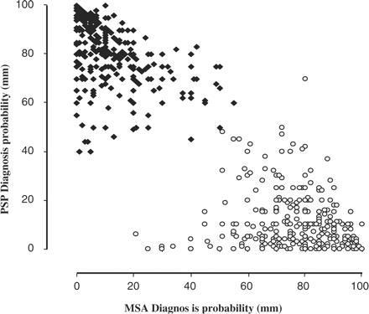
Fig. 4 Convergent validity of NNIPPS Diagnostic Criteria with Investigators’ Diagnostic Probability (VAS). At the ...
Notes:
Fig. 4 Convergent validity of NNIPPS Diagnostic Criteria with Investigators’ Diagnostic Probability (VAS). At the inclusion visit, following patients’ assignment to strata using the NNIPPS diagnostic criteria, investigators were asked to evaluate the probability of each diagnosis (PSP, MSA), using a 100 mm VAS. All 760 patients are plotted on the graph according to the probability score on each VAS (PSP-vertical axis, MSA-horizontal axis). Solid diamonds represent patients included in the PSP stratum; White circles represent patients included in the MSA stratum. Convergent validity of the NNIPPS inclusion criteria with the investigators’ assessment of diagnostic probability was tested with the point-biserial correlation. MSA, rpb = 0.93 (P < 0.0001), PSP, rpb = 0.95, (P < 0.0001).
Unless provided in the caption above, the following copyright applies to the content of this slide: © 2008 The Author(s)This is an Open Access article distributed under the terms of the Creative Commons Attribution Non-Commercial License (http://creativecommons.org/licenses/by-nc/2.0/uk/) which permits unrestricted non-commercial use, distribution, and reproduction in any medium, provided the original work is properly cited.

Slide 5
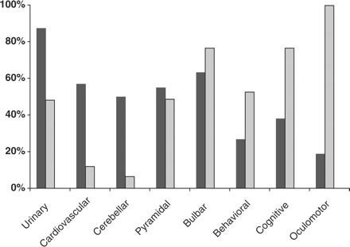
Fig. 5 Syndrome profile of patients in PSP and MSA Strata. At the inclusion visit, and based on the clinical ...
Notes:
Fig. 5 Syndrome profile of patients in PSP and MSA Strata. At the inclusion visit, and based on the clinical neurological assessments, investigators were asked to describe the syndrome profile of the patients using a systematic (yes/no) questionnaire. Each bar represents the percentage of patients within each stratum positive for a given syndrome. Black bars represent the MSA stratum, grey bars the PSP stratum. The akinetic rigid syndrome was a mandatory inclusion criterion for both strata and therefore is not represented.
Unless provided in the caption above, the following copyright applies to the content of this slide: © 2008 The Author(s)This is an Open Access article distributed under the terms of the Creative Commons Attribution Non-Commercial License (http://creativecommons.org/licenses/by-nc/2.0/uk/) which permits unrestricted non-commercial use, distribution, and reproduction in any medium, provided the original work is properly cited.

