Slide 1
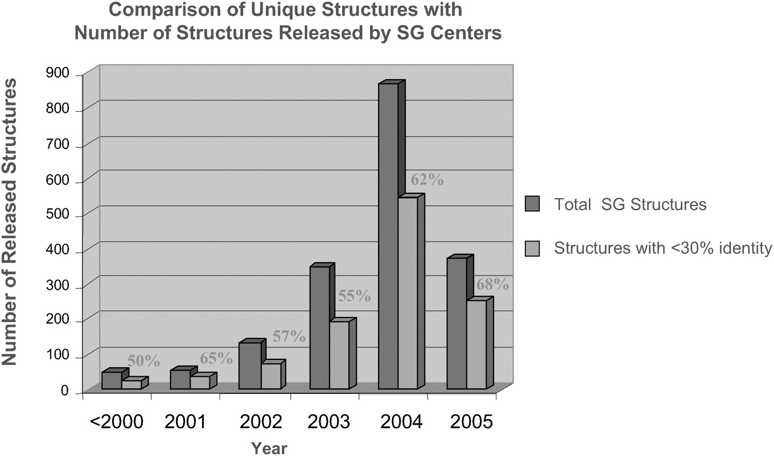
Figure 1 August 2005 report from the structural genomics information portal showing structural genomics structures ...
Notes:
Figure 1 August 2005 report from the structural genomics information portal showing structural genomics structures with sequence similarity <30% relative to solved structures in the PDB by year. Sequence comparisons are performed using the blastclust application (7).
Unless provided in the caption above, the following copyright applies to the content of this slide: © The Author 2006. Published by Oxford University Press. All rights reserved The online version of this article has been published under an open access model. Users are entitled to use, reproduce, disseminate, or display the open access version of this article for non-commercial purposes provided that: the original authorship is properly and fully attributed; the Journal and Oxford University Press are attributed as the original place of publication with the correct citation details given; if an article is subsequently reproduced or disseminated not in its entirety but only in part or as a derivative work this must be clearly indicated. For commercial re-use, please contact journals.permissions@oxfordjournals.org

Slide 2
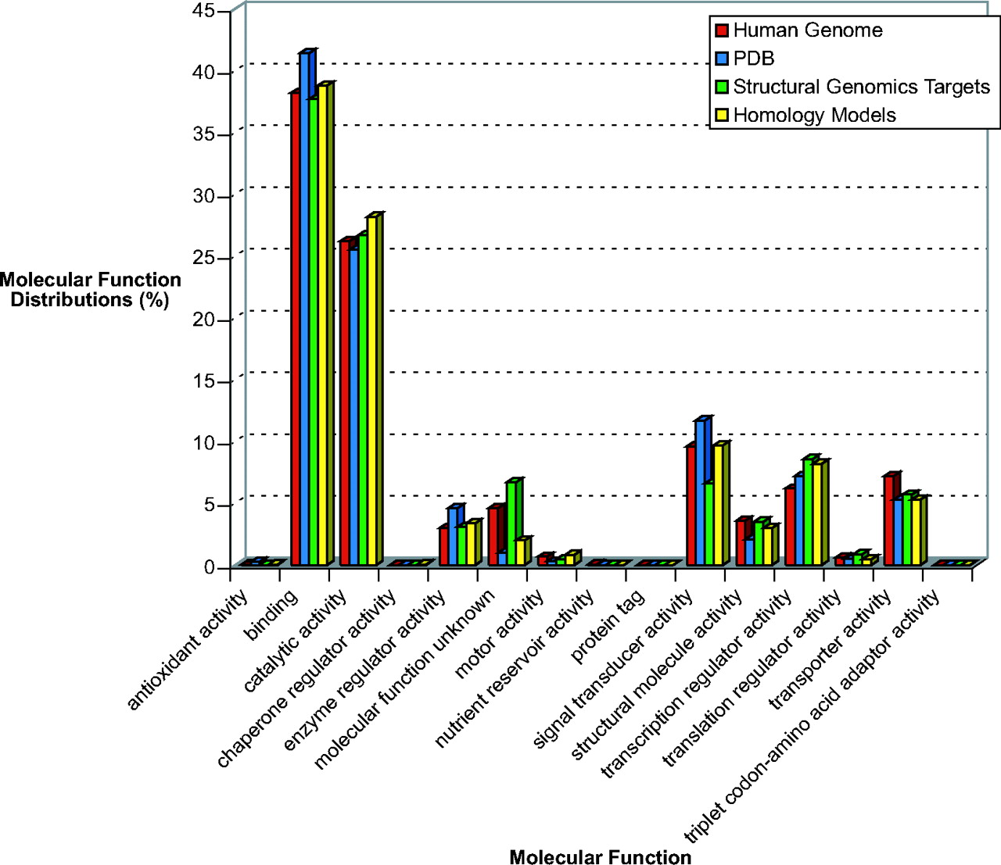
Figure 2 Normalized functional coverage of the human genome by sequence (from Ensembl; red), by structures from the ...
Notes:
Figure 2 Normalized functional coverage of the human genome by sequence (from Ensembl; red), by structures from the PDB (blue), by structural genomics targets (green) and homology models from SUPERFAMILY (yellow). When viewing the figure from the online structural genomics portal, clicking on the appropriate bar of the histogram will produce a list of sequences or structures that define the distribution.
Unless provided in the caption above, the following copyright applies to the content of this slide: © The Author 2006. Published by Oxford University Press. All rights reserved The online version of this article has been published under an open access model. Users are entitled to use, reproduce, disseminate, or display the open access version of this article for non-commercial purposes provided that: the original authorship is properly and fully attributed; the Journal and Oxford University Press are attributed as the original place of publication with the correct citation details given; if an article is subsequently reproduced or disseminated not in its entirety but only in part or as a derivative work this must be clearly indicated. For commercial re-use, please contact journals.permissions@oxfordjournals.org

