Slide 1
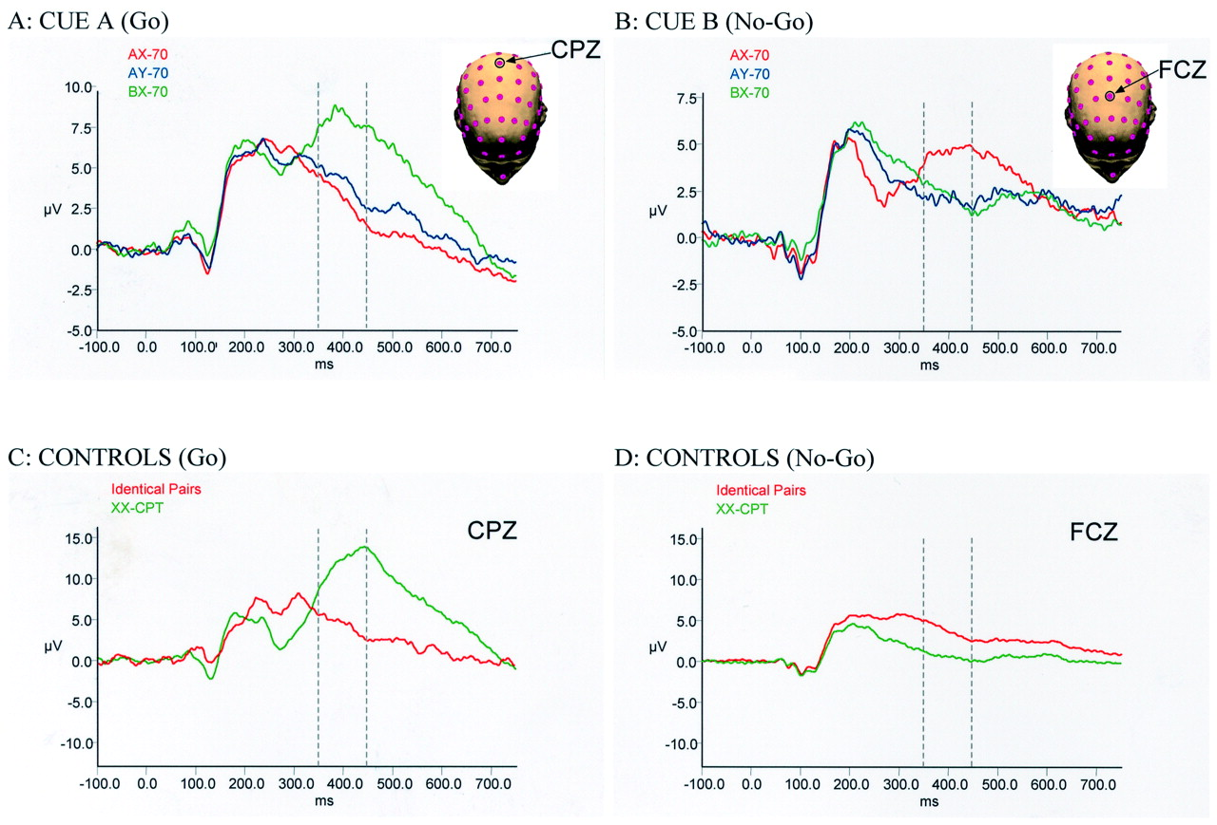
Figure 1. Global Context effects. Comparison of the potentials evoked by presentation of the cue (time = 0 ms) in the ...
Notes:
Figure 1. Global Context effects. Comparison of the potentials evoked by presentation of the cue (time = 0 ms) in the different tasks. Group-averaged ERP are shown from the electrodes where maximal response was recorded, as illustrated on the insets. (A) For cue(A), the data from scalp site CPZ is shown. The trace for AX-70 is in red, AY-70 is in blue and BX-70 in green. (B) For cue(B), the data from electrode FCZ is shown. Conventions are the same as in (A). (C) For Controls (Go) the data from electrode CPZ is shown. (D) For Controls (No-Go) the data from electrode FCZ is shown. The trace for the Identical Pairs task is in red and for the XX-CPT task is in green. The dashed lines mark the period used for the statistical analysis.
Unless provided in the caption above, the following copyright applies to the content of this slide: © Oxford University Press

Slide 2
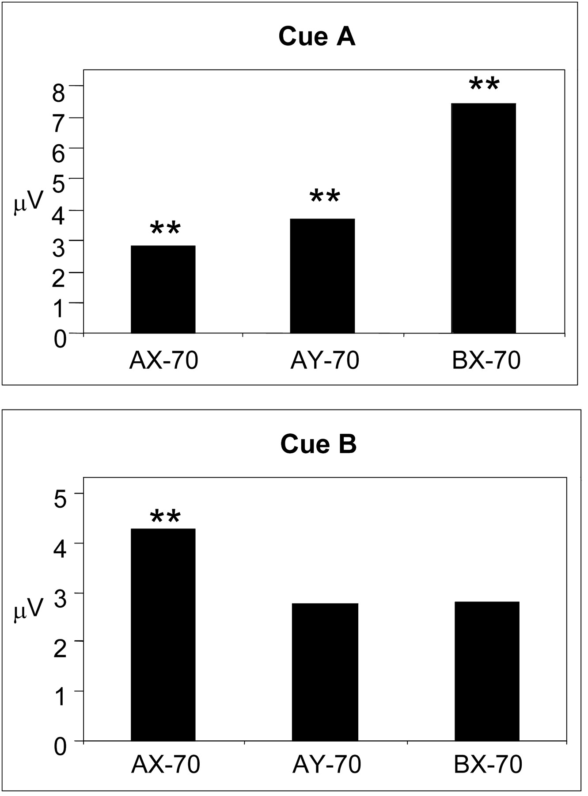
Figure 2. Histograms comparing mean amplitude of potentials recorded between 350 and 450 ms after presentation of cue A ...
Notes:
Figure 2. Histograms comparing mean amplitude of potentials recorded between 350 and 450 ms after presentation of cue A and cue B.
Unless provided in the caption above, the following copyright applies to the content of this slide: © Oxford University Press

Slide 3
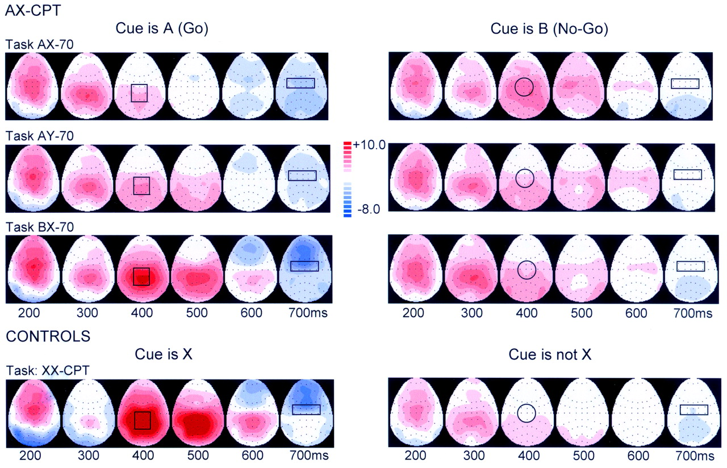
Figure 3. Topographical voltage distribution (top view, anterior is up, left is left) of the group-averaged potentials ...
Notes:
Figure 3. Topographical voltage distribution (top view, anterior is up, left is left) of the group-averaged potentials recorded after presentation of the cues, at six time points (200 to 700 ms, at 100 ms intervals). Each dot represents an electrode location in the 64-electrode array. Scale represents activities from −8 to 10 μV. Boxes include electrodes used for statistical analysis.
Unless provided in the caption above, the following copyright applies to the content of this slide: © Oxford University Press

Slide 4
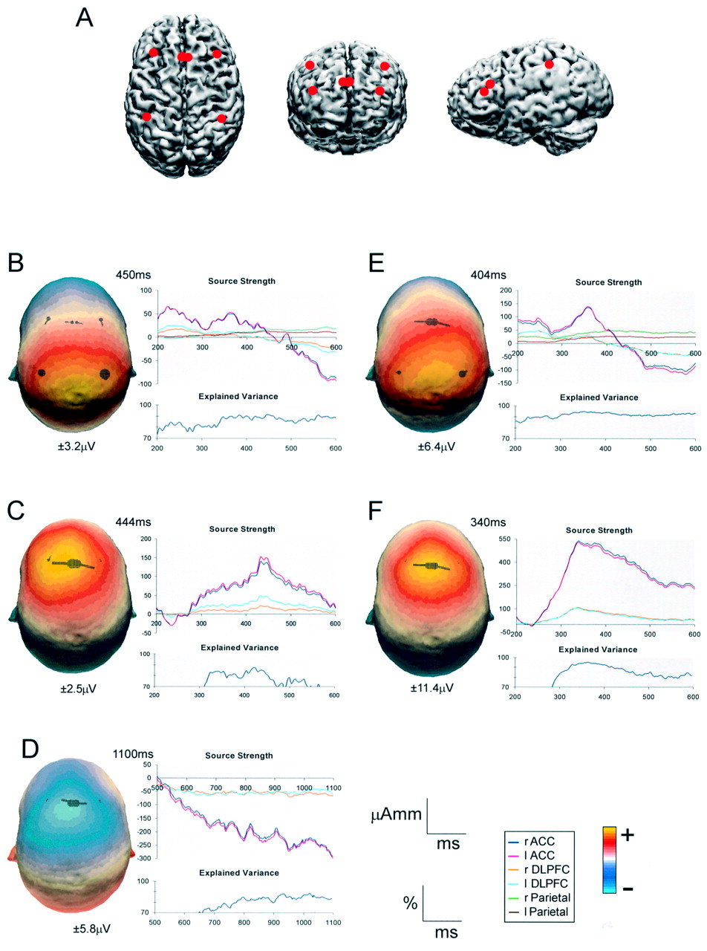
Figure 4. (A) Illustration of the dipole positions used, projected onto the cortical surface in top, front and side ...
Notes:
Figure 4. (A) Illustration of the dipole positions used, projected onto the cortical surface in top, front and side views. Tailarach coordinates for the positions were: ACC (3, 19, 35 mm/–3, 19, 35 mm), DLPFC (34, 25, 26 mm/–34, 25, 26 mm), BA 40 (40, −49, 46 mm/–40, −49, 46 mm) (B–F). Left: Top view of the scalp distribution of the potentials at the moment they reach their peak amplitude, for each case. Dipoles are projected onto the surface for comparison. The relative sizes of the dipoles are scaled to the source strength for each dipole in each case. Values under scalp representations indicate the scale values for each case. Right: The top graph in each composite illustrates the temporal evolution of the strength of source in μA mm × ms for all dipoles tested. The bottom graph illustrates the variance explained by the dipoles in % × ms. (B) Cue Go. Difference potential: cue(A) in BX-70 minus cue(A) in AY-70. Parietal dipoles were also included. (C) Cue No-Go: difference potential: cue(B) in AX-70 task minus cue(B) in AY-70 task. (D) Late negativity: difference potential: cue(A) in BX-70 task minus cue(B) in BX-70 task. The potentials could be mostly explained by dipoles localized in ACC and DLPFC, but their orientations were opposite to those of the No-Go situations, i.e. negative values. (E) Target Go. Difference potential: target(X) in BX-70 task, cue(A) minus target(X) in BX-70 task, cue(B). Parietal dipoles also included. Conventions as in B. (F) Target No-Go: difference potential: target(Y) in AX-70 task, cue(A) minus target(Y) in AX-70 task, cue(B). Notice that in both cases where there is a No-Go situation (C and F) the potential are represented more anteriorly than when there is a change in task expectation, but is a Go situation (B and E).
Unless provided in the caption above, the following copyright applies to the content of this slide: © Oxford University Press

Slide 5
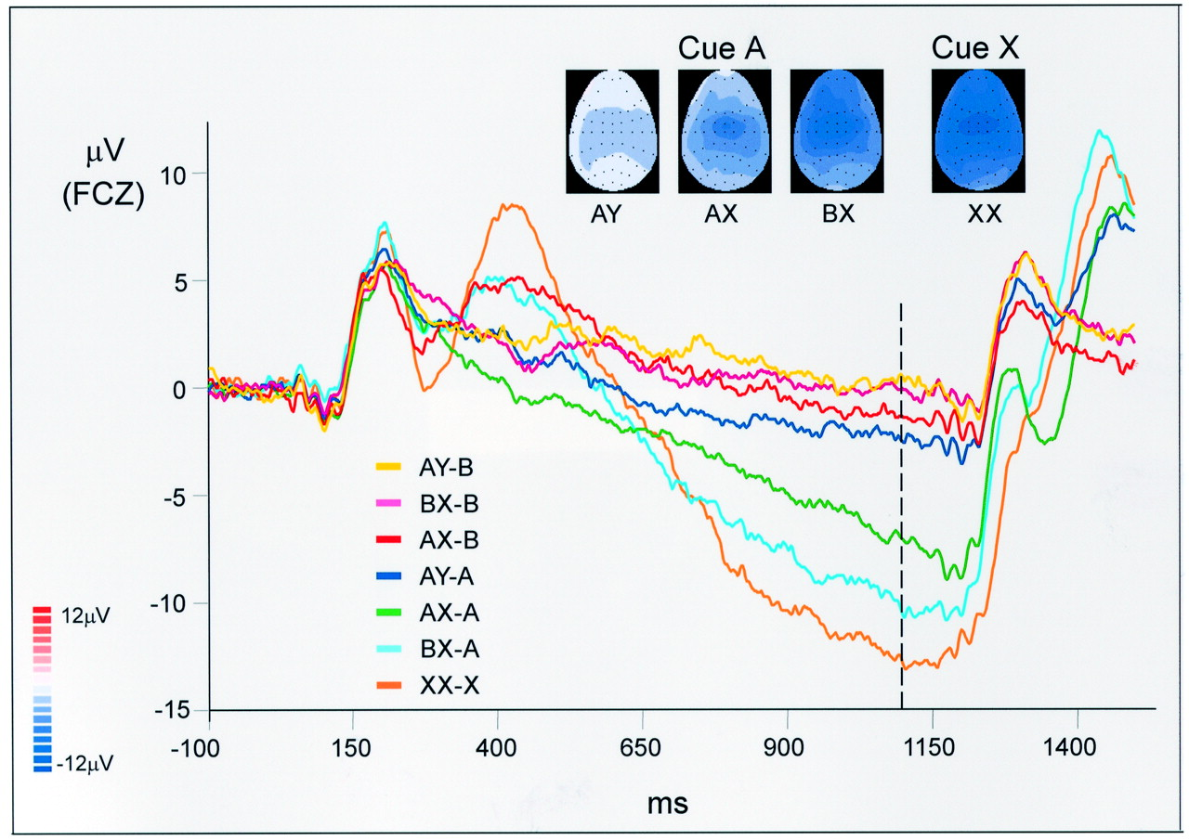
Figure 5. Temporal evolution of the ERP throughout the delay period (Cue On = 0 ms), illustrating the late negativity. ...
Notes:
Figure 5. Temporal evolution of the ERP throughout the delay period (Cue On = 0 ms), illustrating the late negativity. The scalp distribution of potentials at 1100 ms after presentation of the cue (dashed line), i.e. just before the presentation of the target, is illustrated for the cases where the cue was Go. Tasks represented: AX-70, AY-70, BX-70 and XX-CPT.
Unless provided in the caption above, the following copyright applies to the content of this slide: © Oxford University Press

Slide 6
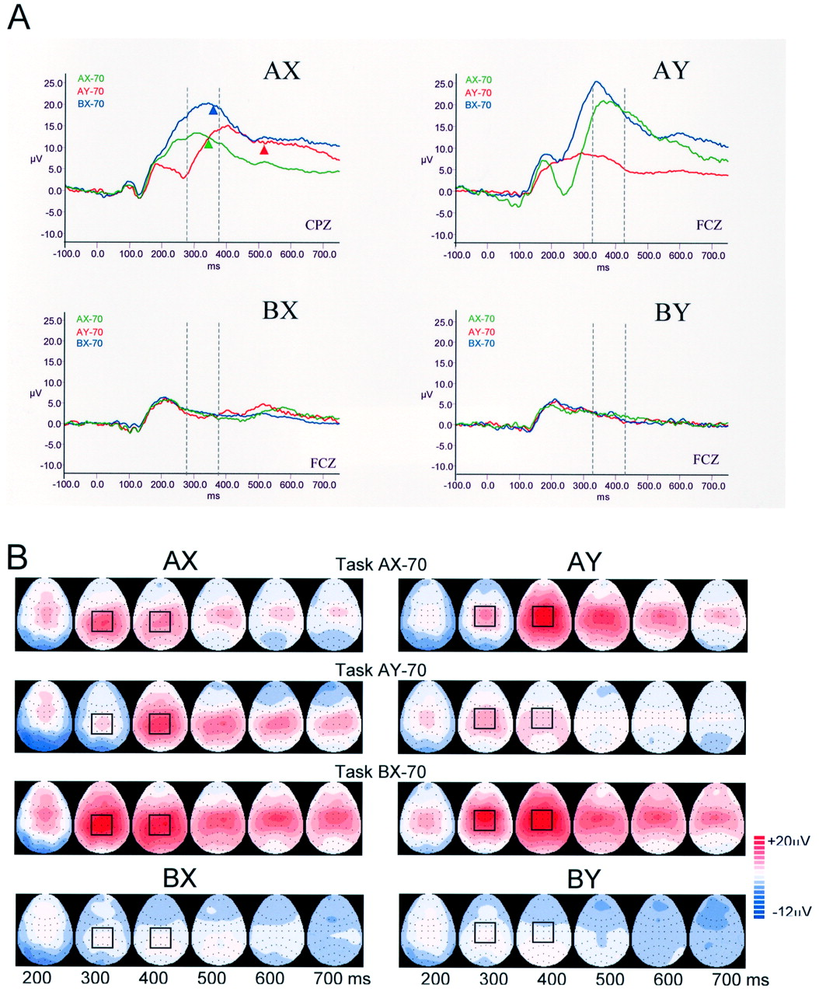
Figure 6. (A) Comparison of grand mean potentials recorded after presentation of the target in all three AX-CPT tasks ...
Notes:
Figure 6. (A) Comparison of grand mean potentials recorded after presentation of the target in all three AX-CPT tasks for each type of trial. All four types of trials were presented in each task, in pseudo-random order and following predetermined probabilities. Arrowheads under potentials in AX trials mark the mean response reaction time for each task. (B) Scalp distribution of the potentials at six time points (200 to 700 ms, at 100 ms intervals). Scale represents activities from −12 to 20 μV. Other conventions as in Figure 3.
Unless provided in the caption above, the following copyright applies to the content of this slide: © Oxford University Press

Slide 7
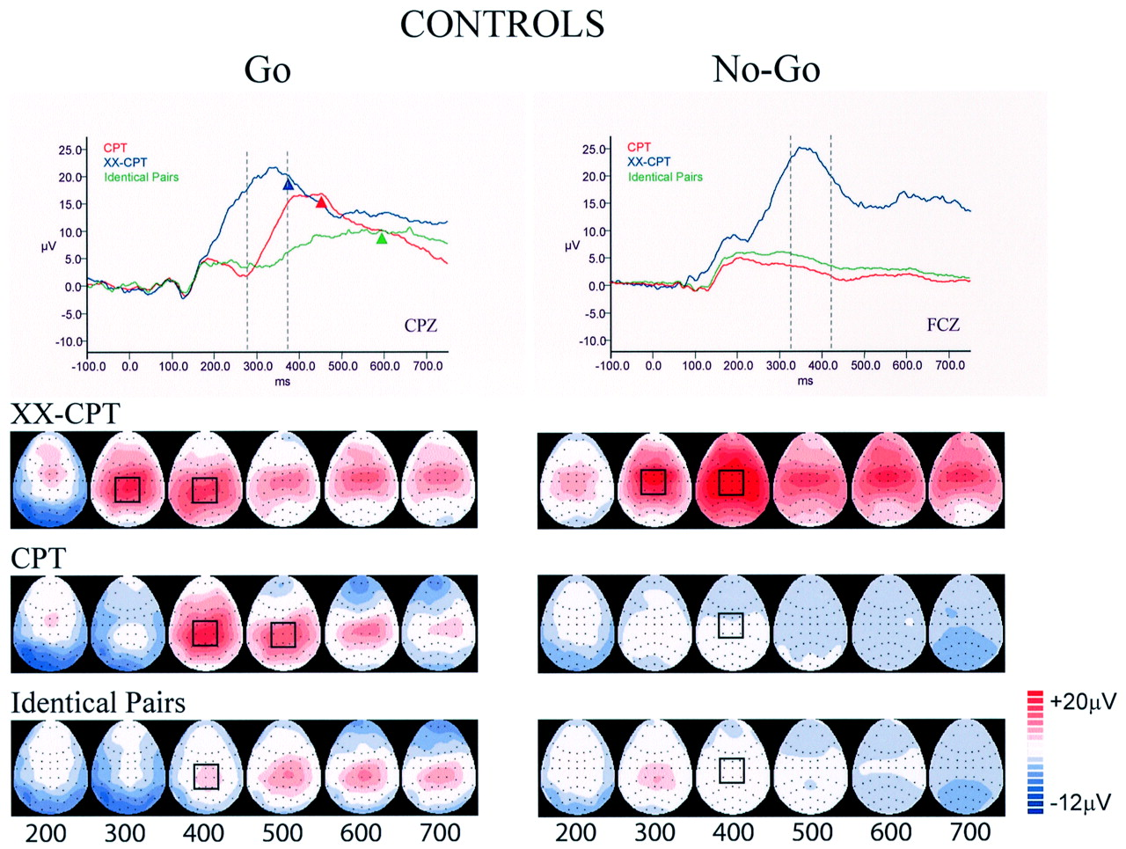
Figure 7. Top: Grand mean potentials recorded after presentation of the target in control tasks CPT, XX-CPT and ...
Notes:
Figure 7. Top: Grand mean potentials recorded after presentation of the target in control tasks CPT, XX-CPT and Identical Pairs. Bottom: Scalp distribution of these potentials. All conventions as in Figure 6.
Unless provided in the caption above, the following copyright applies to the content of this slide: © Oxford University Press

