Slide 1
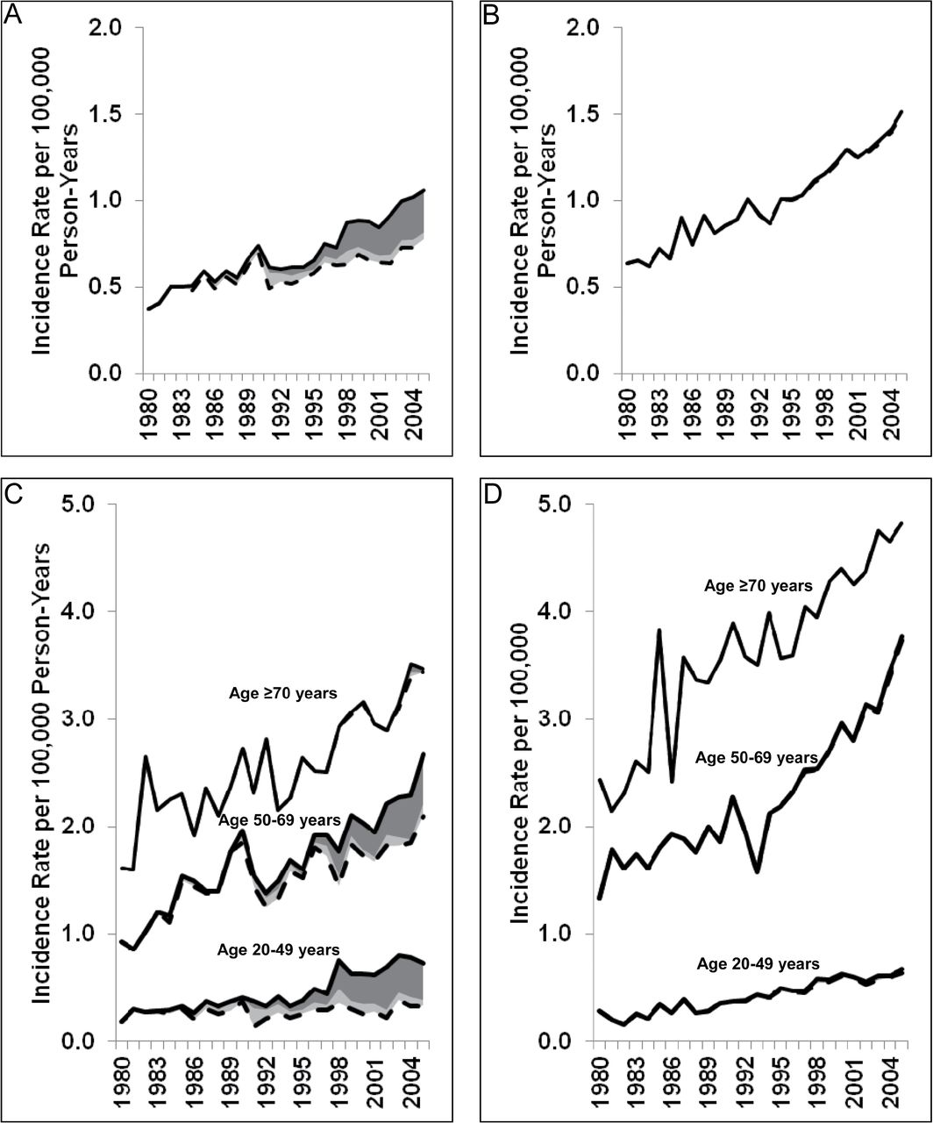
Figure 1. Anal cancer incidence in the general population with and without HIV-infected anal cancer cases, by age and ...
Notes:
Figure 1. Anal cancer incidence in the general population with and without HIV-infected anal cancer cases, by age and sex, between 1980 and 2005. The solid lines represent the overall incidence rates of anal cancers in the general population; the dashed lines represent the incidence rates for anal cancers without HIV-infected anal cancer cases; the dark gray shaded areas represent anal cancer cases with AIDS, and the light gray shaded areas represent anal cancer cases with HIV-only. A) Incidence rates in males. B) Incidence rates in females. C) Incidence rates in males, stratified by age group. D) Incidence rates in females, stratified by age group.
Unless provided in the caption above, the following copyright applies to the content of this slide: Published by Oxford University Press 2012.

Slide 2
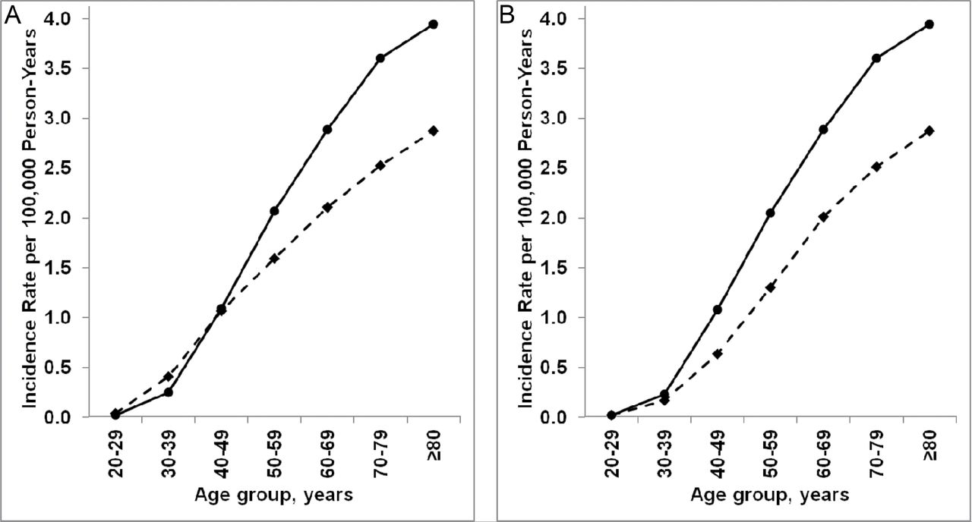
Figure 2. Anal cancer incidence in the general population in males and females by age group. Solid lines represent ...
Notes:
Figure 2. Anal cancer incidence in the general population in males and females by age group. Solid lines represent rates in females and dashed lines represent rates in males. A) Incidence rates in males and females overall. B) Incidence rates in males and females in the absence of HIV-infected anal cancer cases.
Unless provided in the caption above, the following copyright applies to the content of this slide: Published by Oxford University Press 2012.

