Slide 1
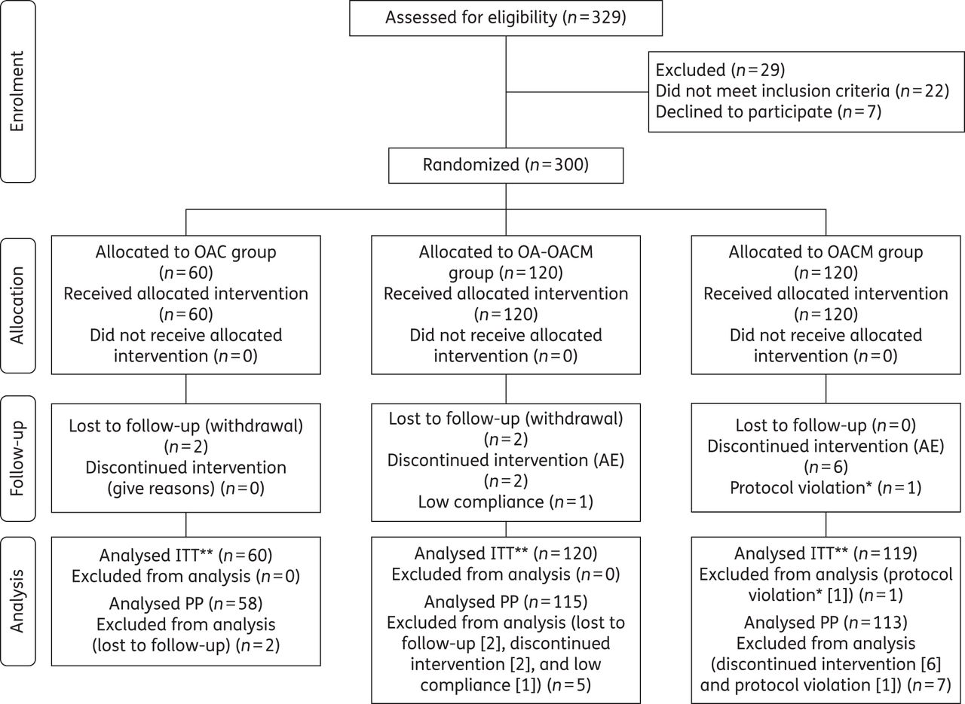
Figure 1. Flow diagram of the subjects enrolled in the study. AE, adverse events. *Diagnosis of H. pylori infection was ...
Notes:
Figure 1. Flow diagram of the subjects enrolled in the study. AE, adverse events. *Diagnosis of H. pylori infection was based on serology in patient no. 48. **Patients without an observed outcome were considered as treatment failures.
Unless provided in the caption above, the following copyright applies to the content of this slide: © The Author 2015. Published by Oxford University Press on behalf of the British Society for Antimicrobial Chemotherapy. All rights reserved. For Permissions, please e-mail: journals.permissions@oup.com

