Slide 1
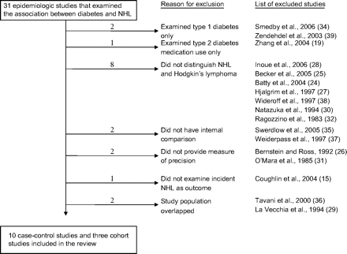
FIGURE 1. List of excluded studies. NHL, non-Hodgkin lymphoma.
Notes:
FIGURE 1. List of excluded studies. NHL, non-Hodgkin lymphoma.
Unless provided in the caption above, the following copyright applies to the content of this slide: American Journal of Epidemiology © The Author 2008. Published by the Johns Hopkins Bloomberg School of Public Health. All rights reserved. For permissions, please e-mail: journals.permissions@oxfordjournals.org.

Slide 2
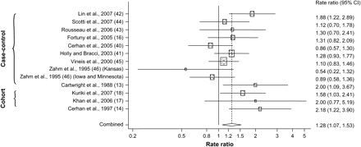
FIGURE 2. Rate ratio of non-Hodgkin lymphoma associated with diabetes. CI, confidence interval.
Notes:
FIGURE 2. Rate ratio of non-Hodgkin lymphoma associated with diabetes. CI, confidence interval.
Unless provided in the caption above, the following copyright applies to the content of this slide: American Journal of Epidemiology © The Author 2008. Published by the Johns Hopkins Bloomberg School of Public Health. All rights reserved. For permissions, please e-mail: journals.permissions@oxfordjournals.org.

Slide 3
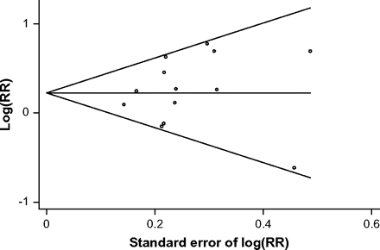
FIGURE 3. Begg's funnel plot with pseudo 95% confidence limits for assessment of publication bias. RR, rate ratio.
Notes:
FIGURE 3. Begg's funnel plot with pseudo 95% confidence limits for assessment of publication bias. RR, rate ratio.
Unless provided in the caption above, the following copyright applies to the content of this slide: American Journal of Epidemiology © The Author 2008. Published by the Johns Hopkins Bloomberg School of Public Health. All rights reserved. For permissions, please e-mail: journals.permissions@oxfordjournals.org.

