Slide 1
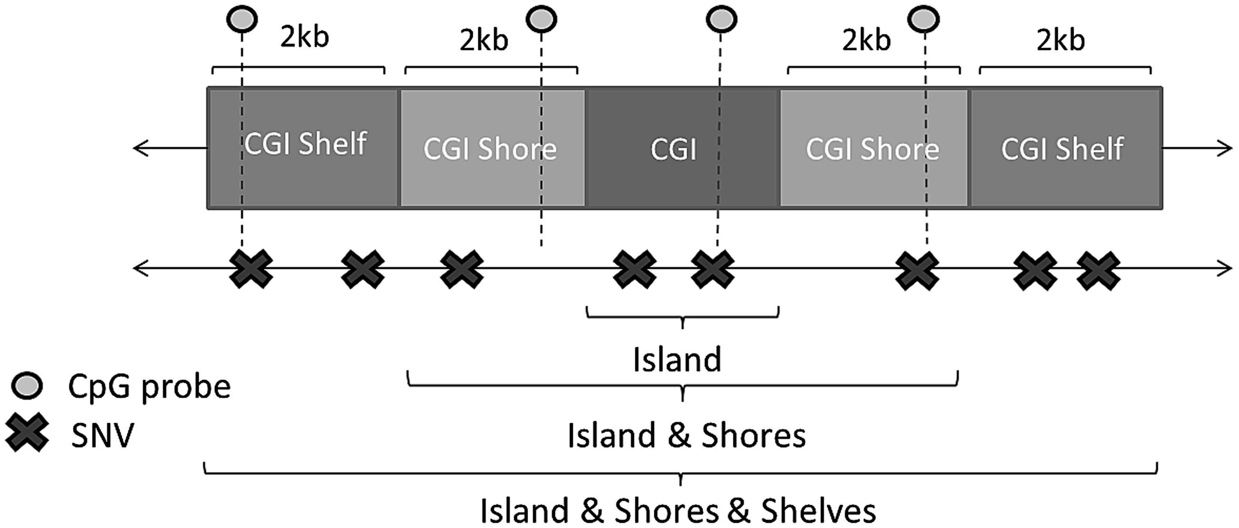
Figure 1. A simple diagram of a theoretical CpG Island and flanking regions. These regions of interest were proposed to ...
Notes:
Figure 1. A simple diagram of a theoretical CpG Island and flanking regions. These regions of interest were proposed to aggregate variants together over and analyse their combined effect on measures of methylation at CpG probes.
Unless provided in the caption above, the following copyright applies to the content of this slide: © The Author 2016. Published by Oxford University Press.This is an Open Access article distributed under the terms of the Creative Commons Attribution License (http://creativecommons.org/licenses/by/4.0/), which permits unrestricted reuse, distribution, and reproduction in any medium, provided the original work is properly cited.

Slide 2
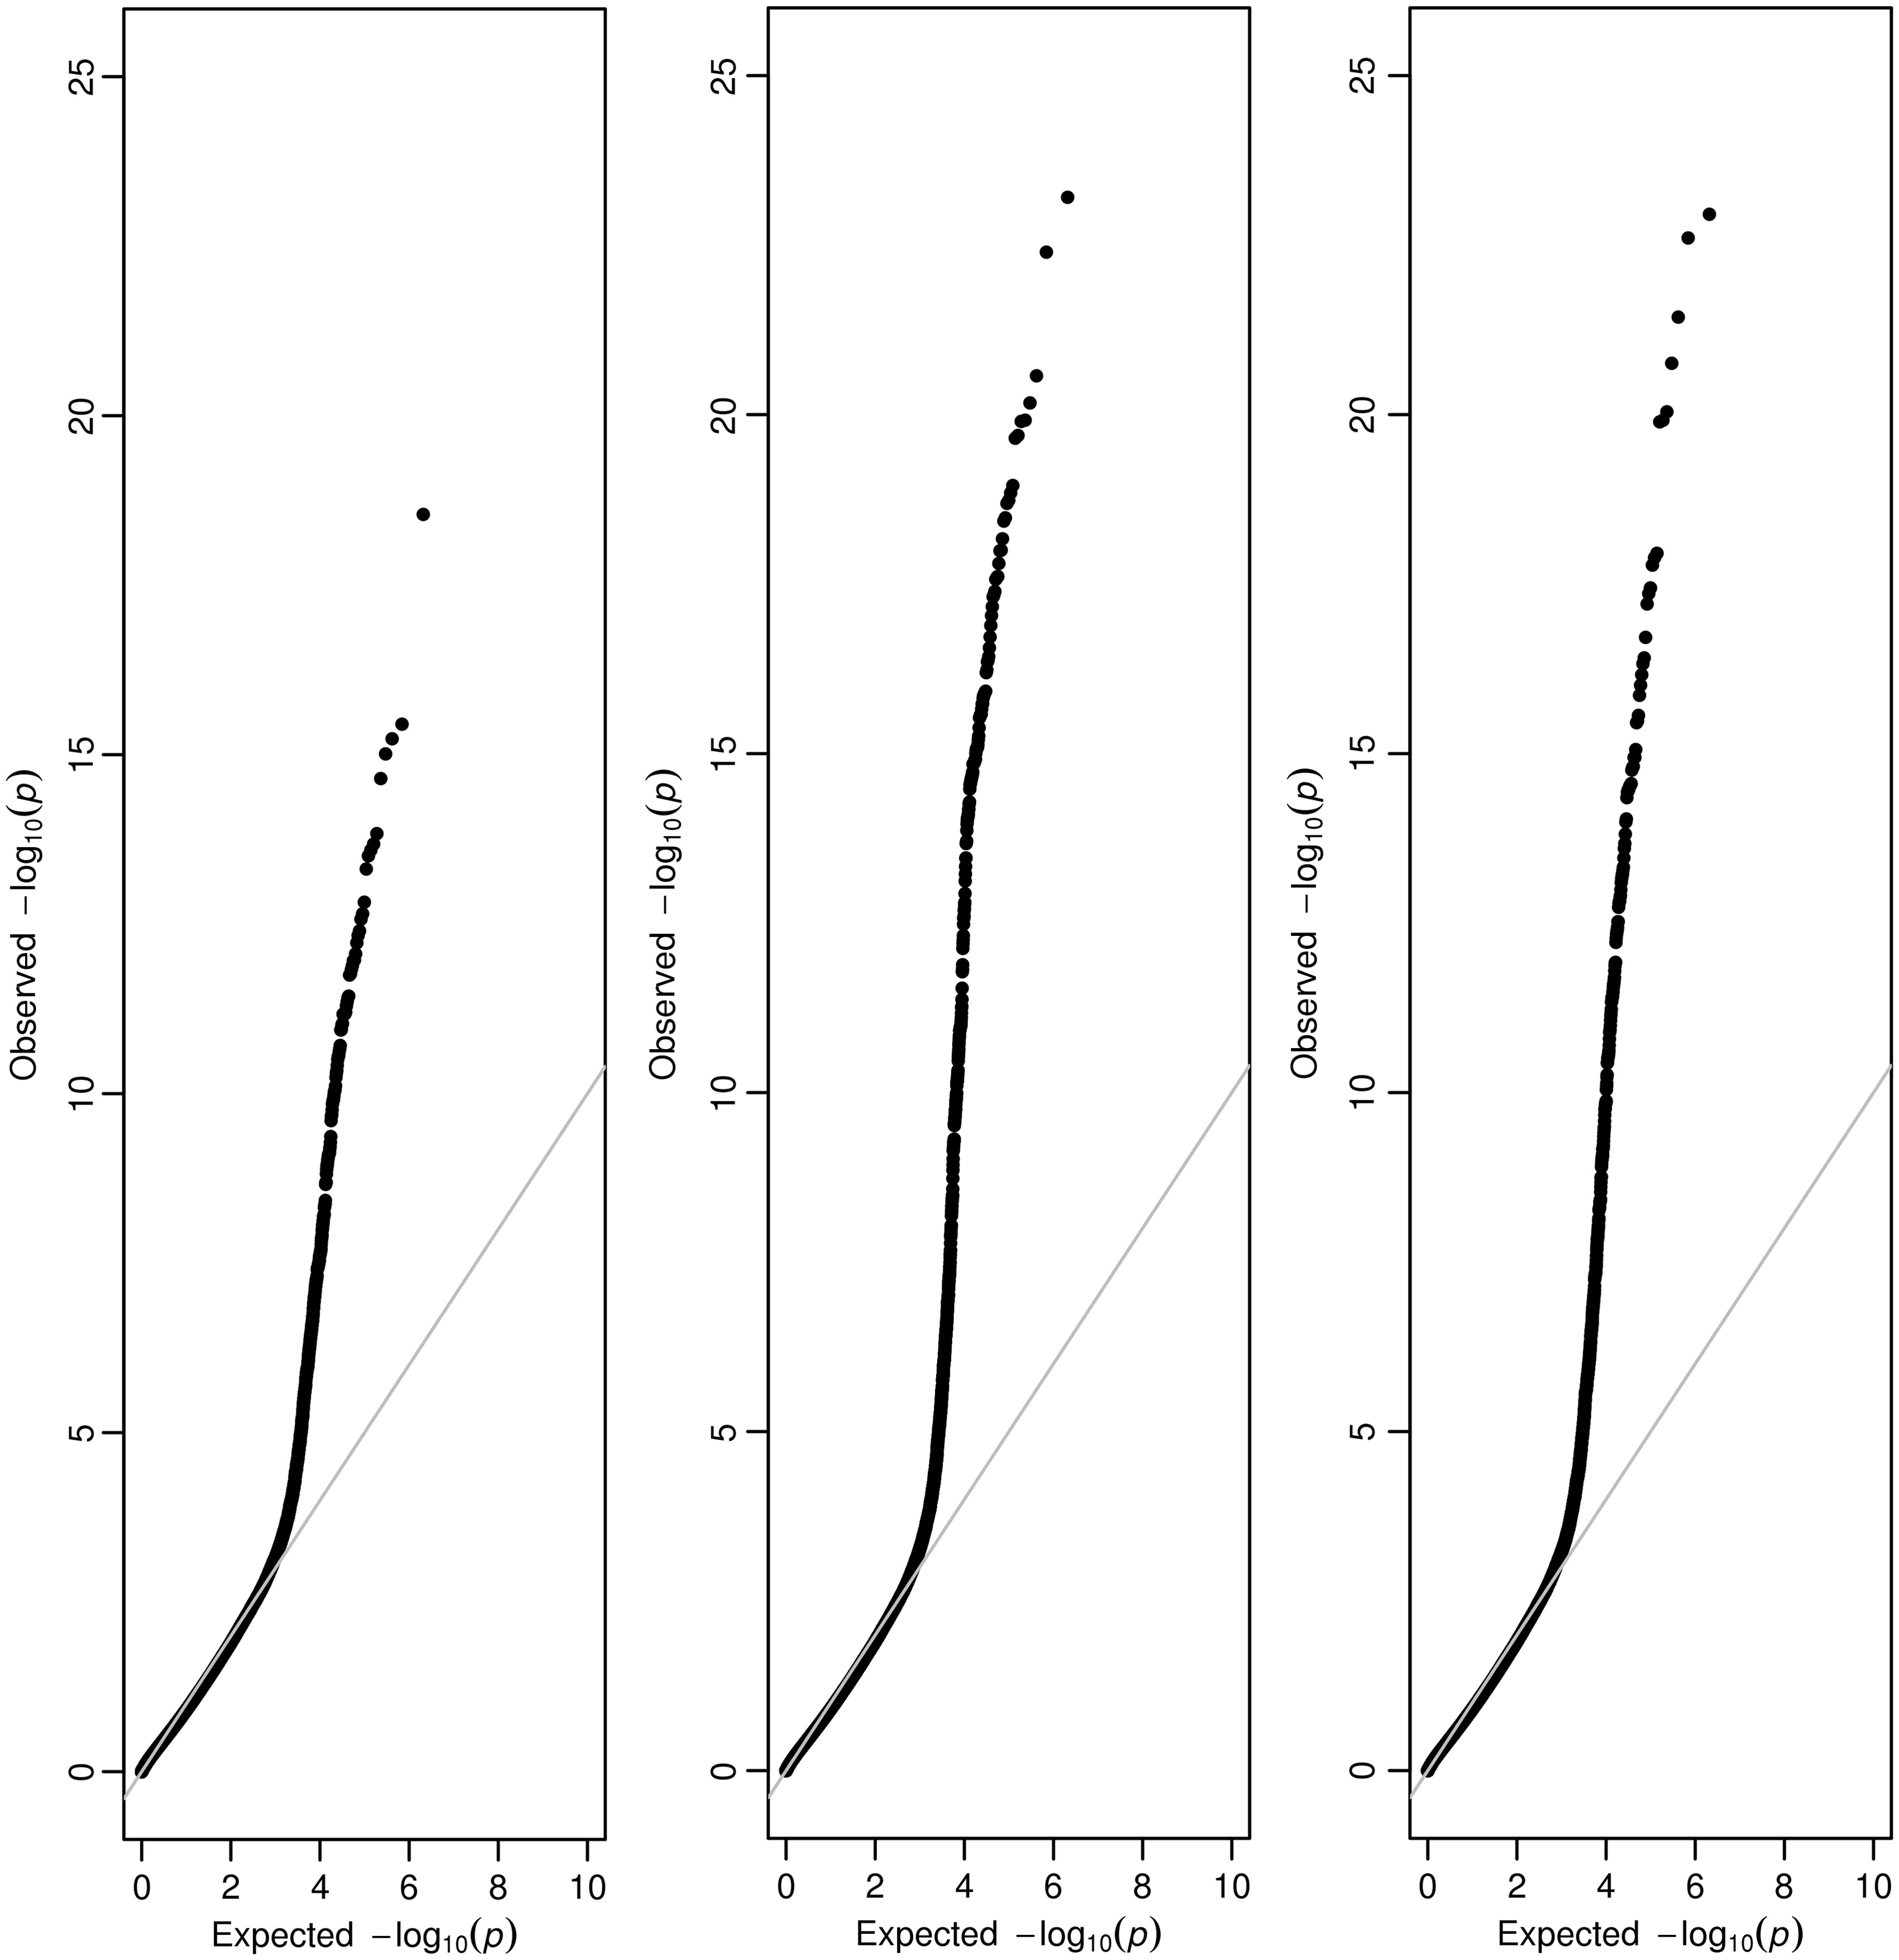
Figure 2. Quantile-Quantile plots for results of the cis-mQTL analysis after aggregating variants according to 1) CpG ...
Notes:
Figure 2. Quantile-Quantile plots for results of the cis-mQTL analysis after aggregating variants according to 1) CpG islands 2) CpG islands & shores 3) CpG islands, shores and shelves. Analysis of variants within CpG islands & shores (MAF ≤ 5%) CpG Island & ShoresNearest GeneProbenVarsP-valuechr21:45,728,220–45,732,444PFKLcg2106949466.24x10−24chr8:144,715,866–144,720,798ZNF623cg1631616234.02x10−23chr11:66,492,937–66,498,387SPTBN2cg2485165162.68x10−21chr2:75,785,717–75,790,312EVA1Acg2617578986.73x10−21chr12:120,753,346–120,757,672PLA2G1Bcg0637936151.21x10−20chr7:100,873,555–100,878,212CLDN15cg0129999771.26x10−20chr3:53,076,956–53,083,101RFT1cg04865290102.03x10−20chr2:196,519,555–196,524,950SLC39A10cg1965519582.23x10−20chr1:1,287,707–1,293,126MXRA8cg1713207931.11x10−19chr11:64,407,877–64,413,253NRXN2cg1939570641.43x10−19Top 10 results for analysis between low frequency variants collapsed within CpG Island & flanking Shore regions (where there is no previously reported single variant mQTL effect) and nearby methylation probe (+/- 1Mb of region analysed). nVars = number of variants analysed. Probe = 450k probe ID. P-value = P-value according to SKAT.
Unless provided in the caption above, the following copyright applies to the content of this slide: © The Author 2016. Published by Oxford University Press.This is an Open Access article distributed under the terms of the Creative Commons Attribution License (http://creativecommons.org/licenses/by/4.0/), which permits unrestricted reuse, distribution, and reproduction in any medium, provided the original work is properly cited.

