Slide 1
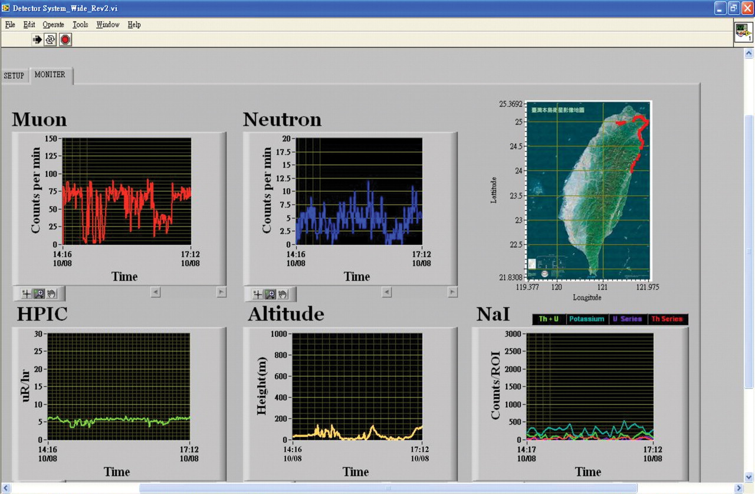
Figure 1. Real-time display of measured results from Hsinchu to Hualien.
Notes:
Figure 1. Real-time display of measured results from Hsinchu to Hualien.
Unless provided in the caption above, the following copyright applies to the content of this slide: © The Author 2010. Published by Oxford University Press. All rights reserved. For Permissions, please email: journals.permissions@oup.com

Slide 2
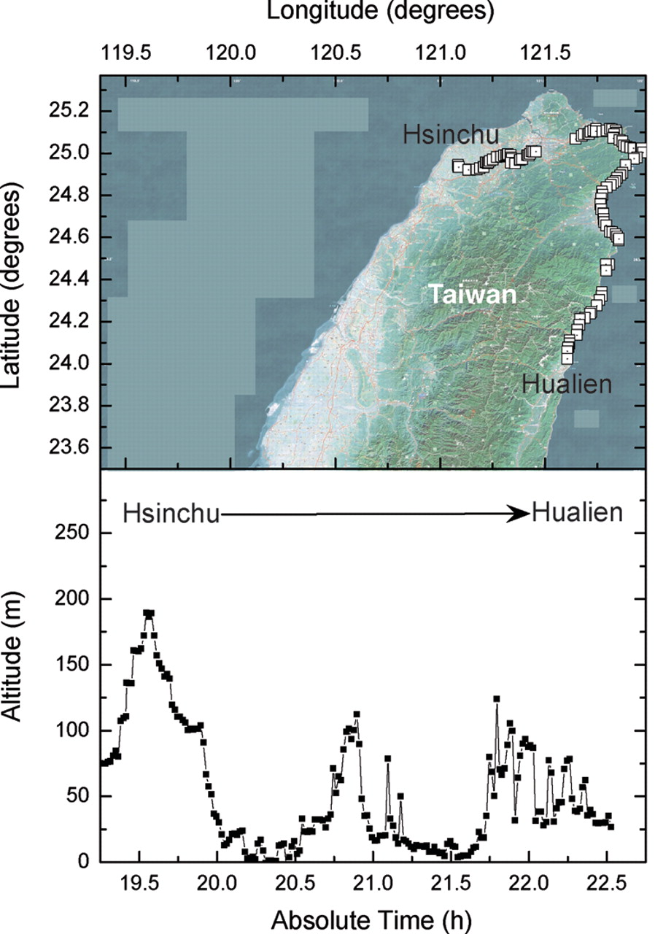
Figure 2. The display of GPS data.
Notes:
Figure 2. The display of GPS data.
Unless provided in the caption above, the following copyright applies to the content of this slide: © The Author 2010. Published by Oxford University Press. All rights reserved. For Permissions, please email: journals.permissions@oup.com

Slide 3
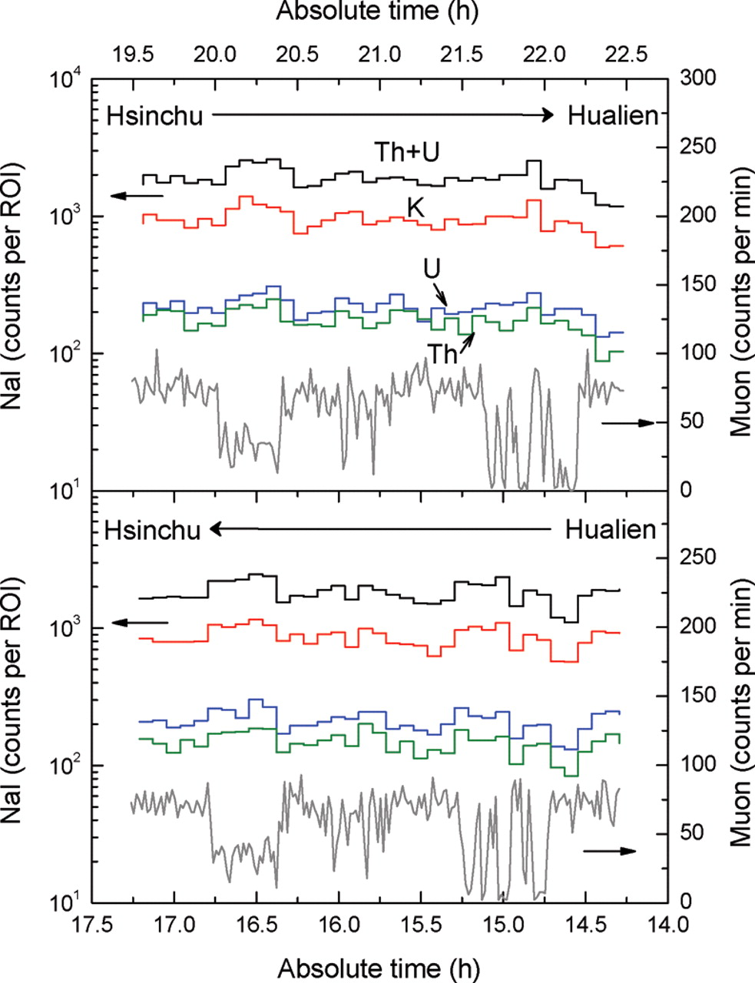
Figure 3. Four components of the NaI(Tl) signals measured from Hsinchu to Hualien and from Hualien to Hsinchu.
Notes:
Figure 3. Four components of the NaI(Tl) signals measured from Hsinchu to Hualien and from Hualien to Hsinchu.
Unless provided in the caption above, the following copyright applies to the content of this slide: © The Author 2010. Published by Oxford University Press. All rights reserved. For Permissions, please email: journals.permissions@oup.com

