Slide 1
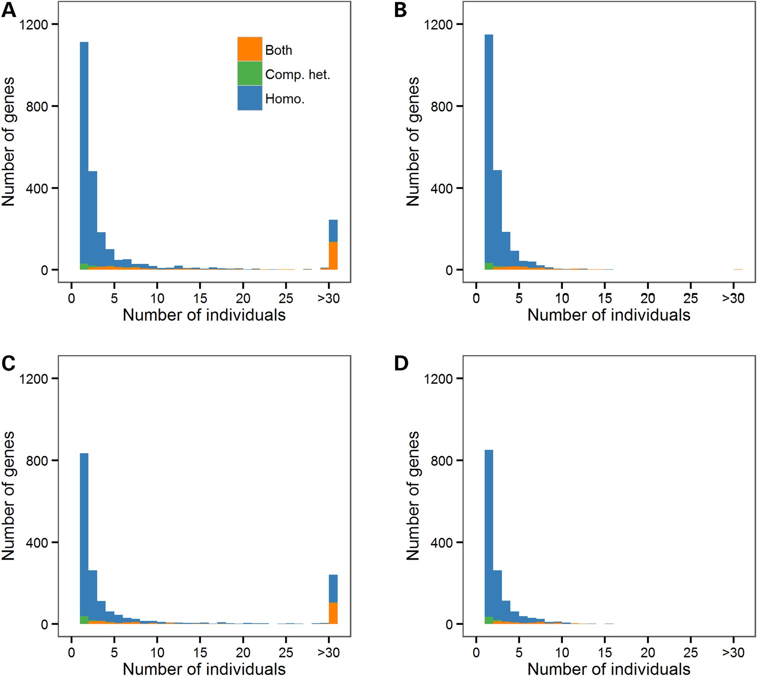
Figure 1. Distributions of the number of NHLBI Exome Sequence Project (ESP) participants with predicted gene knockouts ...
Notes:
Figure 1. Distributions of the number of NHLBI Exome Sequence Project (ESP) participants with predicted gene knockouts (KOs). We present distributions in African Americans (A and B) and European Americans (C and D). We include all loss-of-function (LoF: nonsense, stop-loss, splice site, frameshift indel) variants in (A) and (C), whereas only rare/low-frequency LoF variants (minor allele frequency <5%) are included in (B) and (D). Homo., gene KO due to homozygosity; Comp. het., gene KO due to compound heterozygosity; Both, genes with homozygous and compound heterozygous LoF variants.
Unless provided in the caption above, the following copyright applies to the content of this slide: © The Author 2016. Published by Oxford University Press.This is an Open Access article distributed under the terms of the Creative Commons Attribution License (http://creativecommons.org/licenses/by/4.0/), which permits unrestricted reuse, distribution, and reproduction in any medium, provided the original work is properly cited.

Slide 2
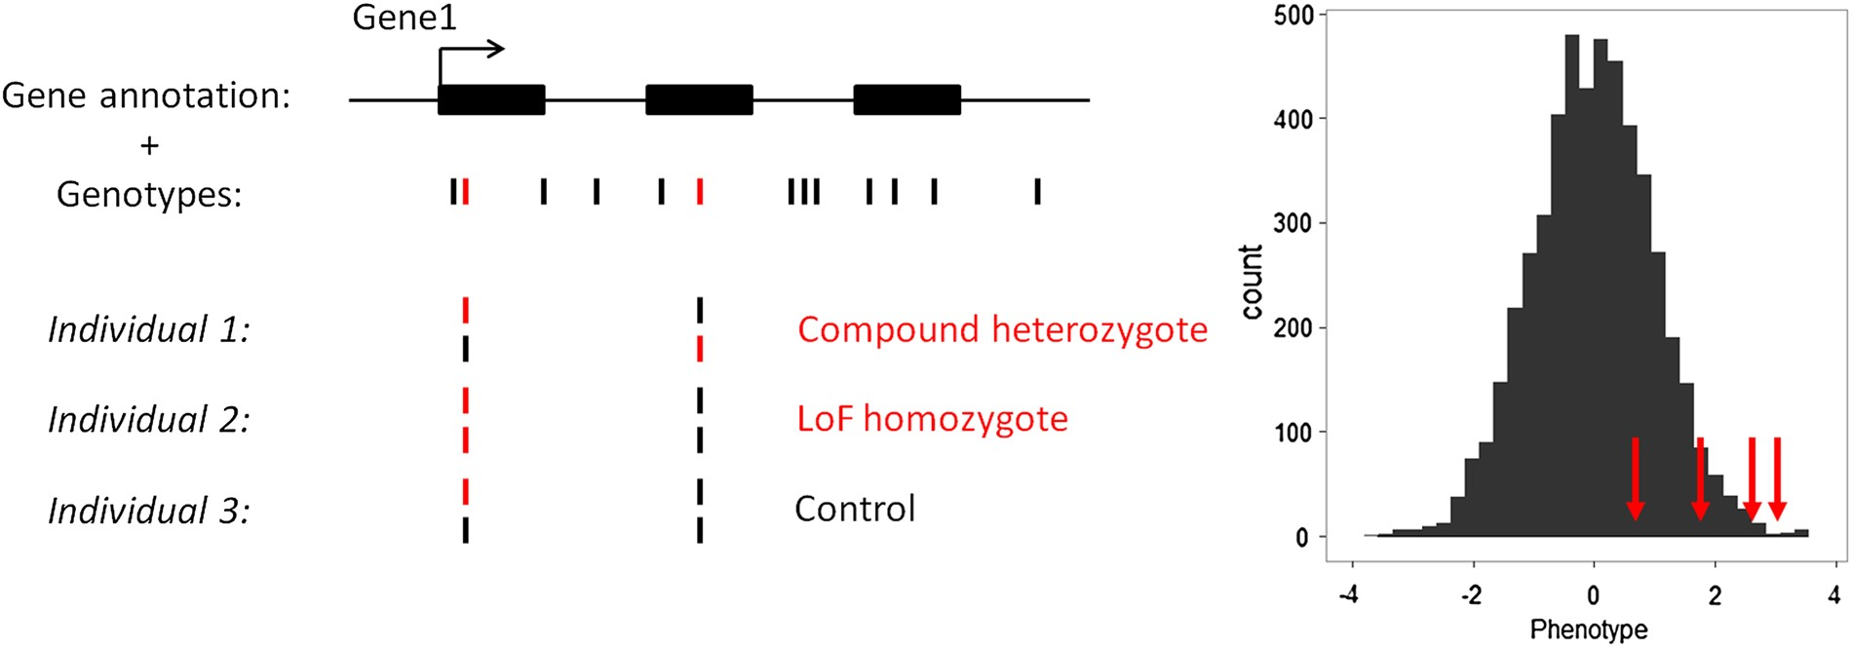
Figure 2. Schematic representation of the method to detect association between gene knockouts (KOs) and human ...
Notes:
Figure 2. Schematic representation of the method to detect association between gene knockouts (KOs) and human quantitative variation. This example depicts a fictive gene with three exons (GENE1) that contains several SNPs. Our analytical framework only considers loss-of-function (LoF) variants (shown in red). GENE1 KOs are individuals who are either compound heterozygous of homozygous for LoF variants (individual 1 and 2). The histogram shows the distribution of a normalized human quantitative trait. Our method tests whether individuals that are KOs for a given gene (red arrows) have on average more extreme phenotypes than the rest of the individuals.
Unless provided in the caption above, the following copyright applies to the content of this slide: © The Author 2016. Published by Oxford University Press.This is an Open Access article distributed under the terms of the Creative Commons Attribution License (http://creativecommons.org/licenses/by/4.0/), which permits unrestricted reuse, distribution, and reproduction in any medium, provided the original work is properly cited.

Slide 3
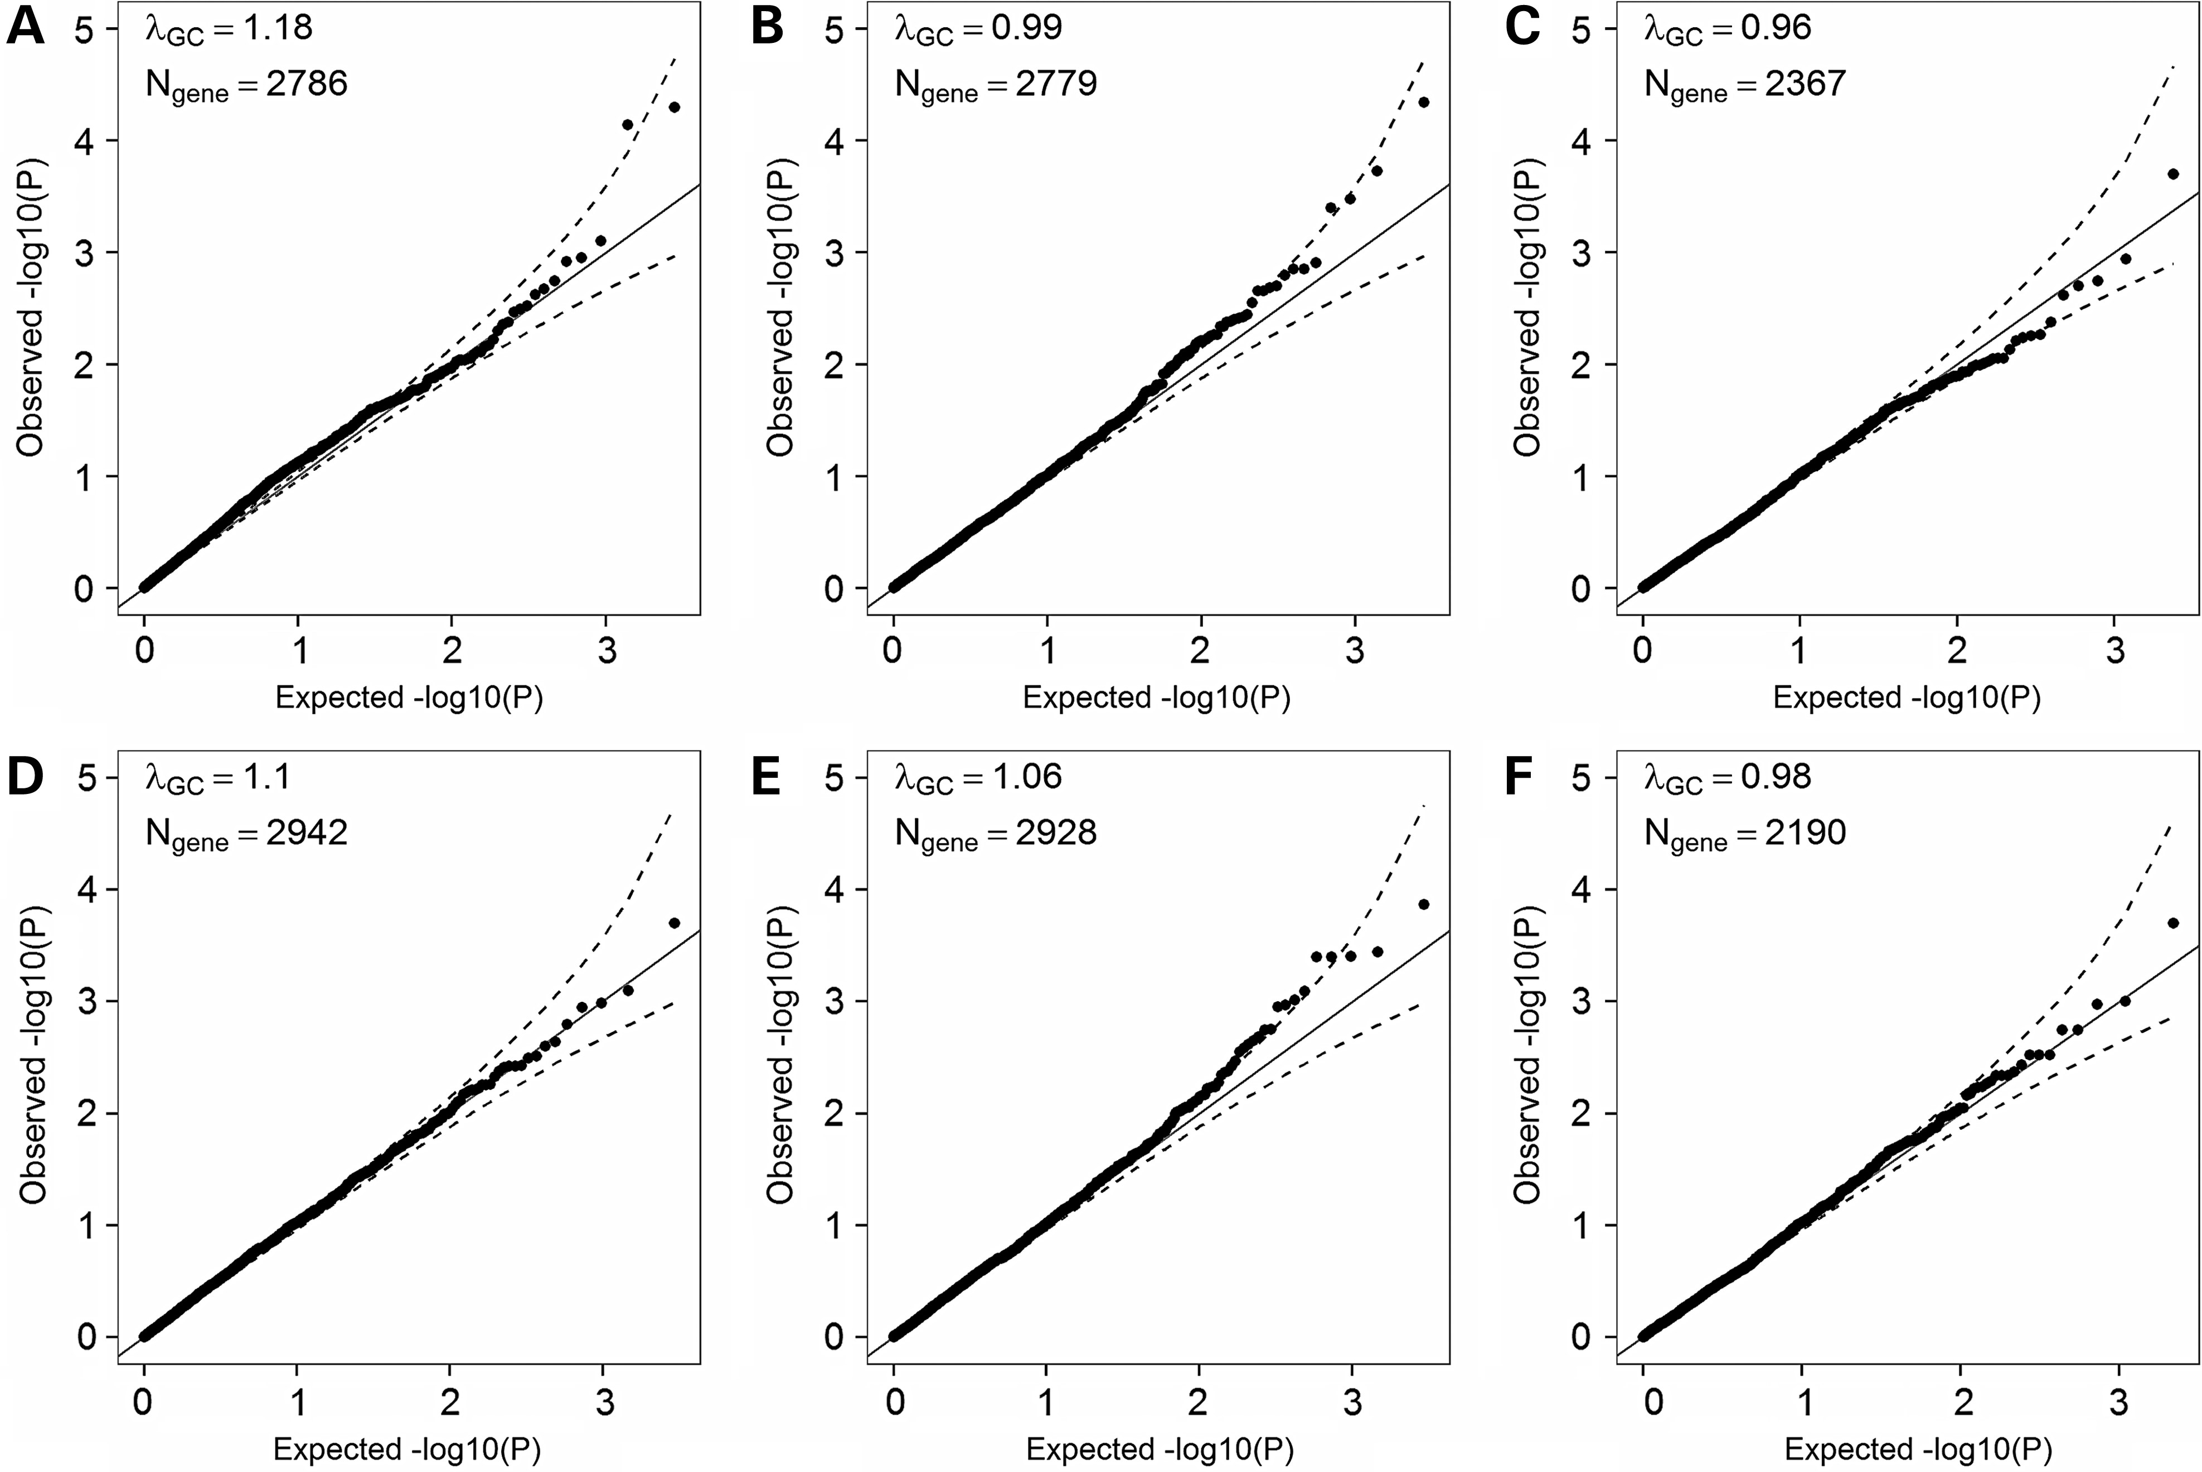
Figure 3. Quantile-quantile (QQ) plots of association results between predicted gene knockouts (KOs) and anthropometric ...
Notes:
Figure 3. Quantile-quantile (QQ) plots of association results between predicted gene knockouts (KOs) and anthropometric traits in the (A–C) NHLBI Exome Sequence Project (ESP) and (D–F) GIANT ExomeChip datasets. In these datasets, we only considered loss of function (LoF) variants (nonsense, stop-loss, splice site, frameshift indels (ESP only)) with a minor allele frequency (MAF) <5%. We analyzed three anthropometric traits: (A) body mass index (BMI) (Nparticipants = 4475), (B) height (Nparticipants = 4423) and (C) waist-to-hip ratio (WHR) (Nparticipants = 2973). We performed these analyses stratified by ethnicity, and then combined the European American and African American results using meta-analysis methodology. We analyzed the same traits in the GIANT dataset: (D) BMI (Nparticipants = 103 838), (E) height (Nparticipants = 102 775) and (F) WHR (Nparticipants = 62 355). Results are not corrected for the genomic inflation factor. The dash lines correspond to the 95% confidence interval. λGC, genomic inflation factor; Ngene, number of genes with at least one participant that carries two LoF alleles.
Unless provided in the caption above, the following copyright applies to the content of this slide: © The Author 2016. Published by Oxford University Press.This is an Open Access article distributed under the terms of the Creative Commons Attribution License (http://creativecommons.org/licenses/by/4.0/), which permits unrestricted reuse, distribution, and reproduction in any medium, provided the original work is properly cited.

Slide 4
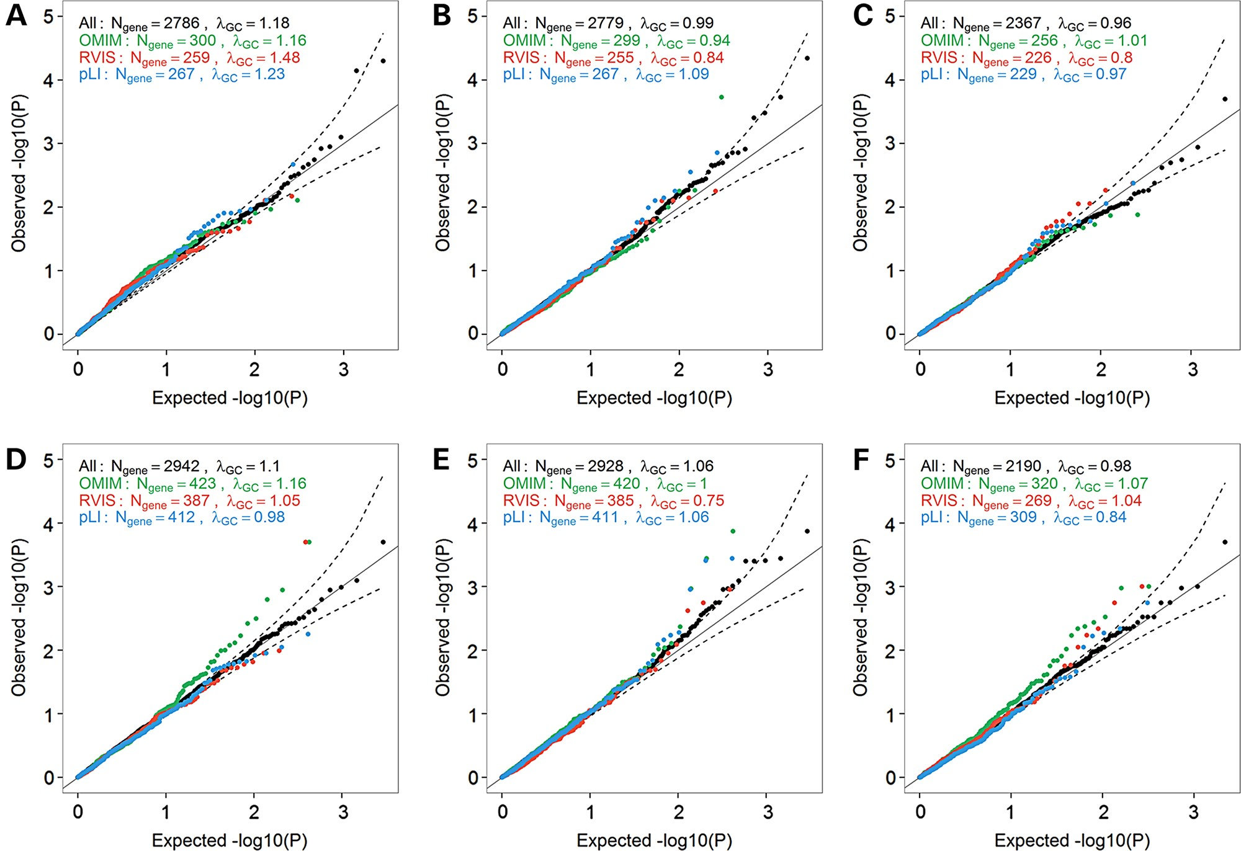
Figure 4. Quantile-quantile (QQ) plots of association results between predicted gene knockouts (KOs) in candidate-genes ...
Notes:
Figure 4. Quantile-quantile (QQ) plots of association results between predicted gene knockouts (KOs) in candidate-genes and anthropometric traits. We restricted these analyses to OMIM disease-causing genes (green), genes with Residual Variation Intolerance Score (RVIS) score 0.9 (blue). We report results for three anthropometric traits in the NHLBI Exome Sequence Project (ESP): (A) body mass index (BMI) (Nparticipants = 4475), (B) height (Nparticipants = 4423) and (C) waist-to-hip ratio (WHR) (Nparticipants = 2973). We also report results for the same traits in the GIANT ExomeChip datasets: (D) BMI (Nparticipants = 103 838), (E) height (Nparticipants = 102 775), and (F) WHR (Nparticipants = 62 355). Results are not corrected for the genomic inflation factor. The dash lines correspond to the 95% confidence interval. λGC, genomic inflation factor; Ngene, number of genes with at least one participant that carries two LoF alleles.
Unless provided in the caption above, the following copyright applies to the content of this slide: © The Author 2016. Published by Oxford University Press.This is an Open Access article distributed under the terms of the Creative Commons Attribution License (http://creativecommons.org/licenses/by/4.0/), which permits unrestricted reuse, distribution, and reproduction in any medium, provided the original work is properly cited.

