Slide 1
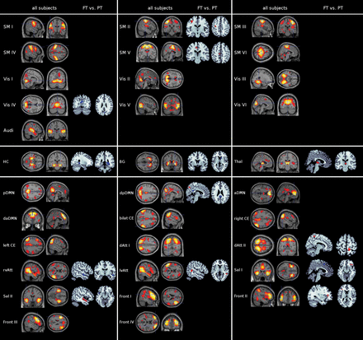
Figure 1. Intrinsic brain networks and correspondent group differences in pre- and full-term born adults at the age of ...
Notes:
Figure 1. Intrinsic brain networks and correspondent group differences in pre- and full-term born adults at the age of 26 years. Spatial maps are based on all subjects and plotted as t-statistical parametric maps (SPM) (P 20 voxels). SPMs of full- and preterm (FT, PT) born adults are based on two-sample t-tests (P < 0.05, FWE cluster-corrected for multiple comparisons; blue: PT FT). Results are arranged according to their classification as unimodal (upper row), subcortical (middle-row), or multimodal networks (bottom row) and displayed at the 2 most informative slices. SM I–VI, sensorimotor networks I–VI; Vis I–VI, visual networks I–VI; Audi, auditory network; HC, hippocampus network; BG, basal ganglia network; Thal, thalamus network; pDMN, posterior default mode network; dpDMN, dorsal posterior default mode network; aDMN, anterior default mode network; daDMN, dorsal anterior default mode network; bilat CE, bilateral central executive network; right CE, right central executive network; left CE, left central executive network; dAtt I, dorsal attention network I; dAtt II, dorsal attention network II; rvAtt, right ventral attention network; lvAtt, left ventral attention network; Sal I, salience network I; Sal II, salience network II; Front I–IV, frontal networks I–IV.
Unless provided in the caption above, the following copyright applies to the content of this slide: © The Author 2014. Published by Oxford University Press. All rights reserved. For permissions, please e-mail: journals.permissions@oup.com

Slide 2
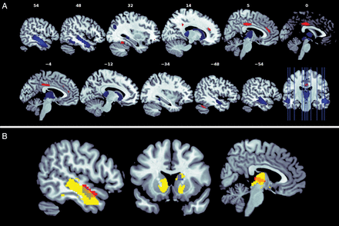
Figure 2. Aberrant gray matter in preterm born adults revealed by voxel-based morphometry overlaps with aberrant ...
Notes:
Figure 2. Aberrant gray matter in preterm born adults revealed by voxel-based morphometry overlaps with aberrant intrinsic functional connectivity in the ventral brain. (A) Based on structural MRI, differences in VBM were calculated by a two-sample t-test thresholded at P 20 voxels (blue: PT FT); White numbers on top of each slice represent the x-coordinates in MNI space (MNI, Montreal Neurological Institute). (B) Overlapping VBM and iFC changes (see Fig. 1). Networks with overlapping iFC and VBM changes are the thalamus network, basal ganglia network, right ventral attention, and salience network II of Figure 1. Aberrant iFC is presented by blue (PT FT), aberrant VBM by yellow (FT < PT) clusters.
Unless provided in the caption above, the following copyright applies to the content of this slide: © The Author 2014. Published by Oxford University Press. All rights reserved. For permissions, please e-mail: journals.permissions@oup.com

Slide 3
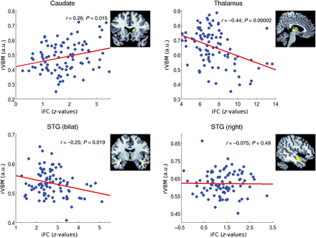
Figure 3. Partial correlations between overlapping aberrant intrinsic functional connectivity (iFC) and regional ...
Notes:
Figure 3. Partial correlations between overlapping aberrant intrinsic functional connectivity (iFC) and regional voxel-based morphometry values (rVBM) in preterm born adults at the age of 26. For 4 intrinsic networks, overlapping aberrant iFC and brain volume was found: in the caudate of the basal ganglia network, in the thalamus of the thalamus network, in the bilateral superior temporal gyrus (bilat. STG) of the salience network II, and in the right STG of the right ventral attention networks (network names are defined in Fig. 1). Partial correlations between overlapping iFC and rVBM are based on data from 92 preterm born adults and included as additional co-variates gender, scanner, and full-scale IQ. iFC is expressed as averaged z-values derived from spatial z-maps reflecting functional connectivity; rVBM is expressed as averaged regional gray-matter VBM values.
Unless provided in the caption above, the following copyright applies to the content of this slide: © The Author 2014. Published by Oxford University Press. All rights reserved. For permissions, please e-mail: journals.permissions@oup.com

Slide 4
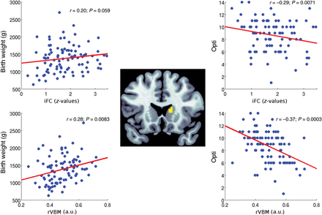
Figure 4. Partial correlations of caudate's intrinsic functional connectivity (iFC) and regional voxel-based ...
Notes:
Figure 4. Partial correlations of caudate's intrinsic functional connectivity (iFC) and regional voxel-based morphometry values (rVBM), respectively, with birth weight (BW) and postnatal medical status (Opti). Partial correlations are based on data from 92 preterm born adults and included as additional co-variates gender, scanner, and full-scale IQ. iFC is expressed as averaged z-values derived from spatial z-maps reflecting functional connectivity; rVBM is expressed as averaged regional gray-matter VBM values.
Unless provided in the caption above, the following copyright applies to the content of this slide: © The Author 2014. Published by Oxford University Press. All rights reserved. For permissions, please e-mail: journals.permissions@oup.com

