Slide 1
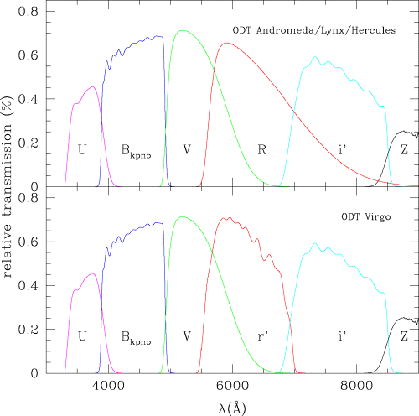
1 The system response, determined from the filter transmission curves and the CCD response, for the full set of ...
Notes:
1 The system response, determined from the filter transmission curves and the CCD response, for the full set of ODTS filters (U BV Ri′Z).
Unless provided in the caption above, the following copyright applies to the content of this slide: © 2004 RAS

Slide 2
1 Field centres for the ODT survey in equatorial and Galactic coordinates.
Notes:
1 Field centres for the ODT survey in equatorial and Galactic coordinates.
Unless provided in the caption above, the following copyright applies to the content of this slide: © 2004 RAS

Slide 3
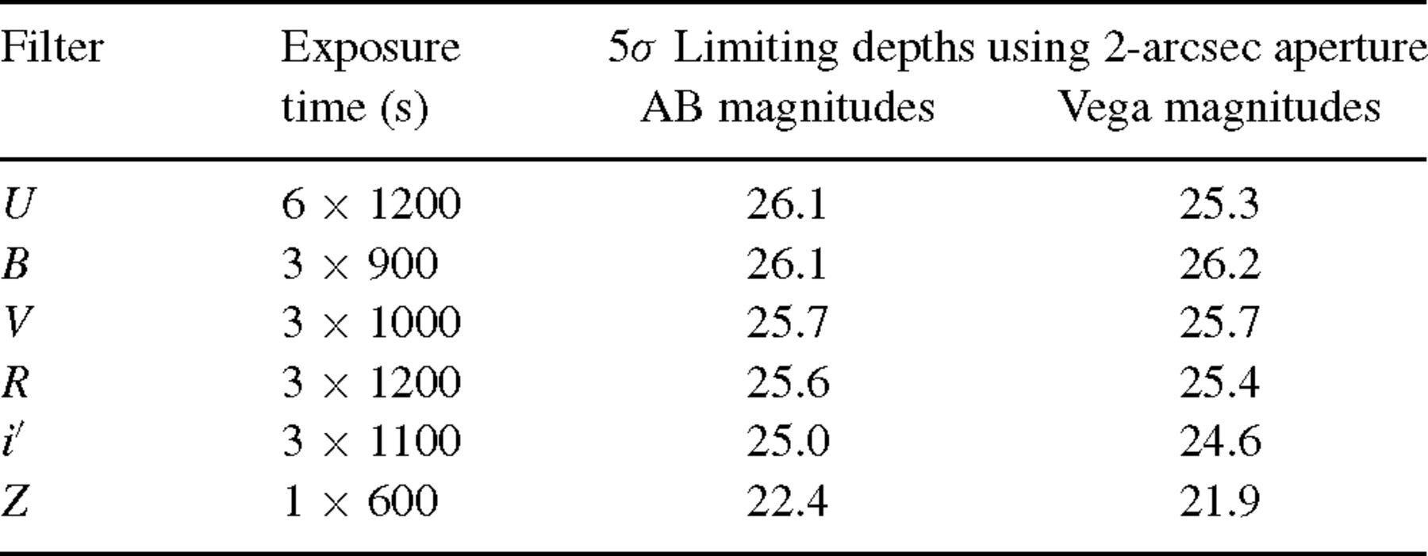
2 The exposure times and expected detection limits (5σ aperture Vega and AB magnitudes) for the various ...
Notes:
2 The exposure times and expected detection limits (5σ aperture Vega and AB magnitudes) for the various passbands used for the ODTS. With the exception of the U and Z images, each pointing is segregated into three separate exposures with 5-arcsec offsets of the telescope.
Unless provided in the caption above, the following copyright applies to the content of this slide: © 2004 RAS

Slide 4
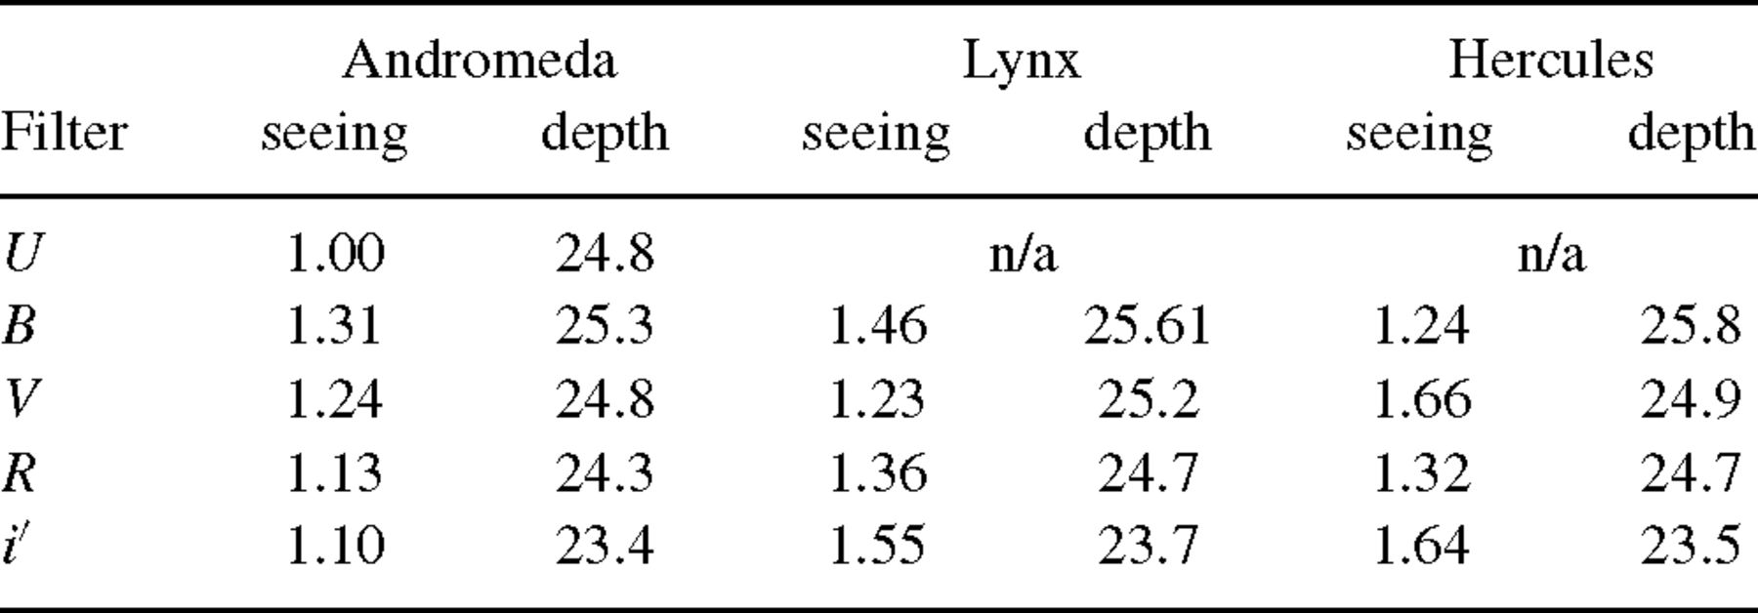
3 Median seeing and median depths reached (Vega magnitudes) for the reduced field data, where the depth of each ...
Notes:
3 Median seeing and median depths reached (Vega magnitudes) for the reduced field data, where the depth of each frame has been determined from the turn over in number counts.
Unless provided in the caption above, the following copyright applies to the content of this slide: © 2004 RAS

Slide 5
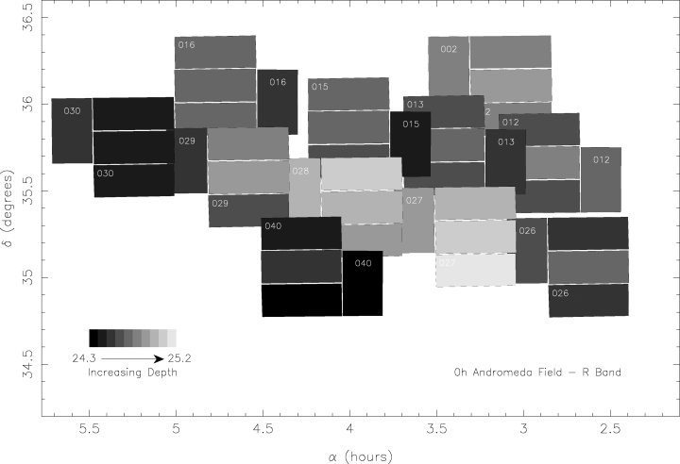
2 A grey-scale image of the reduced R-band Andromeda data (totalling 2.78 deg²), demonstrating how ...
Notes:
2 A grey-scale image of the reduced R-band Andromeda data (totalling 2.78 deg2), demonstrating how the depths reached vary across the field. Frame depths vary from 24.3 to 25.2 mag where the lighter the shade, the greater the depth. Variable conditions and individual chip response differences lead to slight changes of depth within each pointing as expected. It should be noted that there are small gaps (≈1 arcmin) present between the WFC chips.
Unless provided in the caption above, the following copyright applies to the content of this slide: © 2004 RAS

Slide 6
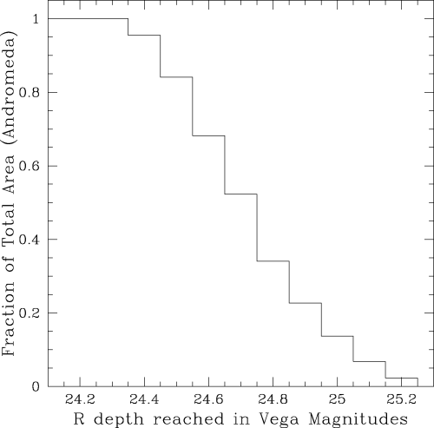
3 The cumulative distribution of the fraction of area (totalling 2.78 deg²) versus R depth reached ...
Notes:
3 The cumulative distribution of the fraction of area (totalling 2.78 deg2) versus R depth reached for the reduced Andromeda data. Frame depths vary from 24.3 to 25.2.
Unless provided in the caption above, the following copyright applies to the content of this slide: © 2004 RAS

Slide 7
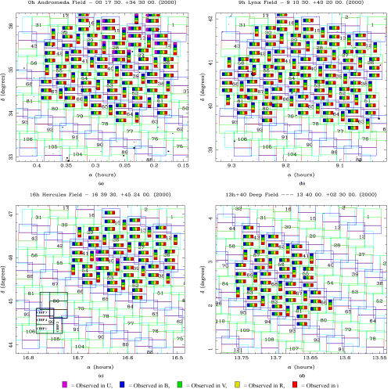
4 The (a) 0-h Andromeda, (b) 9-h Lynx, (c) 16-h Hercules and (d) 13-h Virgo fields divided into diagonal grids, ...
Notes:
4 The (a) 0-h Andromeda, (b) 9-h Lynx, (c) 16-h Hercules and (d) 13-h Virgo fields divided into diagonal grids, where each numbered grid element represents one WFC pointing. The four individual chips of the WFC can be seen and in the bottom left corner of diagram (c) two of the WFC pointings are outlined in black for clarity, and the chip numbers have been marked. Coloured coded bars illustrate the coverage of each subfield to date.
Unless provided in the caption above, the following copyright applies to the content of this slide: © 2004 RAS

Slide 8
4 Current areas of observed and reduced multiband (U BV Ri′) data for the four ODTS fields.
Notes:
4 Current areas of observed and reduced multiband (U BV Ri′) data for the four ODTS fields.
Unless provided in the caption above, the following copyright applies to the content of this slide: © 2004 RAS

Slide 9
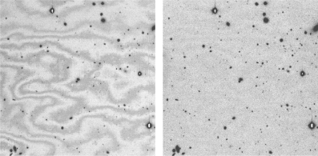
5 A subsection of an i′ image before (left) and after (right) undergoing defringing.
Notes:
5 A subsection of an i′ image before (left) and after (right) undergoing defringing.
Unless provided in the caption above, the following copyright applies to the content of this slide: © 2004 RAS

Slide 10
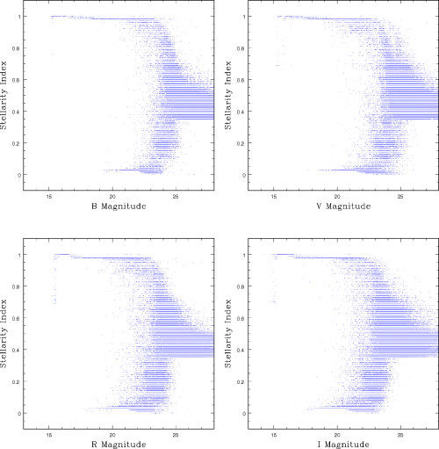
6 SEXTRACTOR star–galaxy classifier (stellarity index), where 1 represents a star and 0 a galaxy, against ...
Notes:
6 SEXTRACTOR star–galaxy classifier (stellarity index), where 1 represents a star and 0 a galaxy, against magnitude for that of the Andromeda pointings.
Unless provided in the caption above, the following copyright applies to the content of this slide: © 2004 RAS

Slide 11
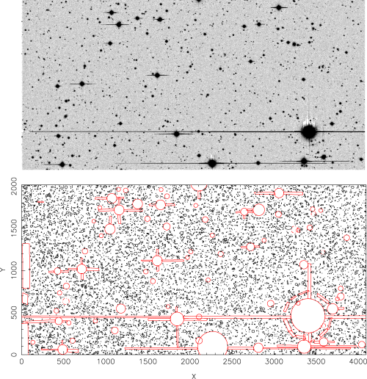
7 An example of the reduced data (an R-band image in Andromeda) and the corresponding image mask created ...
Notes:
7 An example of the reduced data (an R-band image in Andromeda) and the corresponding image mask created manually to ensure complete removal of all image defects. The black circles in the lower figure represent the extracted sources from the above image, and the red shapes represent the masking out of the bright stars, diffraction spikes and spurious detections appearing at the edge of the chip.
Unless provided in the caption above, the following copyright applies to the content of this slide: © 2004 RAS

Slide 12
5 Areas of the fully reduced, masked data for each band to date in the ODTS fields.
Notes:
5 Areas of the fully reduced, masked data for each band to date in the ODTS fields.
Unless provided in the caption above, the following copyright applies to the content of this slide: © 2004 RAS

Slide 13
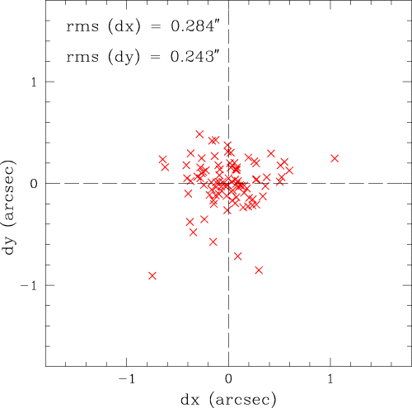
8 Scatter diagram of the astrometric differences in arcsec between the matched ODT and USNO objects for an ...
Notes:
8 Scatter diagram of the astrometric differences in arcsec between the matched ODT and USNO objects for an example field. The rms differences are small. The pixel size is 0.33 arcsec.
Unless provided in the caption above, the following copyright applies to the content of this slide: © 2004 RAS

Slide 14
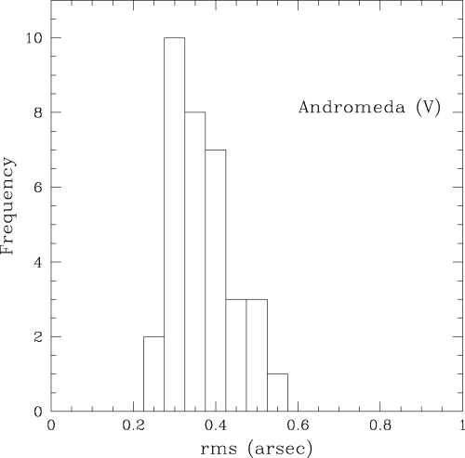
9 Histogram of the rms astrometric residuals between the ODTS and USNO data found for each individual CCD frame ...
Notes:
9 Histogram of the rms astrometric residuals between the ODTS and USNO data found for each individual CCD frame after the final iteration of the astrometric matching procedure for the V-band Andromeda data.
Unless provided in the caption above, the following copyright applies to the content of this slide: © 2004 RAS

Slide 15
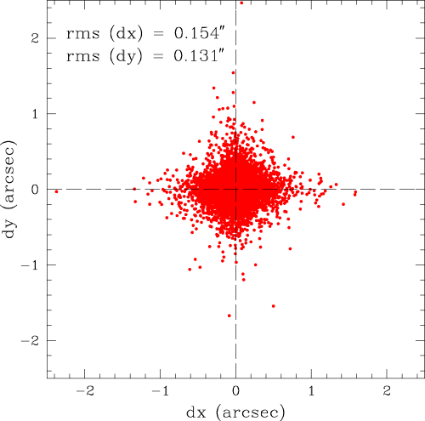
10 Scatter diagram of the astrometric differences in arcsec between the matched objects in all the overlap ...
Notes:
10 Scatter diagram of the astrometric differences in arcsec between the matched objects in all the overlap regions of the reduced V-band Andromeda data. Objects with V < 24.5 have been used so as to avoid using data from overlapping frames which reach different depths.
Unless provided in the caption above, the following copyright applies to the content of this slide: © 2004 RAS

Slide 16
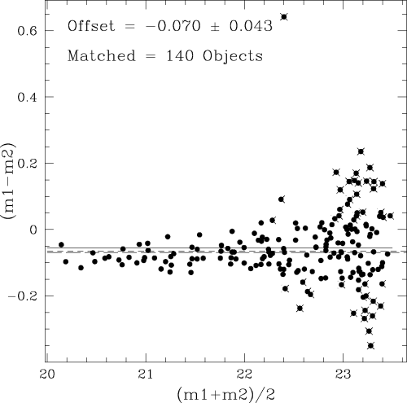
11 The V-band magnitude (photometric) difference between objects in the overlap region of two adjacent frames ...
Notes:
11 The V-band magnitude (photometric) difference between objects in the overlap region of two adjacent frames plotted against the mean magnitude, where each point represents a matched pair of objects. The three lines represent the value of the mean determined after the first (solid line), second (short broken line) and third (long broken line) iterations of linear fitting to the data, where points deviating from the mean by >1.5σ are rejected after each fit (crossed out objects). The magnitude dependence of the photometric errors determined during source extraction is obvious.
Unless provided in the caption above, the following copyright applies to the content of this slide: © 2004 RAS

Slide 17
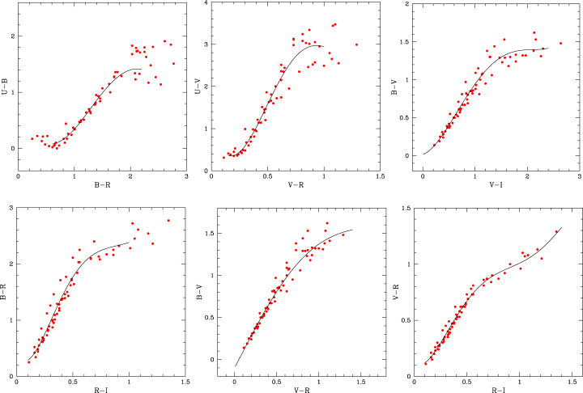
12 The best-fitting polynomials (black lines) used in the photometric calibration of the ODTS data. Filled red ...
Notes:
12 The best-fitting polynomials (black lines) used in the photometric calibration of the ODTS data. Filled red circles represent the colours of Pickles (1998) stellar data in the ODTS filter system, as seen in six different colour–colour planes.
Unless provided in the caption above, the following copyright applies to the content of this slide: © 2004 RAS

Slide 18
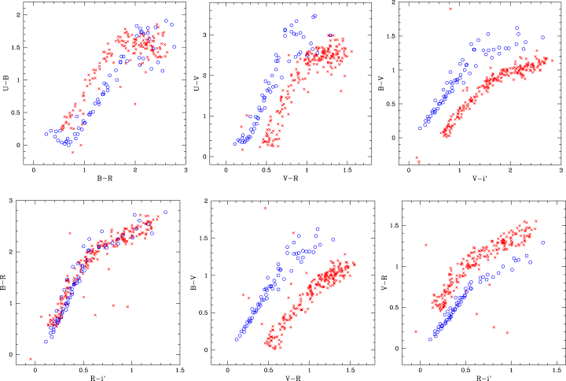
13 Stellar colours with uncorrected photometric zero-points for an example frame. The open blue circles ...
Notes:
13 Stellar colours with uncorrected photometric zero-points for an example frame. The open blue circles represent the colours of Pickles (1998) stellar data in the ODTS filter system and the red crosses show the ODTS stellar data. Large initial offsets were expected due to the differing observing conditions.
Unless provided in the caption above, the following copyright applies to the content of this slide: © 2004 RAS

Slide 19
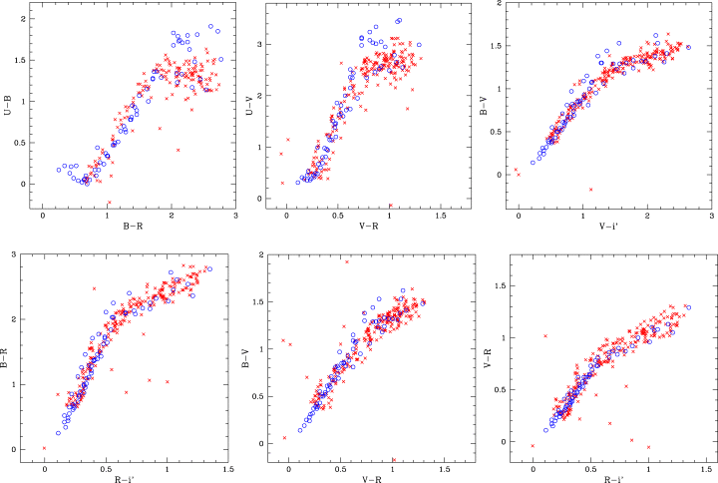
14 Stellar colours with corrected photometric zero-points for an example frame. The open blue circles represent ...
Notes:
14 Stellar colours with corrected photometric zero-points for an example frame. The open blue circles represent the colours of Pickles (1998) stellar data in the ODTS filter system and the red crosses show the ODTS stellar data.
Unless provided in the caption above, the following copyright applies to the content of this slide: © 2004 RAS

Slide 20
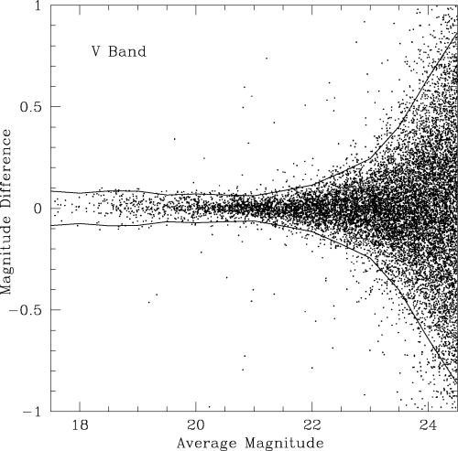
15 V-band magnitude difference between common objects in overlap regions against the mean magnitude for the ...
Notes:
15 V-band magnitude difference between common objects in overlap regions against the mean magnitude for the reduced Andromeda data after photometric calibration. 2σ error curves have been plotted and objects with V < 24.5 have been used so as to avoid using data from overlapping frames which reach different depths.
Unless provided in the caption above, the following copyright applies to the content of this slide: © 2004 RAS

Slide 21
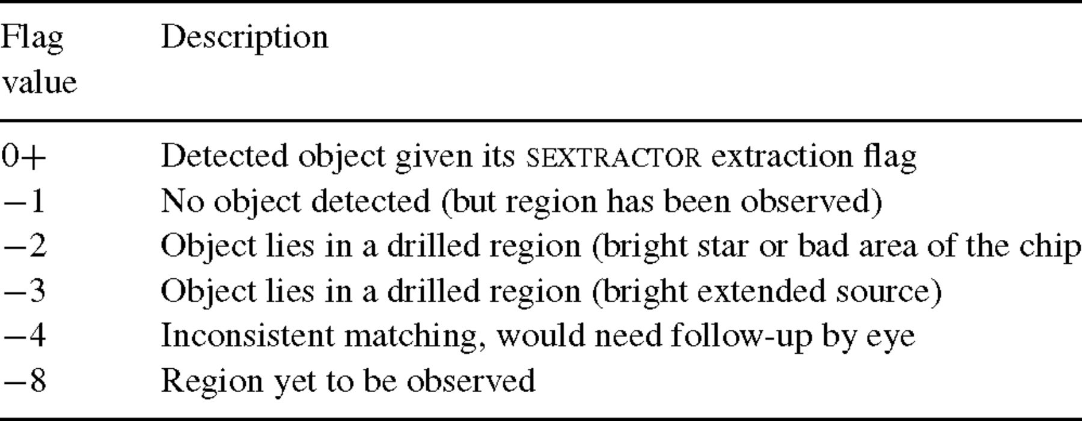
6 Flags used in the matched catalogues determining the reliability of objects or reasons for not matching. The ...
Notes:
6 Flags used in the matched catalogues determining the reliability of objects or reasons for not matching. The catalogue stores one flag for each filter for every catalogue object.
Unless provided in the caption above, the following copyright applies to the content of this slide: © 2004 RAS

Slide 22
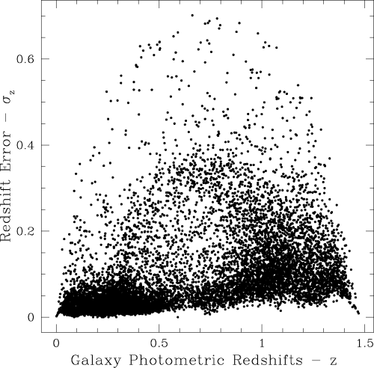
16 Determined photometric redshifts versus the error in the redshift for a subsection of the matched data from ...
Notes:
16 Determined photometric redshifts versus the error in the redshift for a subsection of the matched data from the Andromeda field. All galaxies have R < 23 to avoid including fainter galaxies with large photometric errors.
Unless provided in the caption above, the following copyright applies to the content of this slide: © 2004 RAS

Slide 23
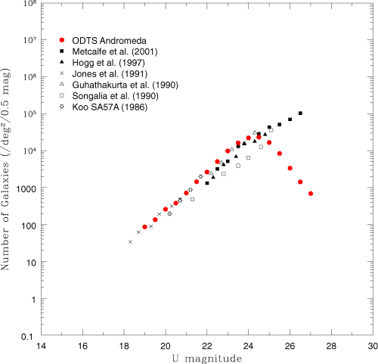
17 U-band galaxy number counts from the ODTS compared with a complication of results taken from various sources. ...
Notes:
17 U-band galaxy number counts from the ODTS compared with a complication of results taken from various sources. All counts have been converted to the standard photoelectric system. Conversion of the ODTS U data to the standard U filter (using equation 8) requires matches in U and B, and consequently the completeness of the U data will be dependent of the shallowest depths reached by the matched ODTS U- and B-band data. Here, U is found to be complete to a depth of 24.4. Table 7 presents the data in numerical form.
Unless provided in the caption above, the following copyright applies to the content of this slide: © 2004 RAS

Slide 24
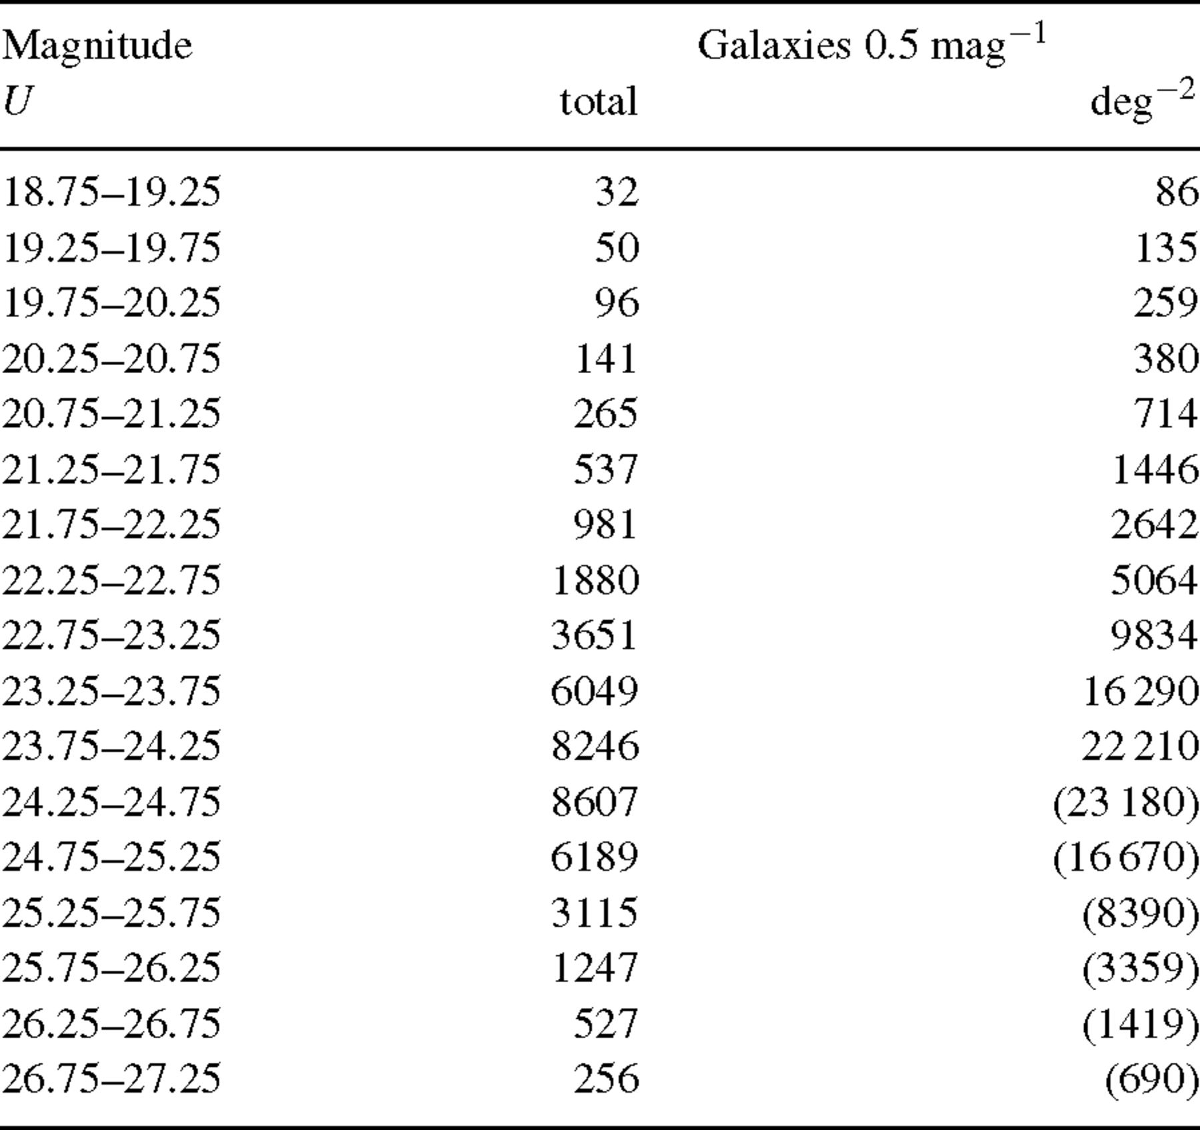
7 U-band number counts for the ODTS, graphed in Fig. 17.
Notes:
7 U-band number counts for the ODTS, graphed in Fig. 17.
Unless provided in the caption above, the following copyright applies to the content of this slide: © 2004 RAS

Slide 25
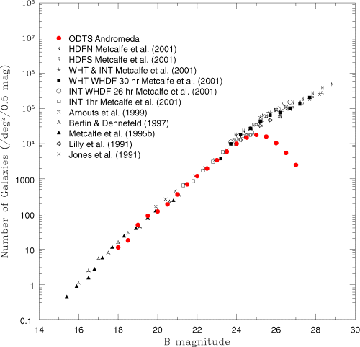
18 B-band galaxy number counts from the ODTS compared with a complication of results taken from various sources. ...
Notes:
18 B-band galaxy number counts from the ODTS compared with a complication of results taken from various sources. All counts have been converted to the standard photoelectric system. Conversion of the ODTS B data to the standard B filter (using equation 9) requires matches in B and V, and consequently the completeness of the B data will be dependent of the shallowest depths reached by the matched ODTS B- and V-band data. Here, B is found to be complete to a depth of 25.1. Table 8 presents the data in numerical form.
Unless provided in the caption above, the following copyright applies to the content of this slide: © 2004 RAS

Slide 26
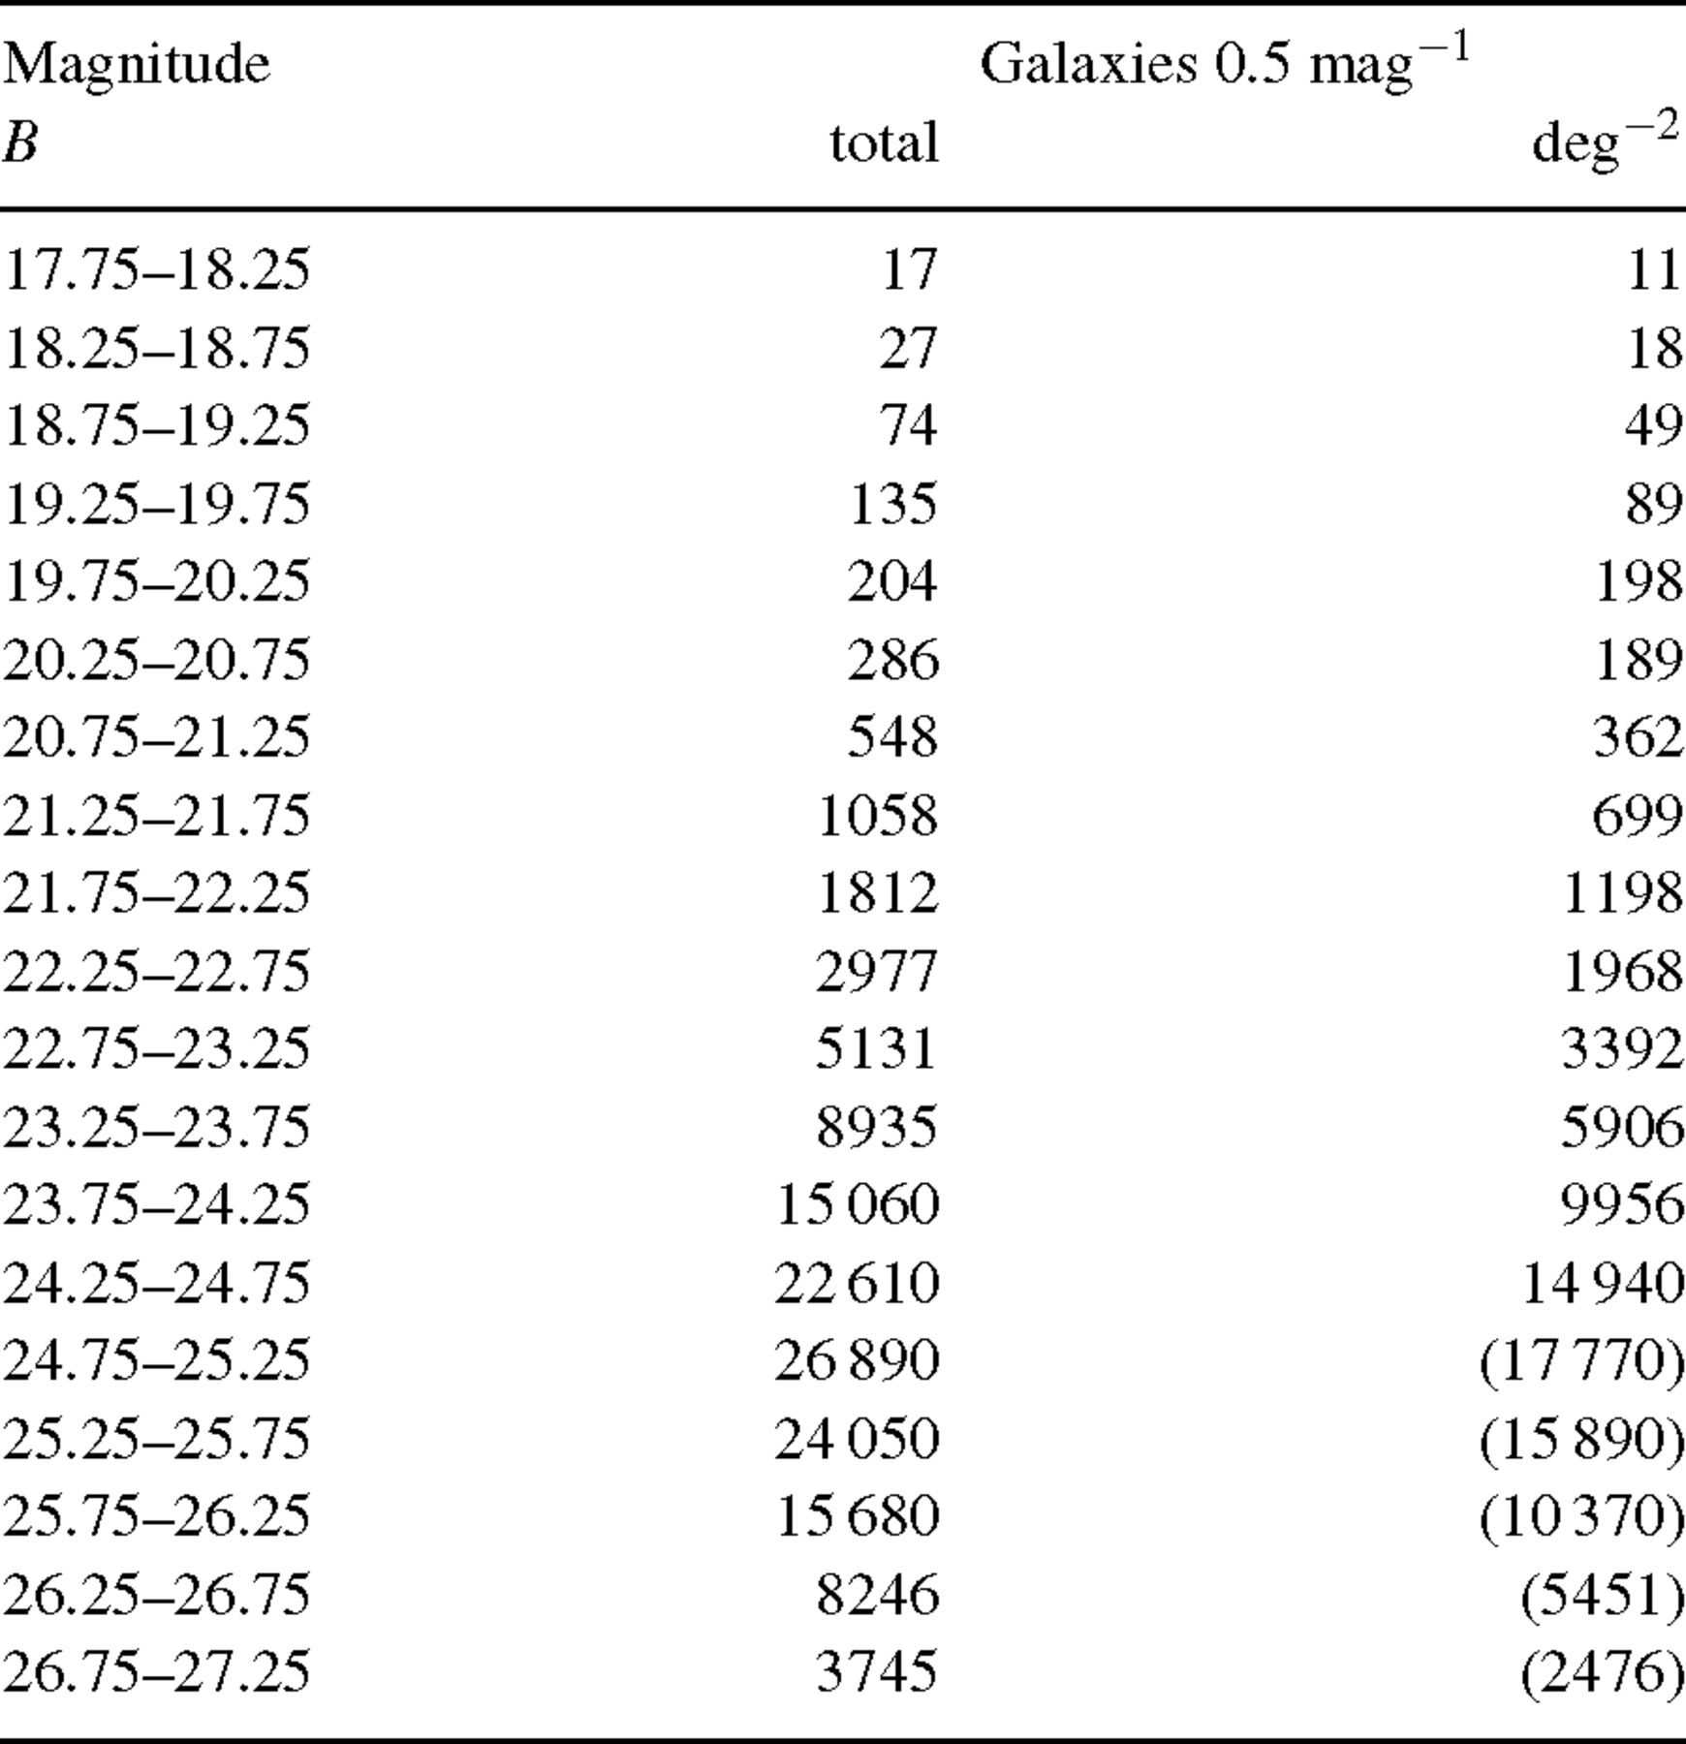
8 B-band number counts for the ODTS, graphed in Fig. 18.
Notes:
8 B-band number counts for the ODTS, graphed in Fig. 18.
Unless provided in the caption above, the following copyright applies to the content of this slide: © 2004 RAS

Slide 27
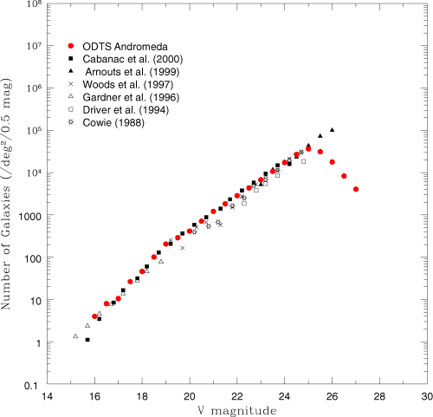
19 V-band galaxy number counts from the ODTS compared with a complication of results taken from various sources. ...
Notes:
19 V-band galaxy number counts from the ODTS compared with a complication of results taken from various sources. All counts have been converted to the standard photoelectric system. As the Harris V filter used in the ODTS is approximately the same as the standard V filter, no conversion of the ODTS data was required. Consequently, the completeness of the V data will only be dependent on the shallowest depths reached by the ODTS V data. Here, V is found to be complete to a depth of 24.8. Table 9 presents the data in numerical form.
Unless provided in the caption above, the following copyright applies to the content of this slide: © 2004 RAS

Slide 28
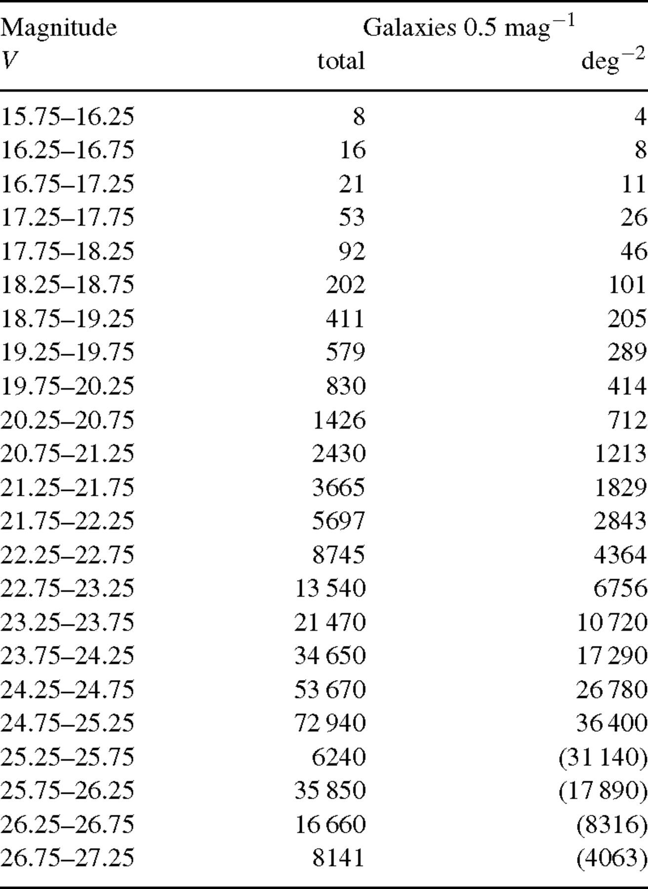
9 V-band number counts for the ODTS, graphed in Fig. 19.
Notes:
9 V-band number counts for the ODTS, graphed in Fig. 19.
Unless provided in the caption above, the following copyright applies to the content of this slide: © 2004 RAS

Slide 29
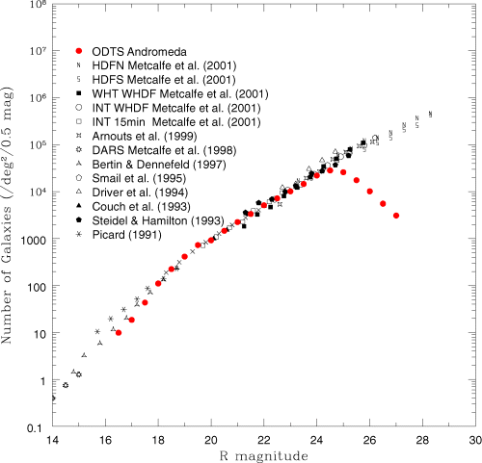
20 R-band galaxy number counts from the ODTS compared with a complication of results taken from various sources. ...
Notes:
20 R-band galaxy number counts from the ODTS compared with a complication of results taken from various sources. All counts have been converted to the standard photoelectric system. As the Harris R filter used in the ODTS is approximately the same as the standard R filter, no conversion of the ODTS data was required. Consequently, the completeness of the R data will only be dependent on the shallowest depths reached by the ODTS R data. Here, R is found to be complete to a depth of 24.3. Table 10 presents the data in numerical form.
Unless provided in the caption above, the following copyright applies to the content of this slide: © 2004 RAS

Slide 30
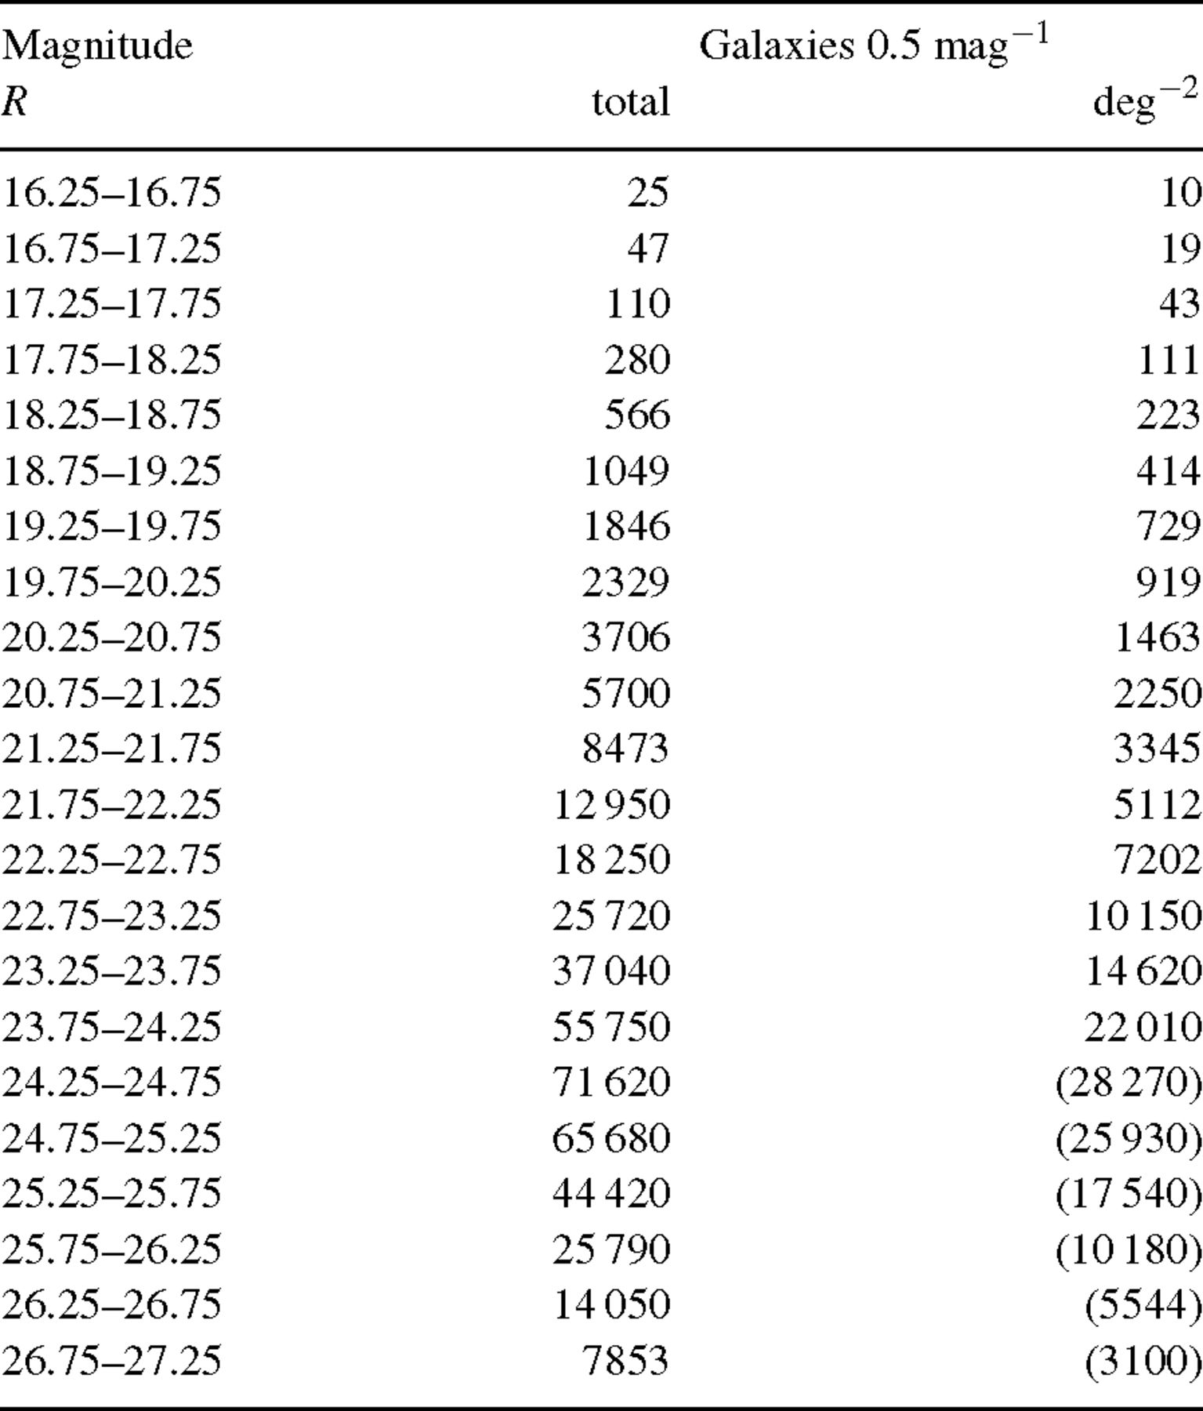
10 R-band number counts for the ODTS, graphed in Fig. 20.
Notes:
10 R-band number counts for the ODTS, graphed in Fig. 20.
Unless provided in the caption above, the following copyright applies to the content of this slide: © 2004 RAS

Slide 31
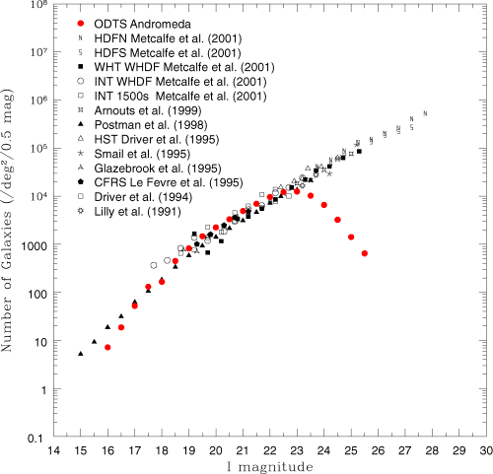
21 I-band galaxy number counts from the ODTS compared with a complication of results taken from various sources. ...
Notes:
21 I-band galaxy number counts from the ODTS compared with a complication of results taken from various sources. All counts have been converted to the standard photoelectric system. Conversion of the ODTS i′ data to the standard I filter (using equation 10) requires matches in R and i′, and consequently the completeness of the I data will be dependent of the shallowest depths reached by the matched ODTS R- and i′-band data. Here, I is found to be complete to a depth of 22.8. Table 11 presents the data in numerical form.
Unless provided in the caption above, the following copyright applies to the content of this slide: © 2004 RAS

Slide 32
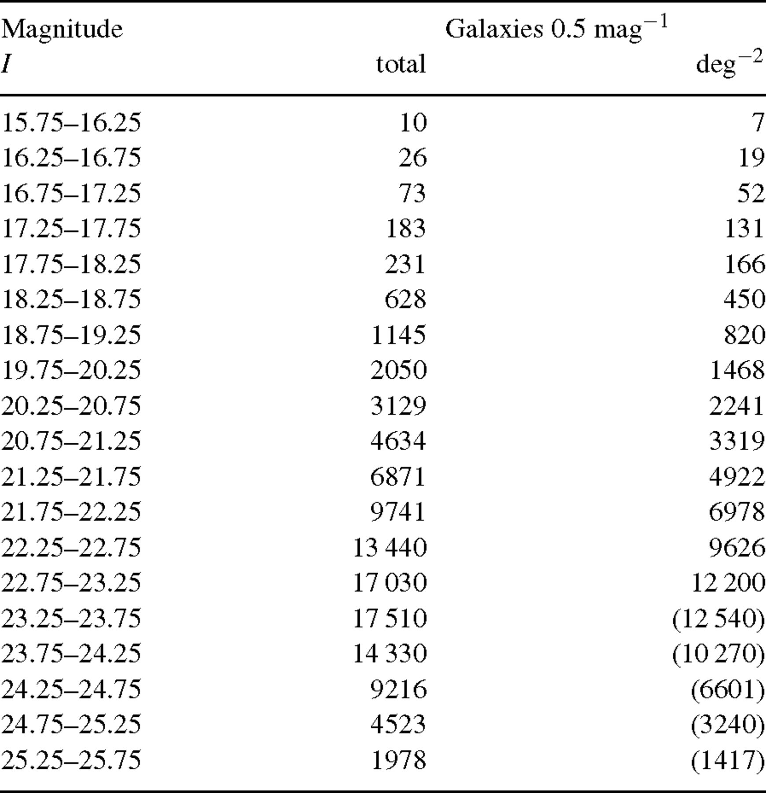
11 I-band number counts for the ODTS, graphed in Fig. 21.
Notes:
11 I-band number counts for the ODTS, graphed in Fig. 21.
Unless provided in the caption above, the following copyright applies to the content of this slide: © 2004 RAS

