Slide 1
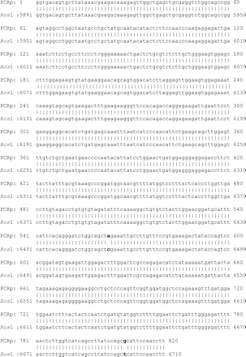
Figure 1. Comparison of partial nucleotide acid sequences of human epididymal ros (PCRp) and human ros1. The nucleotide ...
Notes:
Figure 1. Comparison of partial nucleotide acid sequences of human epididymal ros (PCRp) and human ros1. The nucleotide changes are marked with bold letters. Numbers on the left correspond to the nucleic acid positions of human ros1 cDNA.
Unless provided in the caption above, the following copyright applies to the content of this slide: Molecular Human Reproduction vol. 10 no. 9 © European Society of Human Reproduction and Embryology 2004; all rights reserved

Slide 2
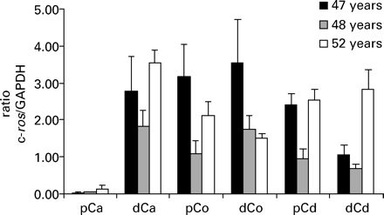
Figure 2. C-ros transcript expression in three different human epididymides. Levels of c-ros and GAPDH mRNA were ...
Notes:
Figure 2. C-ros transcript expression in three different human epididymides. Levels of c-ros and GAPDH mRNA were measured by real-time PCR concentrations on human epididymal proximal (pCa) and distal (dCa) caput, proximal (pCo) and distal (dCo) corpus, and proximal (pCp) and distal (pCd) cauda. Results are expressed as a ratio of c-ros/GAPDH. Results are expressed as mean±SEM for three independent experiments. The age of each donor is indicated in years.
Unless provided in the caption above, the following copyright applies to the content of this slide: Molecular Human Reproduction vol. 10 no. 9 © European Society of Human Reproduction and Embryology 2004; all rights reserved

Slide 3
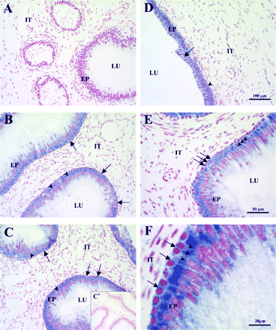
Figure 3. In situ localization of c-ros transcripts along the human epididymis. Cryosections of human: (A) ...
Notes:
Figure 3. In situ localization of c-ros transcripts along the human epididymis. Cryosections of human: (A) ‘initial-segment-like’, (B) caput, (C,E,F) corpus, and (D) cauda segments of the epididymis were probed with DIG-labelled antisense or sense [negative control; (C*) corpus] c-ros cRNA probe. C-ros mRNA was detected by immunostaining using an alkaline phosphatase-labelled anti-DIG, which appears as a blue staining following incubation with Nitroblue Tetrazolium/S-bromo-Δ-chloro-3-indolyl phosphate substrate. Tissues were counterstained with Neutral Red to visualize nuclei. Epididymal segments were dissected according to previously described methods (Légaré et al., 1999). EP = epididymal epithelium; IT = interstitial compartment; LU = epididymal lumen. Arrows show basal cells and arrowheads principal cells, both positively stained for c-ros mRNA. Panels A-D are at the same magnification.
Unless provided in the caption above, the following copyright applies to the content of this slide: Molecular Human Reproduction vol. 10 no. 9 © European Society of Human Reproduction and Embryology 2004; all rights reserved

Slide 4
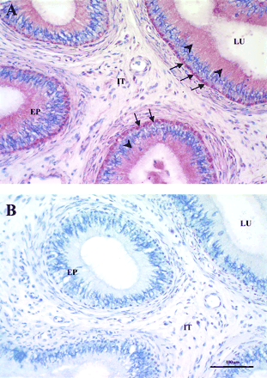
Figure 4. Immunohistochemical localization of c-ros in human epididymis. Immunoperoxidase staining of tissue sections ...
Notes:
Figure 4. Immunohistochemical localization of c-ros in human epididymis. Immunoperoxidase staining of tissue sections was performed employing the anti-ros antibody. Red staining shows the presence of c-ros in (A) corpus epididymis. Negative control (B): corpus epididymis probed with a negative preimmune serum control. Tissues were counterstained in blue. EP = epididymal epithelium; IT = interstitial compartment; LU = epididymal lumen. Arrows show basal cells and arrowheads principal cells, both positively stained for c-ros.
Unless provided in the caption above, the following copyright applies to the content of this slide: Molecular Human Reproduction vol. 10 no. 9 © European Society of Human Reproduction and Embryology 2004; all rights reserved

