Slide 1
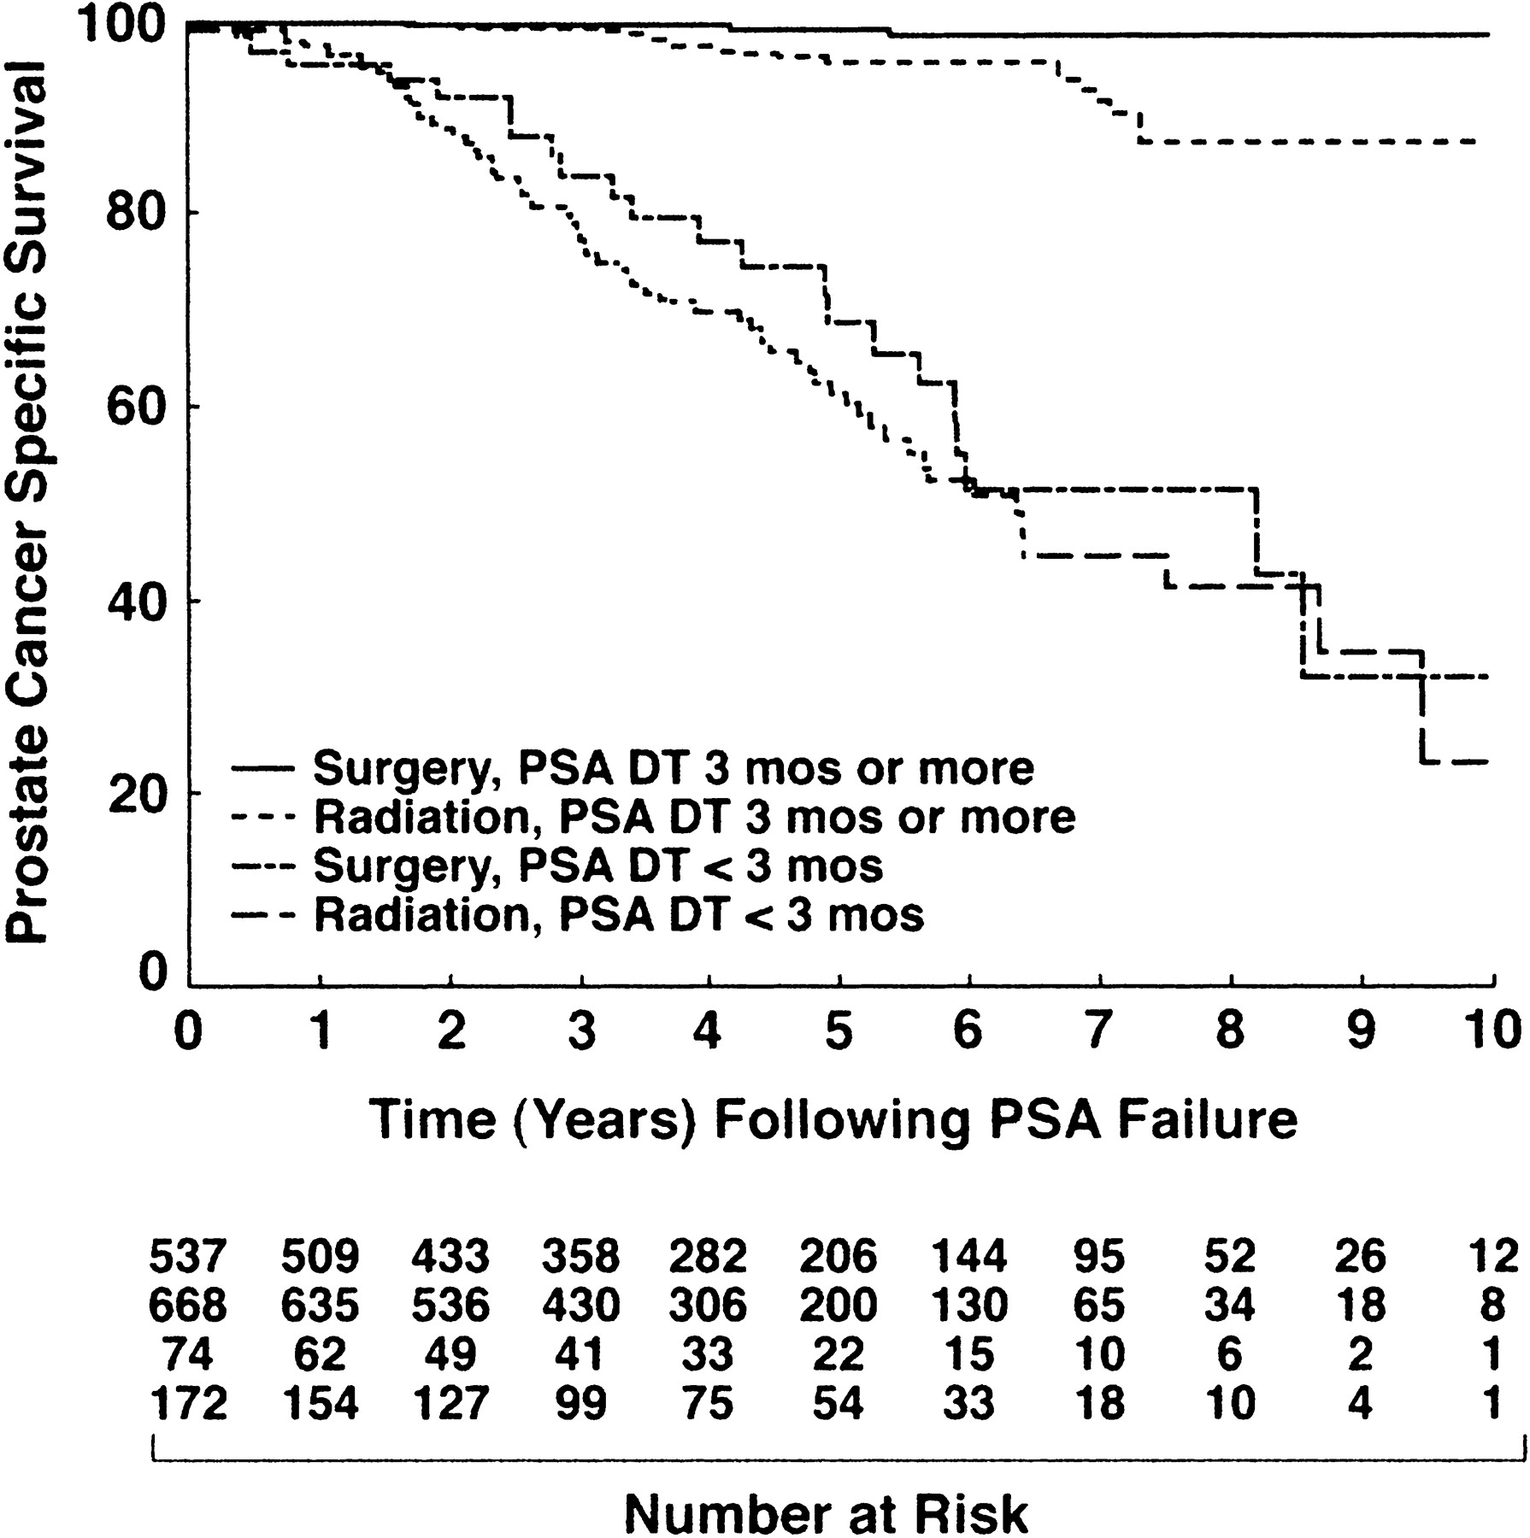
Fig. 1. Prostate cancer–specific survival after prostate-specific antigen (PSA)–defined recurrence stratified by ...
Notes:
Fig. 1. Prostate cancer–specific survival after prostate-specific antigen (PSA)–defined recurrence stratified by treatment received and the value of the post-treatment PSA doubling time (PSA-DT). A pairwise two-sided log-rank test was used. P values are as follows: for a PSA-DT of less than 3 months (surgery versus radiation), P = .38; for PSA-DT of 3 months or more (surgery versus radiation), P<.001; for PSA-DT of less than 3 months versus PSA-DT of 3 months or more (surgery), P<.001; for PSA-DT of less than 3 months versus PSA-DT of 3 months or more (radiation), P<.001. For PSA-DT of 3 months or more (surgery), at 3 years, 99.8 (95% confidence interval [CI] = 99.4 to 100); at 5 years, 99.4 (95% CI = 98.6 to 100); at 8 years, 98.9 (95% CI = 97.6 to 100). For PSA-DT of 3 months or more (radiation), at 3 years, 99.6 (95% CI = 99.1 to 100); at 5 years, 96.1 (95% CI = 94 to 98.2); at 8 years, 87.6 (95% CI = 81.2 to 94). For PSA-DT of less than 3 months (surgery), at 3 years, 84.1 (95% CI = 74.4 to 93.8); at 5 years, 68.8 (95% CI = 55 to 82.6); at 8 years, 51.5 (95% CI = 34.8 to 68.3). For PSA-DT of less than 3 months (radiation), at 3 years, 79.1 (95% CI = 72.5 to 85.8); at 5 years, 61.6 (95% CI = 53 to 70.4); at 8 years, 41.6 (95% CI = 29.8 to 53.4).
Unless provided in the caption above, the following copyright applies to the content of this slide: © Oxford University Press

Slide 2
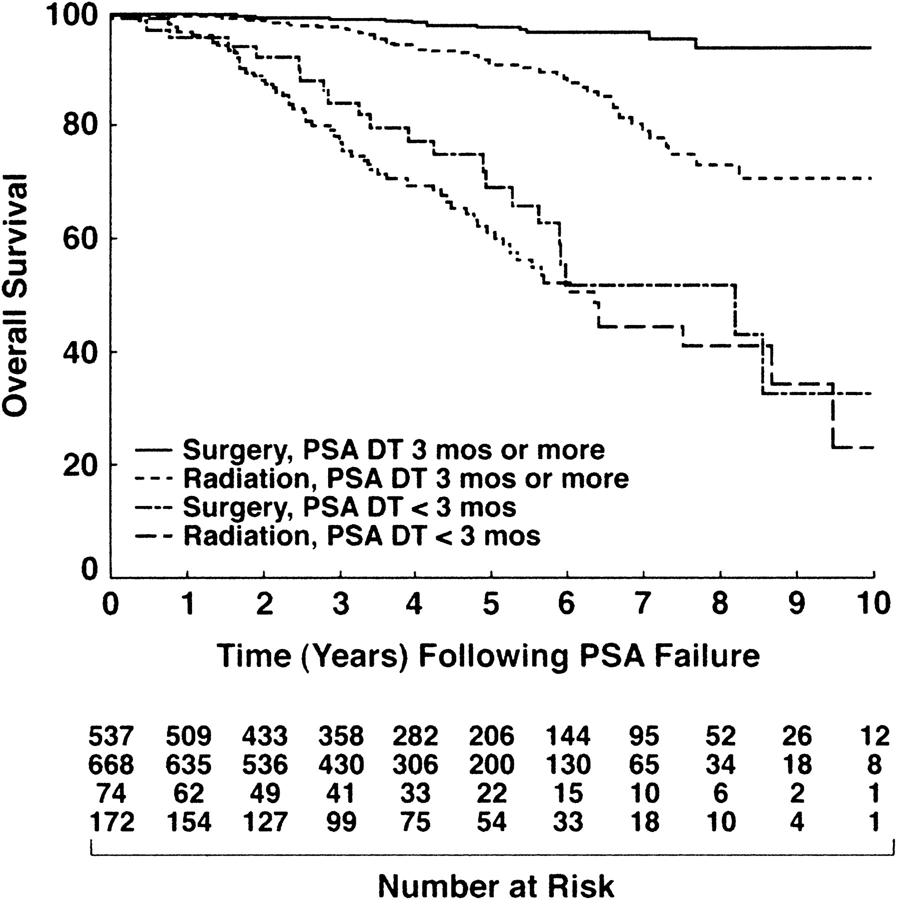
Fig. 2. Overall survival after prostate-specific antigen (PSA)–defined recurrence stratified by treatment received ...
Notes:
Fig. 2. Overall survival after prostate-specific antigen (PSA)–defined recurrence stratified by treatment received and the value of the post-treatment PSA doubling time (PSA-DT). A pairwise two-sided log-rank test was used. P values are as follows: for PSA-DT of less than 3 months (surgery versus radiation), P = .34; for PSA-DT of 3 months or more (surgery versus radiation), P<.001; for PSA-DT of less than 3 months versus PSA-DT of 3 months or more (surgery), P<.001; for PSA-DT of less than 3 months versus PSA-DT of 3 months or more (radiation), P<.001. For PSA-DT of 3 months or more (surgery), at 3 years, 99.1 (95% confidence interval [CI] = 98.2 to 100); at 5 years, 97.6 (95% CI = 95.9 to 99.3); at 8 years, 93.9 (95% CI = 89.7 to 98.1). For PSA-DT of 3 months or more (radiation), at 3 years, 97.7 (95% CI = 96.4 to 98.9); at 5 years, 91.7 (95% CI = 88.9 to 94.6); at 8 years, 73 (95% CI = 64.8 to 81.4). For PSA-DT of less than 3 months (surgery), at 3 years, 84.1 (95% CI = 74.4 to 93.8); at 5 years, 68.8 (95% CI = 55 to 82.6); at 8 years, 51.5 (95% CI = 34.8 to 68.3). For PSA-DT of less than 3 months (radiation), at 3 years, 78.5 (95% CI = 71.8 to 85.3); at 5 years, 61 (95% CI = 52.1 to 69.8); at 8 years, 41 (95% CI = 29.1 to 52.8).
Unless provided in the caption above, the following copyright applies to the content of this slide: © Oxford University Press

