Slide 1
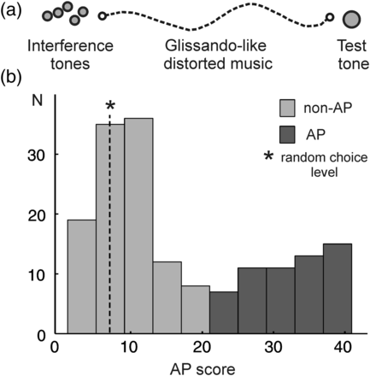
Figure 1. Absolute pitch test shows bimodal distribution of AP perception. (a) Test design: the test tone (500 ms) is ...
Notes:
Figure 1. Absolute pitch test shows bimodal distribution of AP perception. (a) Test design: the test tone (500 ms) is preceded by interference stimuli, namely 5 nonequally tempered sequential instrumental tones (2.5 s) followed by glissando-like continuously distorted music pieces (18 s). The test comprises 41 test items consisting of instrumental, sine tones, and active tone production tasks. For correct tones 1 point and for semitone errors 0.5 point is accredited. (b) One hundred sixty-two musicians performed the AP test, which yields a bimodal distribution of AP (red) and non-AP possessors (blue). Inclusion criteria for the AP group are 22–41 score points, (random choice level is 6.9; marked with an asterisk).
Unless provided in the caption above, the following copyright applies to the content of this slide: © The Author 2013. Published by Oxford University Press. All rights reserved. For Permissions, please e-mail: journals.permissions@oup.com

Slide 2
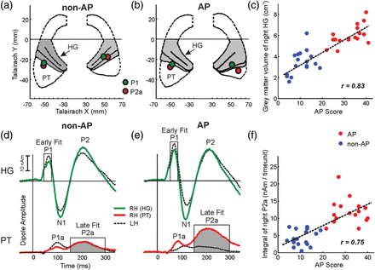
Figure 2. Morphology and function of right auditory cortex in AP. (a and b) Averaged individual auditory cortex ...
Notes:
Figure 2. Morphology and function of right auditory cortex in AP. (a and b) Averaged individual auditory cortex landmarks illustrate increased size of HG (marked in gray) and subsequently smaller PT in the right hemisphere of the AP group when compared with the non-AP group (green dots: MEG dipole localization of early P1 response in HG, red dots: P2a dipoles in PT). According to neurological convention, the right hemisphere is shown on the reader's right side. (c) Correlation of gray matter volume of right HG with AP proficiency (blue dots: non-AP subjects, red dots: AP subjects). (d and e) Average MEG source waveforms in response to auditory stimulation of right HG (green trace), right PT (red trace), and left HG and PT (dashed traces) in non-AP and AP groups. P2a amplitude in right PT of AP possessors was increased compared with the left hemisphere and in comparison with non-AP musicians (P2a integral and fit interval between 150 and 300 ms marked in gray). (f) Correlation of the integral of P2a in right PT with AP proficiency.
Unless provided in the caption above, the following copyright applies to the content of this slide: © The Author 2013. Published by Oxford University Press. All rights reserved. For Permissions, please e-mail: journals.permissions@oup.com

Slide 3
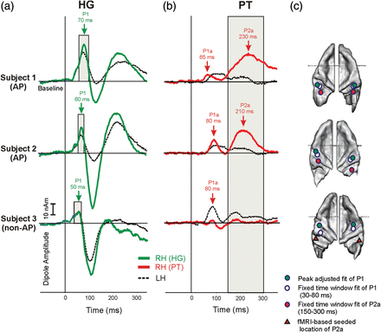
Figure 3. Individual source modeling of primary and secondary auditory evoked fields. Three (exemplary) individual ...
Notes:
Figure 3. Individual source modeling of primary and secondary auditory evoked fields. Three (exemplary) individual source waveforms in response to auditory stimulation of right HG (green traces), right PT (red traces), left HG and PT (dashed traces), showing the fitting intervals to obtain the primary P1 response of HG and the secondary P2a response of PT. While the fitting intervals of the P1 response were individually adjusted to time intervals around the P1 peak defined by their half-side lobes, the fitting interval of the P2a response was defined as a fixed interval (150–300 ms) for all subjects. Based on a grand average of 2600 tones, the fitted location of the P1 response in HG was robust in all cases. Regarding the later P2a response of PT, the fitted location was robust in most cases. In subjects with a very broad or weak P2a response, dipole coordinates were seeded based on the center of gravity of BOLD activation in the fMRI experiment (subject 3, red triangle).
Unless provided in the caption above, the following copyright applies to the content of this slide: © The Author 2013. Published by Oxford University Press. All rights reserved. For Permissions, please e-mail: journals.permissions@oup.com

Slide 4
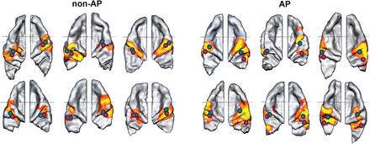
Figure 4. Individual morphology and function of the auditory cortex. Individual fMRI responses and MEG dipoles are ...
Notes:
Figure 4. Individual morphology and function of the auditory cortex. Individual fMRI responses and MEG dipoles are superimposed onto the respective bilateral auditory cortices. Six representative examples of each group are shown (green dots: localization of early P1 response in HG, red dots: P2a dipoles in PT). The right auditory cortex is dominant in the AP group in terms of morphology and BOLD activation in comparison with the left side and to non-AP musicians. Increased posterior shift of the P2a dipole leads to a separation of right-hemispheric dipoles in the AP group.
Unless provided in the caption above, the following copyright applies to the content of this slide: © The Author 2013. Published by Oxford University Press. All rights reserved. For Permissions, please e-mail: journals.permissions@oup.com

Slide 5
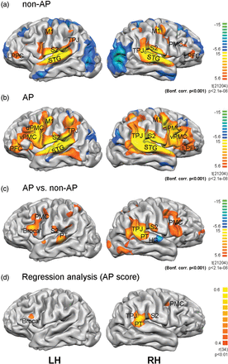
Figure 5. Multisensory and right-dominant network in AP perception. BOLD activations after auditory stimulation are ...
Notes:
Figure 5. Multisensory and right-dominant network in AP perception. BOLD activations after auditory stimulation are rendered onto the normalized brain surface of the subject with the highest AP score (LH: left hemisphere, RH: right hemisphere). Fixed effects separate subjects analyses (P < 0.001, Bonferroni corrected) are shown in (a) non-AP and (b) AP musicians as well as in the (c) group contrast map. (d) Random effects analysis using the AP score as a covariate. Superior temporal gyrus (STG), Heschl's Gyrus (HG), planum temporale (PT), temporo-parietal junction (TPJ), secondary somatosensory cortex (S2), primary motor cortex (M1), lateral prefrontal cortex (LPFC), ventral premotor cortex (vPMC), dorsal premotor cortex (dPMC).
Unless provided in the caption above, the following copyright applies to the content of this slide: © The Author 2013. Published by Oxford University Press. All rights reserved. For Permissions, please e-mail: journals.permissions@oup.com

Slide 6
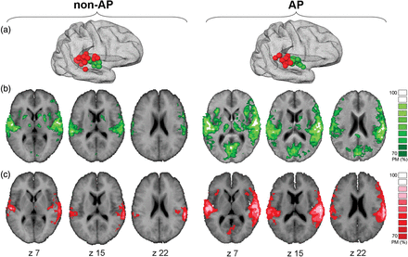
Figure 6. FMRI-based functional connectivity of right HG and PT. (a) Individual localization of the fMRI center of ...
Notes:
Figure 6. FMRI-based functional connectivity of right HG and PT. (a) Individual localization of the fMRI center of gravity of right-hemispheric HG (green) and PT (red) coordinates in non-AP musicians and AP musicians. (b and c) Probability maps of fMRI-based instantaneous functional connectivity based on individual seed regions of right HG (green, b) and right PT (red, c). Individual FDR correction. P 70% are superimposed on the averaged brain of all non-AP and AP subjects, respectively.
Unless provided in the caption above, the following copyright applies to the content of this slide: © The Author 2013. Published by Oxford University Press. All rights reserved. For Permissions, please e-mail: journals.permissions@oup.com

