Slide 1
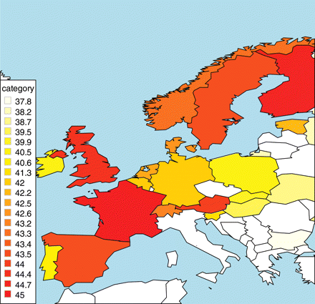
Figure 1 Reported age that a woman is too old to consider having more children, respondents aged 25–42 years old, ...
Notes:
Figure 1 Reported age that a woman is too old to consider having more children, respondents aged 25–42 years old, selected European countries. Source: Created by authors using Wave 3 of the European Social Survey, collected in 2006 in 23 countries. Notes: Analysis restricted to individuals aged 25-42 years old at the time of the survey. The specific question (38a) asked: After what age would you say a woman is generally too old to consider having any more children?
Unless provided in the caption above, the following copyright applies to the content of this slide: © The Author 2011. Published by Oxford University Press on behalf of the European Society of Human Reproduction and Embryology. All rights reserved. For Permissions, please email: journals.permissions@oup.com

Slide 2
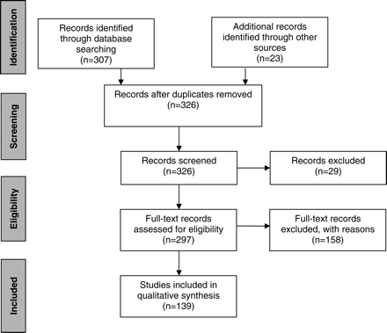
Figure 2 PRISMA flow diagram of review process.
Notes:
Figure 2 PRISMA flow diagram of review process.
Unless provided in the caption above, the following copyright applies to the content of this slide: © The Author 2011. Published by Oxford University Press on behalf of the European Society of Human Reproduction and Embryology. All rights reserved. For Permissions, please email: journals.permissions@oup.com

Slide 3
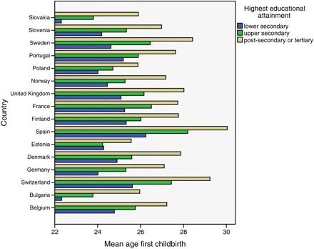
Figure 3 Mean age at first birth by educational level, women born 1960–1969, selected European countries. Source: ...
Notes:
Figure 3 Mean age at first birth by educational level, women born 1960–1969, selected European countries. Source: European Social Survey, 2006, women only, born 1960–1969, n = 7307, calculations by authors.
Unless provided in the caption above, the following copyright applies to the content of this slide: © The Author 2011. Published by Oxford University Press on behalf of the European Society of Human Reproduction and Embryology. All rights reserved. For Permissions, please email: journals.permissions@oup.com

