Slide 1
Fig. 1 The S&P 500 index between April 28, 1989, and February 26, 2009: (a) the returns, (b) the posterior median of ...
Notes:
Fig. 1 The S&P 500 index between April 28, 1989, and February 26, 2009: (a) the returns, (b) the posterior median of volatility (solid line) with 95% credible interval (dashed line) using the Inf-Sup Gamma OU model, and (c) the posterior median of volatility (solid line) with 95% credible interval (dashed line) using the Inf-Sup NP OU model
Unless provided in the caption above, the following copyright applies to the content of this slide: © Oxford University Press 2011

Slide 2
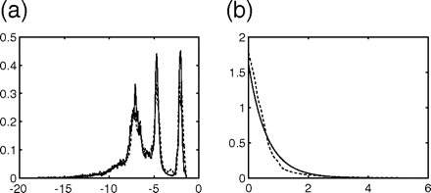
Fig. 2 The S&P 500 index between April 28, 1989, and February 26, 2009: (a) the posterior mean of F_{λ} and ...
Notes:
Fig. 2 The S&P 500 index between April 28, 1989, and February 26, 2009: (a) the posterior mean of Fλ and (b) posterior mean of FJ using the Inf-Sup Gamma OU (solid line) and the Inf-Sup NP OU (dashed line)
Unless provided in the caption above, the following copyright applies to the content of this slide: © Oxford University Press 2011

Slide 3
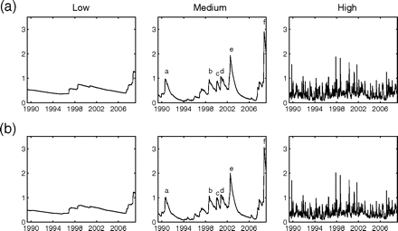
Fig. 3 The S&P 500 index between April 28, 1989, and February 26, 2009: posterior mean volatility in the three ...
Notes:
Fig. 3 The S&P 500 index between April 28, 1989, and February 26, 2009: posterior mean volatility in the three frequency categories using (a) the Inf-Sup Gamma OU model and (b) the Inf-Sup NP OU model
Unless provided in the caption above, the following copyright applies to the content of this slide: © Oxford University Press 2011

Slide 4
Fig. 4 The returns for the NASDAQ 100, FTSE 100, and Nikkei 225 indices
Notes:
Fig. 4 The returns for the NASDAQ 100, FTSE 100, and Nikkei 225 indices
Unless provided in the caption above, the following copyright applies to the content of this slide: © Oxford University Press 2011

Slide 5
Fig. 5 The posterior mean of F_{J} for the NASDAQ 100, FTSE 100, and Nikkei 225 indices using the Inf-Sup ...
Notes:
Fig. 5 The posterior mean of FJ for the NASDAQ 100, FTSE 100, and Nikkei 225 indices using the Inf-Sup Gamma OU (solid line) and the Inf-Sup NP OU (dashed line)
Unless provided in the caption above, the following copyright applies to the content of this slide: © Oxford University Press 2011

Slide 6
Fig. 6 The posterior mean of F_{λ} for the NASDAQ 100, FTSE 100, and Nikkei 225 indices using the Inf-Sup ...
Notes:
Fig. 6 The posterior mean of Fλ for the NASDAQ 100, FTSE 100, and Nikkei 225 indices using the Inf-Sup Gamma OU (solid line) and the Inf-Sup NP OU (dashed line)
Unless provided in the caption above, the following copyright applies to the content of this slide: © Oxford University Press 2011

Slide 7
Fig. 7 Posterior median of the volatility (solid line) with 95% credible interval (dashed line) for the NASDAQ 100, ...
Notes:
Fig. 7 Posterior median of the volatility (solid line) with 95% credible interval (dashed line) for the NASDAQ 100, FTSE 100, and Nikkei 225 indices using the Inf-Sup NP OU
Unless provided in the caption above, the following copyright applies to the content of this slide: © Oxford University Press 2011

Slide 8
Fig. 8 The posterior mean volatility in the medium-frequency category for the NASDAQ 100, FTSE 100, and Nikkei 225 ...
Notes:
Fig. 8 The posterior mean volatility in the medium-frequency category for the NASDAQ 100, FTSE 100, and Nikkei 225 (solid line) with the posterior mean volatility in the medium-frequency category for the S&P 500 index (dashed line)
Unless provided in the caption above, the following copyright applies to the content of this slide: © Oxford University Press 2011

Slide 9
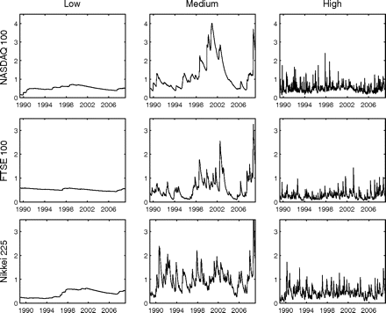
Fig. 9 The posterior mean volatility in the three frequency categories for the NASDAQ 100, FTSE 100, and Nikkei 225 ...
Notes:
Fig. 9 The posterior mean volatility in the three frequency categories for the NASDAQ 100, FTSE 100, and Nikkei 225 using the Inf-Sup NP OU model
Unless provided in the caption above, the following copyright applies to the content of this slide: © Oxford University Press 2011

