Slide 1
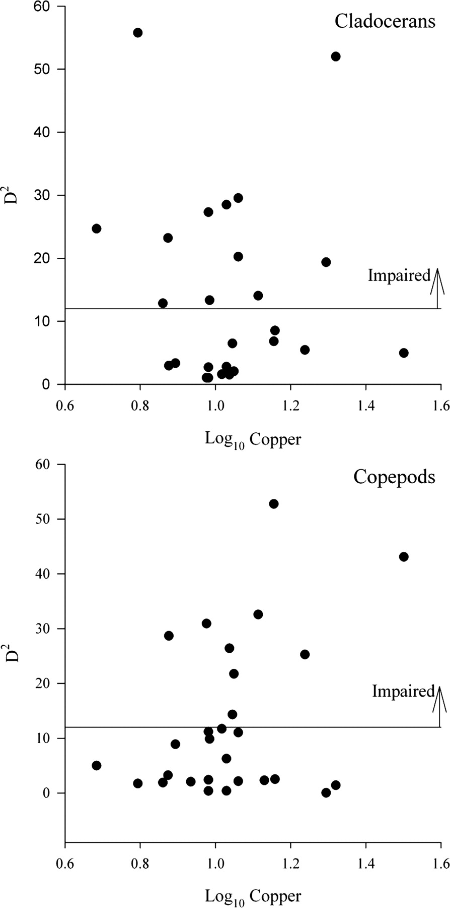
Fig. 4. Relationship between copper concentrations (log-transformed) and each lake distance from reference condition ...
Notes:
Fig. 4. Relationship between copper concentrations (log-transformed) and each lake distance from reference condition in the urban lakes group. Distance (D2) is a generalized Euclidean distance calculated using the first two axes of a PCA of cladoceran and copepod species abundance. Lakes falling above the horizontal line are significantly different from reference.
Unless provided in the caption above, the following copyright applies to the content of this slide: © The Author 2011. Published by Oxford University Press. All rights reserved. For permissions, please email: journals.permissions@oup.com

Slide 2
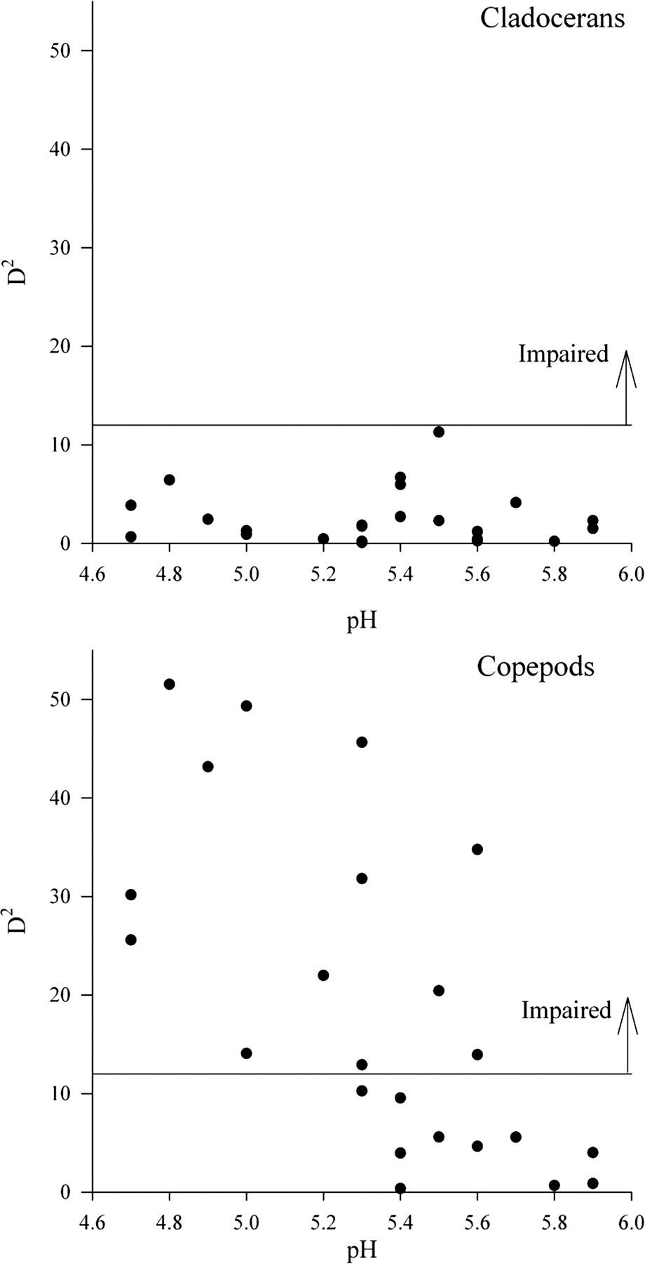
Fig. 3. Relationship between pH and each lake distance from reference condition in the acid lakes group. Distance ...
Notes:
Fig. 3. Relationship between pH and each lake distance from reference condition in the acid lakes group. Distance (D2) is a generalized Euclidean distance calculated using the first two axes of a PCA of cladoceran and copepod species abundance. Lakes falling above the horizontal line are significantly different from reference.
Unless provided in the caption above, the following copyright applies to the content of this slide: © The Author 2011. Published by Oxford University Press. All rights reserved. For permissions, please email: journals.permissions@oup.com

Slide 3
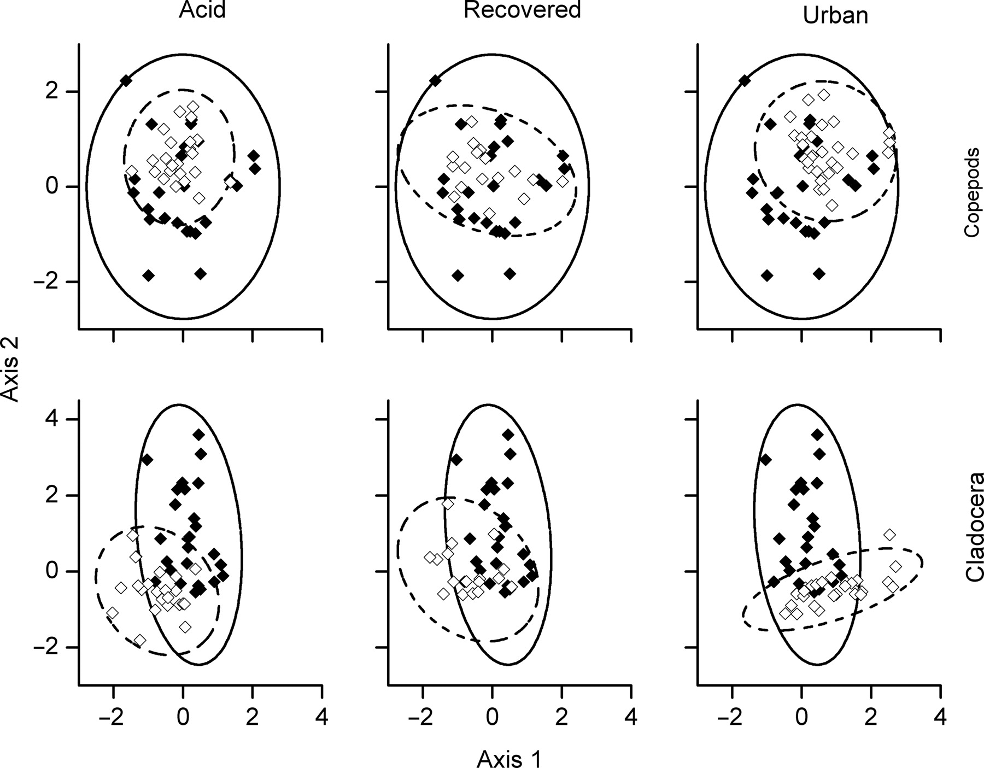
Fig. 2. Biplot of axis scores (PCA1 and PCA2) for the cladoceran and copepod communities in the reference lakes ...
Notes:
Fig. 2. Biplot of axis scores (PCA1 and PCA2) for the cladoceran and copepod communities in the reference lakes (closed symbols) relative to the test lakes (open symbols). Ellipses represent 95% confidence regions for the data values for each lake group (acid, recovered, urban—dotted lines) compared to the reference lake group (solid lines).
Unless provided in the caption above, the following copyright applies to the content of this slide: © The Author 2011. Published by Oxford University Press. All rights reserved. For permissions, please email: journals.permissions@oup.com

Slide 4
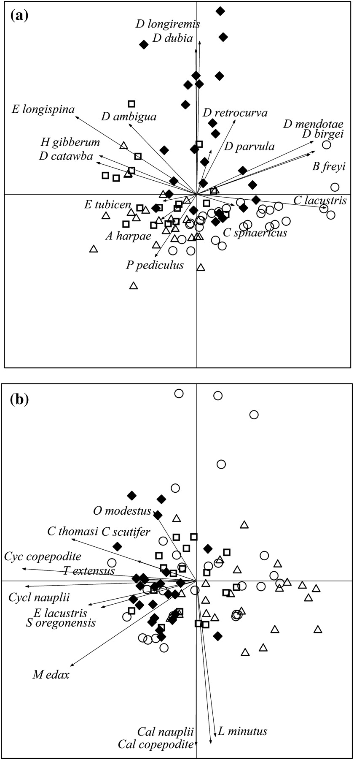
Fig. 1. Principal component analysis biplot on (a) cladoceran zooplankton and (b) copepod zooplankton in the 87 study ...
Notes:
Fig. 1. Principal component analysis biplot on (a) cladoceran zooplankton and (b) copepod zooplankton in the 87 study lakes. Lake groups are indicated by the following symbols: acid lakes (triangle), recovered lakes (square), reference lakes (diamond) and urban lakes (circle).
Unless provided in the caption above, the following copyright applies to the content of this slide: © The Author 2011. Published by Oxford University Press. All rights reserved. For permissions, please email: journals.permissions@oup.com

