Slide 1
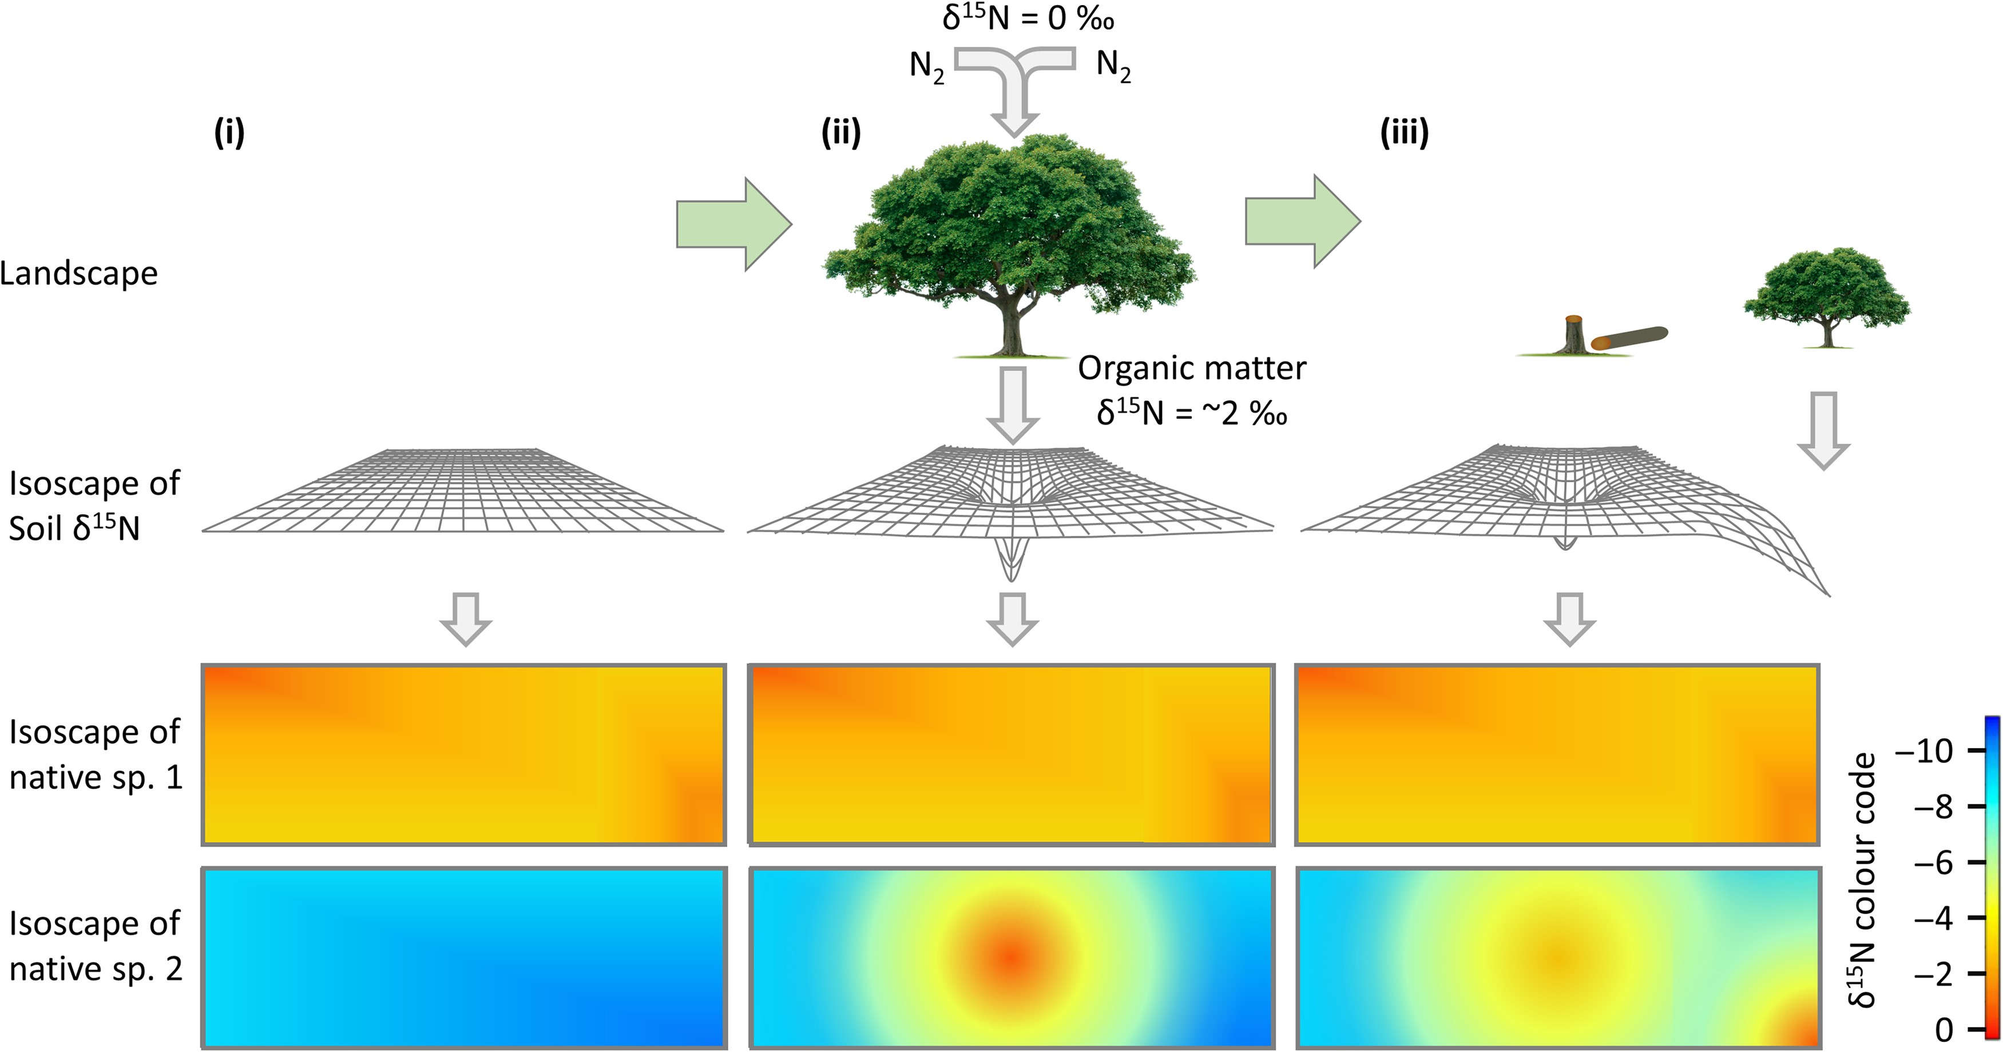
Figure 1. Temporal progression of how an N₂-fixing exotic species may impact soil nitrogen and ...
Notes:
Figure 1. Temporal progression of how an N2-fixing exotic species may impact soil nitrogen and species-specific isoscapes in the leaves of two native species homogeneously distributed across a landscape. Situation (i) represents natural variation across an uninvaded landscape, (ii) the same landscape impacted by a single N2-fixing tree and (iii) a complex landscape showing legacy effects after tree removal as well as the impact of further recruitment. The interpolated isoscape of native species 1 shows it to have a less negative δ15N value than species 2 at a given point in the landscape with no response to the exotic tree invasion. Species 2 in contrast shows a substantial change in its isoscape in response to a nitrogen cycle perturbed by the invasive tree. Studying the spatial and temporal dynamics of changing isoscapes can provide insight into the interactions between native and exotic species.
Unless provided in the caption above, the following copyright applies to the content of this slide: © The Author 2016. Published by Oxford University Press. All rights reserved. For permissions, please e-mail: journals.permissions@oup.com

