Slide 1
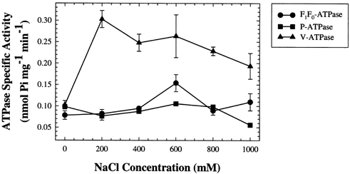
1 The effect of NaCl on cellular ATPase activities (F₁F₀-ATPase, P-ATPase, V-ATPase) in ...
Notes:
1 The effect of NaCl on cellular ATPase activities (F1F0-ATPase, P-ATPase, V-ATPase) in wild-type yeast. Cultures were grown 16–24 h in the presence of 0–1000 mM NaCl in SC medium. Values shown are means±S.E.M. (n=3). Results shown are representative of three independent trials.
Unless provided in the caption above, the following copyright applies to the content of this slide: © 2002 Federation of European Microbiological Societies

Slide 2
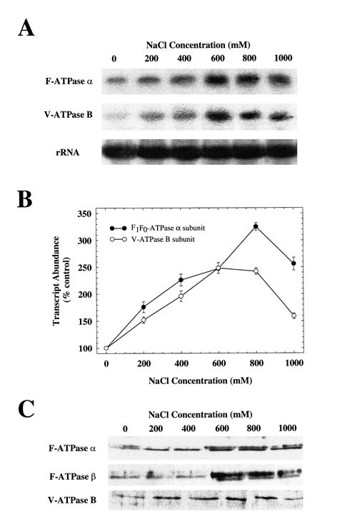
2 The effect of NaCl on expression of F₁F₀-ATPase and V-ATPase. A: Levels of the ...
Notes:
2 The effect of NaCl on expression of F1F0-ATPase and V-ATPase. A: Levels of the transcripts encoding the F1F0-ATPase α subunit and V-ATPase B subunit were measured by Northern analysis. B: Relative abundance of transcripts as measured by densitometry. The ratio of mRNA/rRNA measured at each concentration of NaCl was compared to the control value for each transcript. Values shown are means±S.E.M. (n=3). C: Determination of protein levels of V-ATPase (B subunit) and F1F0-ATPase (α and β subunits) by Western analysis. Cross-reacting bands were visualized using a chemiluminescent detection system. Samples shown are representative lanes selected from triplicates and compiled using Adobe Photoshop? version 5.5. For all panels, data shown are representative of two independent trials.
Unless provided in the caption above, the following copyright applies to the content of this slide: © 2002 Federation of European Microbiological Societies

Slide 3
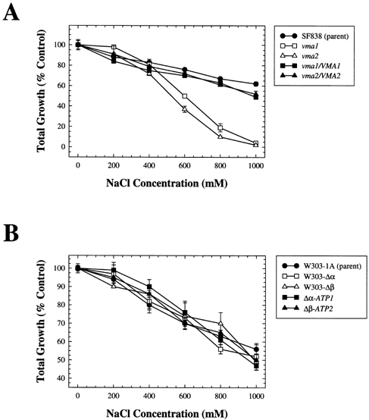
3 The effect of ATPase mutations on NaCl tolerance in yeast. A: Yeast strains carrying LEU2 insertion mutations ...
Notes:
3 The effect of ATPase mutations on NaCl tolerance in yeast. A: Yeast strains carrying LEU2 insertion mutations in the VMA1 and VMA2 genes (vma1, vma2), their isogenic parent strain (SF838), and strains carrying wild-type copies of the VMA1 and VMA2 genes on low-copy plasmids (vma1/VMA1, vma2/VMA2) were grown for 16–24 h in SC minimal medium (pH 4.5) containing 0–1000 mM NaCl. B: Yeast strains with null deletion mutations in the atp1 and atp2 genes (W303-Δα, W303-Δβ), their isogenic wild-type parent strain (W303-1A) and strains carrying wild-type copies of the atp1 and atp2 genes on low-copy plasmids (Δα-ATP1, Δβ-ATP2) were grown for 16–24 h in SC minimal medium (pH 4.5) containing 0–1000 mM NaCl. Total growth (OD600) of each culture was measured and compared to the control (0 NaCl) values for each strain. Values shown are means±S.E.M. (n=3). Results shown are representative of three independent trials.
Unless provided in the caption above, the following copyright applies to the content of this slide: © 2002 Federation of European Microbiological Societies

Slide 4
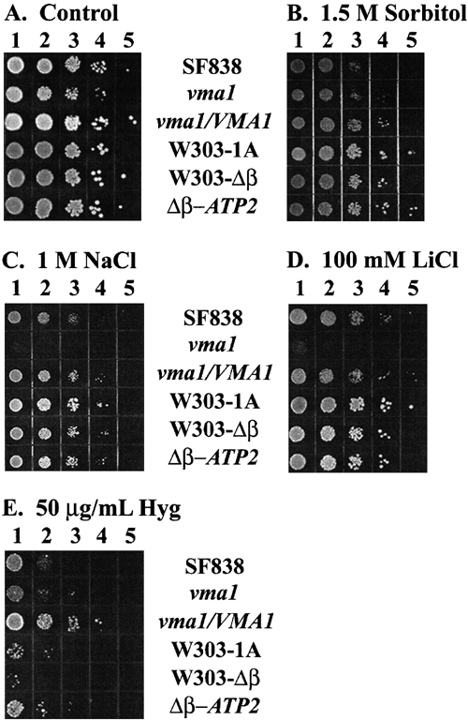
4 Halotolerance of V-ATPase and F₁F₀-ATPase mutant strains. Saturated cultures of ...
Notes:
4 Halotolerance of V-ATPase and F1F0-ATPase mutant strains. Saturated cultures of wild-type parent (SF838, W303-1A), mutant (vma1, W303-Δβ) and complemented (vma1/VMA1, Δβ-ATP2) strains were serially diluted and 5-μl aliquots spotted onto YPD plates containing (A) no added compounds, (B) 1.5 M sorbitol, (C) 1 M NaCl, (D) 100 mM LiCl or (E) 50 μg ml−1 hygromycin B. Results shown are representative of two independent trials.
Unless provided in the caption above, the following copyright applies to the content of this slide: © 2002 Federation of European Microbiological Societies

