Slide 1
Fig. 1. An example multiple alignment of six reads with quality scores and three sequencing errors shown in boxes. ...
Notes:
Fig. 1. An example multiple alignment of six reads with quality scores and three sequencing errors shown in boxes. The quality of the multiple alignment is 0.968. (i) In column 8, there is an insertion in read 2. The quality scores of reads 1 and 3 shown in bold face are computed as averages of the quality scores of the bases flanking the gap. The support of the consensus at that column is 0.67 and the weighted support is 0.70. (ii) In column 24, there is a mismatch in read 6. Here the support of the consensus is 0.83 and the weighted support is 0.86. If the support and the weighted support meet the corresponding thresholds, the quality score of the substituted base will be 38. (iii) In column 27, there is a deletion in read 4. The quality score of read 4 shown in bold face is calculated as an average of the bases flanking the gap. The support of the consensus is 0.83 and the weighted support is 0.87. If the support and the weighted support meet the corresponding thresholds, the quality score of the inserted base will be 40.
Unless provided in the caption above, the following copyright applies to the content of this slide: © The Author 2011. Published by Oxford University Press. All rights reserved. For Permissions, please email: journals.permissions@oup.com

Slide 2
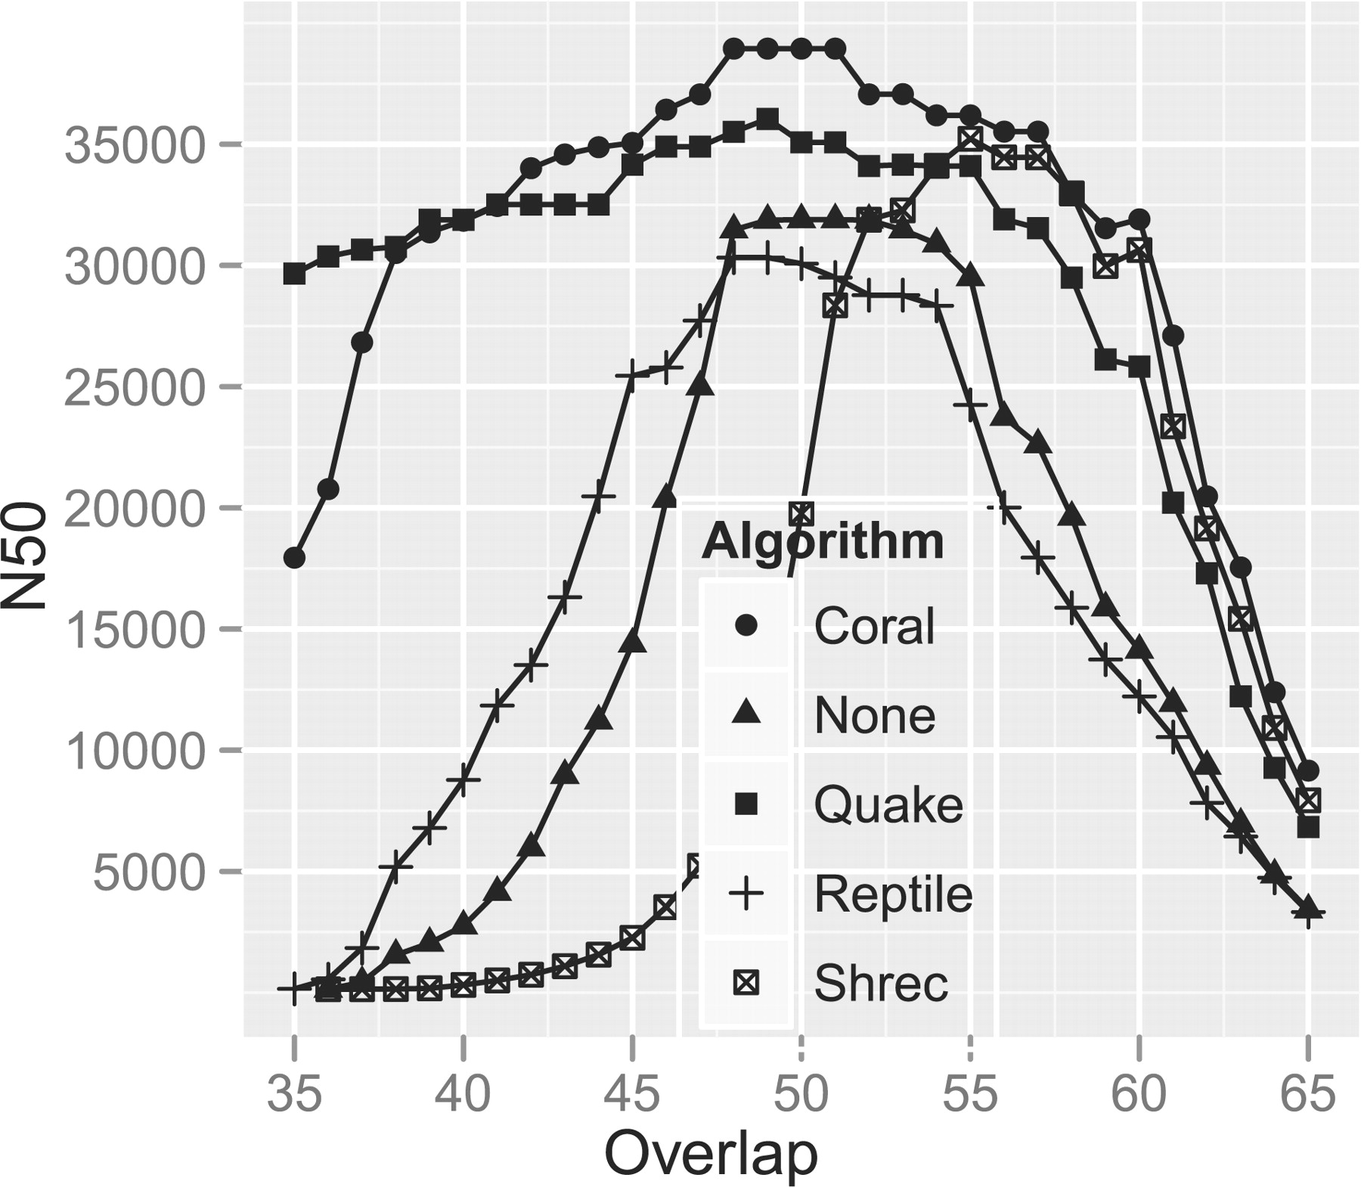
Fig. 2. Assembly performance of the Edena assembler on dataset D4 and error corrected versions of it.
Notes:
Fig. 2. Assembly performance of the Edena assembler on dataset D4 and error corrected versions of it.
Unless provided in the caption above, the following copyright applies to the content of this slide: © The Author 2011. Published by Oxford University Press. All rights reserved. For Permissions, please email: journals.permissions@oup.com

