Slide 1
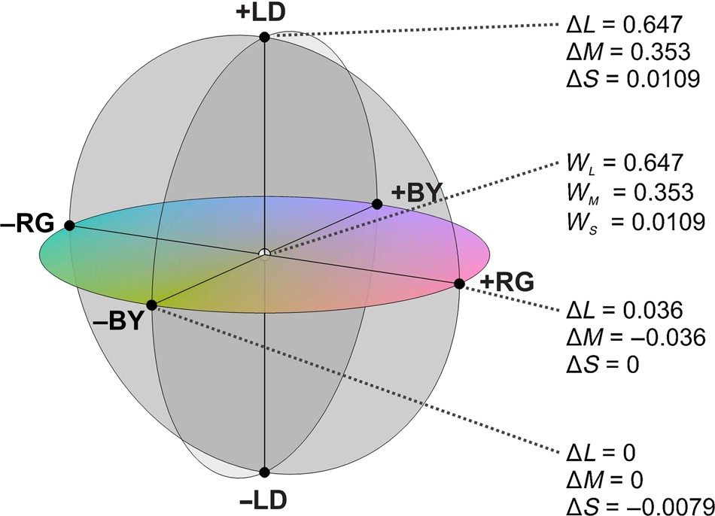
Figure 1. Color space. The equiluminant chromatic plane is defined by the red/green (RG) and blue/yellow (BY) axes ...
Notes:
Figure 1. Color space. The equiluminant chromatic plane is defined by the red/green (RG) and blue/yellow (BY) axes while the light/dark (LD) axis is orthogonal to this plane. The red/green axis is calculated as Δ(L − M), the blue/yellow axis as Δ(S − (L + M)) and the light/dark axis as Δ(L + M + S), where L, M, and S are the excitations for the 3 different types of cones. WL, WM, and WS are the excitations at the white point for the L, M, and S cones, respectively. Changes in cone excitations for each of the axes are shown.
Unless provided in the caption above, the following copyright applies to the content of this slide: © The Author 2014. Published by Oxford University PressThis is an Open Access article distributed under the terms of the Creative Commons Attribution Non-Commercial License (http://creativecommons.org/licenses/by-nc/4.0/), which permits non-commercial re-use, distribution, and reproduction in any medium, provided the original work is properly cited. For commercial re-use, please contact journals.permissions@oup.com

Slide 2
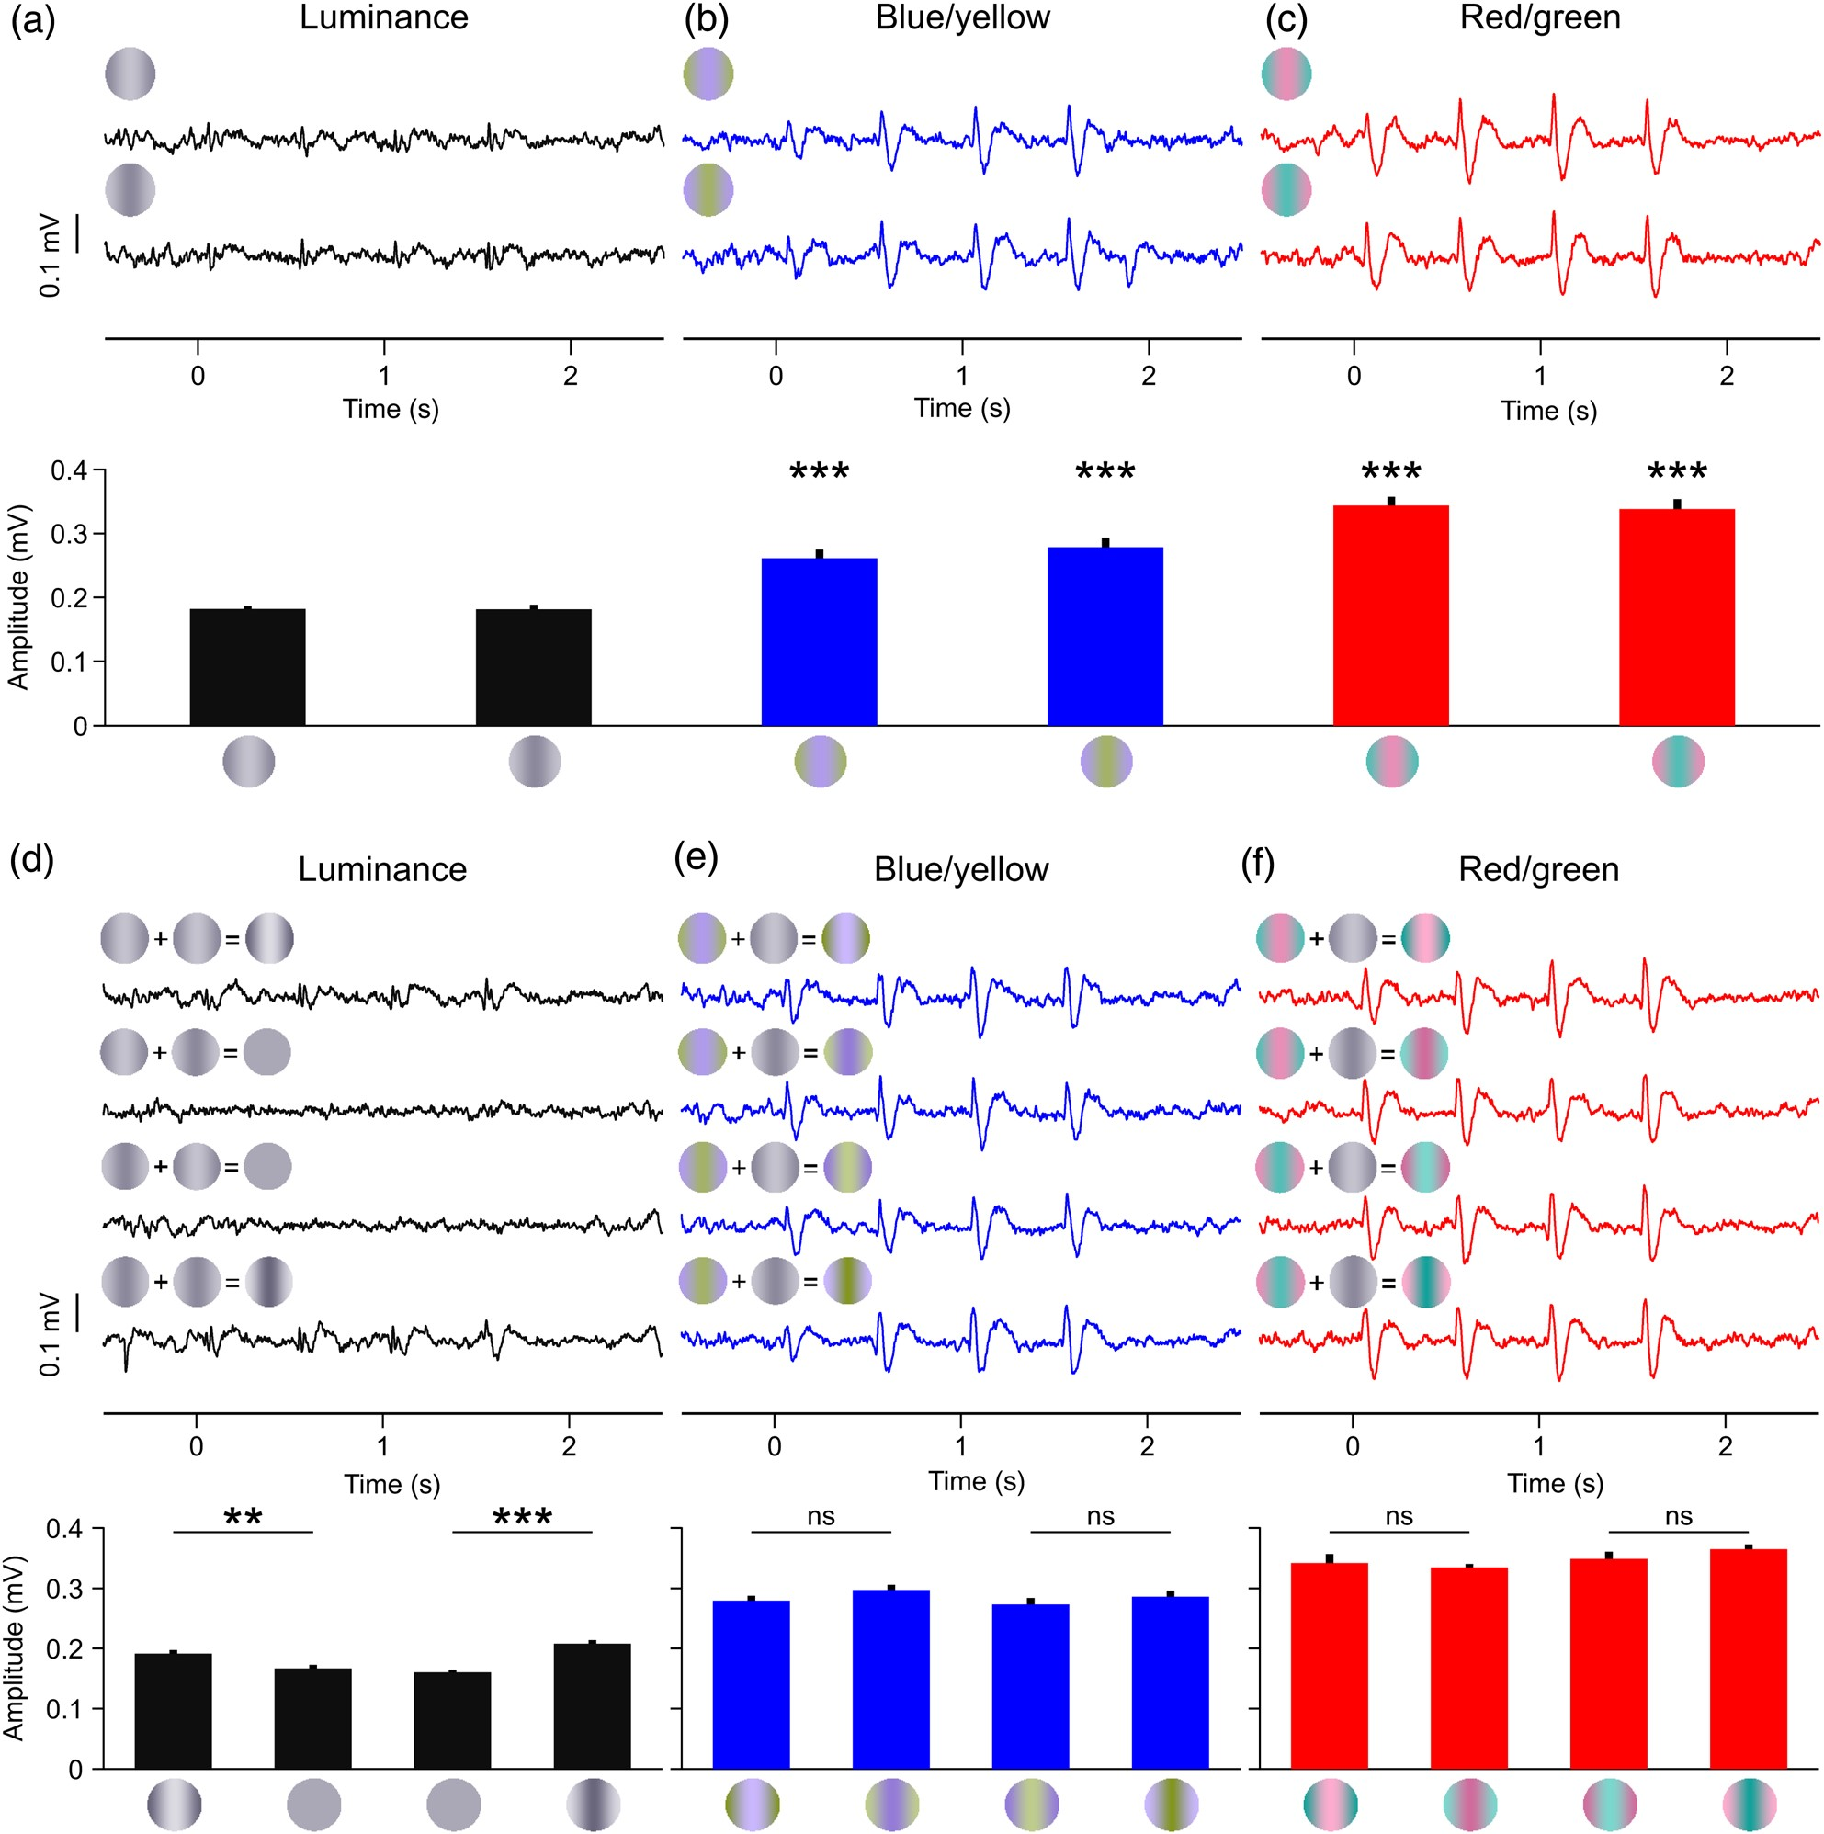
Figure 2. LFP chromatic responses for the contrast test (a–c) and the phase test (d–f). LFP traces (top) and mean LFP ...
Notes:
Figure 2. LFP chromatic responses for the contrast test (a–c) and the phase test (d–f). LFP traces (top) and mean LFP amplitude (bottom) for the 3 cardinal axis: luminance (a,d), blue/yellow (b,e), and red/green (c,f). The gratings at the top left corner of the LFP trace illustrate the stimulus phase (a–c) or the phase combination used to construct the stimulus (d–f). See Materials and Methods for details. t-Test: ***P < 0.001, **P < 0.01, *P < 0.05, ns = not significant, n = 8 trials.
Unless provided in the caption above, the following copyright applies to the content of this slide: © The Author 2014. Published by Oxford University PressThis is an Open Access article distributed under the terms of the Creative Commons Attribution Non-Commercial License (http://creativecommons.org/licenses/by-nc/4.0/), which permits non-commercial re-use, distribution, and reproduction in any medium, provided the original work is properly cited. For commercial re-use, please contact journals.permissions@oup.com

Slide 3
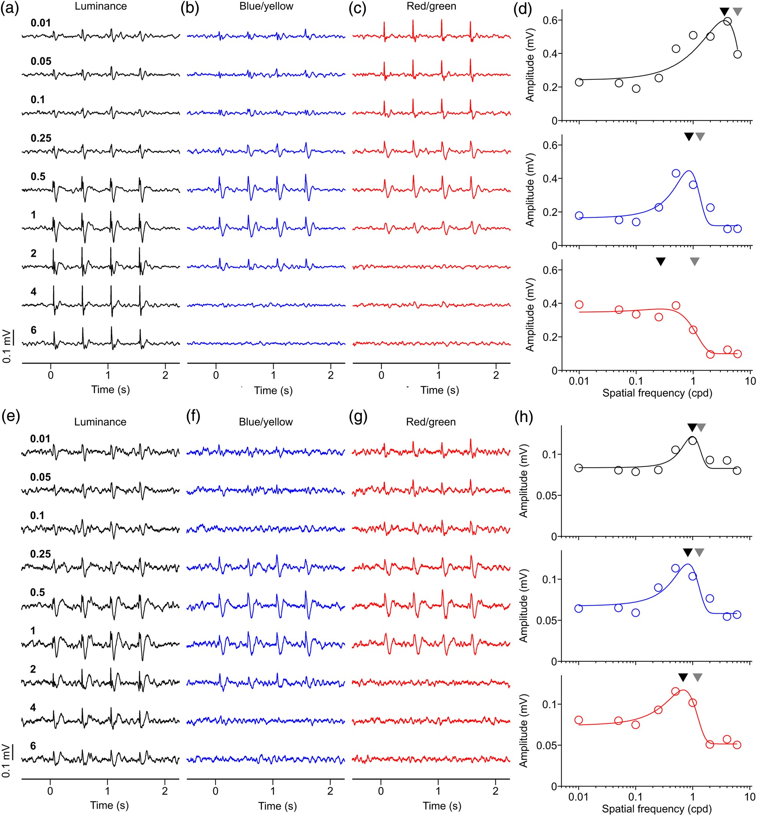
Figure 3. Two examples of LFP spatial frequency tuning. (a–d) LFP recordings with low-pass spatial frequency tuning for ...
Notes:
Figure 3. Two examples of LFP spatial frequency tuning. (a–d) LFP recordings with low-pass spatial frequency tuning for red/green and band-pass tuning for luminance and blue/yellow gratings. (e–h) LFP recording with band-pass spatial frequency tuning for the 3 cardinal axes of color space. Numbers on left side are spatial frequency in cycles per degree (cpd). (d) LFP spatial frequency tunings for first example. Black triangles: spatial frequency peaks. Gray triangles: spatial frequency cutoffs. Visual eccentricity: 10.43° (azimuth: 9.71°, elevation: 3.82°). (h) LFP spatial frequency tunings for second example. Visual eccentricity at 11.20° (azimuth: 10.29°, elevation: 4.41°). For both examples, LFP responses to both blue/yellow and red/green gratings were confirmed as chromatic with both contrast and phase tests. For both examples, maximum axis contrast was 94% for luminance, for blue/yellow and red/green.
Unless provided in the caption above, the following copyright applies to the content of this slide: © The Author 2014. Published by Oxford University PressThis is an Open Access article distributed under the terms of the Creative Commons Attribution Non-Commercial License (http://creativecommons.org/licenses/by-nc/4.0/), which permits non-commercial re-use, distribution, and reproduction in any medium, provided the original work is properly cited. For commercial re-use, please contact journals.permissions@oup.com

Slide 4
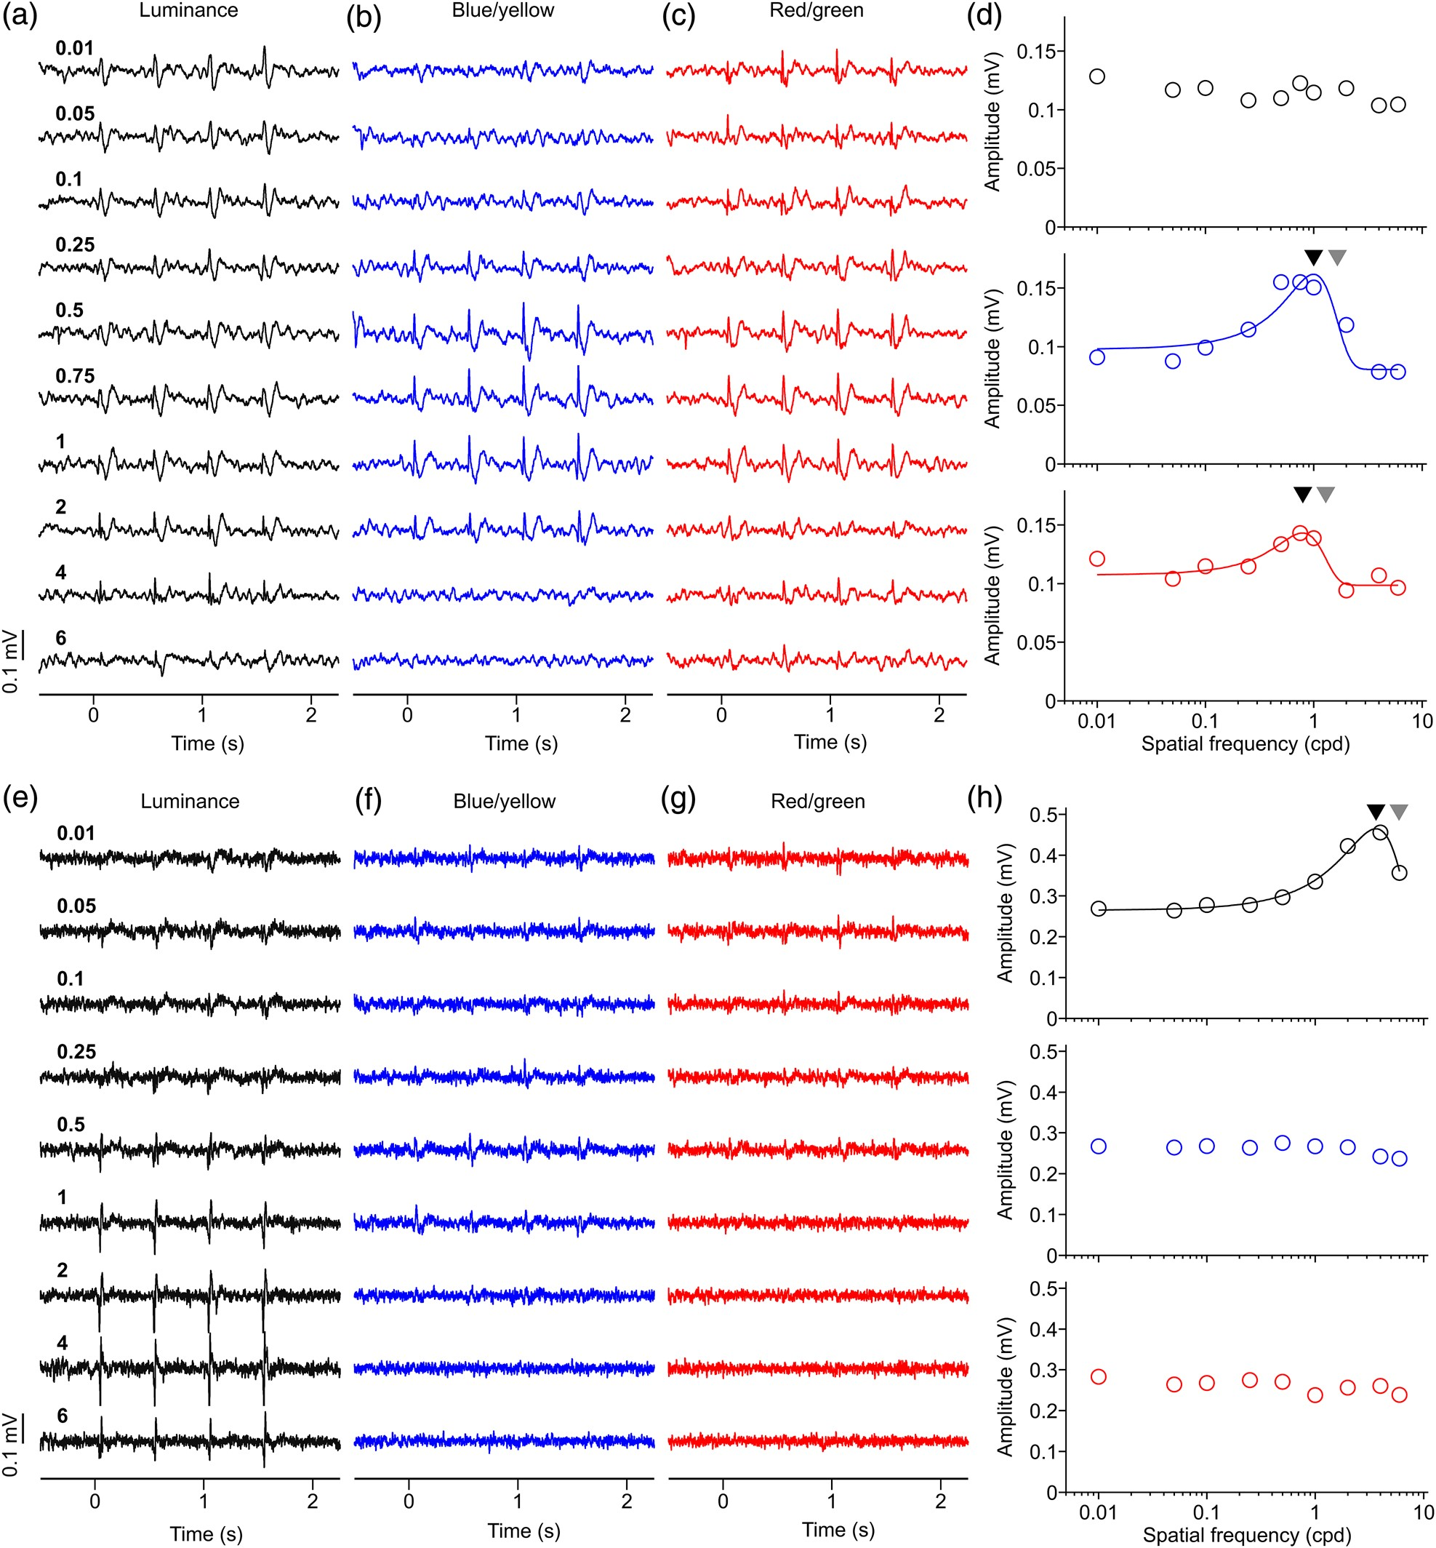
Figure 4. Two more examples of LFP spatial frequency tuning. (a–d) LFP recording with band-pass spatial frequency ...
Notes:
Figure 4. Two more examples of LFP spatial frequency tuning. (a–d) LFP recording with band-pass spatial frequency tuning for red/green and blue/yellow gratings. The tuning for luminance grating could not be fitted because we did not use gratings with spatial frequency high enough to reach the cutoff value. LFP chromatic response could be confirmed with the phase test for red/green gratings but not blue/yellow gratings. Maximum axis contrast was 30% for luminance and 94% for blue/yellow and red/green. Black triangles: spatial frequency peaks. Gray triangles: spatial frequency cutoffs. Visual eccentricity 8.73° (azimuth: 7.76°, elevation: 4°). (e–h) LFP recordings with band-pass spatial frequency tuning for the luminance axis, and no spatial frequency tuning for the chromatic axes. LFP responses to blue/yellow and red/green could not be confirmed as chromatic with either contrast or phase tests. Maximum axis contrast was 94% for luminance, for blue/yellow and red/green. Visual eccentricity 15.31° eccentricity (azimuth: 15.29°, elevation: 0.71°).
Unless provided in the caption above, the following copyright applies to the content of this slide: © The Author 2014. Published by Oxford University PressThis is an Open Access article distributed under the terms of the Creative Commons Attribution Non-Commercial License (http://creativecommons.org/licenses/by-nc/4.0/), which permits non-commercial re-use, distribution, and reproduction in any medium, provided the original work is properly cited. For commercial re-use, please contact journals.permissions@oup.com

Slide 5
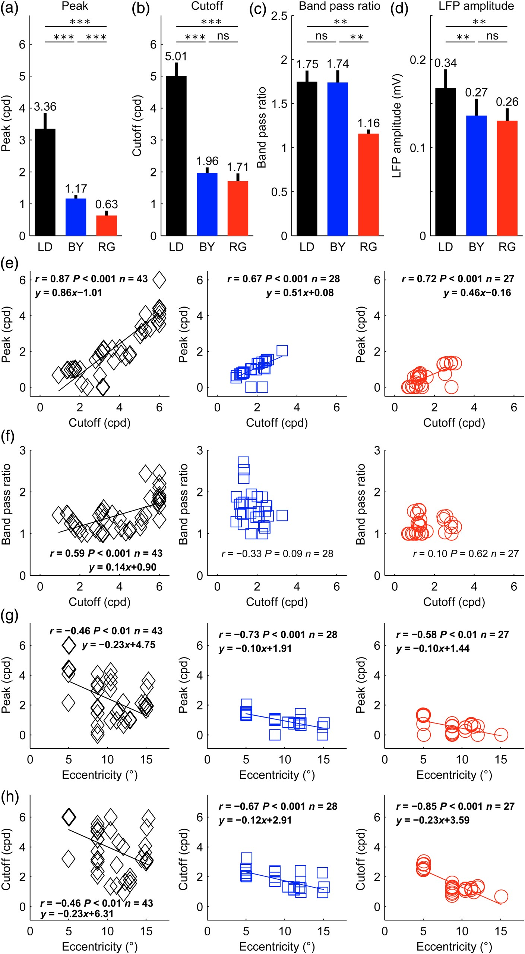
Figure 5. Spatial frequency averages and correlations for each cardinal axis. (a–d) Average differences in spatial ...
Notes:
Figure 5. Spatial frequency averages and correlations for each cardinal axis. (a–d) Average differences in spatial frequency tuning for luminance (LD), blue/yellow (BY), and red/green (RG) gratings for spatial frequency peak (a), cutoff (b), band-pass ratio (c), and LFP amplitude (d). Paired t-test (***P < 0.001, **P < 0.01, ns = not significant). For this analysis, we used only LFP recordings (n = 13) with chromatic responses confirmed for both red/green and blue/yellow axes and significant spatial frequency tuning for all 3 axes (SNR ≥2, r2 ≥ 0.6). Error bars are standard errors. (e) LFP spatial frequency cutoff is correlated with spatial frequency peak for luminance (black diamonds), blue/yellow (blue squares), and red/green gratings (red circles). (f) The LFP spatial frequency cutoff was also correlated with the band-pass ratio for luminance gratings. (g,h) Visual eccentricity is correlated with spatial frequency peak (g) and cutoff (h).
Unless provided in the caption above, the following copyright applies to the content of this slide: © The Author 2014. Published by Oxford University PressThis is an Open Access article distributed under the terms of the Creative Commons Attribution Non-Commercial License (http://creativecommons.org/licenses/by-nc/4.0/), which permits non-commercial re-use, distribution, and reproduction in any medium, provided the original work is properly cited. For commercial re-use, please contact journals.permissions@oup.com

Slide 6
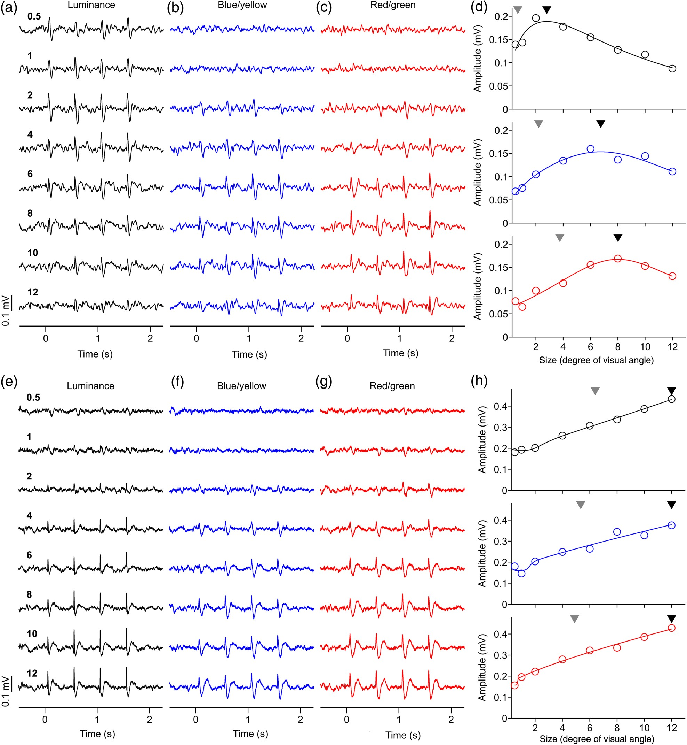
Figure 6. Examples of LFP size tuning. (a–c) LFP recordings showing pronounced response suppression to large stimuli. ...
Notes:
Figure 6. Examples of LFP size tuning. (a–c) LFP recordings showing pronounced response suppression to large stimuli. LFP responses to red/green gratings were confirmed as chromatic with both the contrast and phase tests. LFP responses to blue/yellow were confirmed as chromatic with the contrast test. Numbers on left side are size in degrees of visual angle. (d) LFP size tuning showing strong suppression for large sizes. Black triangle: preferred size. Gray triangle: size that generated half-maximum response. Visual eccentricity: 11.20° (azimuth: 10.29°, elevation: 4.41°). (e–g) LFP recordings showing no response suppression to large stimuli. LFP responses to red/green gratings were confirmed as chromatic with both the contrast and phase tests. LFP responses to blue/yellow were confirmed as chromatic with both the contrast and phase tests. (h) LFP size tuning showing no size suppression. Visual eccentricity: 5.09° (azimuth: 5.06°, elevation: 0.59°). For both examples, maximum axis contrast was 94% for luminance, for blue/yellow and red/green.
Unless provided in the caption above, the following copyright applies to the content of this slide: © The Author 2014. Published by Oxford University PressThis is an Open Access article distributed under the terms of the Creative Commons Attribution Non-Commercial License (http://creativecommons.org/licenses/by-nc/4.0/), which permits non-commercial re-use, distribution, and reproduction in any medium, provided the original work is properly cited. For commercial re-use, please contact journals.permissions@oup.com

Slide 7
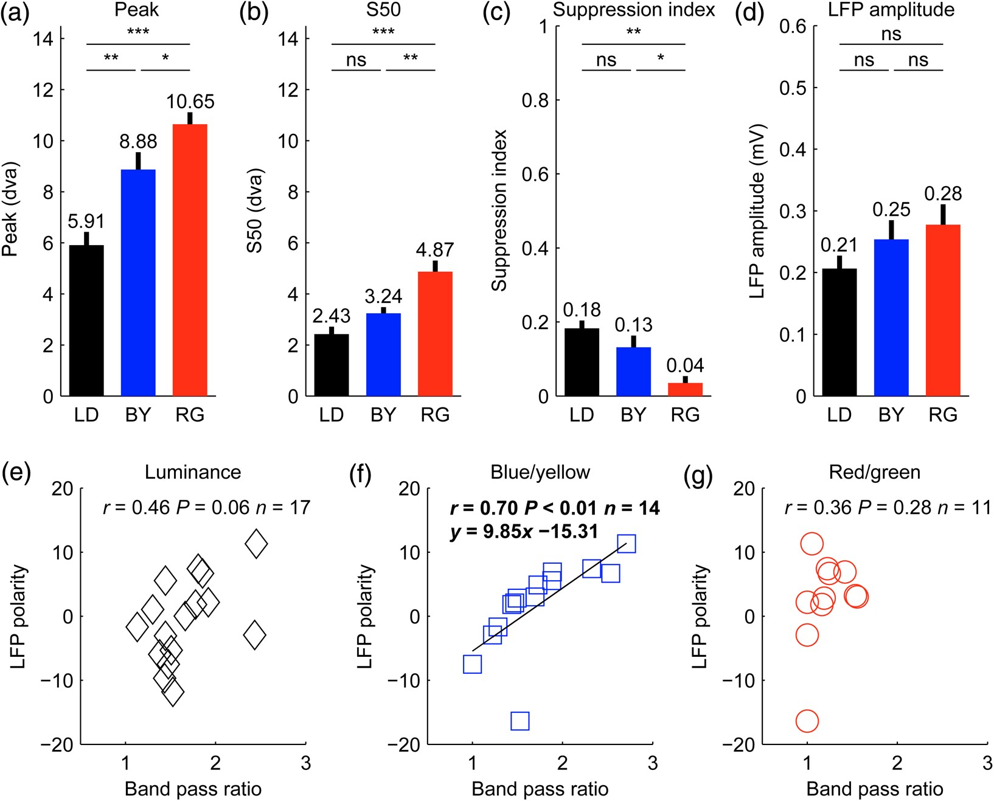
Figure 7. Size tuning and correlations for each cardinal axis (a–d). (a–d) Average differences in size tuning for ...
Notes:
Figure 7. Size tuning and correlations for each cardinal axis (a–d). (a–d) Average differences in size tuning for luminance (LD), blue/yellow (BY), and red/green (RG) gratings for size peak (a), half-maximum response (S50, b), suppression index (c), and LFP amplitude (d). t-Test (***P < 0.001, **P < 0.01, *P < 0.05, ns = not significant). For this analysis, we selected LFP recordings that passed the color test (contrast and/or phase) for blue/yellow and/or red/green. The selected LFP recordings also had SNR ≥2 and r2 ≥ 0.6 goodness of fit for the size tuning. The sample includes 50 LFPs measured with luminance (LD) gratings, 14 LFPs measured with blue/yellow (BY) gratings and 12 measured with red/green (RG) gratings. Error bars are standard errors. (e–g) LFP polarity was correlated with the band-pass spatial frequency ratio of blue/yellow gratings (blue squares, f) but not luminance gratings (black diamonds, e), or red/green gratings (red circles, g). However, this correlation should be interpreted with caution because we tested 8 × 3 correlations with LFP polarity and, therefore, there is more than 5% probability that this correlation reached significance by chance. The grating size used to measure LFP polarity was 1°. LFPs included in this analysis had to pass our criterion for signal-to-noise ratio in the responses to 1° gratings (SNR ≥2). In addition, they had to pass our goodness-of-fit criterion for the spatial frequency tuning (r2 ≥ 0.6), which was needed to measure the spatial frequency band-pass ratio.dva: degrees of visual angle.
Unless provided in the caption above, the following copyright applies to the content of this slide: © The Author 2014. Published by Oxford University PressThis is an Open Access article distributed under the terms of the Creative Commons Attribution Non-Commercial License (http://creativecommons.org/licenses/by-nc/4.0/), which permits non-commercial re-use, distribution, and reproduction in any medium, provided the original work is properly cited. For commercial re-use, please contact journals.permissions@oup.com

Slide 8
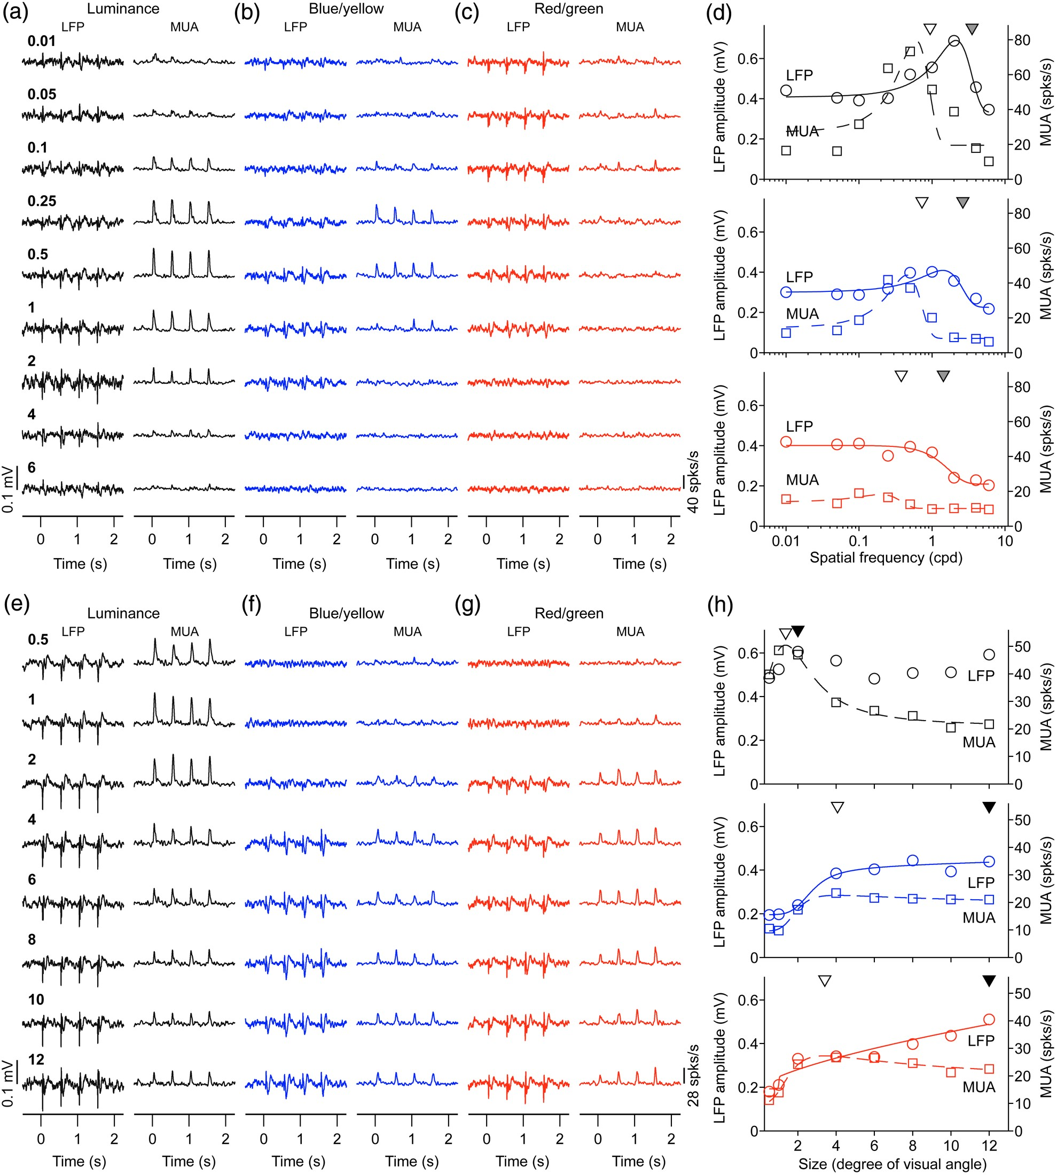
Figure 8. LFP has higher spatial resolution and is less suppressed by low spatial frequencies than MUA. (a–c) LFP and ...
Notes:
Figure 8. LFP has higher spatial resolution and is less suppressed by low spatial frequencies than MUA. (a–c) LFP and MUA responses to different spatial frequencies. (d) Spatial frequency tuning for LFP (continuous lines) and MUA (discontinuous lines). The spatial frequency peak is higher for LFP (gray triangle) than MUA (open triangle). (e–g) LFP and MUA responses to gratings of different sizes. (h) Size tuning for LFP (circles and solid lines) and MUA (squares and dashed lines). Scale is shown on the left for LFP amplitude and on the right for MUA.
Unless provided in the caption above, the following copyright applies to the content of this slide: © The Author 2014. Published by Oxford University PressThis is an Open Access article distributed under the terms of the Creative Commons Attribution Non-Commercial License (http://creativecommons.org/licenses/by-nc/4.0/), which permits non-commercial re-use, distribution, and reproduction in any medium, provided the original work is properly cited. For commercial re-use, please contact journals.permissions@oup.com

Slide 9
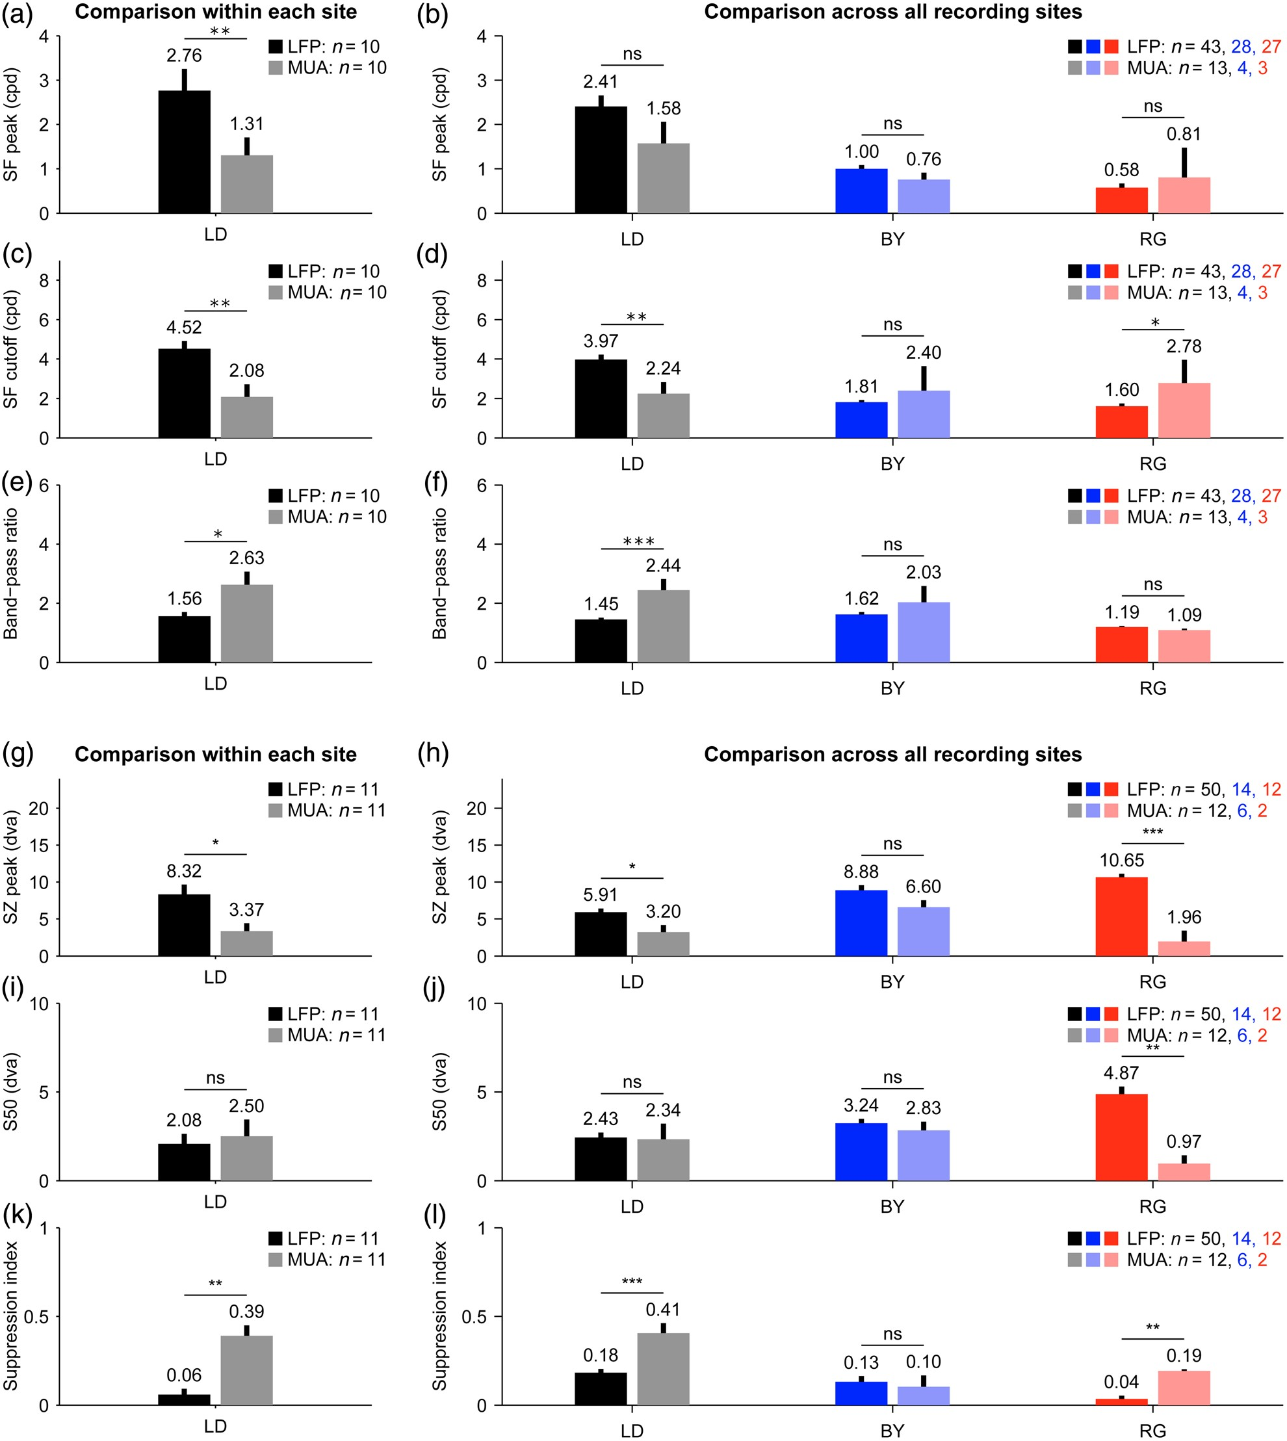
Figure 9. LFP is less suppressed by large stimuli than MUA. (a–l) Average values of LFP (dark colors) and MUA (light ...
Notes:
Figure 9. LFP is less suppressed by large stimuli than MUA. (a–l) Average values of LFP (dark colors) and MUA (light colors) of spatial frequency peak (a,b), cutoff (c,d), band-pass ratio (e,f), size peak (g,h), S50 (i,j), and suppression index (k,l). Left panels (a,c,e,g,i,k) show LFP/MUA recordings from the same electrode tip. Right panels (b,d,f,h,j,l) show LFP/MUA recordings from the same or different electrode tips. The number of recording sites is shown at the upper right corner of each plot. t-Test (***P < 0.001, **P < 0.01, *P < 0.05, ns = not significant). dva: degrees of visual angle.
Unless provided in the caption above, the following copyright applies to the content of this slide: © The Author 2014. Published by Oxford University PressThis is an Open Access article distributed under the terms of the Creative Commons Attribution Non-Commercial License (http://creativecommons.org/licenses/by-nc/4.0/), which permits non-commercial re-use, distribution, and reproduction in any medium, provided the original work is properly cited. For commercial re-use, please contact journals.permissions@oup.com

Slide 10
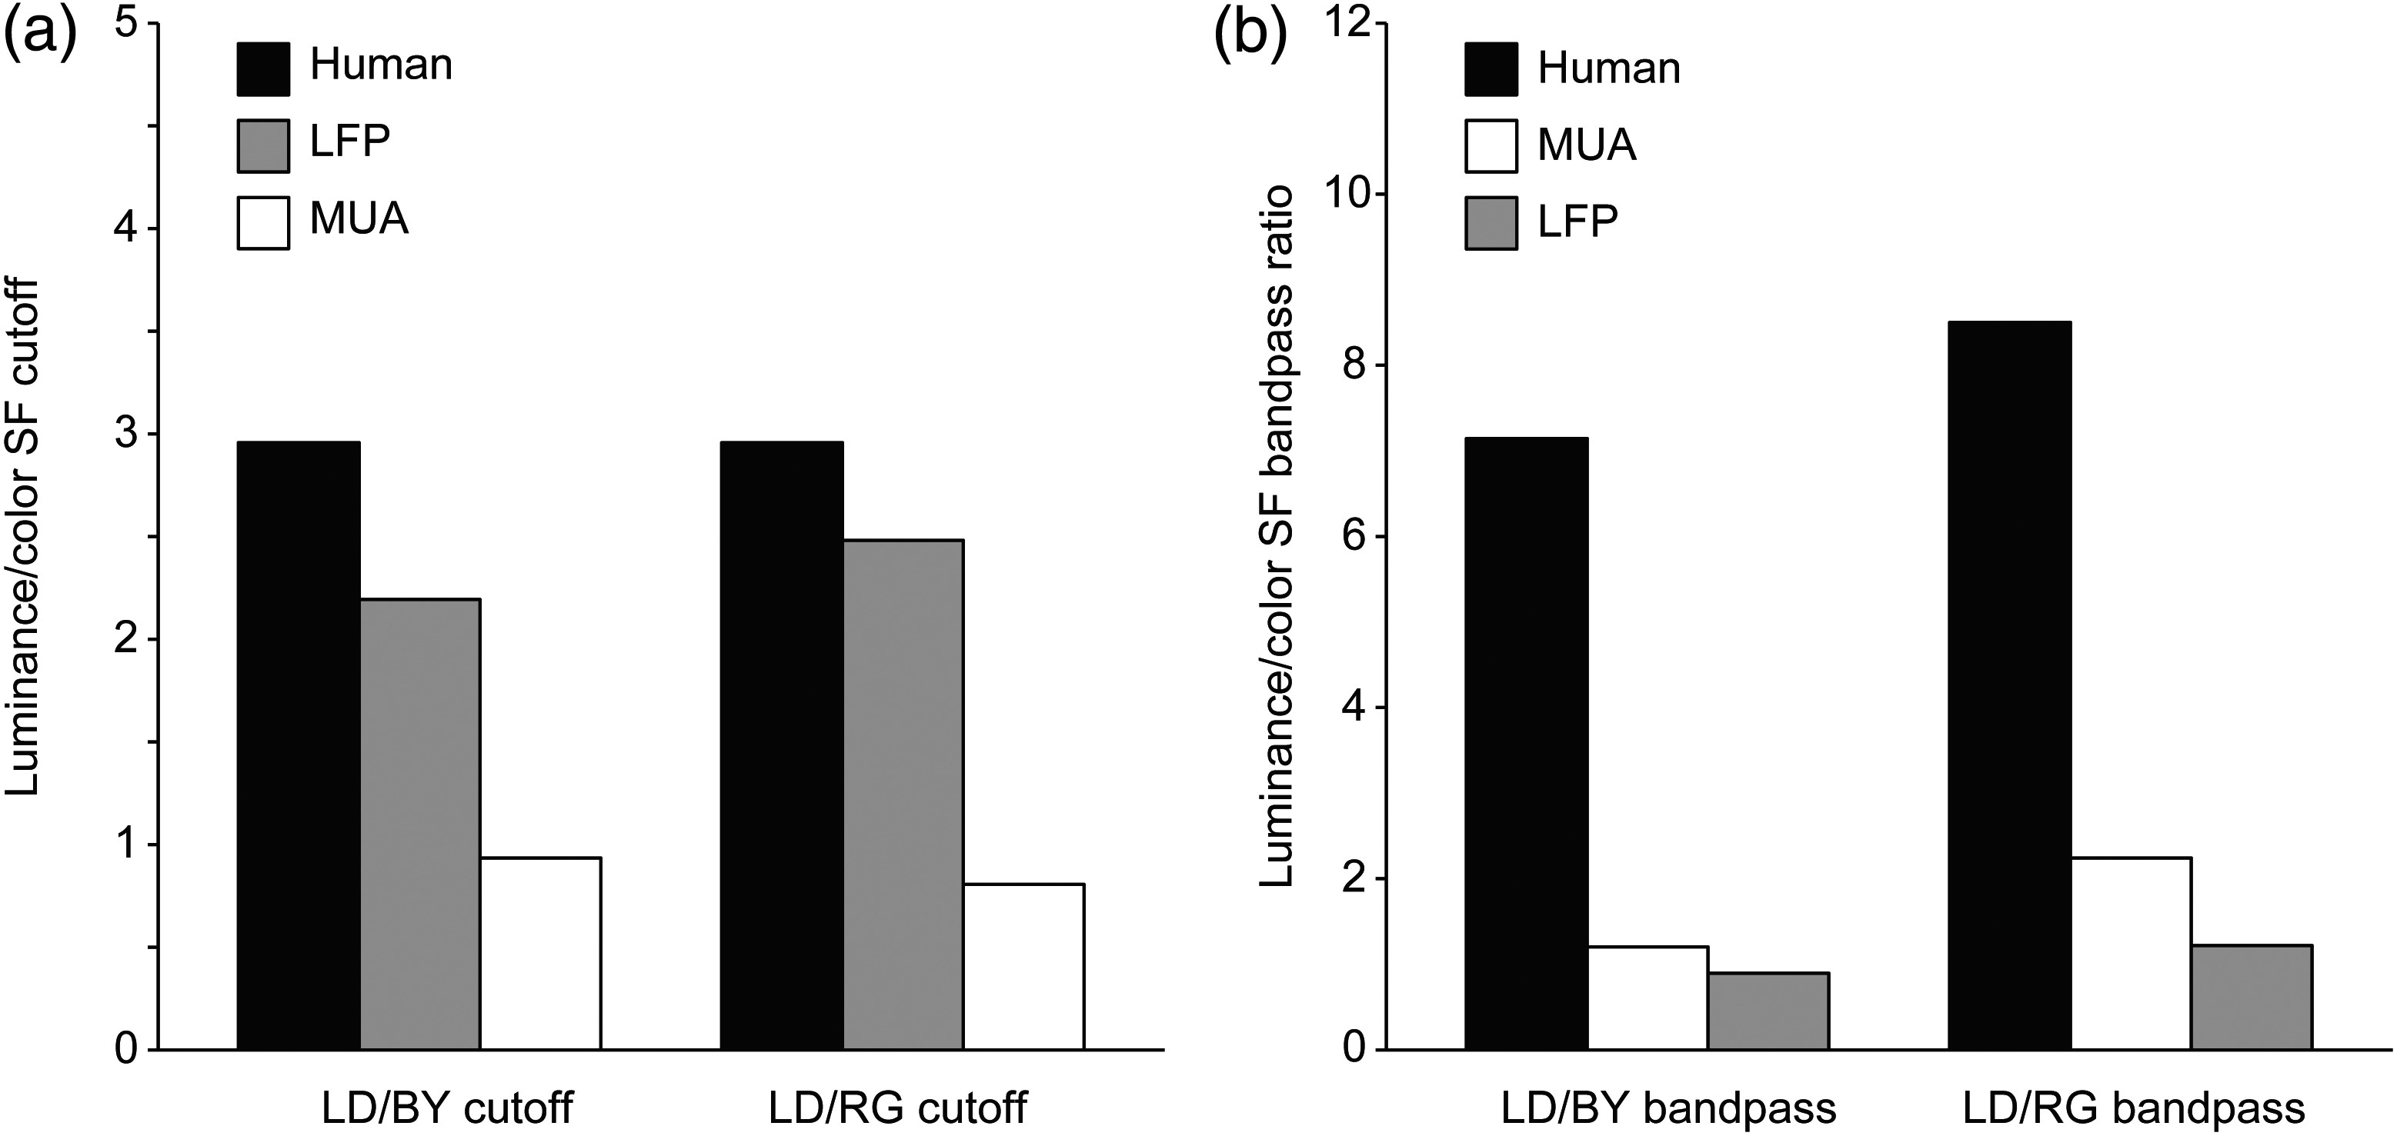
Figure 10. Comparison of achromatic/chromatic spatial resolution and band-pass ratio among LFP, MUA, and human ...
Notes:
Figure 10. Comparison of achromatic/chromatic spatial resolution and band-pass ratio among LFP, MUA, and human psychophysics. (a) The ratio of luminance/color spatial frequency cutoff measured with human psychophysics was closer to the ratio measured with LFP than MUA in macaques, both for blue/yellow (BY) and red/green (RG) gratings. (b) The ratio of luminance/color bandpass measured with human psychophysics was much higher than that measured with LFP and MUA in macaques. Values for human psychophysics were obtained from Mullen (1985). LD, light/dark gratings.
Unless provided in the caption above, the following copyright applies to the content of this slide: © The Author 2014. Published by Oxford University PressThis is an Open Access article distributed under the terms of the Creative Commons Attribution Non-Commercial License (http://creativecommons.org/licenses/by-nc/4.0/), which permits non-commercial re-use, distribution, and reproduction in any medium, provided the original work is properly cited. For commercial re-use, please contact journals.permissions@oup.com

