Slide 1
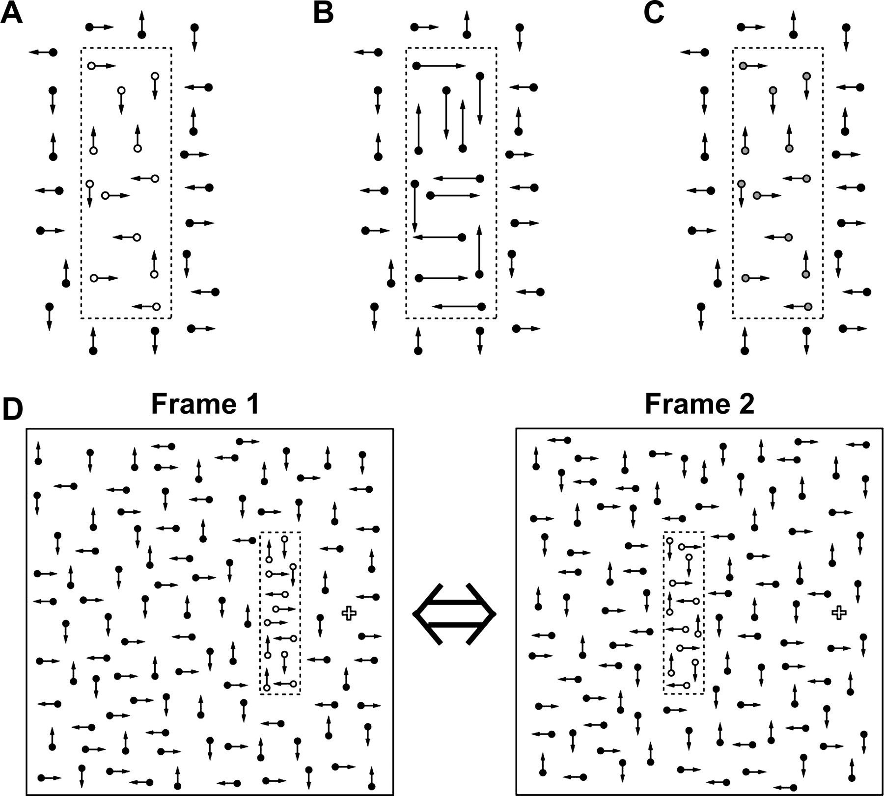
Figure 1. Schematic illustrations of the three apparent motion stimuli used in the present study. All apparent motions ...
Notes:
Figure 1. Schematic illustrations of the three apparent motion stimuli used in the present study. All apparent motions were presented in the left visual field and motion distance was 3°. (A) Object in first-order motion stimulus (1ST). The object (rectangle, shown as area enclosed by broken line, subtending 1.5° × 5.2°) in apparent motion was defined by brighter moving dots (open circles) than those in the background (filled circles). Rectangle contour depicted by the broken line is only for the purposes of illustration. (B) Object in second-order motion condition (2ND). Vector length represents motion speed of each dot. Dots within the rectangle move three times as fast as those in the background, although luminance of all dots is identical. (C) Object in the 1ST-low condition. As in the 1ST condition, dots within the rectangle are brighter than those in the background. However, difference in luminance between rectangle and background was reduced in this condition, to align motion visibility with that in 2ND. (D) Apparent motion presentation. Alternate presentation of these two frames with no inter-frame interval induces apparent motion perception of the rectangle (motion epoch). Although this figure shows only the frames in the 1ST conditions, there are three types of apparent motions according to the three moving objects in A–C.
Unless provided in the caption above, the following copyright applies to the content of this slide: © The Author 2005. Published by Oxford University Press. All rights reserved. For permissions, please e-mail: journals.permissions@oupjournals.org

Slide 2
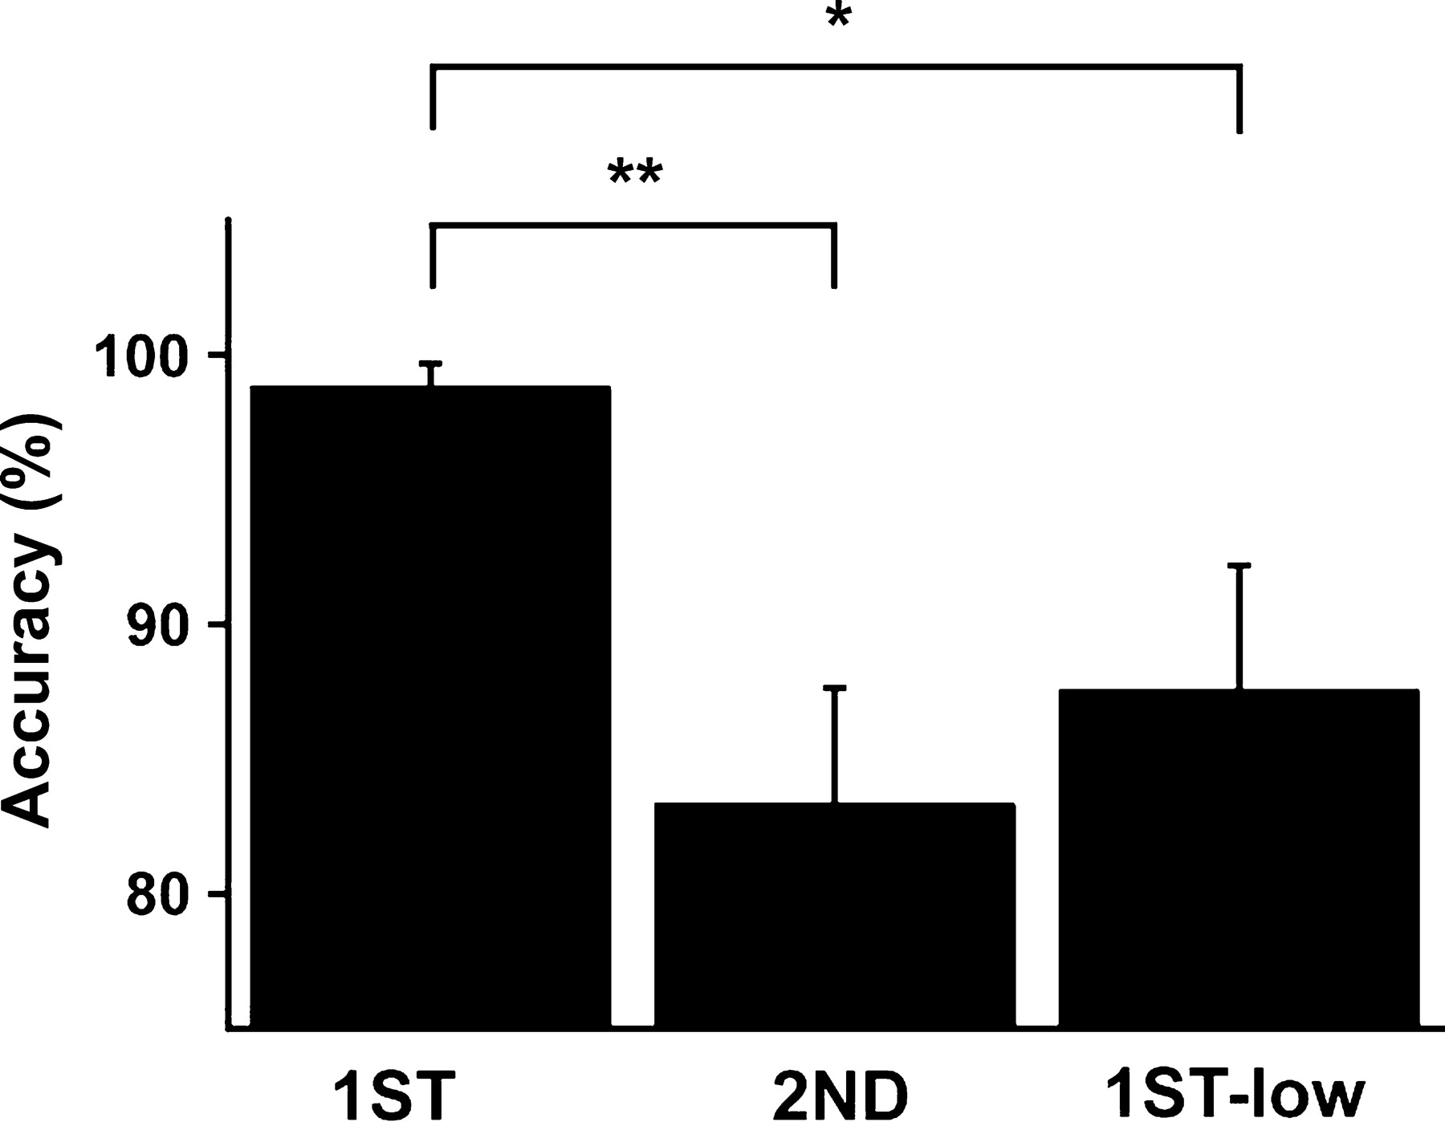
Figure 2. Behavioral accuracy of the direction discrimination task conducted on the 1ST, 2ND and 1ST-low apparent ...
Notes:
Figure 2. Behavioral accuracy of the direction discrimination task conducted on the 1ST, 2ND and 1ST-low apparent motions. As motion direction is either left or right, chance level of the task is 50%. Although significant differences in accuracy existed between 1ST and the other 2 conditions (1ST versus 2ND t = 3.74, P < 0.01; 1ST versus 1ST-low t = 2.49, P 0.05). *P < 0.05; **P < 0.01 (paired t-test).
Unless provided in the caption above, the following copyright applies to the content of this slide: © The Author 2005. Published by Oxford University Press. All rights reserved. For permissions, please e-mail: journals.permissions@oupjournals.org

Slide 3
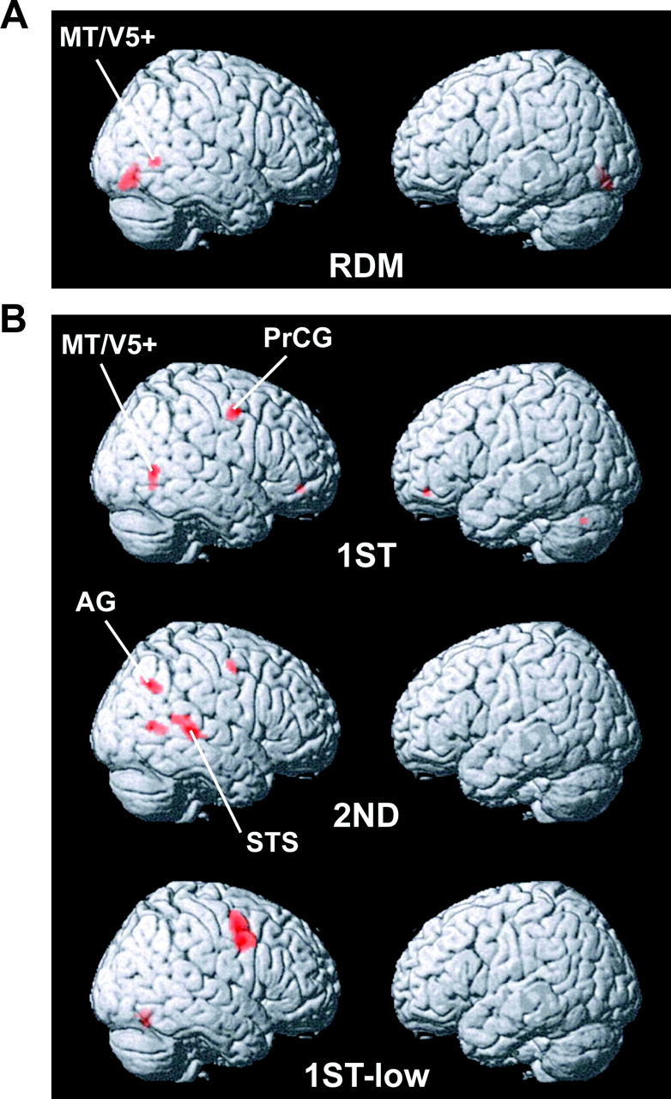
Figure 3. Brain responses in four conditions. (A) Results in RDM condition. Brain activation in response to dynamic ...
Notes:
Figure 3. Brain responses in four conditions. (A) Results in RDM condition. Brain activation in response to dynamic random dots presented in the left visual field was compared with response to static dots. Using SPM99 software, all activated regions were rendered on the surface of a standard brain. (B) Significantly activated brain regions in 1ST, 2ND and 1ST-low conditions. Brain responses in the motion epoch of each condition were compared with those in the control epochs. Other details are the same as (A). Note the 2ND-selective activation in the STS and AG areas.
Unless provided in the caption above, the following copyright applies to the content of this slide: © The Author 2005. Published by Oxford University Press. All rights reserved. For permissions, please e-mail: journals.permissions@oupjournals.org

Slide 4
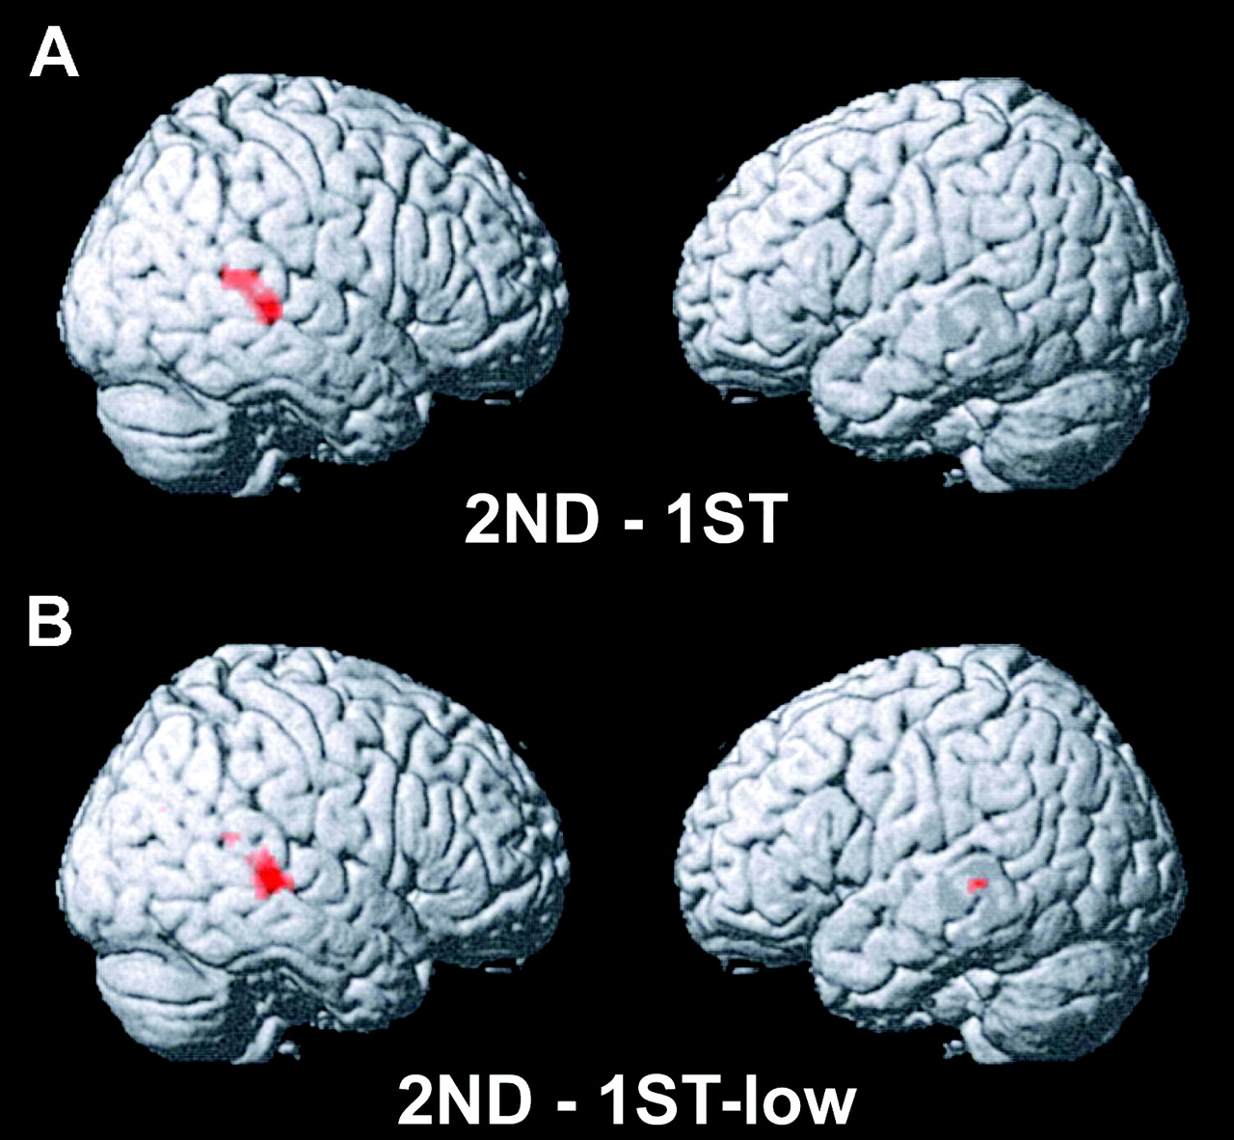
Figure 4. Direct comparison between motion conditions. (A) Comparison of 1ST and 2ND conditions with inclusive masking ...
Notes:
Figure 4. Direct comparison between motion conditions. (A) Comparison of 1ST and 2ND conditions with inclusive masking of 2ND activation (P < 0.001, uncorrected): significant voxels in both 2ND–1ST contrast and in the 2ND condition (Fig. 3B, middle panel) are shown. (B) Comparison of 1ST-low and 2ND conditions with inclusive masking of 2ND activation (P < 0.001, uncorrected). In both constasts, a significant 2ND selectivity was observed in the right STS. Although our statistical threshold was P < 0.001 (uncorrected), the threshold was lowered at P < 0.05 (uncorrected) only for this figure for display purposes.
Unless provided in the caption above, the following copyright applies to the content of this slide: © The Author 2005. Published by Oxford University Press. All rights reserved. For permissions, please e-mail: journals.permissions@oupjournals.org

Slide 5
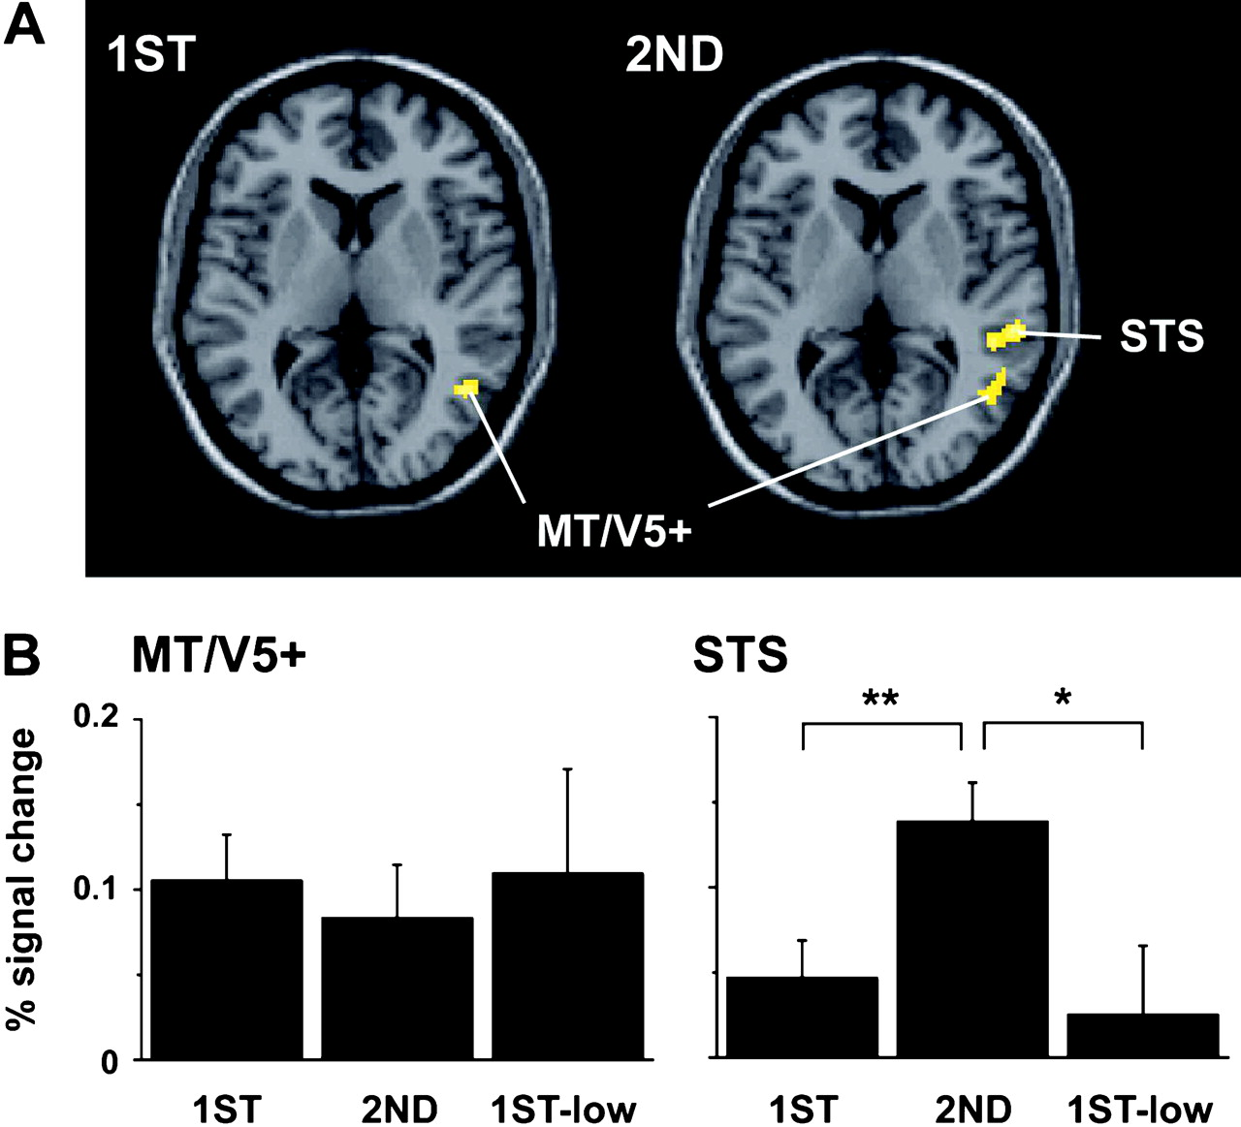
Figure 5. Neural activation in MT/V5+ and STS regions. (A) Axial slices illustrating differences in activation patterns ...
Notes:
Figure 5. Neural activation in MT/V5+ and STS regions. (A) Axial slices illustrating differences in activation patterns in the 1ST (left) and 2ND (right) conditions. Both slices are parallel to the anterior commissure-posterior commissure (AC–PC) line, z = 6 (slice 6 mm above AC–PC line). (B) Mean percentage signal change over all significantly activated voxels in MT/V5+ and STS, calculated for each condition. In this and subsequent figures, the percentage signal change means a BOLD signal increase or decrease during the motion epoch of each stimulus condition as compared to its control epoch. Activation clusters (ROIs) for MT/V5+ and STS were defined based on SPM results of group-analysis in RDM and 2ND conditions, respectively (Fig. 3A,B middle panel). Error bars denote standard error (SE) across subjects. *P < 0.05; **P < 0.01 (paired or two sample t-test).
Unless provided in the caption above, the following copyright applies to the content of this slide: © The Author 2005. Published by Oxford University Press. All rights reserved. For permissions, please e-mail: journals.permissions@oupjournals.org

Slide 6
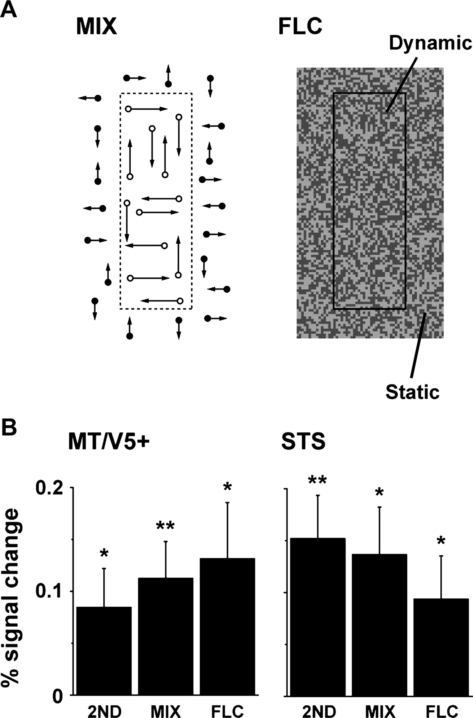
Figure 6. Stimuli and results under MIX and FLC conditions. (A) Moving objects under MIX (left) and FLC (right) ...
Notes:
Figure 6. Stimuli and results under MIX and FLC conditions. (A) Moving objects under MIX (left) and FLC (right) conditions. In MIX, dots in the rectangle are brighter and move faster than those in the background. In FLC, pixel pattern within the rectangle changes dynamically at 60 Hz, while the background remains static. Other details such as structure of motion and control epochs were identical to other apparent motion conditions (1ST, 2ND, 1ST-low). (B) Signal percent changes (mean ± SE) in MT/V5+ (46, −58, 2) and STS (58, −34, 12) areas. As in the 2ND condition, MIX and FLC stimuli induced significant activation in both MT/V5+ and STS regions. *P < 0.05; **P < 0.01 (one sample t-test)
Unless provided in the caption above, the following copyright applies to the content of this slide: © The Author 2005. Published by Oxford University Press. All rights reserved. For permissions, please e-mail: journals.permissions@oupjournals.org

Slide 7
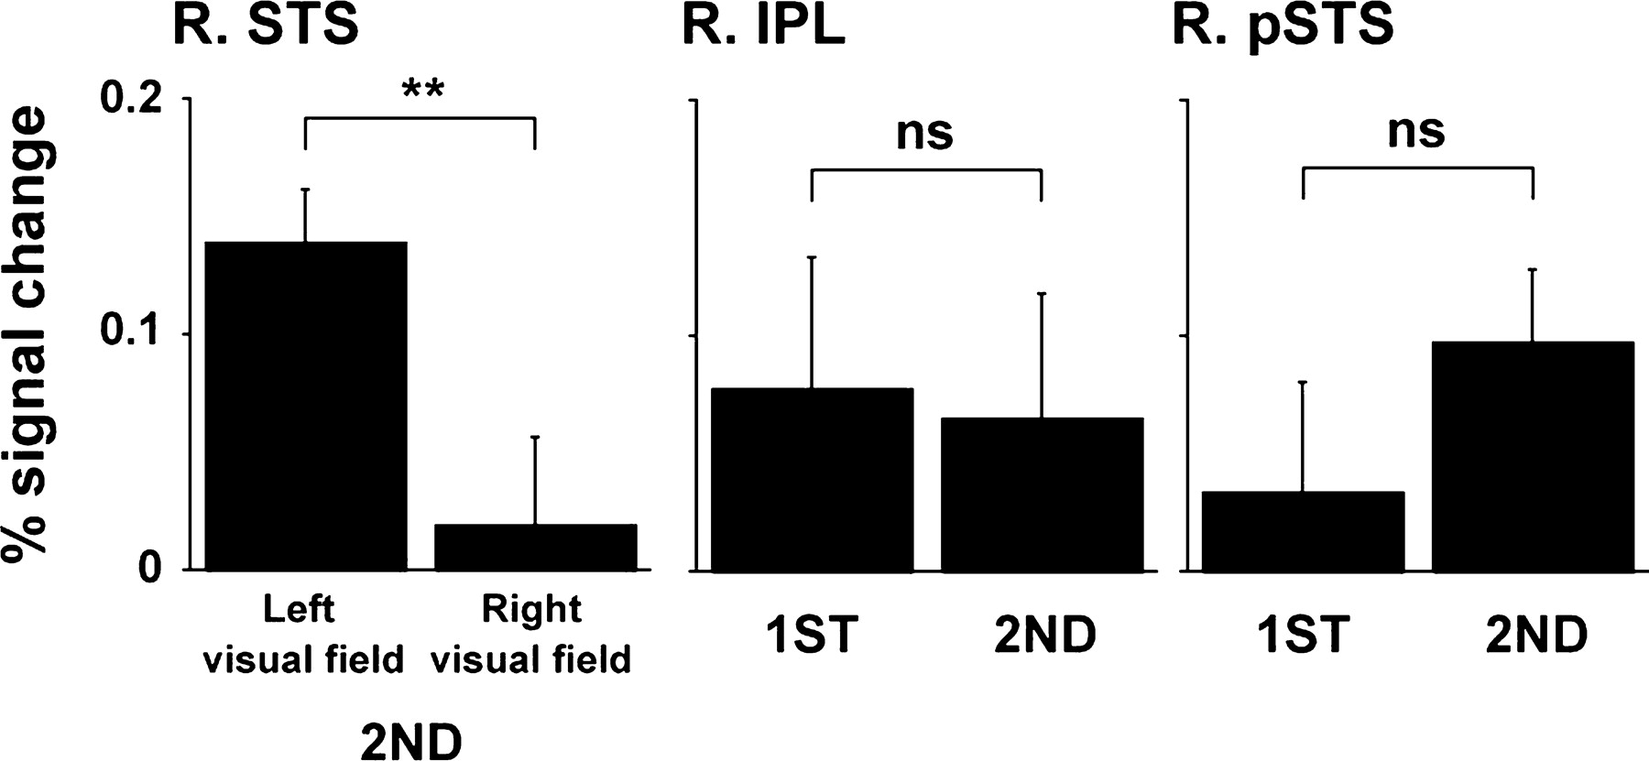
Figure 7. Activation profiles in right STS, right IPL and right pSTS regions. In the left graph, mean signal percentage ...
Notes:
Figure 7. Activation profiles in right STS, right IPL and right pSTS regions. In the left graph, mean signal percentage changes within the activation cluster of the STS, the same ROI as Figure 5B (right), were plotted. Regarding the right IPL and right pSTS, regional coordinates (60, −34, 30 for right IPL; 56, −48, 6 for right pSTS) were determined based on previous reports by Claeys et al. (2003). Error bars denote SE across subjects. **P < 0.01 (two sample t-test); ns, non-significant.
Unless provided in the caption above, the following copyright applies to the content of this slide: © The Author 2005. Published by Oxford University Press. All rights reserved. For permissions, please e-mail: journals.permissions@oupjournals.org

