Slide 1
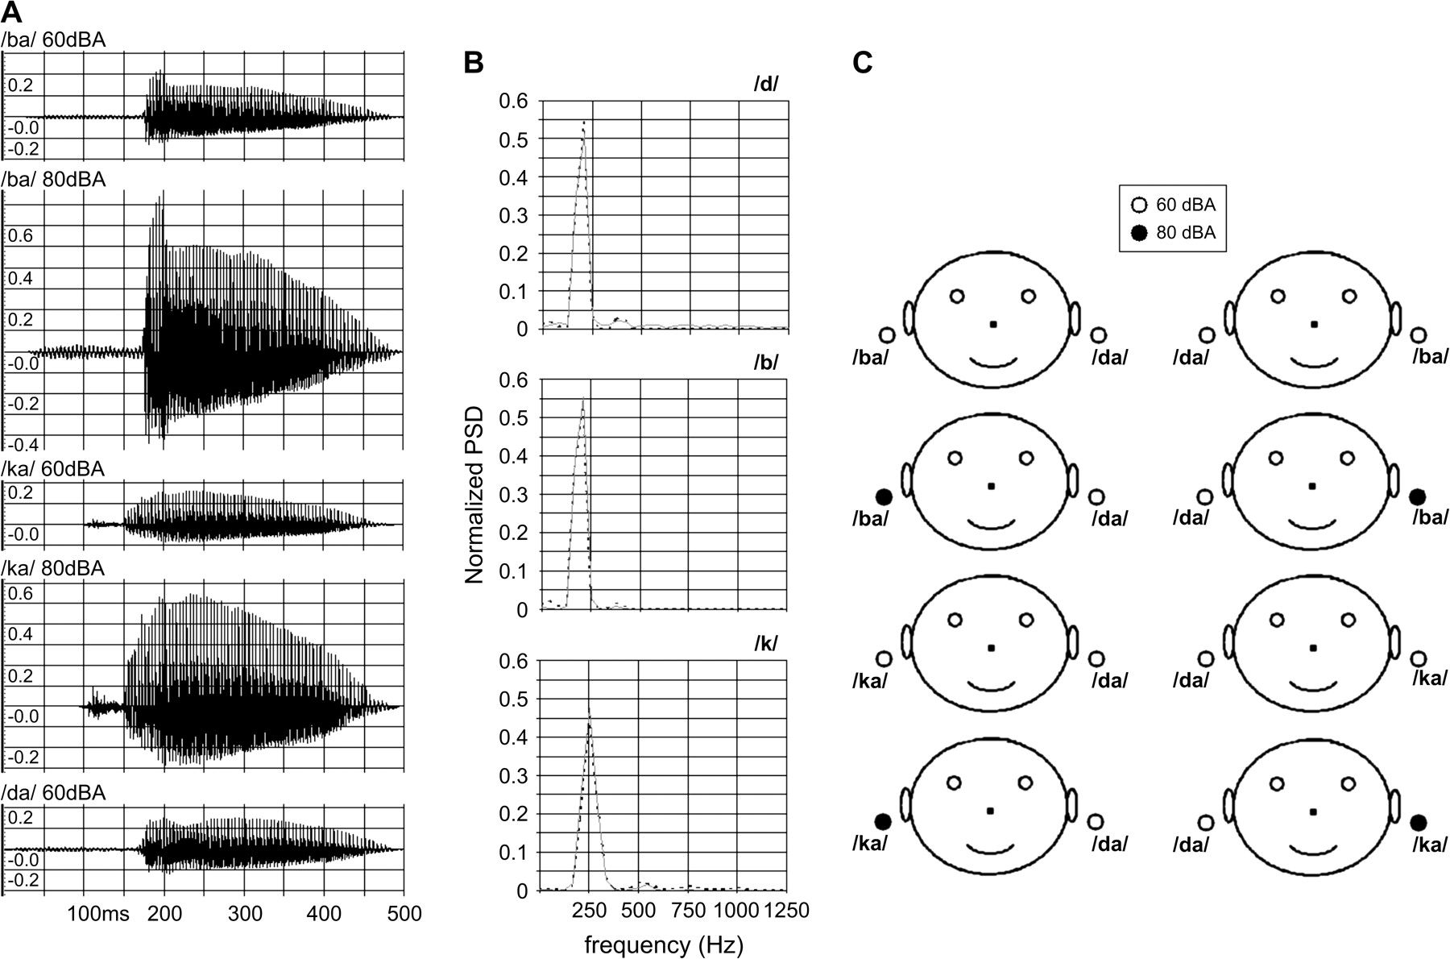
Figure 1. Schematic of the experimental paradigm. (A) Waveforms of the CV-syllables, which constituted the dichotic ...
Notes:
Figure 1. Schematic of the experimental paradigm. (A) Waveforms of the CV-syllables, which constituted the dichotic stimuli. (B) Power spectrum densities of the consonants /d/, /b/, and /k/ forming the CV-syllables (dashed black line - -). The spectral overlap between /d/ and /b/ was estimated to be about 93%, so that we named the syllables /da/ and /ba/ as “competing.” The overlap was reduced to 23% for /d/ and /k/, forming the noncompeting syllables /da/ and /ka/. For each consonant in the CV-syllables, the power spectrum of the sound recorded by a piezoelectric sensor coupled to the plastic ear tubes (coupled to a transducer to deliver the stimuli to the subjects) is also shown (light gray line —). The measured overlap between the consonant before and after the transducer and plastic tubes is 96% for /d/, 97% for /b/, and 96% for /k/. (C) The dichotic stimuli administered during the MEG recordings. Dichotic stimuli were /da/ 60 dBA at the left ear + /ba/ 60 dBA at the right ear; /da/ 60 dBA at the left ear + /ba/ 80 dBA at the right ear; /da/ 60 dBA at the left ear + /ka/ 60 dBA at the right ear; /da/ 60 dBA at the left ear + /ka/ 80 dBA at the right ear (left column); /da/ 60 dBA at the right ear + /ba/ 60 dBA at the left ear; /da/ 60 dBA at the right ear + /ba/ 80 dBA at the left ear; /da/ 60 dBA at the right ear + /ka/ 60 dBA at the left ear; /da/ 60 dBA at the right ear + /ka/ 80 dBA at the left ear (right column).
Unless provided in the caption above, the following copyright applies to the content of this slide: © The Author 2006. Published by Oxford University Press. All rights reserved. For permissions, please e-mail: journals.permissions@oxfordjournals.org

Slide 2
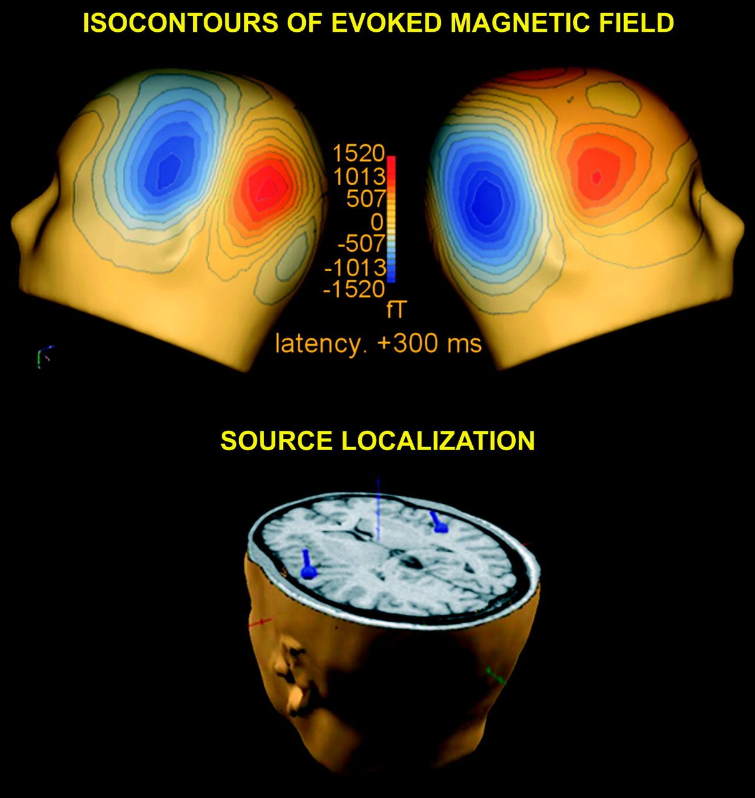
Figure 2. Source localization of AEFs. Upper: Subject 10: Field distribution and isofield contour maps at the second ...
Notes:
Figure 2. Source localization of AEFs. Upper: Subject 10: Field distribution and isofield contour maps at the second AEF peak in response to the dichotic pair “/da/ 60 dBA at the left ear + /ka/ 80 dBA at the right ear.” Peak latency is 300-ms poststimulus onset time. Bottom: Two bilateral ECDs have been localized in the auditory cortex. The position and orientation of the estimated current dipoles are superimposed on the subject's MRI volume.
Unless provided in the caption above, the following copyright applies to the content of this slide: © The Author 2006. Published by Oxford University Press. All rights reserved. For permissions, please e-mail: journals.permissions@oxfordjournals.org

Slide 3
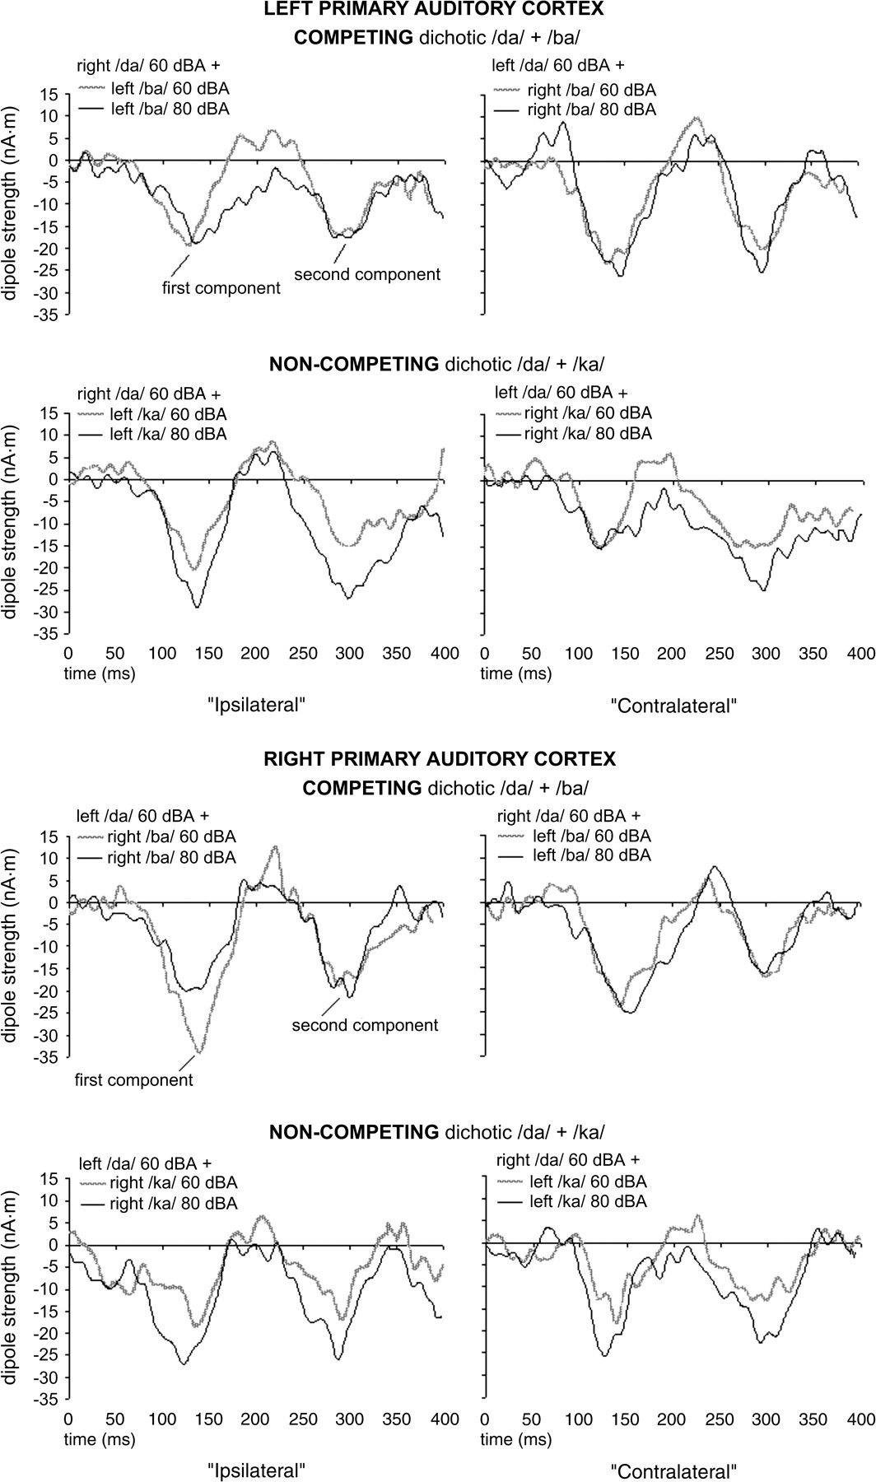
Figure 3. Responses of the primary auditory cortex. Grand-average across subjects of the time courses of the 2 ...
Notes:
Figure 3. Responses of the primary auditory cortex. Grand-average across subjects of the time courses of the 2 bilateral sources localized in the auditory cortex. Stimuli containing the same CV-syllables provided at the same ear are shown on the same plot with gray (60 dBA) and black (80 dBA) lines. The left hemisphere is shown in the upper part of the figure and the right in the lower one. For both hemispheres, an intensity increase can be observed for the dichotic stimulus /da/ + /ka/. For the dichotic stimulus /da/ + /ba/, increases were reduced with different patterns in the right and left hemispheres.
Unless provided in the caption above, the following copyright applies to the content of this slide: © The Author 2006. Published by Oxford University Press. All rights reserved. For permissions, please e-mail: journals.permissions@oxfordjournals.org

Slide 4
Figure 4. Summary of mean amplitude increments in the primary auditory cortex. The averages across subject of the ...
Notes:
Figure 4. Summary of mean amplitude increments in the primary auditory cortex. The averages across subject of the dipole strength increase is shown at the first and second component in both hemispheres. Asterisks show Tukey's post hoc results. No significant differences were found for the first component. For the second component, only in the left hemisphere a statistical interaction was present, indicating a stronger inhibition of the ipsilateral (left ear → left auditory cortex) than contralateral (right ear → left auditory cortex) auditory pathway. Main effect of stimulus type (competing vs. noncompeting) was statistically significant in both hemispheres.
Unless provided in the caption above, the following copyright applies to the content of this slide: © The Author 2006. Published by Oxford University Press. All rights reserved. For permissions, please e-mail: journals.permissions@oxfordjournals.org

