Slide 1
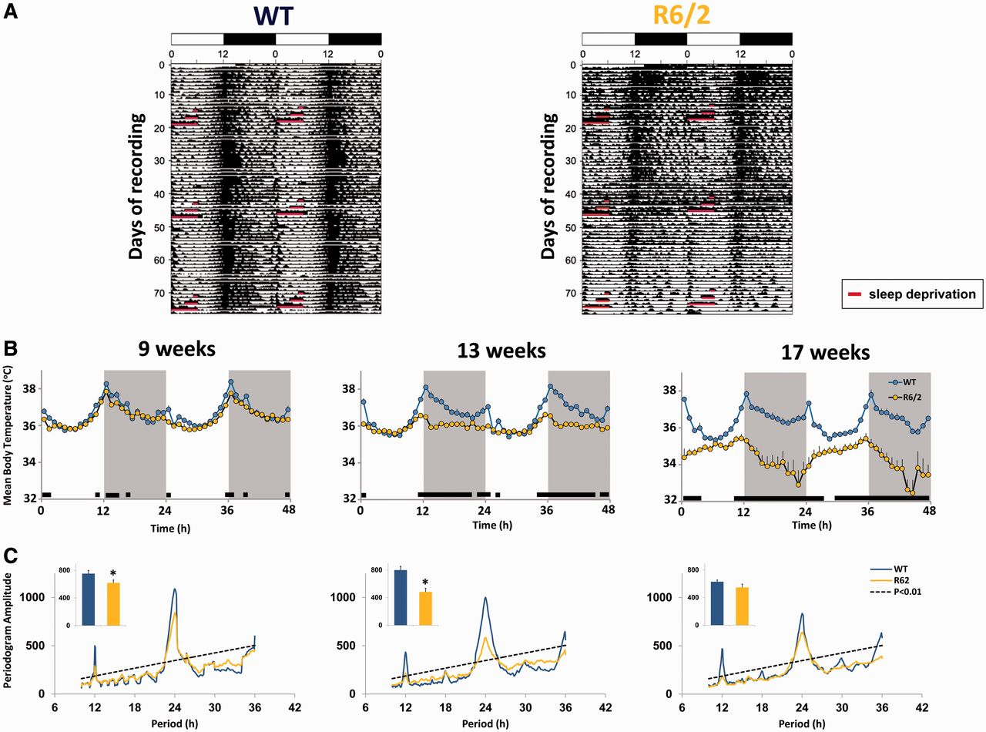
Figure 1 Diurnal rhythms in core body temperature are severely attenuated in R6/2 mice. (A) Representative ...
Notes:
Figure 1 Diurnal rhythms in core body temperature are severely attenuated in R6/2 mice. (A) Representative double-plotted actogram-style plots for body temperature of wild-type (WT, left) and R6/2 mice (right) recorded continuously from ∼8–17 weeks of age maintained under a regular 12:12 light/dark cycle (indicated by black and white bars at the top of the actogram). Each horizontal line represents two consecutive 24 h periods in which the second half of each line is repeated on the first half of the following line. One, 3 and 6 h sleep deprivations performed at 9, 13 and 17 weeks of age are highlighted in red. (B) Forty-eight hour body temperature profiles during baseline recordings at 9, 13 and 17 weeks of age for wild-type (blue circles) and R6/2 mice (gold circles), n = 11–15, mean hourly values ± SEM. Black bars above the x-axis indicate times with significant differences (P < 0.05) between wild-type and R6/2 mice. For full statistical information refer to the Supplementary material. (C) Chi-square periodogram analysis of the amplitude of diurnal rhythmicity (10–35 h) of body temperature. Dotted diagonal line represents P < 0.05 significance level. Inset bar graph represents the magnitude of periodicity in the circadian (23–25 h) range for body temperature of each genotype (*P < 0.05, two-tailed t-test).
Unless provided in the caption above, the following copyright applies to the content of this slide: © The Author (2013). Published by Oxford University Press on behalf of the Guarantors of Brain. All rights reserved. For Permissions, please email: journals.permissions@oup.com

Slide 2
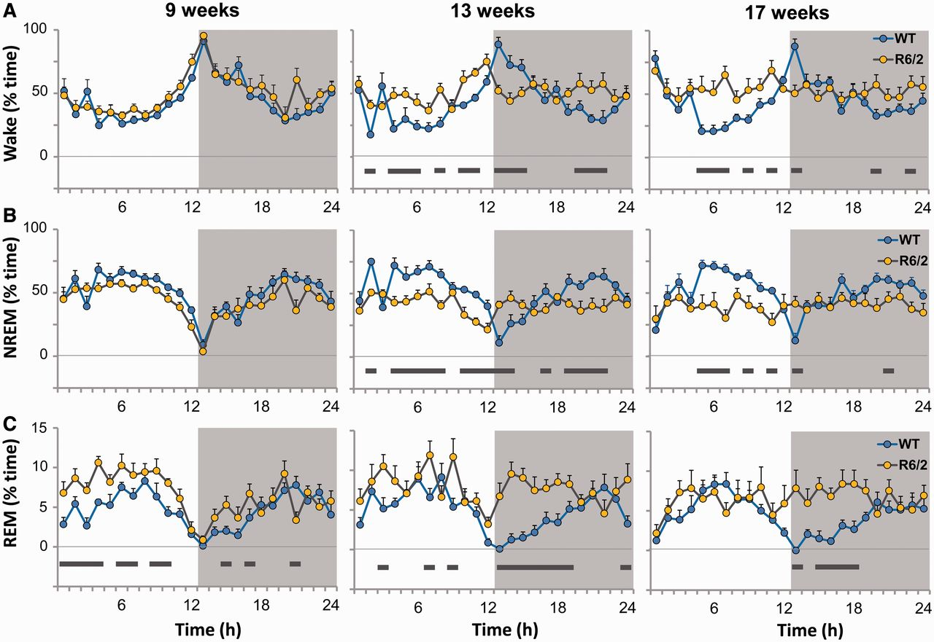
Figure 2 Distribution of sleep/wake states during baseline recordings. Percentage time spent in wakefulness (A), ...
Notes:
Figure 2 Distribution of sleep/wake states during baseline recordings. Percentage time spent in wakefulness (A), non-REM (NREM, B) and REM sleep (C) in wild-type (WT, blue circles) and R6/2 mice (gold circles) across the 24 h day at 9, 13 and 17 weeks of age (n = 8, mean hourly values ± SEM). In all panels, black horizontal bars above the x-axis indicate times when P < 0.05 between the two genotypes. For full statistical information refer to the Supplementary material.
Unless provided in the caption above, the following copyright applies to the content of this slide: © The Author (2013). Published by Oxford University Press on behalf of the Guarantors of Brain. All rights reserved. For Permissions, please email: journals.permissions@oup.com

Slide 3
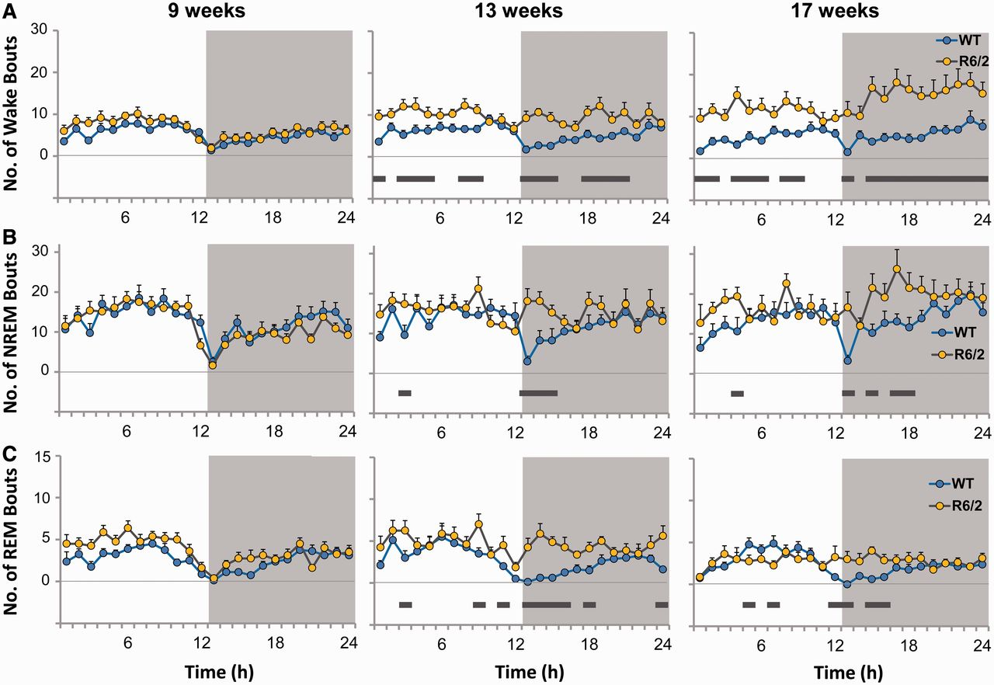
Figure 3 Progressive increases in the number of sleep/wake bouts with disease development in R6/2 mice. Number of wake ...
Notes:
Figure 3 Progressive increases in the number of sleep/wake bouts with disease development in R6/2 mice. Number of wake (A), non-REM (NREM, B) and REM (C) sleep bouts in wild-type (WT, blue circles) and R6/2 mice (gold circles) across the 24 h day during baseline recordings at age 9, 13 and 17 weeks. At 9 weeks, there were no significant differences between wild-type and R6/2 mice in the number of waking, non-REM or REM bouts (n = 8, mean hourly values ± SEM). In all panels, black horizontal bars above the x-axis indicate times when P < 0.05 between the two genotypes. For full statistical information refer to the Supplementary material.
Unless provided in the caption above, the following copyright applies to the content of this slide: © The Author (2013). Published by Oxford University Press on behalf of the Guarantors of Brain. All rights reserved. For Permissions, please email: journals.permissions@oup.com

Slide 4
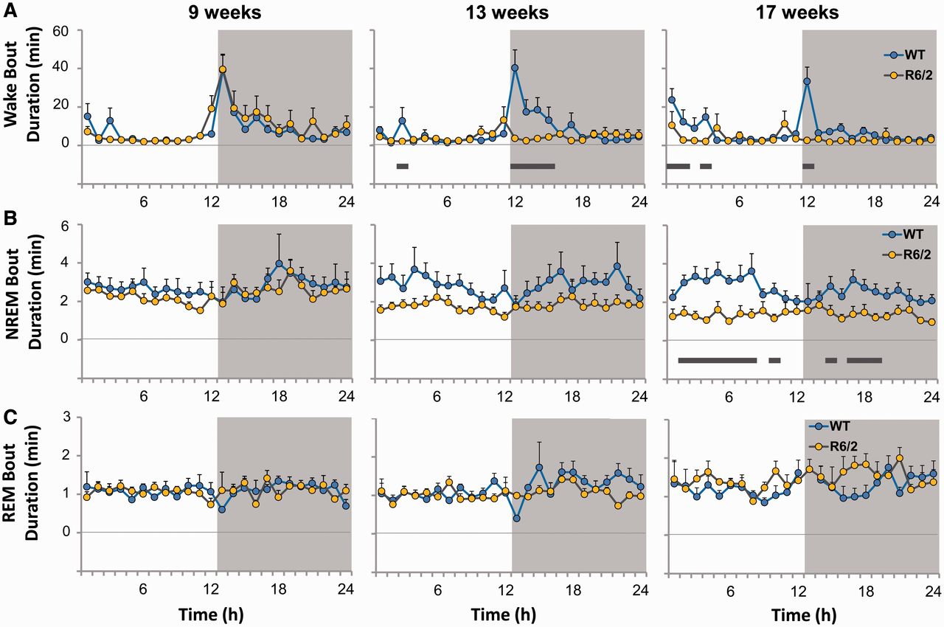
Figure 4 Durations of wakefulness and non-REM sleep bouts are reduced in R6/2 mice. Wake (A), non-REM (NREM, B) and ...
Notes:
Figure 4 Durations of wakefulness and non-REM sleep bouts are reduced in R6/2 mice. Wake (A), non-REM (NREM, B) and REM (C) sleep bout durations in wild-type (WT, blue circles) and R6/2 mice (gold circles) at 9, 13 and 17 weeks of age averaged across the 24 h day (n = 8, mean hourly values ± SEM). In all panels, black horizontal bars above the x-axis indicate times when P < 0.05 between the two genotypes. For full statistical information refer to the Supplementary material.
Unless provided in the caption above, the following copyright applies to the content of this slide: © The Author (2013). Published by Oxford University Press on behalf of the Guarantors of Brain. All rights reserved. For Permissions, please email: journals.permissions@oup.com

Slide 5
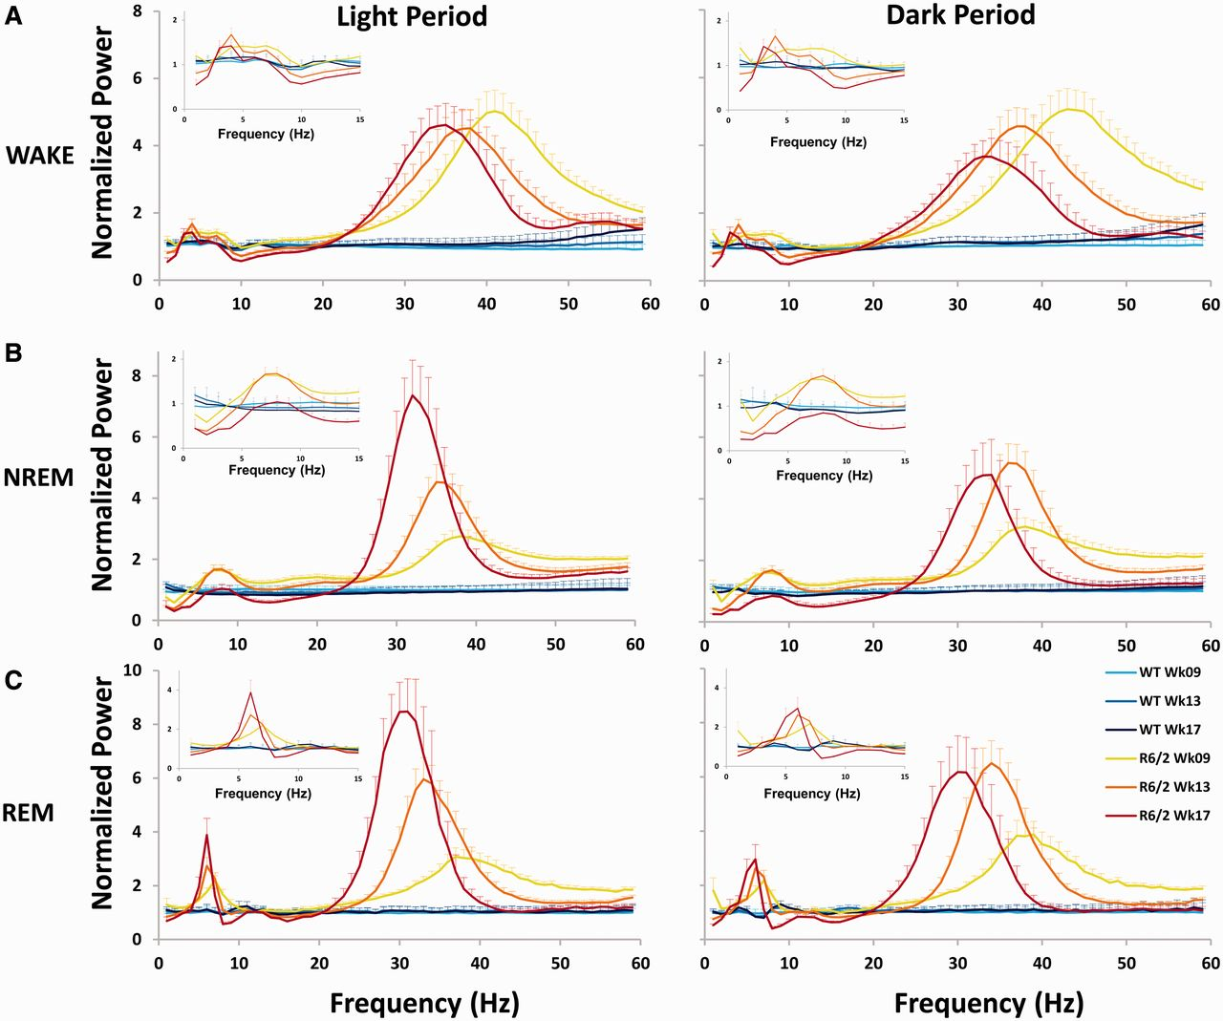
Figure 5 R6/2 mice exhibit profound alterations in normalized sleep/wake EEG spectra. EEG spectra (0–60 Hz at 1 Hz ...
Notes:
Figure 5 R6/2 mice exhibit profound alterations in normalized sleep/wake EEG spectra. EEG spectra (0–60 Hz at 1 Hz resolution) during (A) waking, (B) non-REM (NREM) and (C) REM sleep for the 12 h light and 12 h dark periods during baseline recordings at 9, 13 and 17 weeks of age in wild-type (WT, blue hues) and R6/2 mice (yellow, orange and red curves). Data were normalized to the 24 h average power in the 9 week wild-type baseline condition for each individual 1 Hz frequency bin. All sleep/wake states were dominated by a large increase in the gamma frequency range and theta oscillations evident in non-REM and REM sleep in R6/2 mice relative to wild-type. See Supplementary Table 2 for full statistical analyses of the significant frequencies between genotype (R6/2 versus wild-type) and within genotype (9 versus 13, and 9 versus 17 weeks) n = 8, mean hourly values ± SEM. Inset figures depict the magnified 0–15 Hz frequency range (x-axis) of each graph plotted against normalized power (y-axis).
Unless provided in the caption above, the following copyright applies to the content of this slide: © The Author (2013). Published by Oxford University Press on behalf of the Guarantors of Brain. All rights reserved. For Permissions, please email: journals.permissions@oup.com

Slide 6
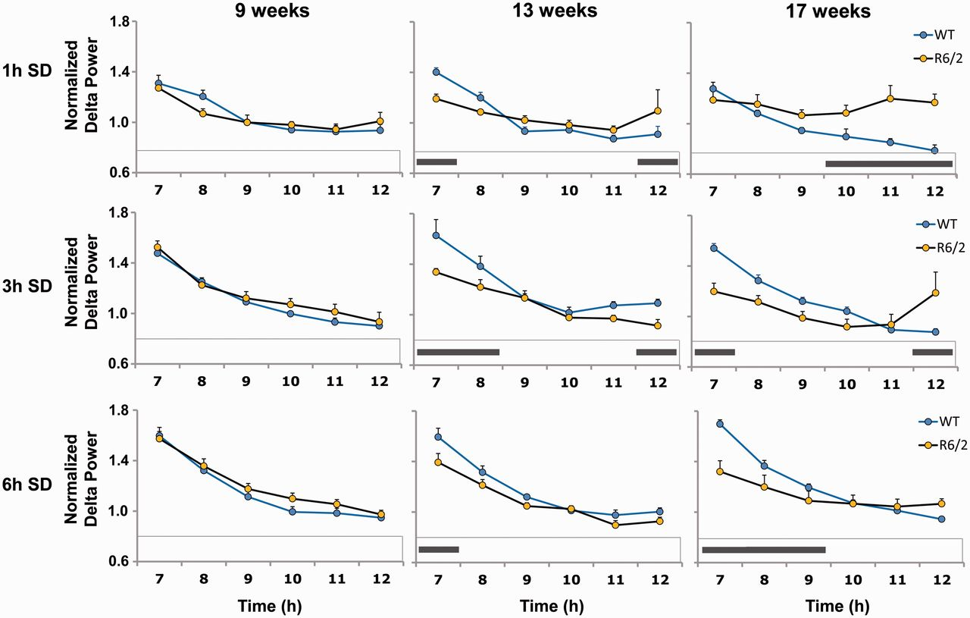
Figure 6 Non-REM delta power during recovery from 1, 3 and 6 h sleep deprivation. Time course of mean normalized EEG ...
Notes:
Figure 6 Non-REM delta power during recovery from 1, 3 and 6 h sleep deprivation. Time course of mean normalized EEG delta power during the 6 h recovery period following sleep deprivation (SD) of 1, 3 and 6 h duration at 9, 13 and 17 weeks of age in wild-type (WT, blue circles) and R6/2 mice (gold circles). To better illustrate differences resulting from the sleep deprivation intervention, values were normalized to each animal’s age-matched baseline delta power (n = 8, for the 17 week R6/2 ‘6 h sleep deprivation condition’ n = 4, mean hourly values ± SEM). In all panels, black horizontal bars above the x-axis indicate times when P < 0.05 between the two genotypes. For full statistical information refer to the Supplementary material.
Unless provided in the caption above, the following copyright applies to the content of this slide: © The Author (2013). Published by Oxford University Press on behalf of the Guarantors of Brain. All rights reserved. For Permissions, please email: journals.permissions@oup.com

Slide 7
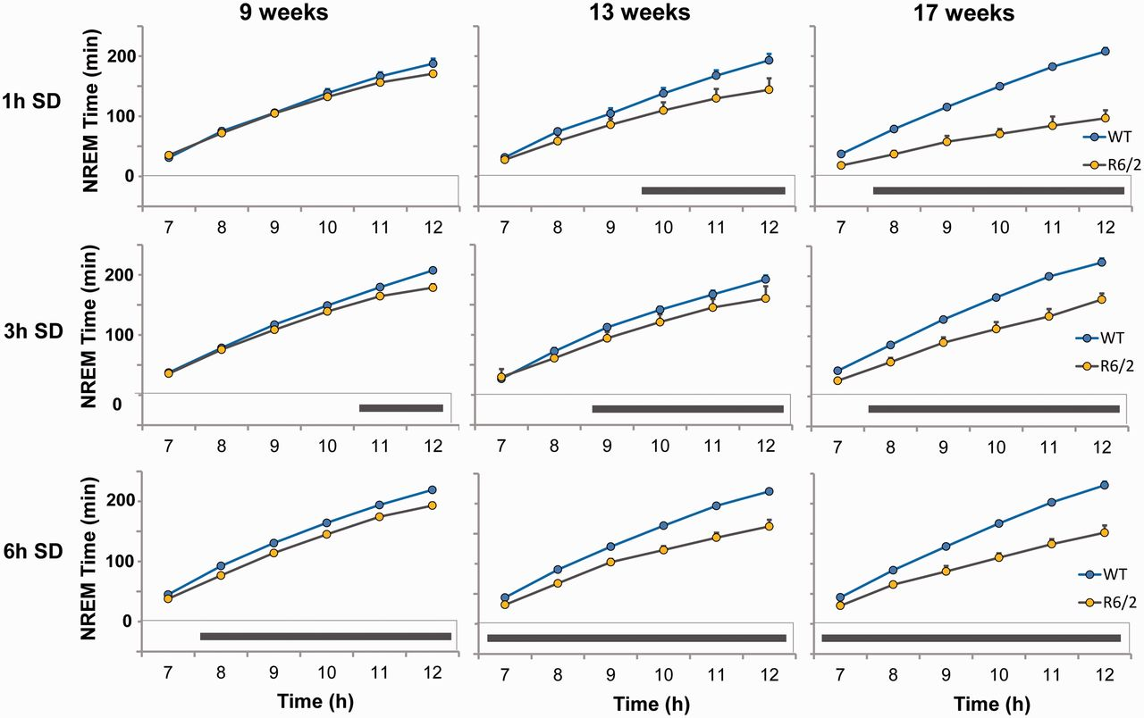
Figure 7 Cumulative non-REM sleep time during recovery from 1, 3 and 6 h sleep deprivation. Cumulative time course of ...
Notes:
Figure 7 Cumulative non-REM sleep time during recovery from 1, 3 and 6 h sleep deprivation. Cumulative time course of non-REM (NREM) sleep during the 6 h recovery period following sleep deprivation (SD) of 1, 3 and 6 h duration at 9, 13 and 17 weeks of age in wild-type (WT, blue circles) and R6/2 mice (gold circles), (n = 8, for the 17 week R6/2 ‘6 h sleep deprivation condition’ n = 4, mean hourly values ± SEM). In all panels, black horizontal bars above the x-axis indicate times when P < 0.05 between the two genotypes. For full statistical information refer to the Supplementary material.
Unless provided in the caption above, the following copyright applies to the content of this slide: © The Author (2013). Published by Oxford University Press on behalf of the Guarantors of Brain. All rights reserved. For Permissions, please email: journals.permissions@oup.com

