Slide 1
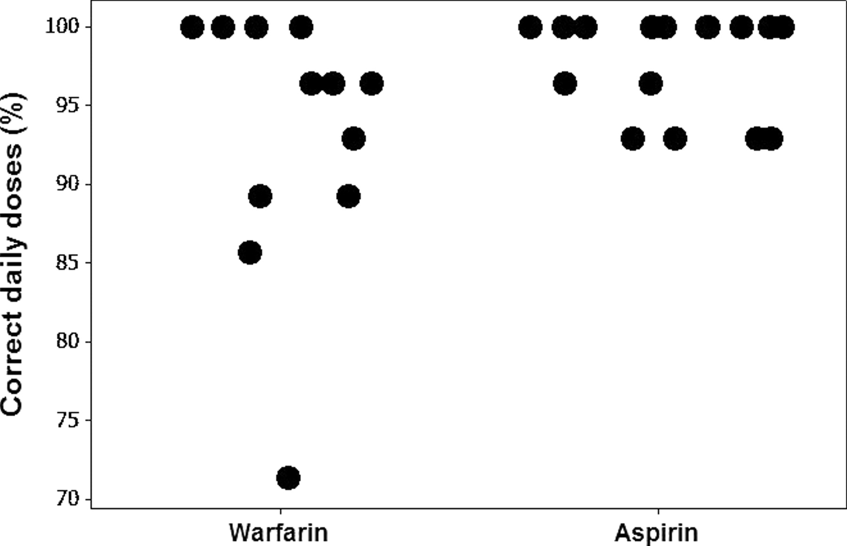
Figure 1 Percentage of days with a correct daily dose taken by warfarin (n = 12) and aspirin (n = 16) treated ...
Notes:
Figure 1 Percentage of days with a correct daily dose taken by warfarin (n = 12) and aspirin (n = 16) treated patients
Unless provided in the caption above, the following copyright applies to the content of this slide: Copyright © The Author 2006. Published by Oxford University Press on behalf of the British Geriatrics Society.

