Slide 1
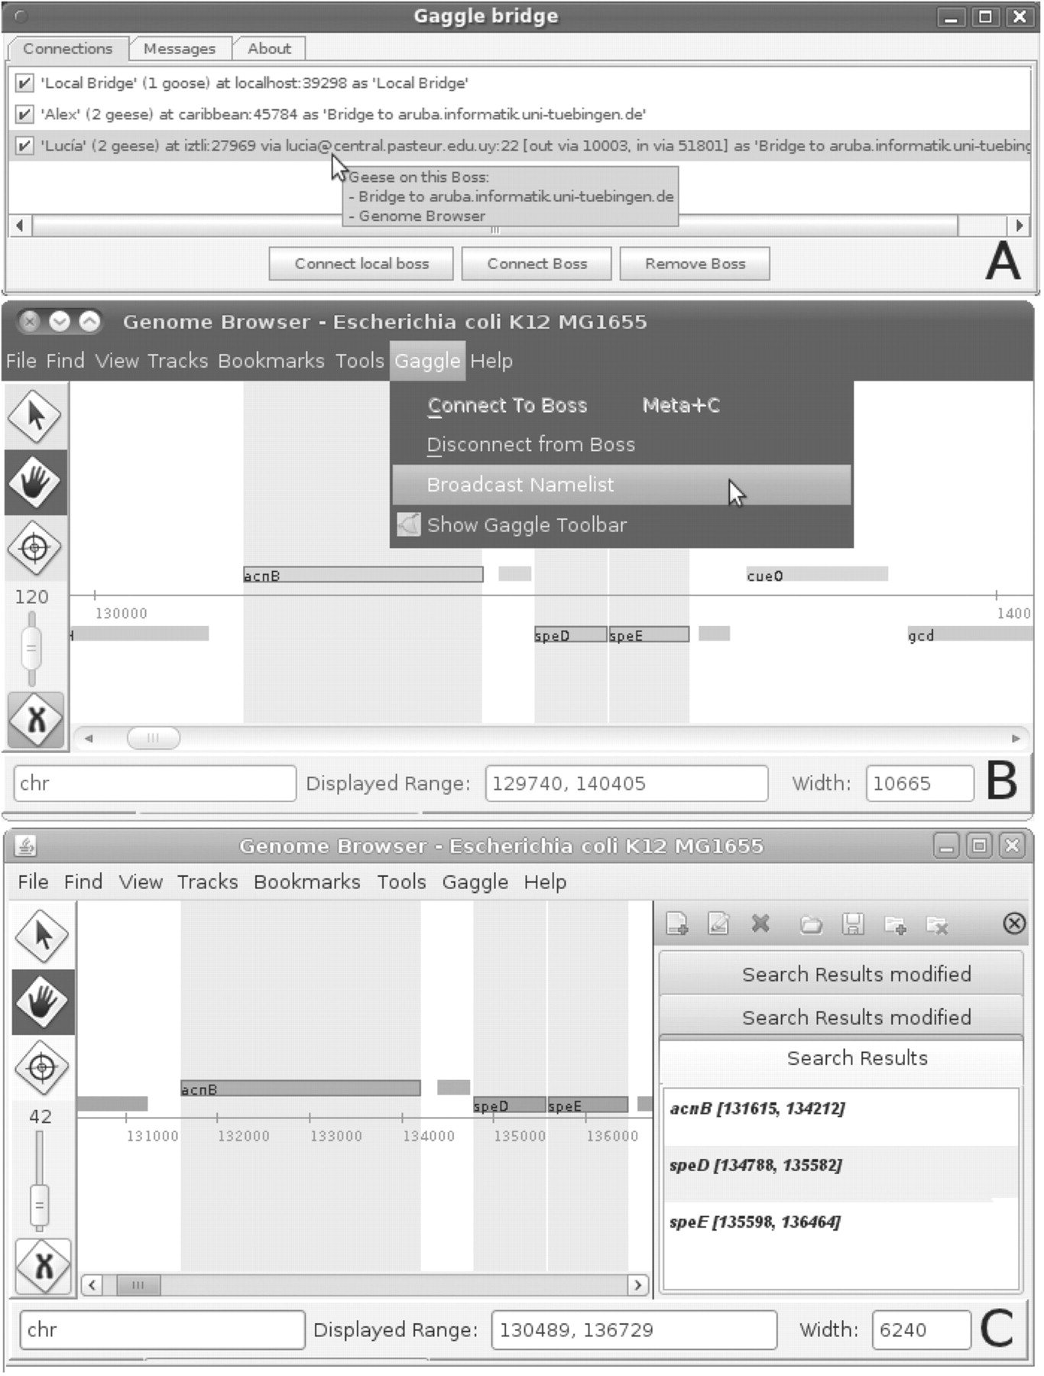
Fig. 1. (A) screenshot showing GaggleBridge with three connected Boss instances, one connection to the locally ...
Notes:
Fig. 1. (A) screenshot showing GaggleBridge with three connected Boss instances, one connection to the locally running Boss instance, one connection to a remote instance without tunneling (user Alex) and one remote connection via SSH tunneling (user Lucía); (B) screenshot of a Gaggle Genome Browser instance (user Lucía) broadcasting a selection of three loci; (C) screenshot of a Gaggle Genome Browser instance (user Alex) receiving this broadcast. The loci are highlighted and added to list of bookmarks on the right.
Unless provided in the caption above, the following copyright applies to the content of this slide: © The Author 2011. Published by Oxford University Press. All rights reserved. For Permissions, please email: journals.permissions@oup.com

Slide 2
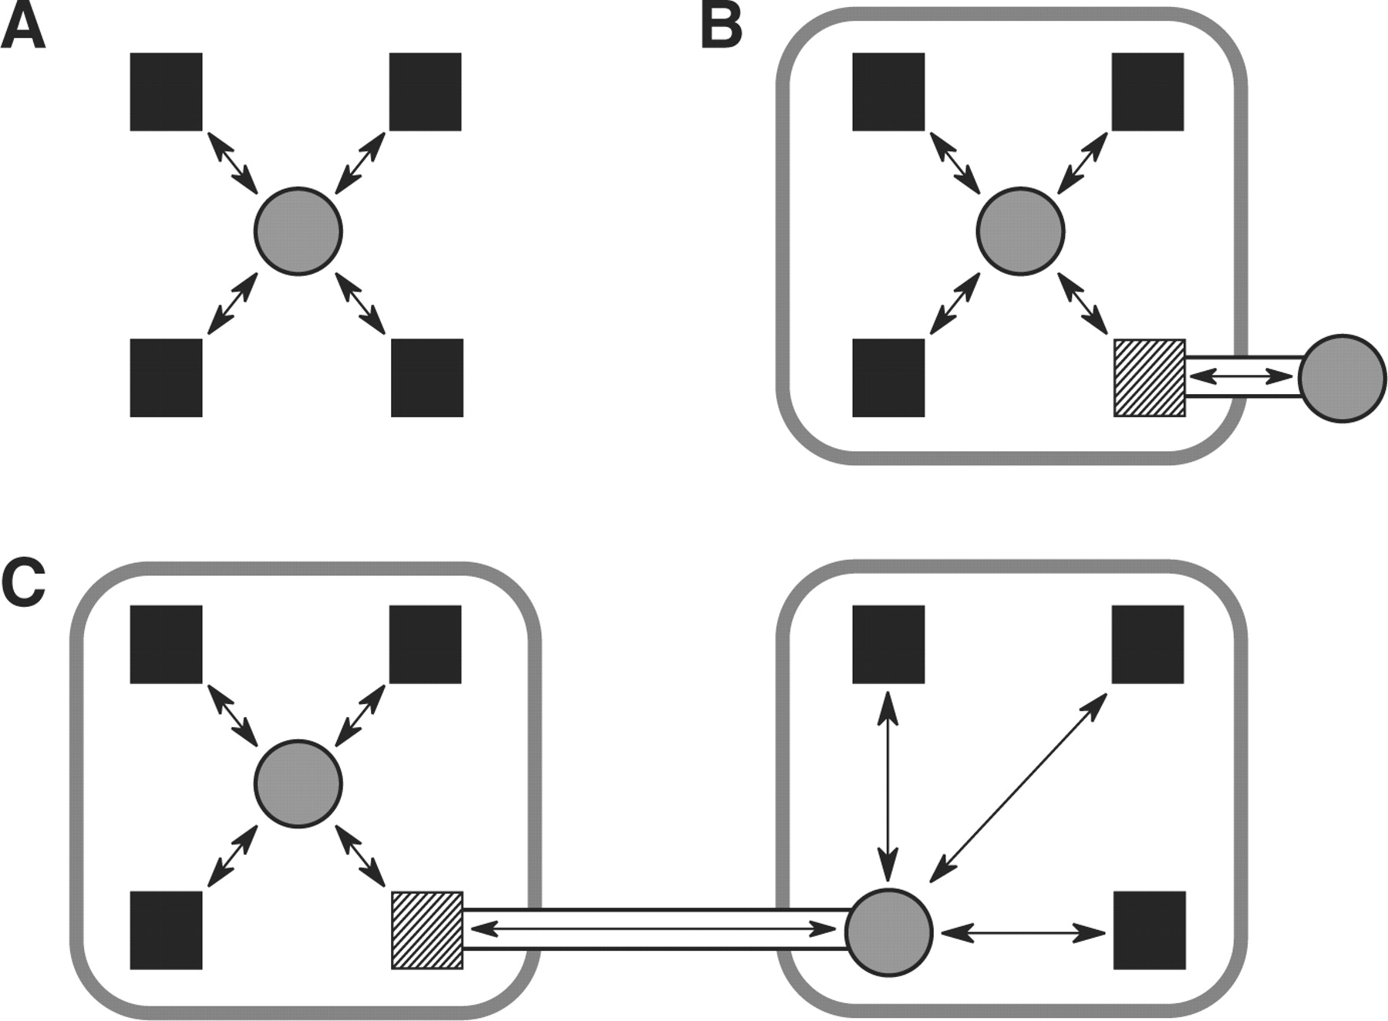
Fig. 2. GaggleBridge network configuration examples. (A) four computers running local Gaggle Boss instances (solid ...
Notes:
Fig. 2. GaggleBridge network configuration examples. (A) four computers running local Gaggle Boss instances (solid boxes) are connected by one computer running both a Boss as well as GaggleBridge (circle); (B) one researcher uses GaggleBridge to connect his local Boss to a network of Gaggle users behind a restrictive firewall (rounded box) using an SSH tunnel to a computer with SSH enabled (hashed box); (C) two groups of users in different networks with restrictive firewalls are connected using one GaggleBridge for each network and one SSH tunnel between the networks.
Unless provided in the caption above, the following copyright applies to the content of this slide: © The Author 2011. Published by Oxford University Press. All rights reserved. For Permissions, please email: journals.permissions@oup.com

