Slide 1
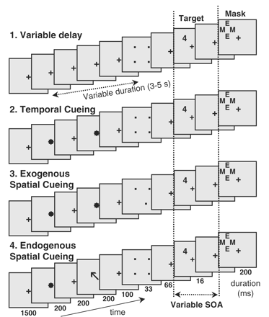
Figure 1 Stimuli used to measure the threshold for access to consciousness during masking. The target consisted of a ...
Notes:
Figure 1 Stimuli used to measure the threshold for access to consciousness during masking. The target consisted of a single digit, appearing at one of four possible locations, and which was replaced after a variable delay (SOA) by a mask consisting of a blank surrounded by four letters. Four conditions of attention were used, manipulating the possible deployment of temporal and/or attention (see text for details).
Unless provided in the caption above, the following copyright applies to the content of this slide: © The Author (2009). Published by Oxford University Press on behalf of the Guarantors of Brain. All rights reserved. For Permissions, please email: journals.permissions@oxfordjournals.org

Slide 2
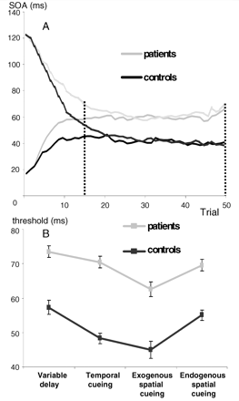
Figure 2 Threshold for conscious access in normal subjects and in patients with prefrontal lesions. (A) Evolution of ...
Notes:
Figure 2 Threshold for conscious access in normal subjects and in patients with prefrontal lesions. (A) Evolution of mean SOA across trials according to the double staircase algorithm. Regardless of starting point, the algorithm quickly converges to a stable SOA which clearly differs between patients and controls. The threshold was estimated as the mean SOA from trials 15 to 50. (B) Mean threshold in the four attention conditions (error bars = 1 standard error).
Unless provided in the caption above, the following copyright applies to the content of this slide: © The Author (2009). Published by Oxford University Press on behalf of the Guarantors of Brain. All rights reserved. For Permissions, please email: journals.permissions@oxfordjournals.org

Slide 3
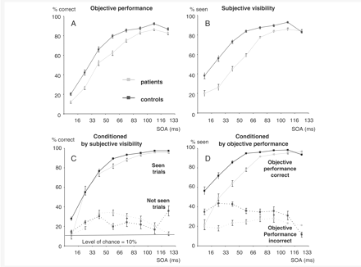
Figure 3 Evolution of objective (A and C) and subjective performance (B and D) as a function of SOA (from 16 to 133 ...
Notes:
Figure 3 Evolution of objective (A and C) and subjective performance (B and D) as a function of SOA (from 16 to 133 ms) in normal subjects and in patients with prefrontal lesions. The top graphs show overall means (error bars = 1 standard error). The bottom graphs show a conditional analysis, with performance split up as a function of subjective (C) or objective (D) responding on the same trial.
Unless provided in the caption above, the following copyright applies to the content of this slide: © The Author (2009). Published by Oxford University Press on behalf of the Guarantors of Brain. All rights reserved. For Permissions, please email: journals.permissions@oxfordjournals.org

Slide 4
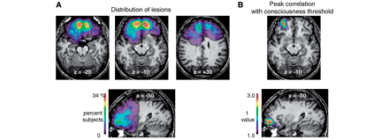
Figure 4 Relationship between prefrontal lesion site and the conscious access threshold. (A) Overlap of the 15 ...
Notes:
Figure 4 Relationship between prefrontal lesion site and the conscious access threshold. (A) Overlap of the 15 patients’ lesions, showing essentially complete PFC coverage with particular concentration in bilateral anterior and inferior frontal areas. (B) Cluster of voxels in left anterior ventral PFC where SPM analysis suggests a significant relation between the presence of lesions and the amount of increase in the conscious access threshold.
Unless provided in the caption above, the following copyright applies to the content of this slide: © The Author (2009). Published by Oxford University Press on behalf of the Guarantors of Brain. All rights reserved. For Permissions, please email: journals.permissions@oxfordjournals.org

