Slide 1
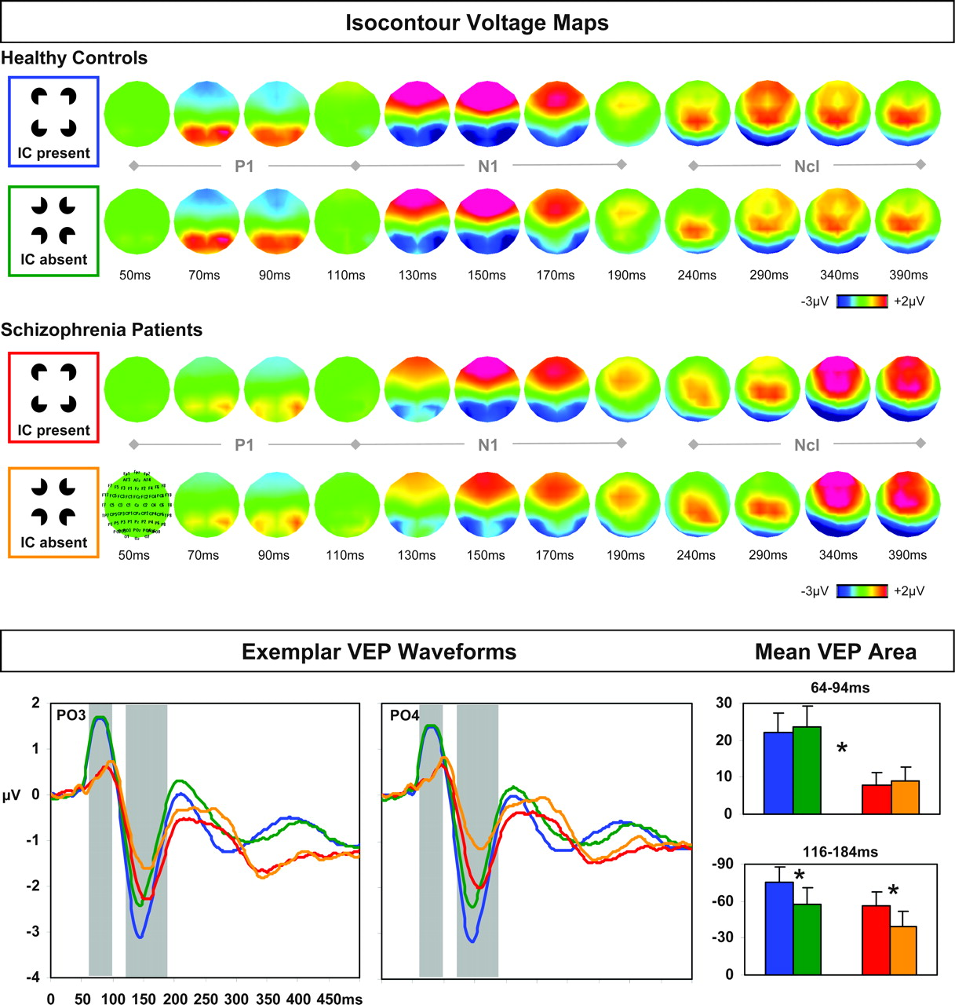
Figure 1. Top. Sequential isocontour voltage maps (latency post-stimulus onset indicated) depict the topography of VEPs ...
Notes:
Figure 1. Top. Sequential isocontour voltage maps (latency post-stimulus onset indicated) depict the topography of VEPs for IC absent and IC present stimulus conditions (left inset, with color coding continued in waveforms and bar graphs) for both healthy controls and schizophrenia patients. All maps are shown with the nose towards the top of the page and left hemiscalp on the left side (scale indicated at bottom). The recording montage is similarly indicated on the bottom-leftmost map. Bottom. VEP waveforms at sites PO3 and PO4 for healthy controls (blue and green traces) and schizophrenia patients (red and orange traces) indicate the presence of a diminished P1 component in patients, as well as intact IC processes during the N1 period in both subject groups. Bar graphs indicate the mean area (versus 0 μV baseline; standard error shown) of the P1 (upper graph) and N1 (lower graph) components for both stimulus conditions and each subject group. Areas were measured from 10 parieto-occipital electrode sites (see Materials and Methods for details).
Unless provided in the caption above, the following copyright applies to the content of this slide: © The Author 2005. Published by Oxford University Press. All rights reserved. For permissions, please e-mail: journals.permissions@oupjournals.org

Slide 2
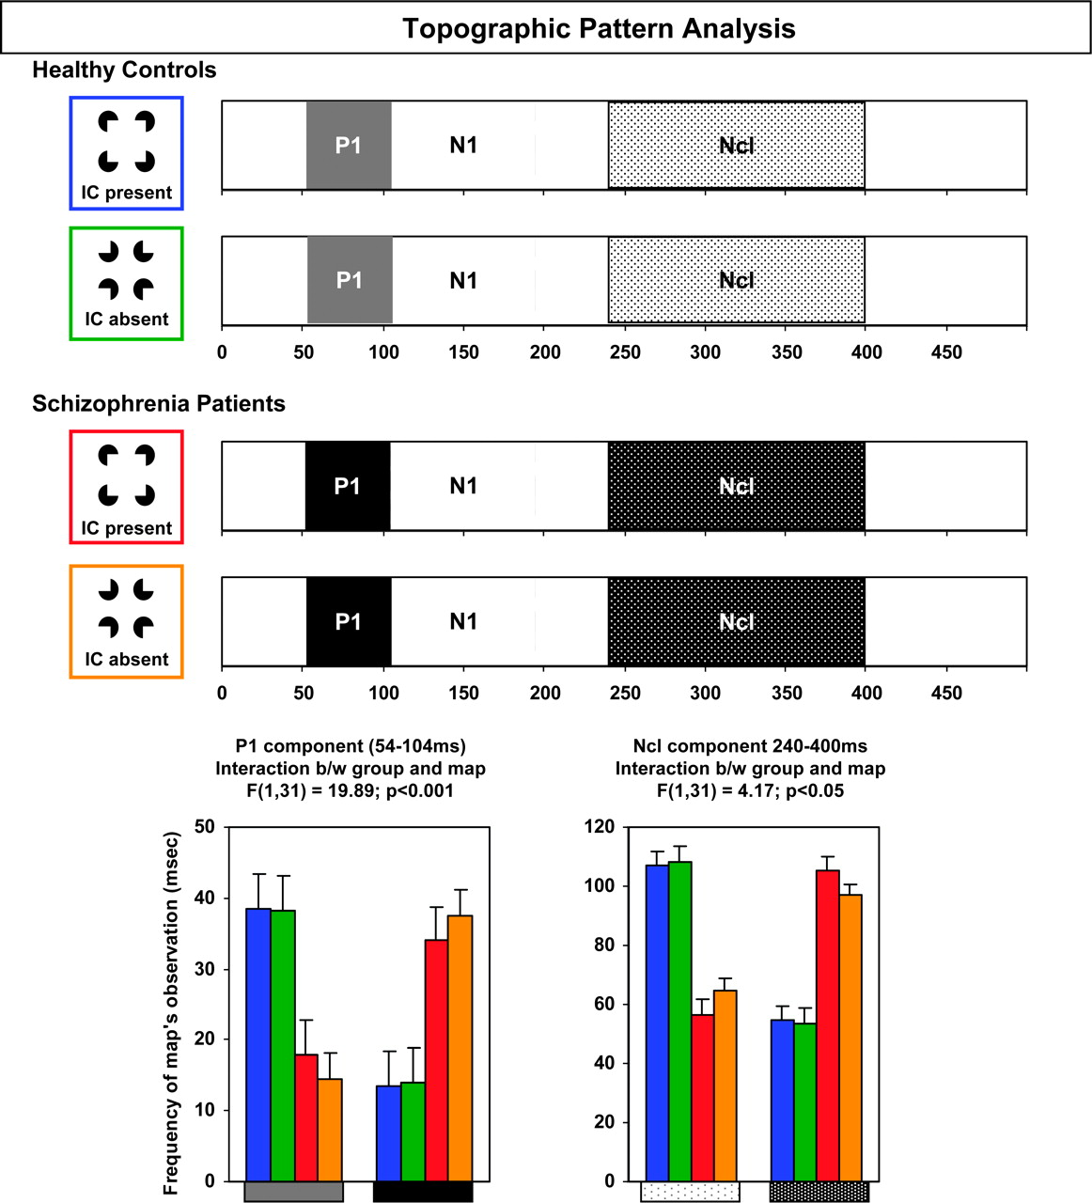
Figure 2. Results of the topographic pattern analysis for the group-averaged VEPs from each subject group and ...
Notes:
Figure 2. Results of the topographic pattern analysis for the group-averaged VEPs from each subject group and experimental condition. The subject group and experimental condition color scheme is identical to that of Figure 1. Over the 54–104 ms period, different scalp topographies were observed for VEPs from healthy controls and schizophrenia patients, irrespective of IC presence versus absence (gray and black boxes, respectively). The respective presence of these topographies in the data of individual subjects was statistically assessed with a fitting procedure (left bar graph), which revealed a significant interaction between map and subject group (see Results for details). No topographic differences were observed over the N1 component period. Over the 240–400 ms period, different scalp topographies were again observed for VEPs from healthy controls and schizophrenia patients, irrespective of IC presence versus absence (stippled boxes). As above, this was assessed with a fitting procedure (right bar graph) that revealed a significant interaction between map and subject group (see Results for details).
Unless provided in the caption above, the following copyright applies to the content of this slide: © The Author 2005. Published by Oxford University Press. All rights reserved. For permissions, please e-mail: journals.permissions@oupjournals.org

Slide 3
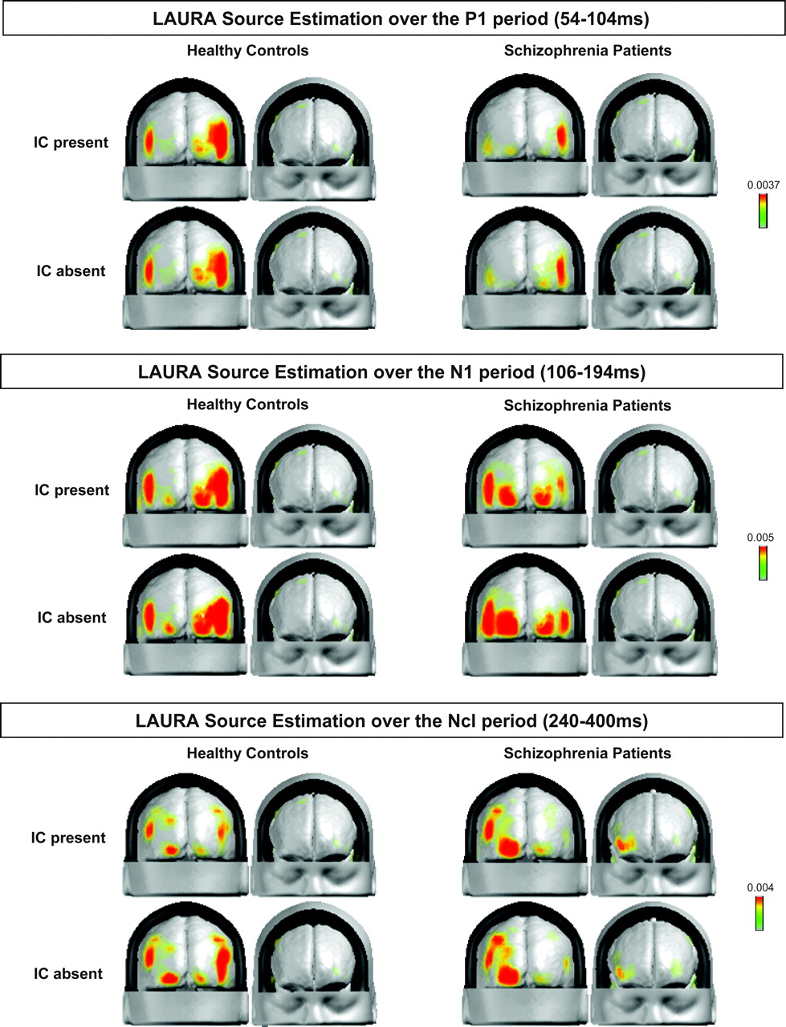
Figure 3. LAURA inverse solution estimations for each subject group and experimental condition over the P1 (54–104 ms), ...
Notes:
Figure 3. LAURA inverse solution estimations for each subject group and experimental condition over the P1 (54–104 ms), N1 (106–194 ms) and Ncl (240–400 ms) components. The LAURA inverse solution space is within the gray matter of the MNI average brain (scale on right).
Unless provided in the caption above, the following copyright applies to the content of this slide: © The Author 2005. Published by Oxford University Press. All rights reserved. For permissions, please e-mail: journals.permissions@oupjournals.org

