Slide 1
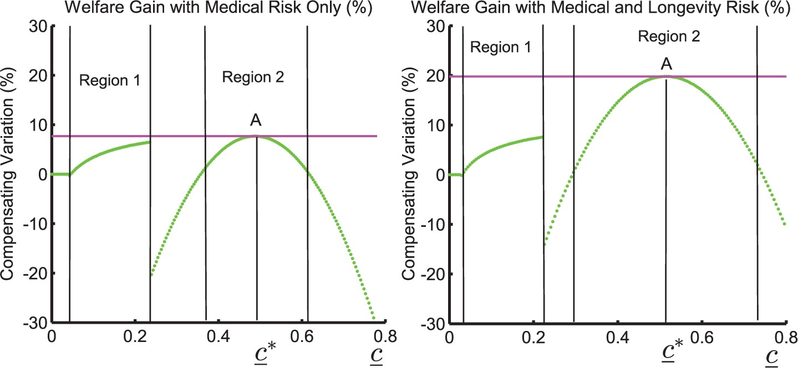
Figure 1 Welfare effects of MTSI for various levels of the consumption floor, c_, in the version of the two-period ...
Notes:
Figure 1 Welfare effects of MTSI for various levels of the consumption floor, c_, in the version of the two-period model with medical risk only and in the version with medical risk and longevity risk
Unless provided in the caption above, the following copyright applies to the content of this slide: © The Author 2016. Published by Oxford University Press on behalf of The Review of Economic Studies Limited.

Slide 2
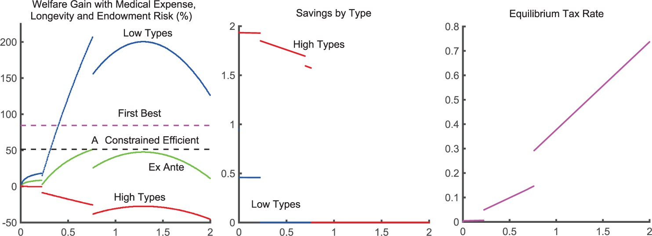
Figure 2 The left panel shows how the welfare effects of MTSI vary with the size of the consumption floor, c_, for the ...
Notes:
Figure 2 The left panel shows how the welfare effects of MTSI vary with the size of the consumption floor, c_, for the two-period model with medical expense, longevity, and endowment risk. The middle graph shows the levels of savings of the two income types for each value of the floor and the right panel shows the tax rate at each value
Unless provided in the caption above, the following copyright applies to the content of this slide: © The Author 2016. Published by Oxford University Press on behalf of The Review of Economic Studies Limited.

Slide 3
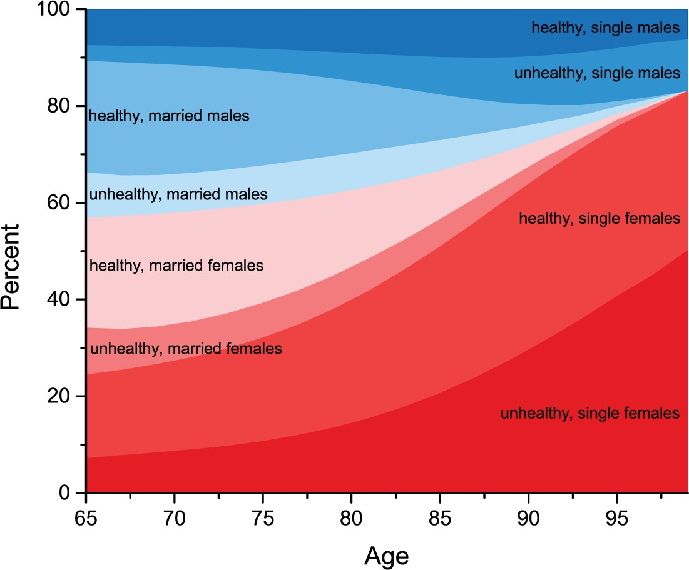
Figure 3 The population distribution of retirees by age. Individuals are classified by gender, health, and marital ...
Notes:
Figure 3 The population distribution of retirees by age. Individuals are classified by gender, health, and marital status Source: Our HRS sample.
Unless provided in the caption above, the following copyright applies to the content of this slide: © The Author 2016. Published by Oxford University Press on behalf of The Review of Economic Studies Limited.

Slide 4
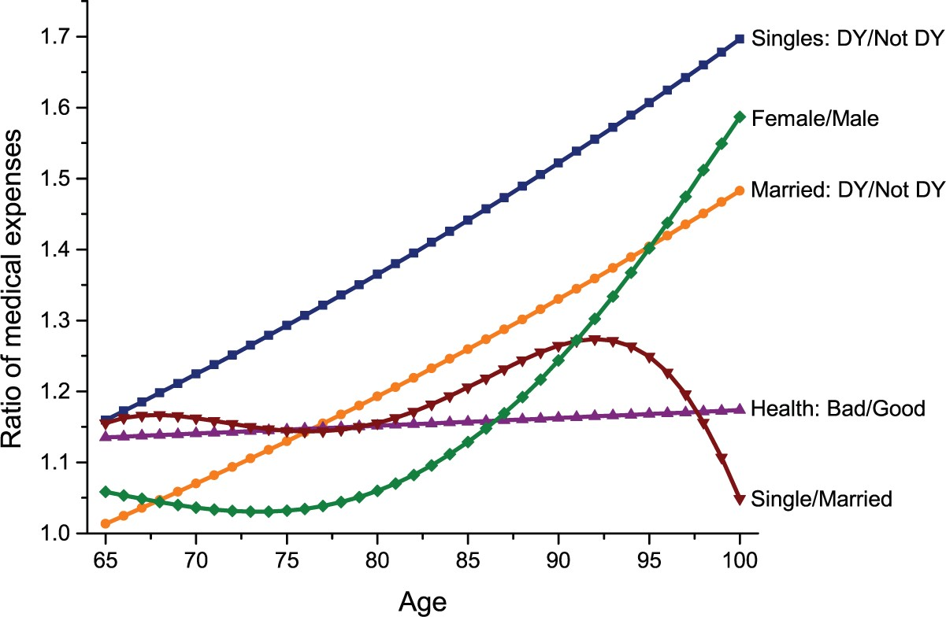
Figure 4 Estimated effects of marital status, health and death year (DY) on individual medical expenses by age. The ...
Notes:
Figure 4 Estimated effects of marital status, health and death year (DY) on individual medical expenses by age. The vertical axis is the ratio of estimated medical expenses for each type pair Source: Authors' computations using our HRS sample.
Unless provided in the caption above, the following copyright applies to the content of this slide: © The Author 2016. Published by Oxford University Press on behalf of The Review of Economic Studies Limited.

Slide 5
Figure 5 OOP medical expenses of married couples (left panel), single females (middle panel), and single males (right ...
Notes:
Figure 5 OOP medical expenses of married couples (left panel), single females (middle panel), and single males (right panel) relative to mean OOP expenses of all households by SS income quintile in the model (squares) and the data (circles)
Unless provided in the caption above, the following copyright applies to the content of this slide: © The Author 2016. Published by Oxford University Press on behalf of The Review of Economic Studies Limited.

Slide 6
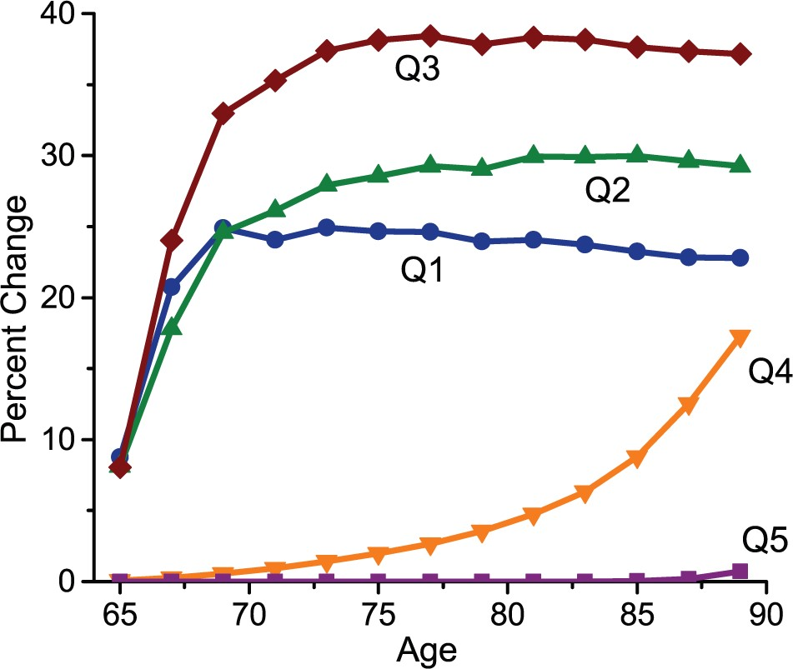
Figure 6 The percentage increase in MTSI recipiency rates of retirees when SS is removed from the baseline economy. ...
Notes:
Figure 6 The percentage increase in MTSI recipiency rates of retirees when SS is removed from the baseline economy. The change in the recipiency rates is shown by age and male permanent earnings quintile. The percentage increase is calculated by subtracting the recipiency rates in the baseline economy from those in the economy with MTSI only
Unless provided in the caption above, the following copyright applies to the content of this slide: © The Author 2016. Published by Oxford University Press on behalf of The Review of Economic Studies Limited.

