Slide 1
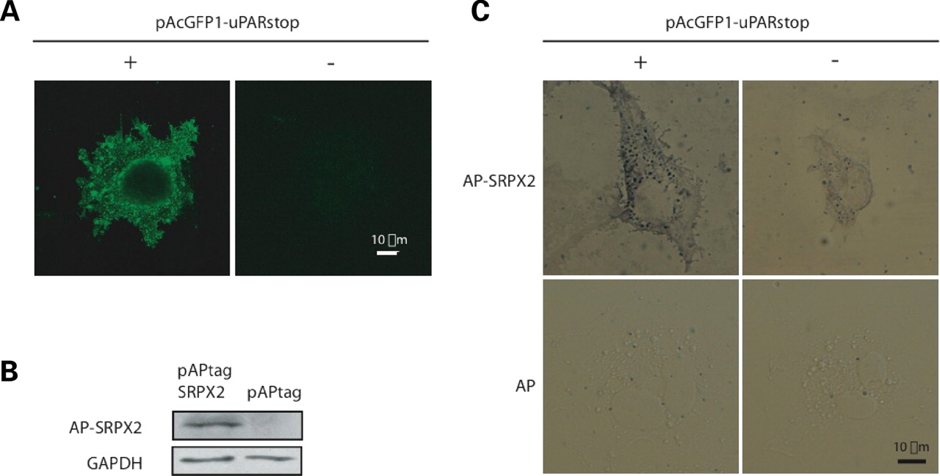
Figure 3. SRPX2 binding to uPAR at the cell surface of transfected COS-7 cells. (A) uPAR immunodetection with anti-uPAR ...
Notes:
Figure 3. SRPX2 binding to uPAR at the cell surface of transfected COS-7 cells. (A) uPAR immunodetection with anti-uPAR antibody at the surface of untransfected (parental) COS-7 cells (−) and at the surface of pAcGFP1-uPARstop transfected (COS-7/uPAR) COS-7 cells (+). Parental cells show weak expression of uPAR at the cell surface while COS-7/uPAR cells show strong expression of uPAR at the cell surface. (B) Production of alkaline phosphatase (AP)-SRPX2 fusion protein in the extracellular medium of COS-7 cells. COS-7 cells were transfected with pAPtag-SRPX2 (left) or with pAPtag (right) vectors. Protein extracts from the extracellular media were resolved by SDS–PAGE, followed by immunoblotting with anti-SRPX2 antibodies. AP-SRPX2 fusion protein was detected only when the pAPtag-SRPX2 was used. No SRPX2 fusion protein was detected when the pAPtag non-recombinant vector was used. The secreted isoform of GAPDH (63) was used as a control of protein extraction. (C) SRPX2 binding at the cell surface of uPAR-transfected COS-7 cells (COS-7/uPAR cells). Untransfected (parental) cells (−) or cells transfected with pAcGFP1-uPARstop (+) were incubated with AP-SRPX2 (top) or with AP (bottom) as a control. No AP activity was detected at the cell surface in the absence of AP-SRPX2. Much stronger AP signals were observed at the cell surface of COS-7/uPAR cells compared with parental COS-7 cells.
Unless provided in the caption above, the following copyright applies to the content of this slide: © The Author 2008. Published by Oxford University Press. All rights reserved. For Permissions, please email: journals.permissions@oxfordjournals.org

Slide 2
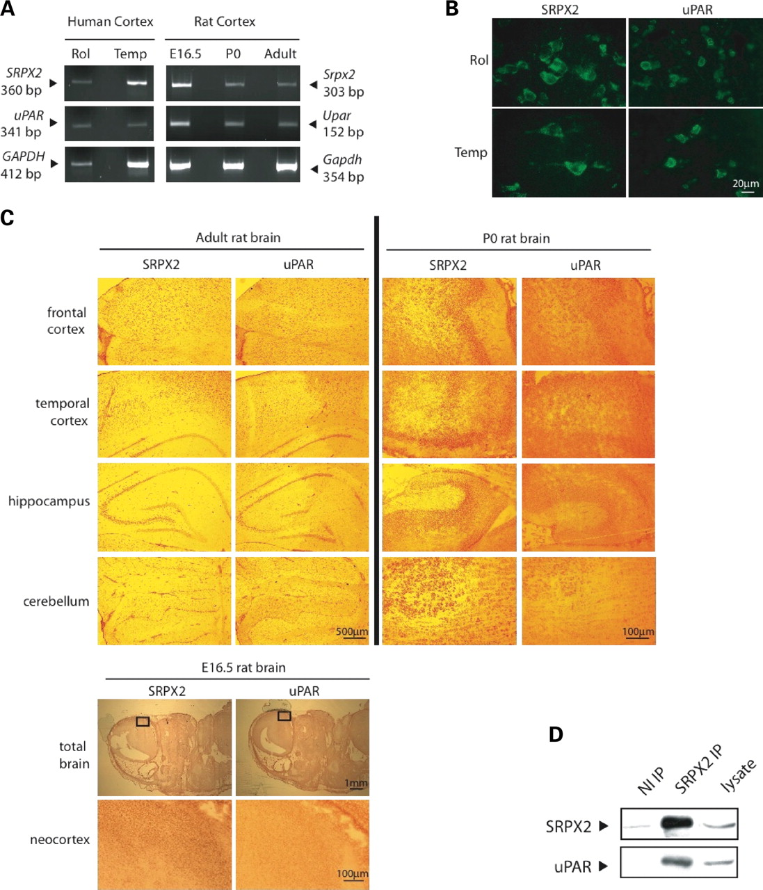
Figure 2. Co-expression and co-IP of SRPX2 and uPAR in vivo. (A) RT–PCR experiments in human (left) and rat (right) ...
Notes:
Figure 2. Co-expression and co-IP of SRPX2 and uPAR in vivo. (A) RT–PCR experiments in human (left) and rat (right) tissues. The sizes of PCR fragments in human and rat are indicated by arrowheads. GAPDH: human expression control. Gapdh: rat expression control. E16.5: rat brain at embryonic day 16.5. P0: rat brain at birth. Rol: rolandic area. Temp: temporal lobe. (B) Immunodetection of SRPX2 and of uPAR in neurons of the human rolandic (Rol) and temporal (Temp) areas. (C) Immunodetection of Srpx2 and Upar proteins in the rat brain. (Top) Left: adult rat brain. Right: rat brain at birth (P0). (Bottom) Embryonic rat brain at day 16.5. (D) Co-IP of SRPX2 and uPAR in the human rolandic area. Protein extracts from the rolandic area were immunoprecipitated with anti-SRPX2 antibody (SRPX2 IP) or with non-immune (control) rabbit IgG (NI IP). The complexes were resolved by SDS–PAGE, followed by immunoblotting for uPAR or SRPX2.
Unless provided in the caption above, the following copyright applies to the content of this slide: © The Author 2008. Published by Oxford University Press. All rights reserved. For Permissions, please email: journals.permissions@oxfordjournals.org

Slide 3
Figure 1. uPAR, CTSB and ADAMTS4 GFP-fusion proteins co-immunoprecipitate with SRPX2-myc in HEK293T cells. Co-IP ...
Notes:
Figure 1. uPAR, CTSB and ADAMTS4 GFP-fusion proteins co-immunoprecipitate with SRPX2-myc in HEK293T cells. Co-IP experiments were performed using anti-myc as precipitating antibody and complexes were resolved by SDS–PAGE, followed by immunoblotting for GFP or myc fusion proteins. (A) pcDNA-SRPX2 and pAcGFP1-uPAR constructs were co-transfected in HEK293T cells and the corresponding proteins efficiently produced (lysate). Proteins precipitated with anti-myc antibody (myc IP) were analyzed by immunoblotting. The anti-GFP antibody detected GFP-tagged uPAR protein at the expected size of 83 kDa. The anti-myc antibody detected myc-tagged SRPX2 protein at the expected size of 58 kDa. No band was obtained when the control vector pcDNA4-sp producing the myc tag with only the signal peptide (sp) of SRPX2 at its N-terminus was co-transfected with pAcGFP-uPAR. (B) pcDNA-SRPX2 and pReceiver-CTSB constructs were co-transfected in HEK293T cells and the corresponding proteins efficiently produced (lysate). Proteins precipitated with anti-myc antibody (myc IP) were analyzed by immunoblotting. The anti-GFP antibody detected GFP-tagged CTSB protein at the expected size of 64 kDa. The anti-myc antibody detected myc-tagged SRPX2 protein at the expected size of 58 kDa. No band was obtained when pcDNA4-sp was co-transfected with pReceiver-CTSB (C). pcDNA-SRPX2 and pReceiver-ADAMTS4 constructs were co-transfected in HEK293T cells and the corresponding proteins efficiently produced (lysate). Proteins precipitated with anti-myc antibody (myc IP) were analyzed by immunoblotting. The anti-GFP antibody detected GFP-tagged ADAMTS4 protein at the expected size of 117 kDa. The anti-myc antibody detected myc-tagged SRPX2 protein at the expected size of 58 kDa. No band was obtained when pcDNA4-sp was co-transfected with pReceiver-ADAMTS4.
Unless provided in the caption above, the following copyright applies to the content of this slide: © The Author 2008. Published by Oxford University Press. All rights reserved. For Permissions, please email: journals.permissions@oxfordjournals.org

Slide 4
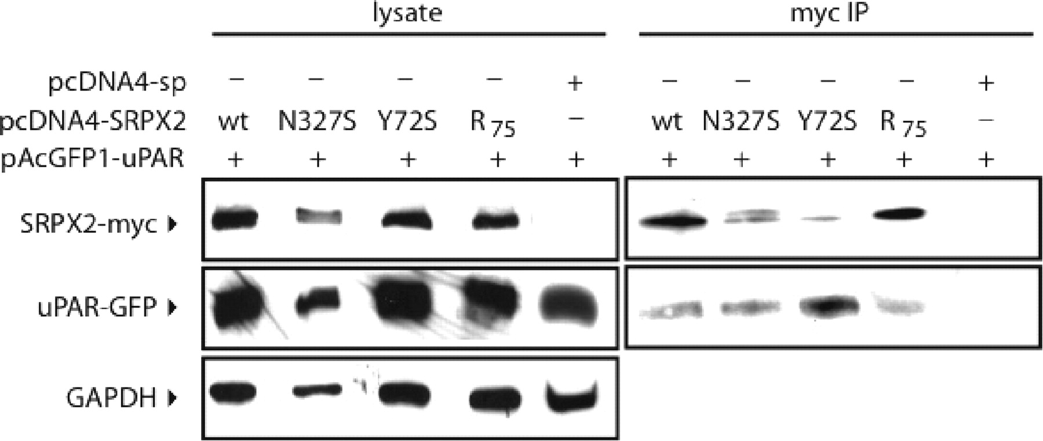
Figure 5. Interaction of mutant SRPX2 proteins with uPAR. Either pcDNA-SRPX2 construct (wt, N327S, Y72S or ...
Notes:
Figure 5. Interaction of mutant SRPX2 proteins with uPAR. Either pcDNA-SRPX2 construct (wt, N327S, Y72S or R75) and the pAcGFP1-uPAR construct were co-transfected in HEK293T cells and the corresponding proteins efficiently produced (lysate). Complexes precipitated with anti-myc antibody (myc IP) were resolved by SDS–PAGE, followed by immunoblotting for GFP or myc fusion proteins. The anti-myc antibody detected myc-tagged SRPX2 protein at the expected size of 58 kDa. For all co-IP with wild-type, disease-causing mutant (p.Y72S, p.N327S) and chimpanzee (R75) SRPX2 proteins, the anti-GFP antibody detected GFP-tagged uPAR protein at the expected size of 83 kDa. No band was obtained when the control vector pcDNA4-sp producing the myc tag with only the signal peptide (sp) of SRPX2 at its N-terminus was co-transfected with pAcGFP-uPAR.
Unless provided in the caption above, the following copyright applies to the content of this slide: © The Author 2008. Published by Oxford University Press. All rights reserved. For Permissions, please email: journals.permissions@oxfordjournals.org

Slide 5
Figure 4. SRPX2 interacts with the D1 and with the D2-D3 domains of uPAR. (A) Structural organization of uPAR ...
Notes:
Figure 4. SRPX2 interacts with the D1 and with the D2-D3 domains of uPAR. (A) Structural organization of uPAR constructs. (B) Truncated uPAR-GFP fusion proteins co-immunoprecipitate with SRPX2-myc in HEK293T cells. pcDNA-SRPX2 and the various pAcGFP1-uPAR constructs were co-transfected in HEK293T cells and the corresponding proteins efficiently produced (lysate). Proteins precipitated with anti-myc antibody (myc IP) were analyzed by immunoblotting for GFP fusion proteins. The anti-GFP antibody detected GFP-tagged truncated (D1, D12, D123, ΔD1) and full-length (full) uPAR proteins. The additional bands of lower molecular weights that could be observed (D12, D123) corresponded to non-N-glycosylated forms of the corresponding truncated protein. The anti-myc antibody detected myc-tagged SRPX2 protein at the expected size (58 kDa). No band was obtained when the control vector pcDNA4-sp producing the myc tag with only the signal peptide (sp) of SRPX2 at its N-terminus was co-transfected with pAcGFP-uPAR.
Unless provided in the caption above, the following copyright applies to the content of this slide: © The Author 2008. Published by Oxford University Press. All rights reserved. For Permissions, please email: journals.permissions@oxfordjournals.org

